Slide 1

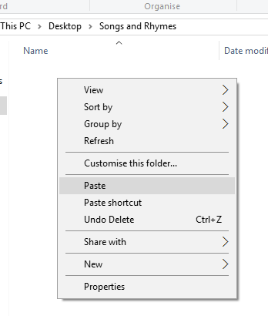


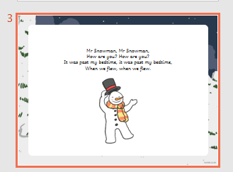
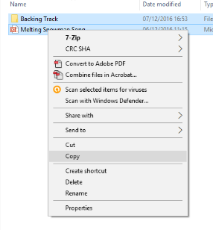
Guidance for Video/Audio in PowerPoints
1. Open the folder and copy all the files.
2. Paste the copied files into a new folder.
3. Open the PowerPoint file, enable editing and enter presentation mode (start the slide show).
Please note the embedded audio may not be compatible with early versions of PowerPoint.
You may wish to delete this slide before beginning the presentation.

Slide 3

Revisit and Review
Let’s revisit last week’s focus words…
I’ll say them and you write them down!

Slide 4











Revisit and Review

Slide 5

Teach
Here are this week’s focus words for reading…
water
where

Slide 6

Teach
Tricky Word Rucksacks
Say the tricky words as they appear from the rucksack.
Watch out for the tricky words water and where!

Slide 7

where
water
where
water
where
asked
called
looked
people
water

Slide 8




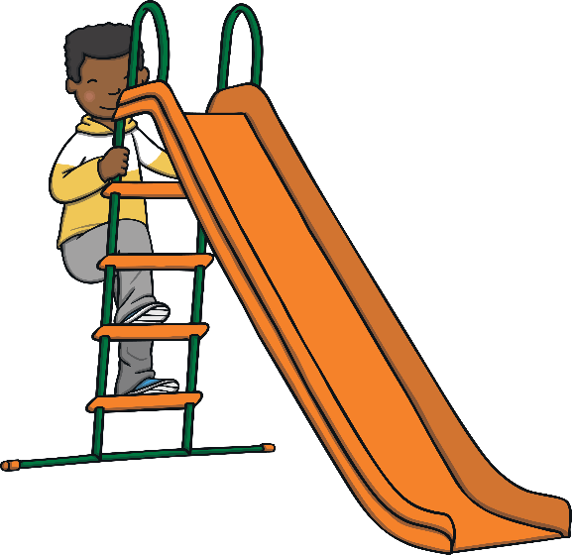




Revisit and Review
Let’s practise Sam’s Sounds and Common Exception Words!
oy
e_e
i_e
o_e
ay
u_e
a_e
ie
ea
oh
would
should
your
their
two
Mr
people
could
Mrs
love
looked
asked
called

Slide 9

Teach
Today, we are learning to write words that contain ou saying /ow/.

Slide 10
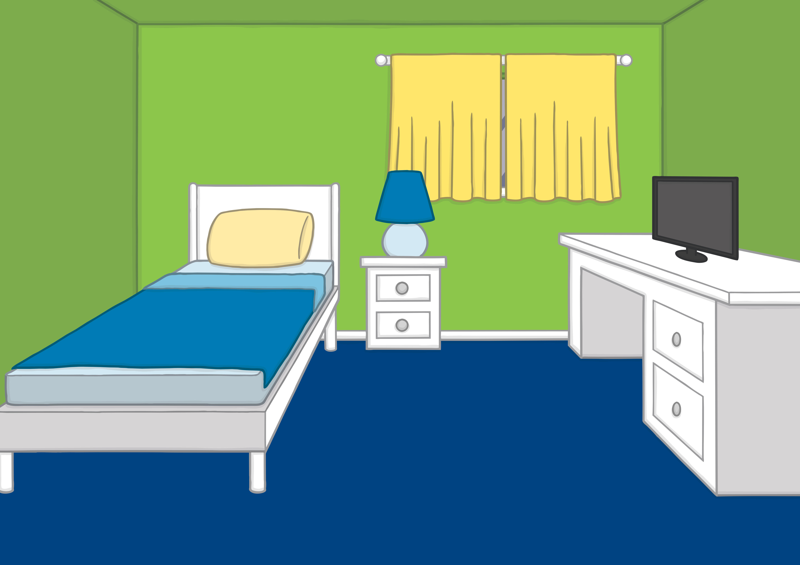


Teach
Kit and Sam were very excited because tonight they were going on their first ever Beaver sleepover. They were going to camp in the woods with some of their friends!

Slide 11

Teach
Mum helped Kit and Sam pack their rucksacks for the trip. They had a long list of things to bring! “Do not forget to pack these,” said Mum as she handed Kit and Sam a water flask each.

Slide 12




Teach
“Do we have to bring a sleeping bag?” asked Kit. “I want to sleep out under the stars!”
Mum replied, “A sleeping bag is on the kit list. I think you might be glad of it when it gets cold in the night.”

Slide 13

Teach
Sometimes the /ow/ sound can be spelt with an o and a u. Together they make ou.
d
u
cl
o

Slide 14

Teach
Kit likes the idea of sleeping out under the stars. Click on the twinkling stars to reveal a word. Can you read the ou words?

Slide 15

about
our
cloud
proud
scout
sprout

Slide 16


Teach
‘ou’ Sleeping Bag
Kit and Sam need a sleeping bag. Click on the sleeping bag to reveal the words. Can you read them?

Slide 17

Practise
shout

Slide 18

Practise
ground

Slide 19
Practise
pound

Slide 20
Practise
mouth

Slide 21
Practise
found

Slide 22


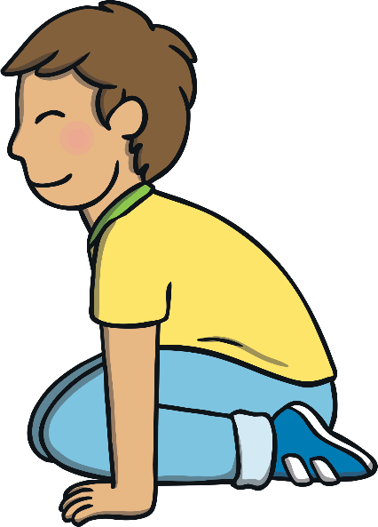
Apply
“I am going to bring my favourite teddy,” Sam said to Kit and Mum. Mum smiled but Kit did not hear Sam because he was crouched down on the floor by the bed.

Slide 23
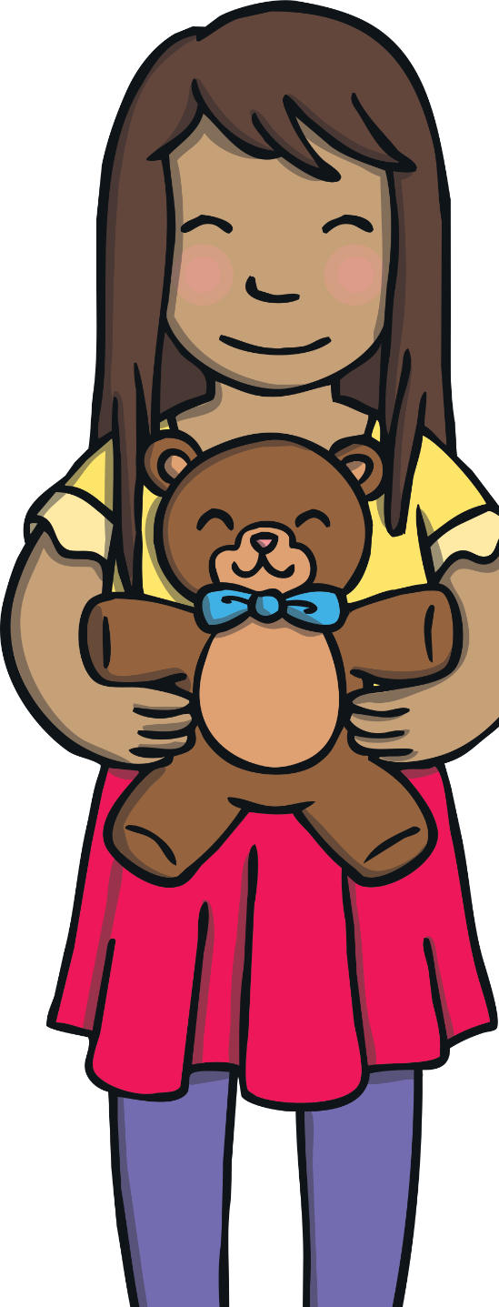

Apply
Kit was busy playing with the torch his Dad had given him. He needed to bring it with him on the camping trip. Mum had not noticed what Kit was up to.

Slide 24

Apply
Sentence Time
As Mum reads down the kit list, she suddenly realises one item is missing from Kit’s rucksack. What is Mum going to ask Kit?

Slide 25

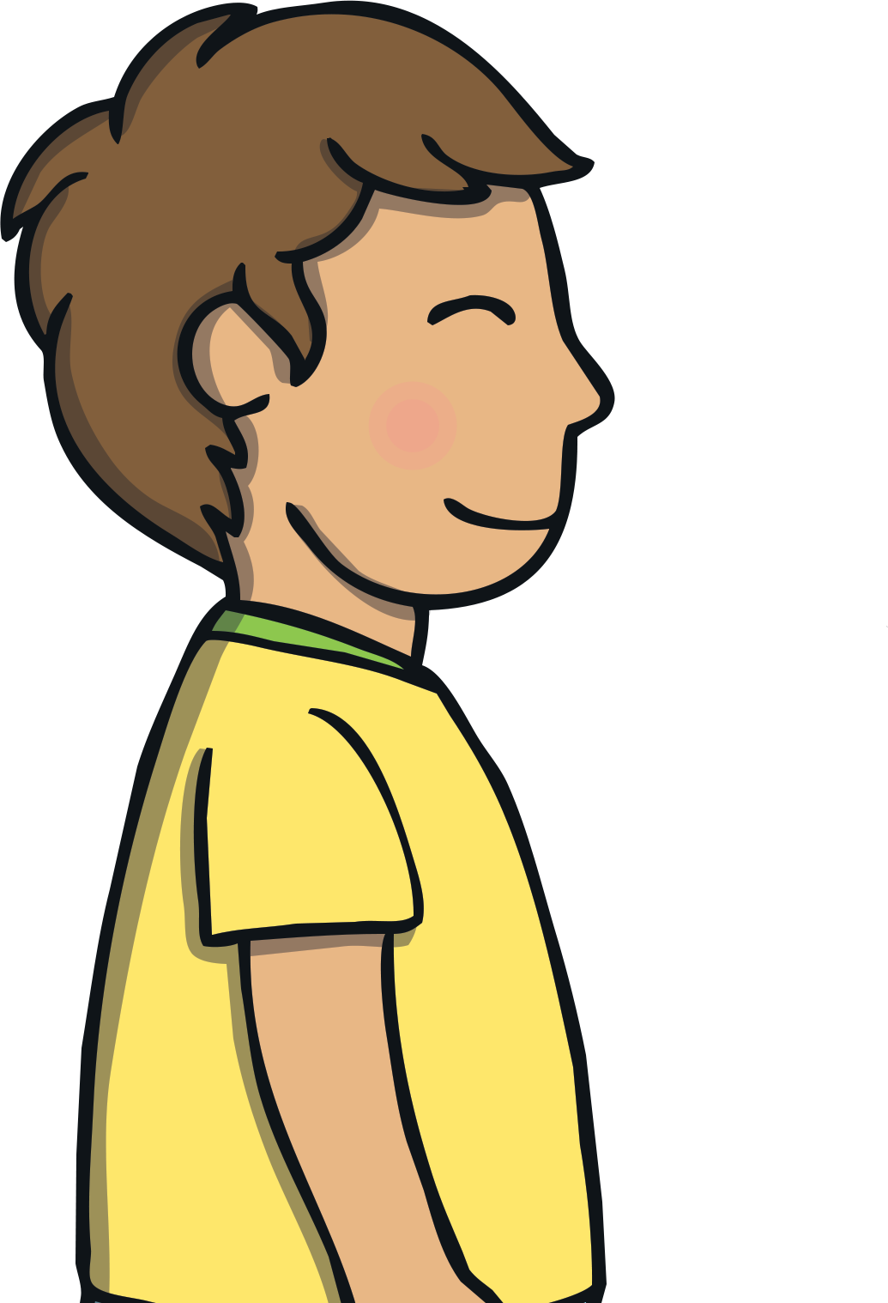

Where is the torch that Dad lent you?
Sound Buttons On/Off
Show

Slide 26


Apply
Kit took a moment to respond. Then, he shouted from under the bed, “it is here! I was just testing the torch out.” He stood back up and smiled.
“OK, pop it into your rucksack. It is time to go,” said Mum.
Sam smiled, “I am super excited for our camping trip!”

Slide 27

Today, we have learnt…
ou
saying /ow/
The adventure continues next lesson!

