Slide 2
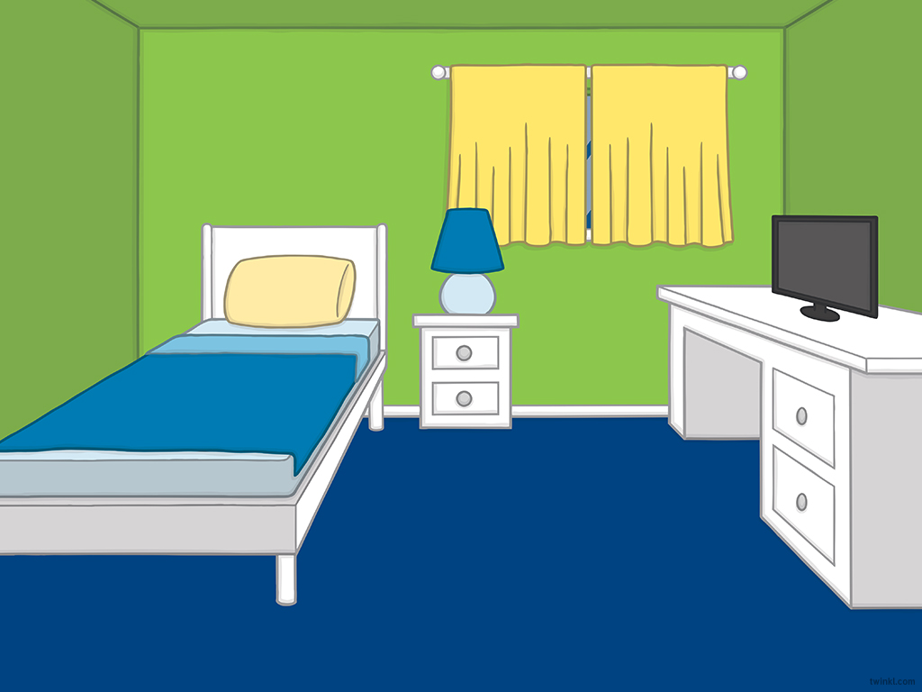
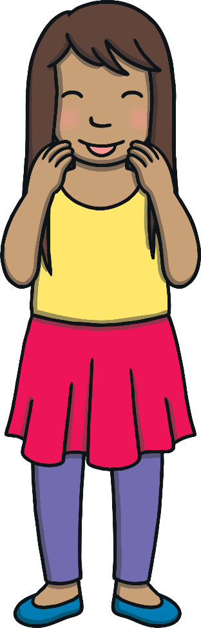


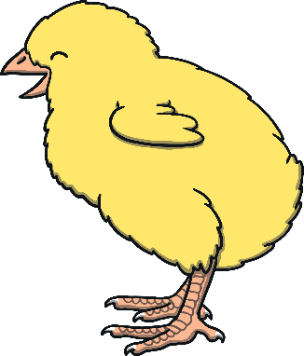


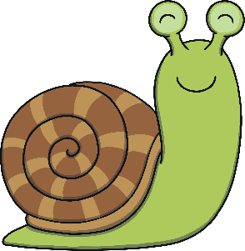
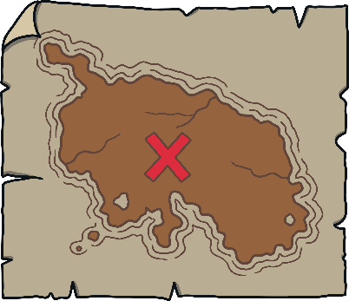


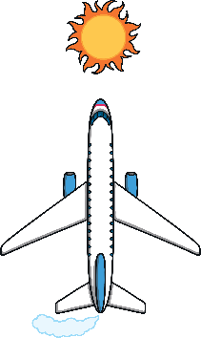
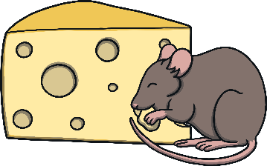










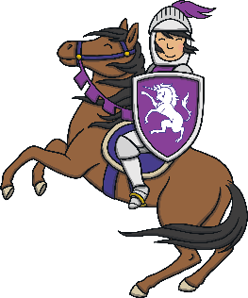
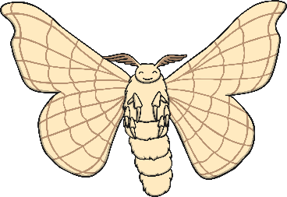
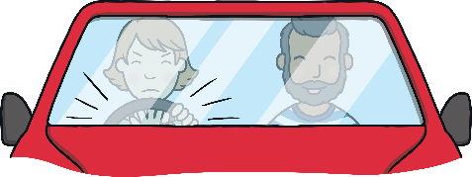


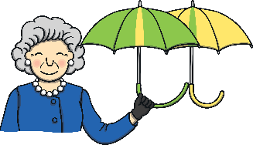

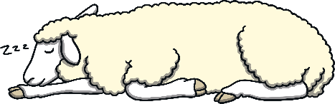
Revisit and Review
Let’s practise Sam’s Sounds and Common Exception Words!
er
y
j
ch
z
ee
air
ai
ear
ng
oi
oa
qu
th
ur
oo
x
v
ar
igh
ow
or
zz
ure
ay
w
oo
th
sh
when
one
out
some
were
should
so
like
there
have
little
come
said
what
do
could
like

Slide 3
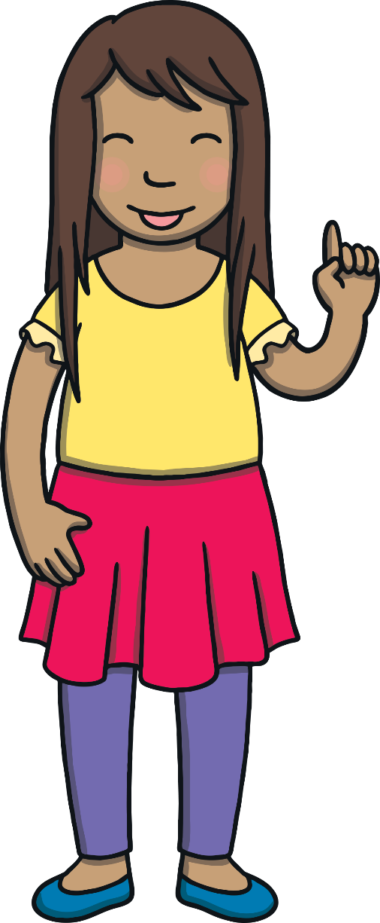
Teach
Here are this week’s focus words for reading:
could
should

Slide 4
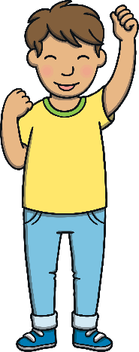
Holiday Play
Teach
Click on the buckets to reveal the common exception words and the hidden starfish.
X
Tricky words are now called ‘common exception words’ because some of them can be decoded. These are in red. Words that can’t yet be decoded are in grey.
Click me for Kit’s teaching tips!

Slide 5


Teach
could
could
should
should
could
should

Slide 6
Teach
Today, we are learning to read words that contain ay.
X
Grapheme ‘ay’ makes the same sound as Level 3 grapheme ‘ai’. It is used when the /ai/ sound comes at the end of a word (except where you would have 3 vowels together or in a compound word, e.g. we write ‘crayon’ instead of ‘craion’).
Click me for Kit’s teaching tips!

Slide 7
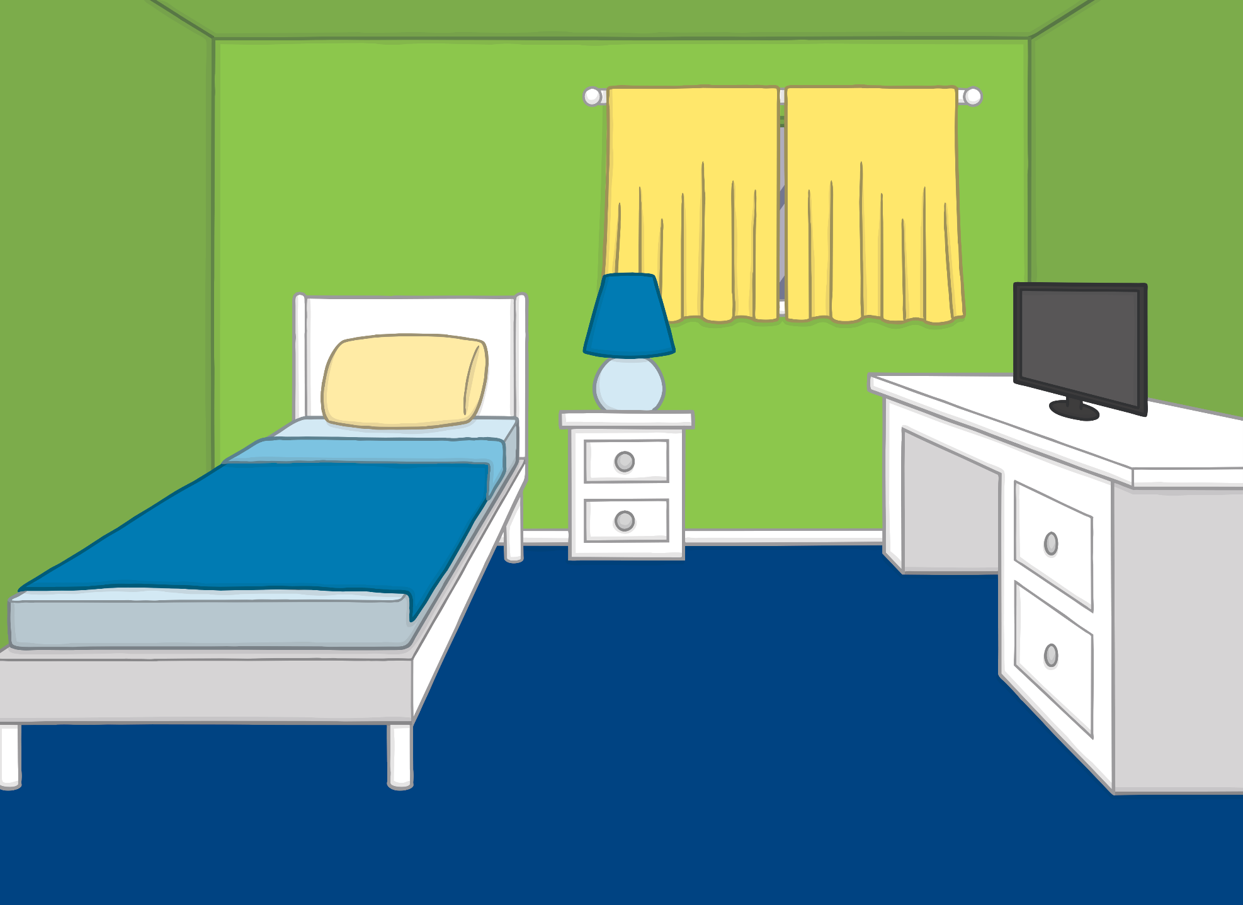
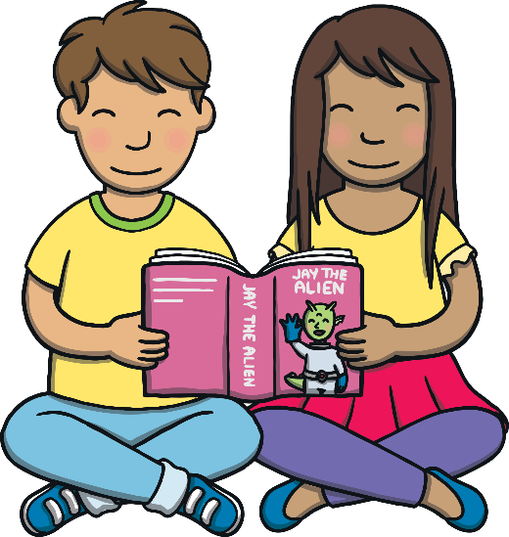
Teach
It was the very last day of the school summer holiday. Kit and Sam were reading a book about an alien called Jay. He really wanted to go on an adventure but he could not leave his planet.

Slide 8
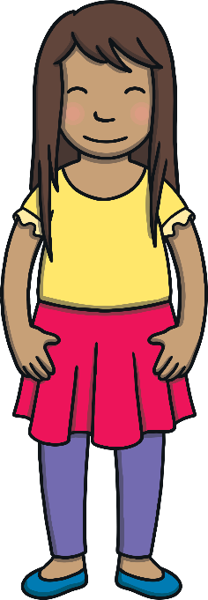

Teach
“Poor Jay,” said Sam. “I wish we could help him.”
“We should get the magic book to send a spaceship and bring him here! Let’s take him on an adventure to school tomorrow,” said Kit.

Slide 9
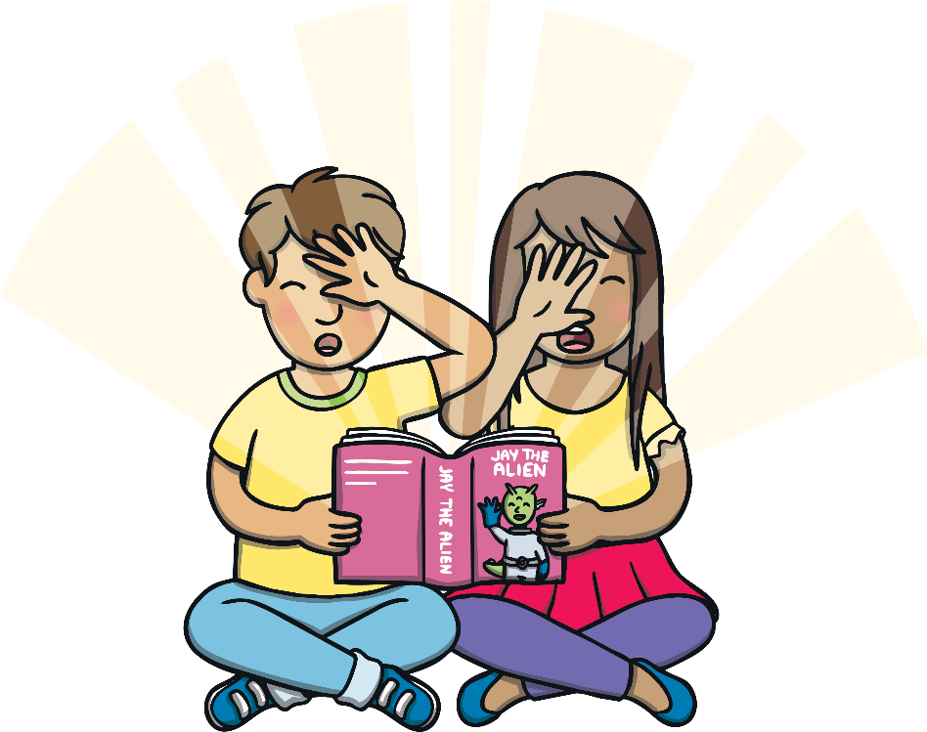
Teach
“Bring Jay to us in a spaceship!” he shouted, as he opened the magic book. A beam of light shot out from the book and they realised a little spaceship had now appeared in the air!

Slide 10


Teach
Kit and Sam have used their magic book to help Jay have an exciting adventure. His adventure started when he climbed into the spaceship. Can you read the ay words on the spaceships?

Slide 11


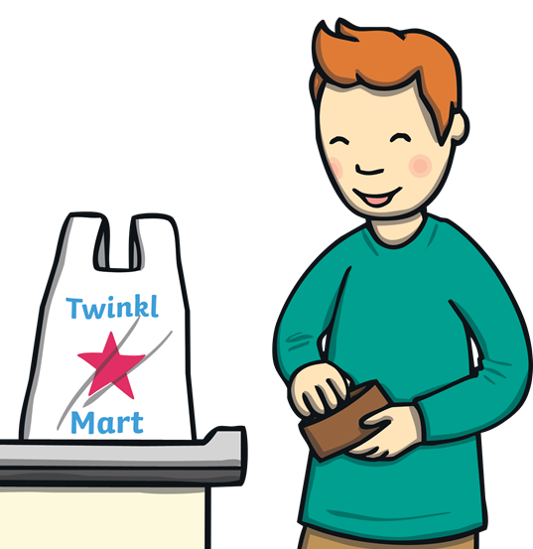



Teach
ray
tray
pay
play
crayon

Slide 12

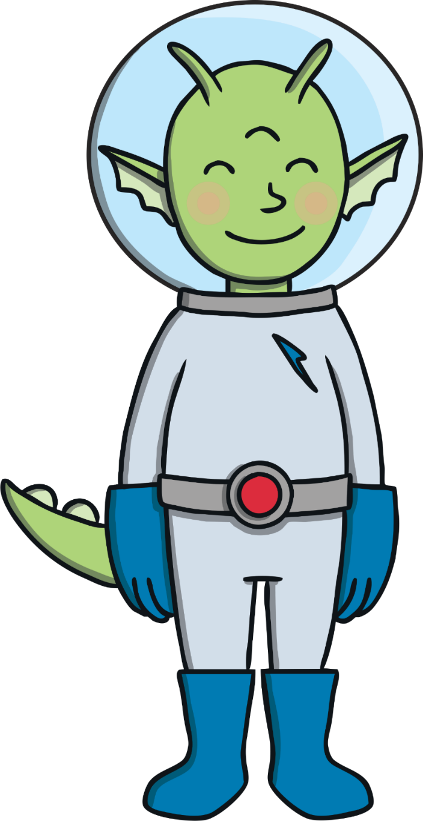
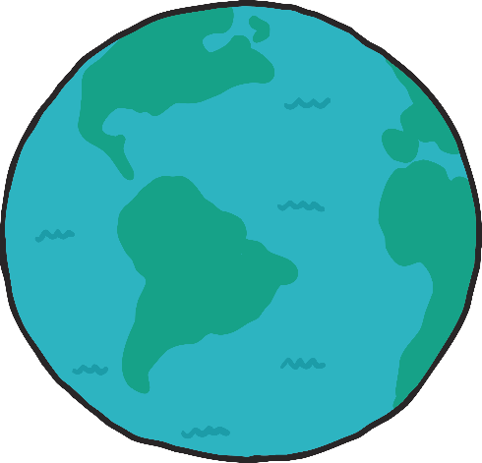
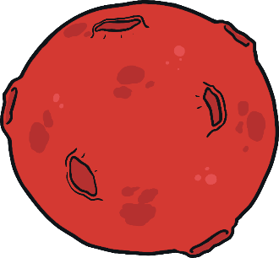
Planet Play
Practise
Jay is zooming past lots of planets. Can you spot any ay words as he flies?

Slide 13
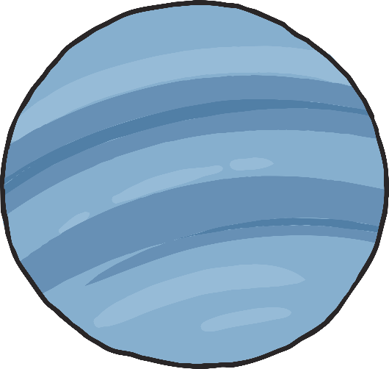





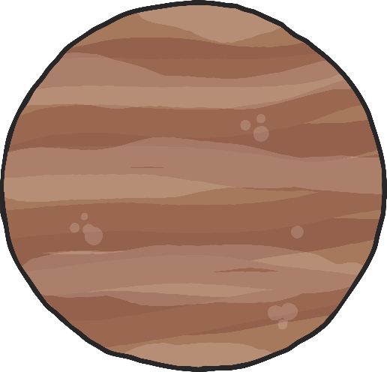

sway
Practise
stray
hay
say
Sunday
clay
way

Slide 14
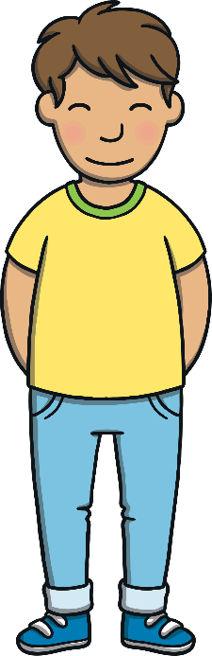

Apply
Kit and Sam watched Jay’s tiny spaceship sway as it landed on the floor of Kit’s bedroom. It lay there for a moment. Kit didn’t know what to say.

Slide 15


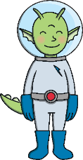
Apply
There was a gentle hiss as the spaceship door opened and out of the doorway hopped little Jay. “Hello Jay!” said Kit and Sam. “It’s lovely to have you here!”

Slide 16

Sentence Time
Apply
Jay looks around Kit’s bedroom and smiles. What do you think he said to Kit and Sam?

Slide 17

Apply
“Could I come and play for the day?”
Sound Buttons On/Off
Show

Slide 18

Apply
“Of course!” exclaimed Kit and Sam. “It is our first day back at school tomorrow. Come and have an adventure with us!”
“Hooray!” cheered Jay.

Slide 19
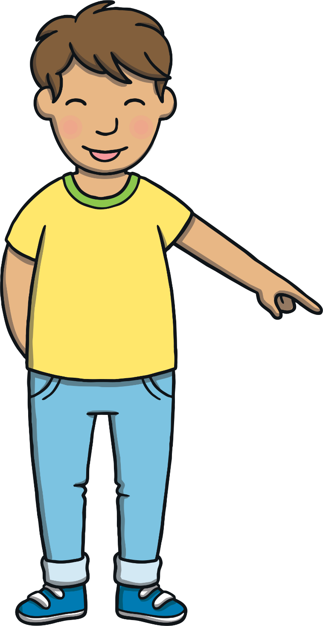

Today, we have learnt…
ay
saying /ai/
The adventure continues next lesson!

Slide 20
