Slide 2
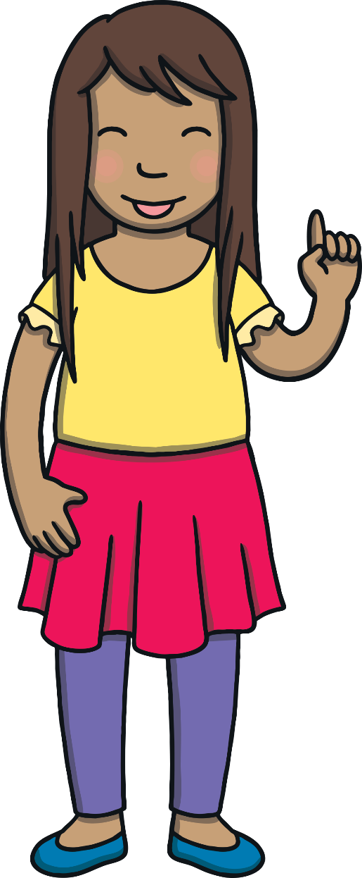
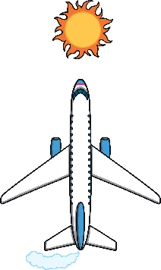
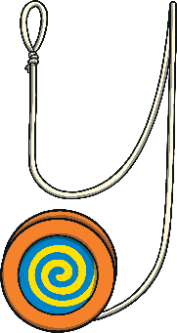
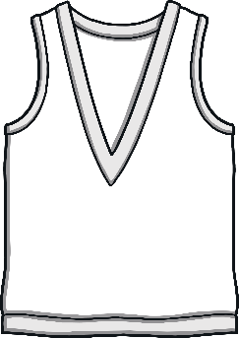
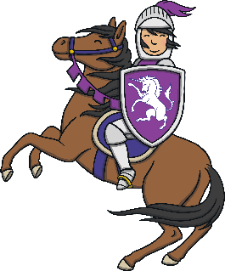
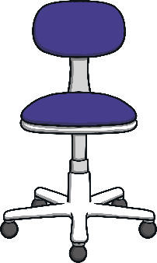
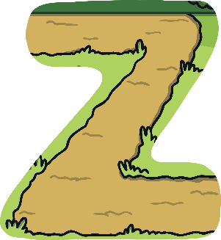
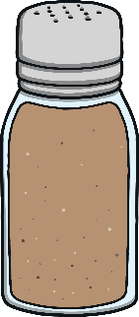

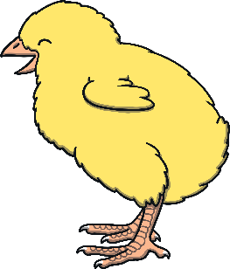
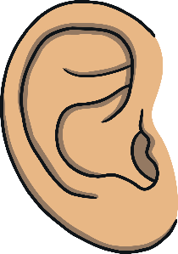

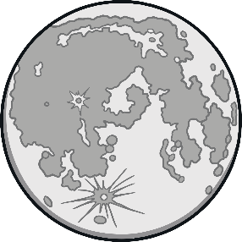
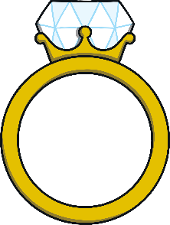
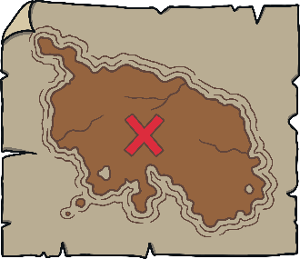
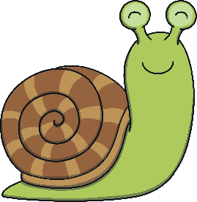
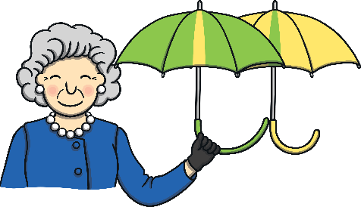
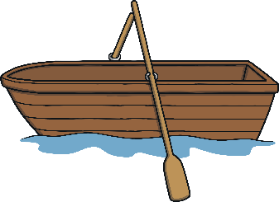

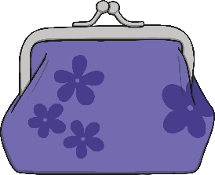
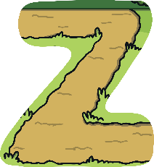
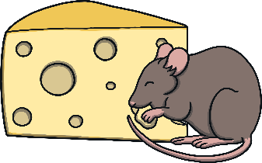
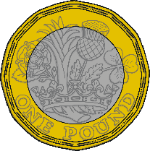
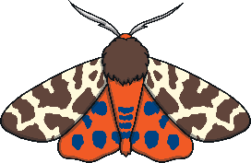
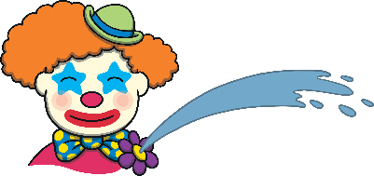
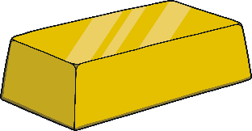
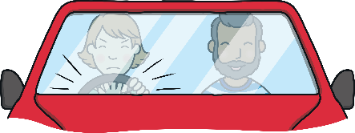
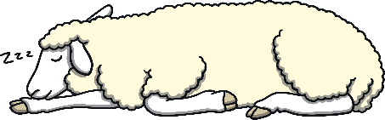

Revisit and Review
Let’s practise Sam’s Sounds and Tricky Words!
v
air
er
j
z
ch
y
ng
qu
ear
x
igh
ai
oo
ar
oa
th
oi
ee
w
ure
ur
ow
zz
oo
or
th
sh
one
little
there
were
some
come
have
said
do
like
so
when
out
what

Slide 3
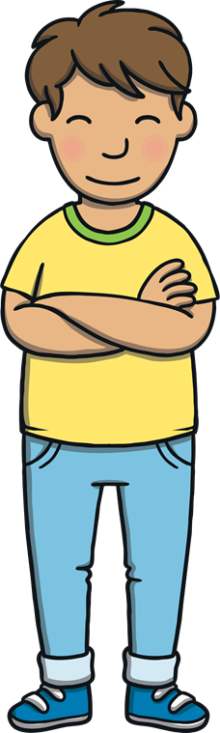
Revisit and Review
Today, we are practising writing words that contain
consonant blends.

Slide 4
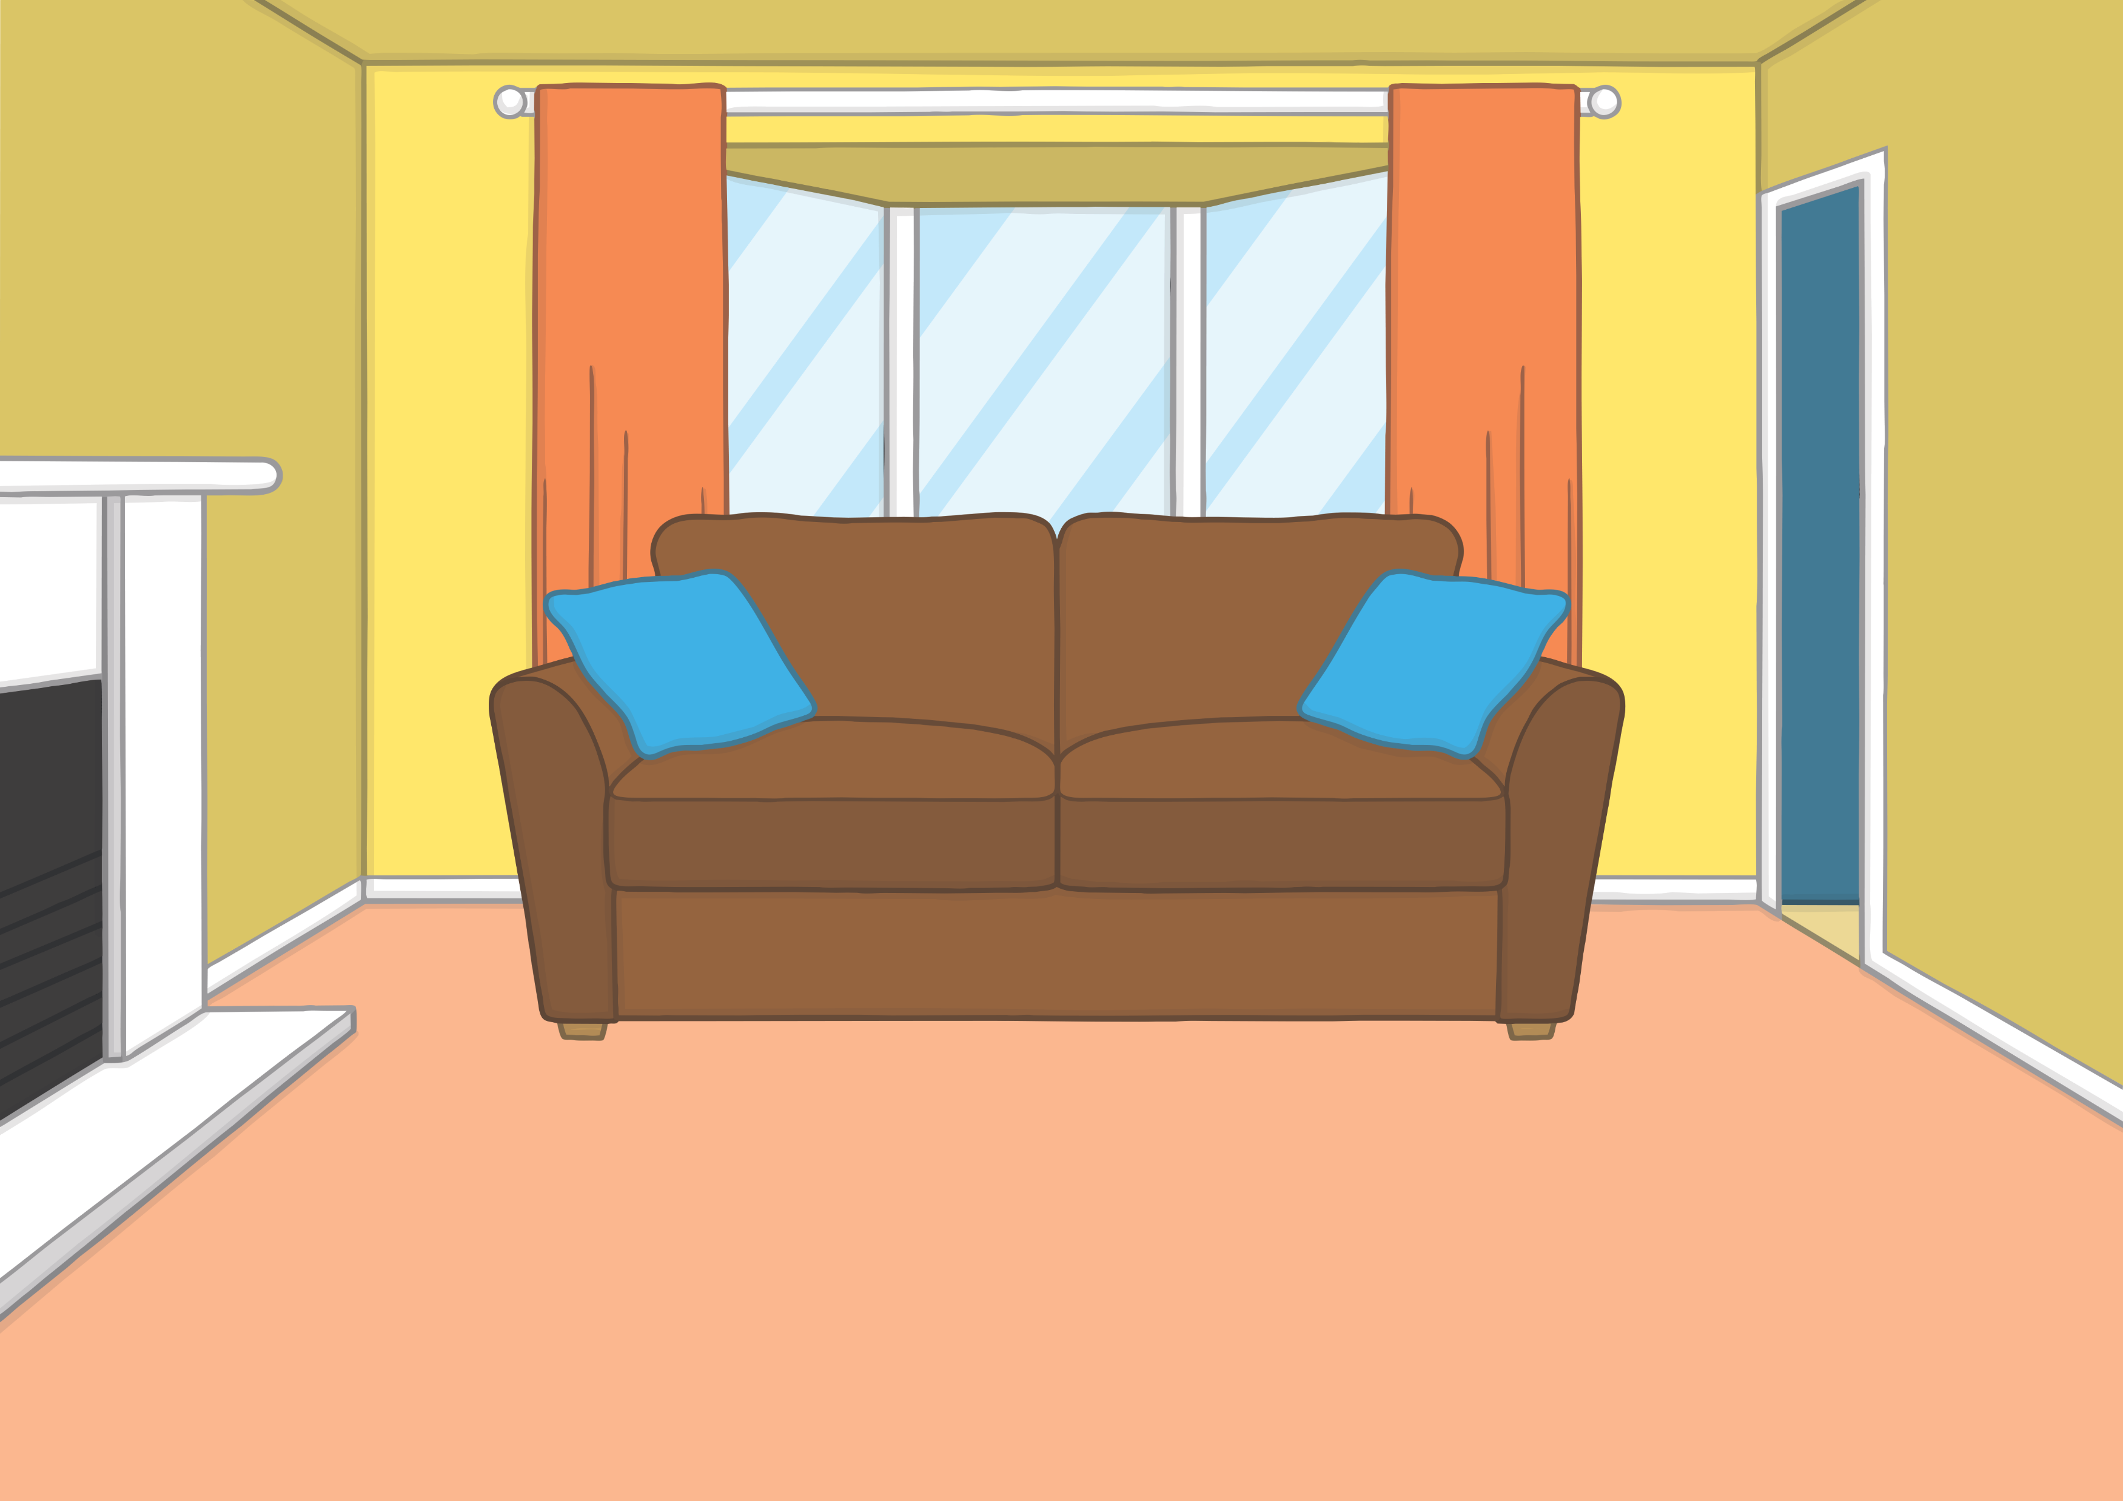
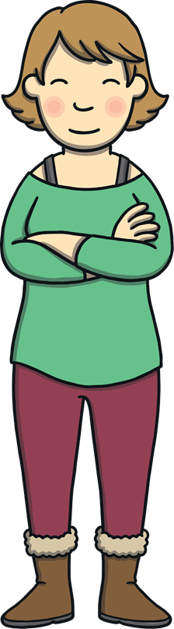
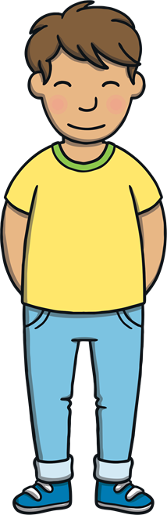
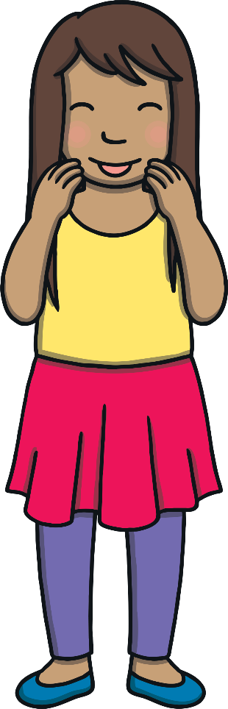
Teach
Kit, Sam and Mum were back from their trip to the library. “We had a great time,” said Kit and Sam with a twinkle in their eyes.
“Good,” said Mum, “now we have to put away all the books we took out.”

Slide 5

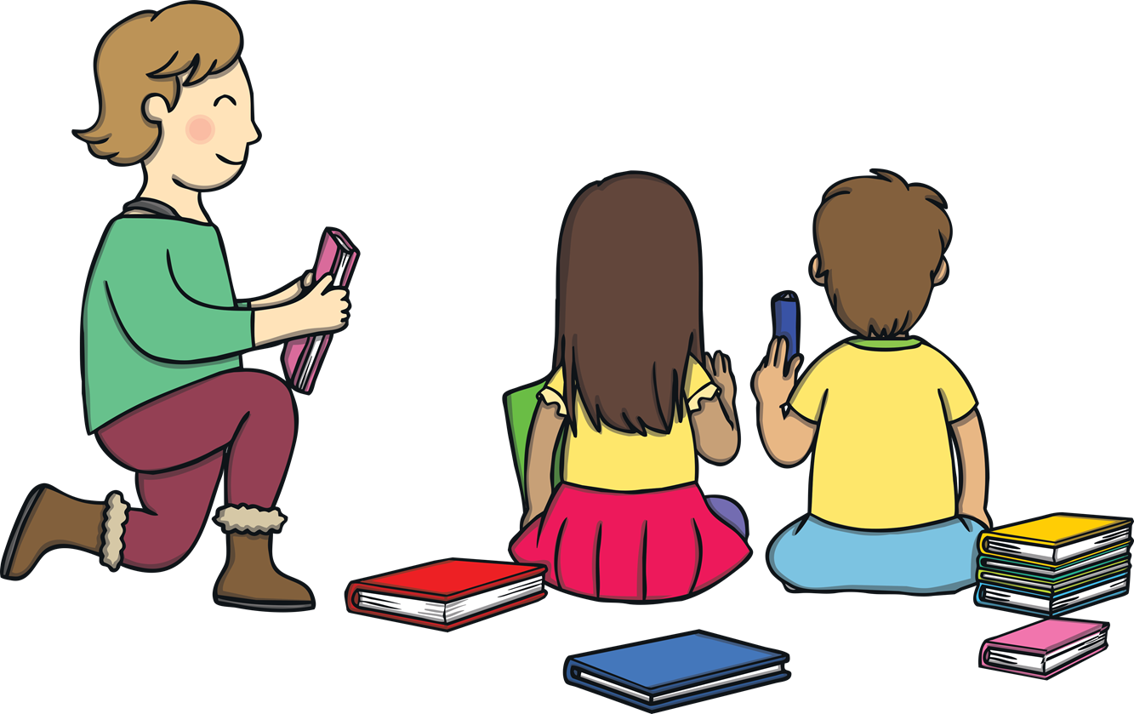
Teach
They all helped to put the books away. “Phew!” said Mum. “Thank goodness it has stopped raining.”

Slide 6
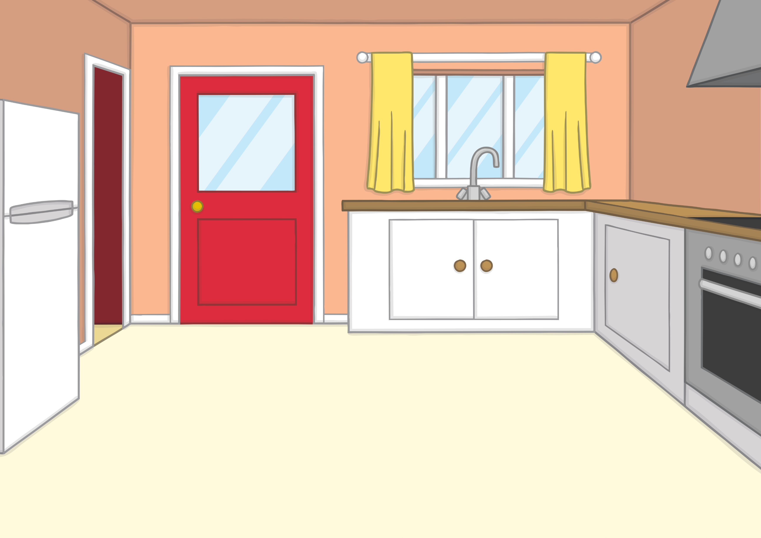
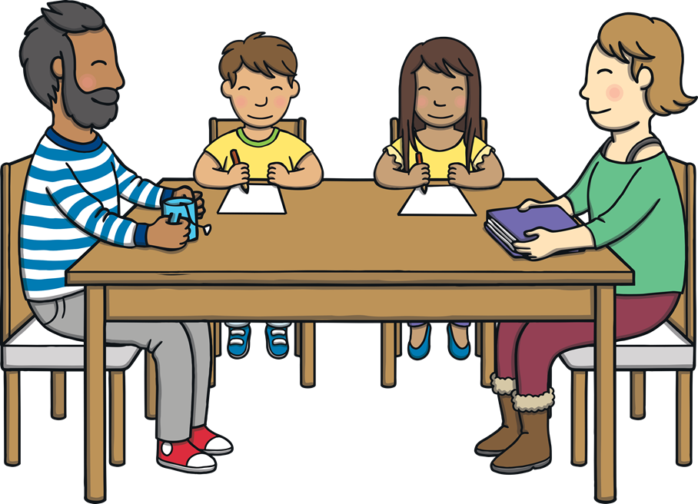
Teach
When Mum left the room, Kit and Sam followed her to the kitchen. They talked about their adventure with the magic book. “I think we should write our own pirate adventure book,” said Sam. “You write and I’ll draw,” said Kit.

Slide 7
Teach
Pirate Captions
Can you match the captions that Sam has written to the pictures that Kit has drawn?

Slide 8
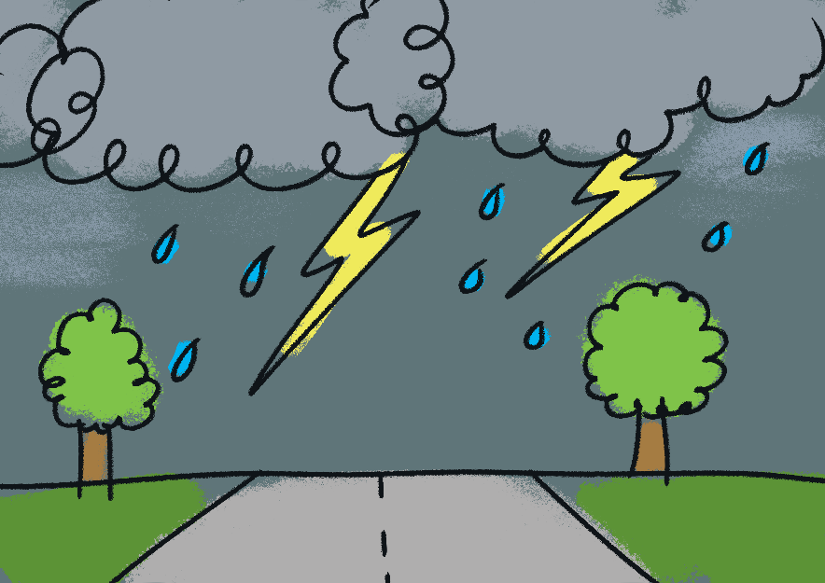
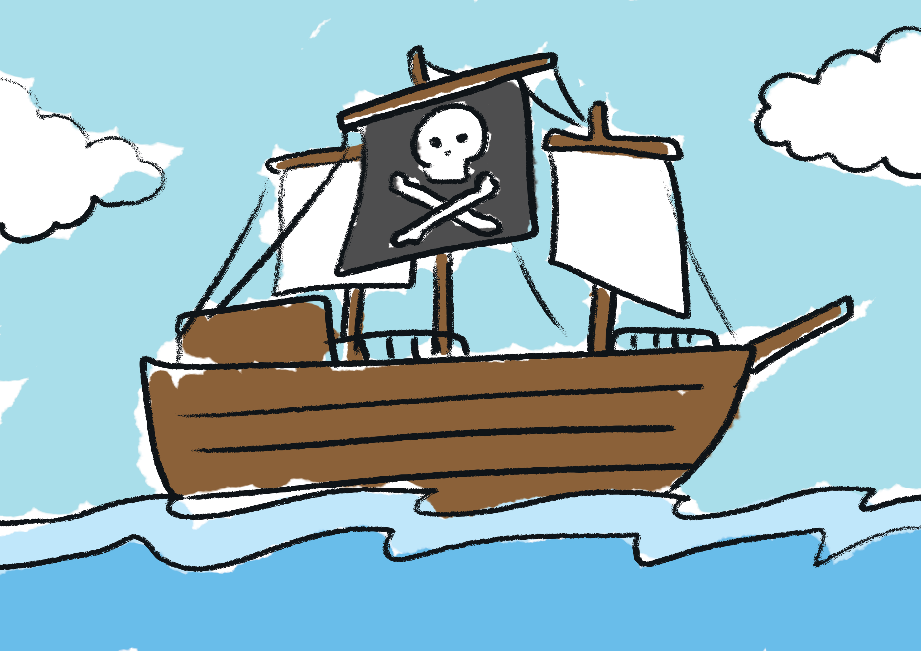
Practise
a big thunderstorm

Slide 9
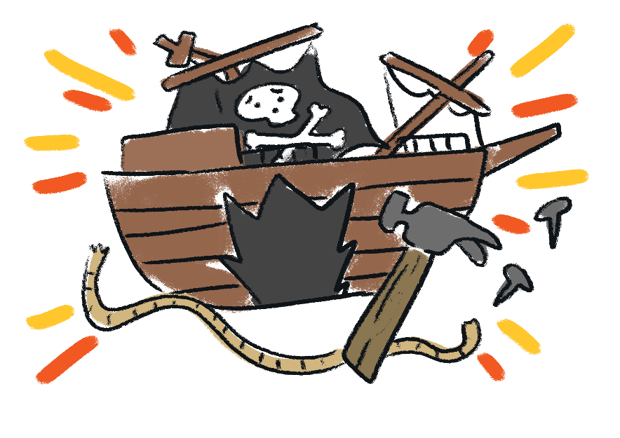
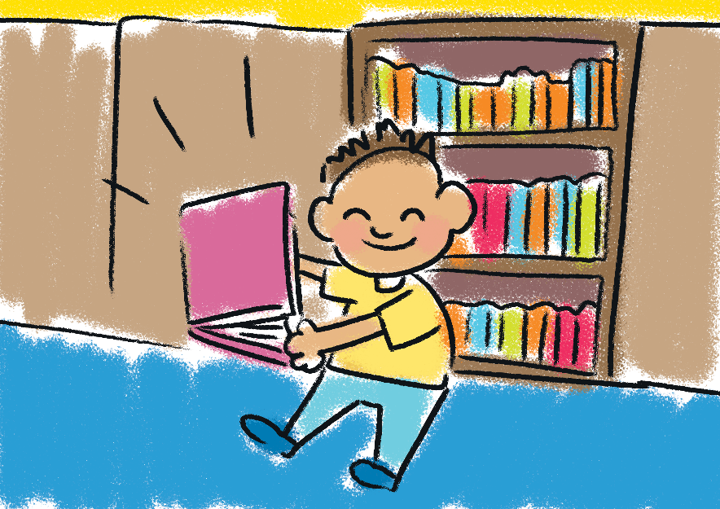
Practise
get some books

Slide 10
Practise
fix the ship

Slide 11

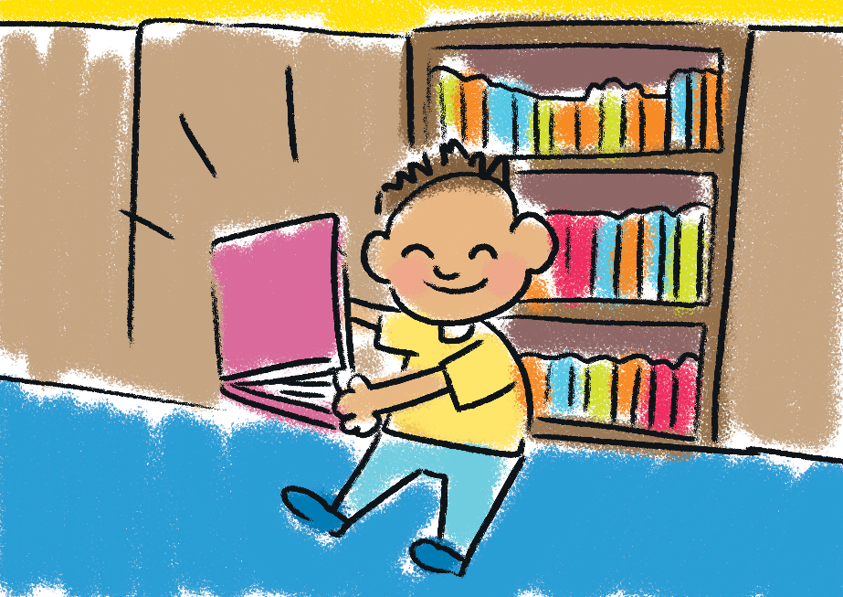
Practise
a trip in a ship

Slide 12
Teach
“OK,” said Kit, “so you know what to write for each picture.”
“Let’s get working!” said Sam.

Slide 13
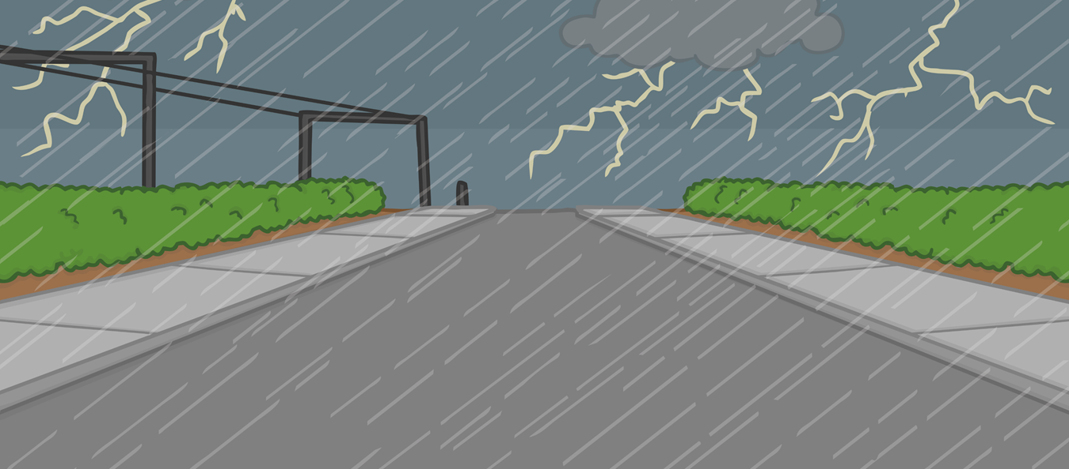
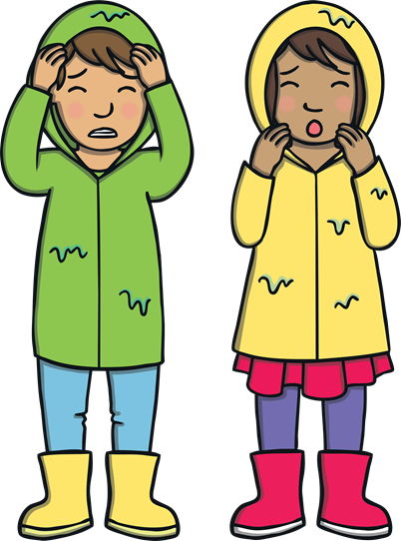
Apply
The Storm
A ‘Let’s Write Together!’ Book

Slide 14
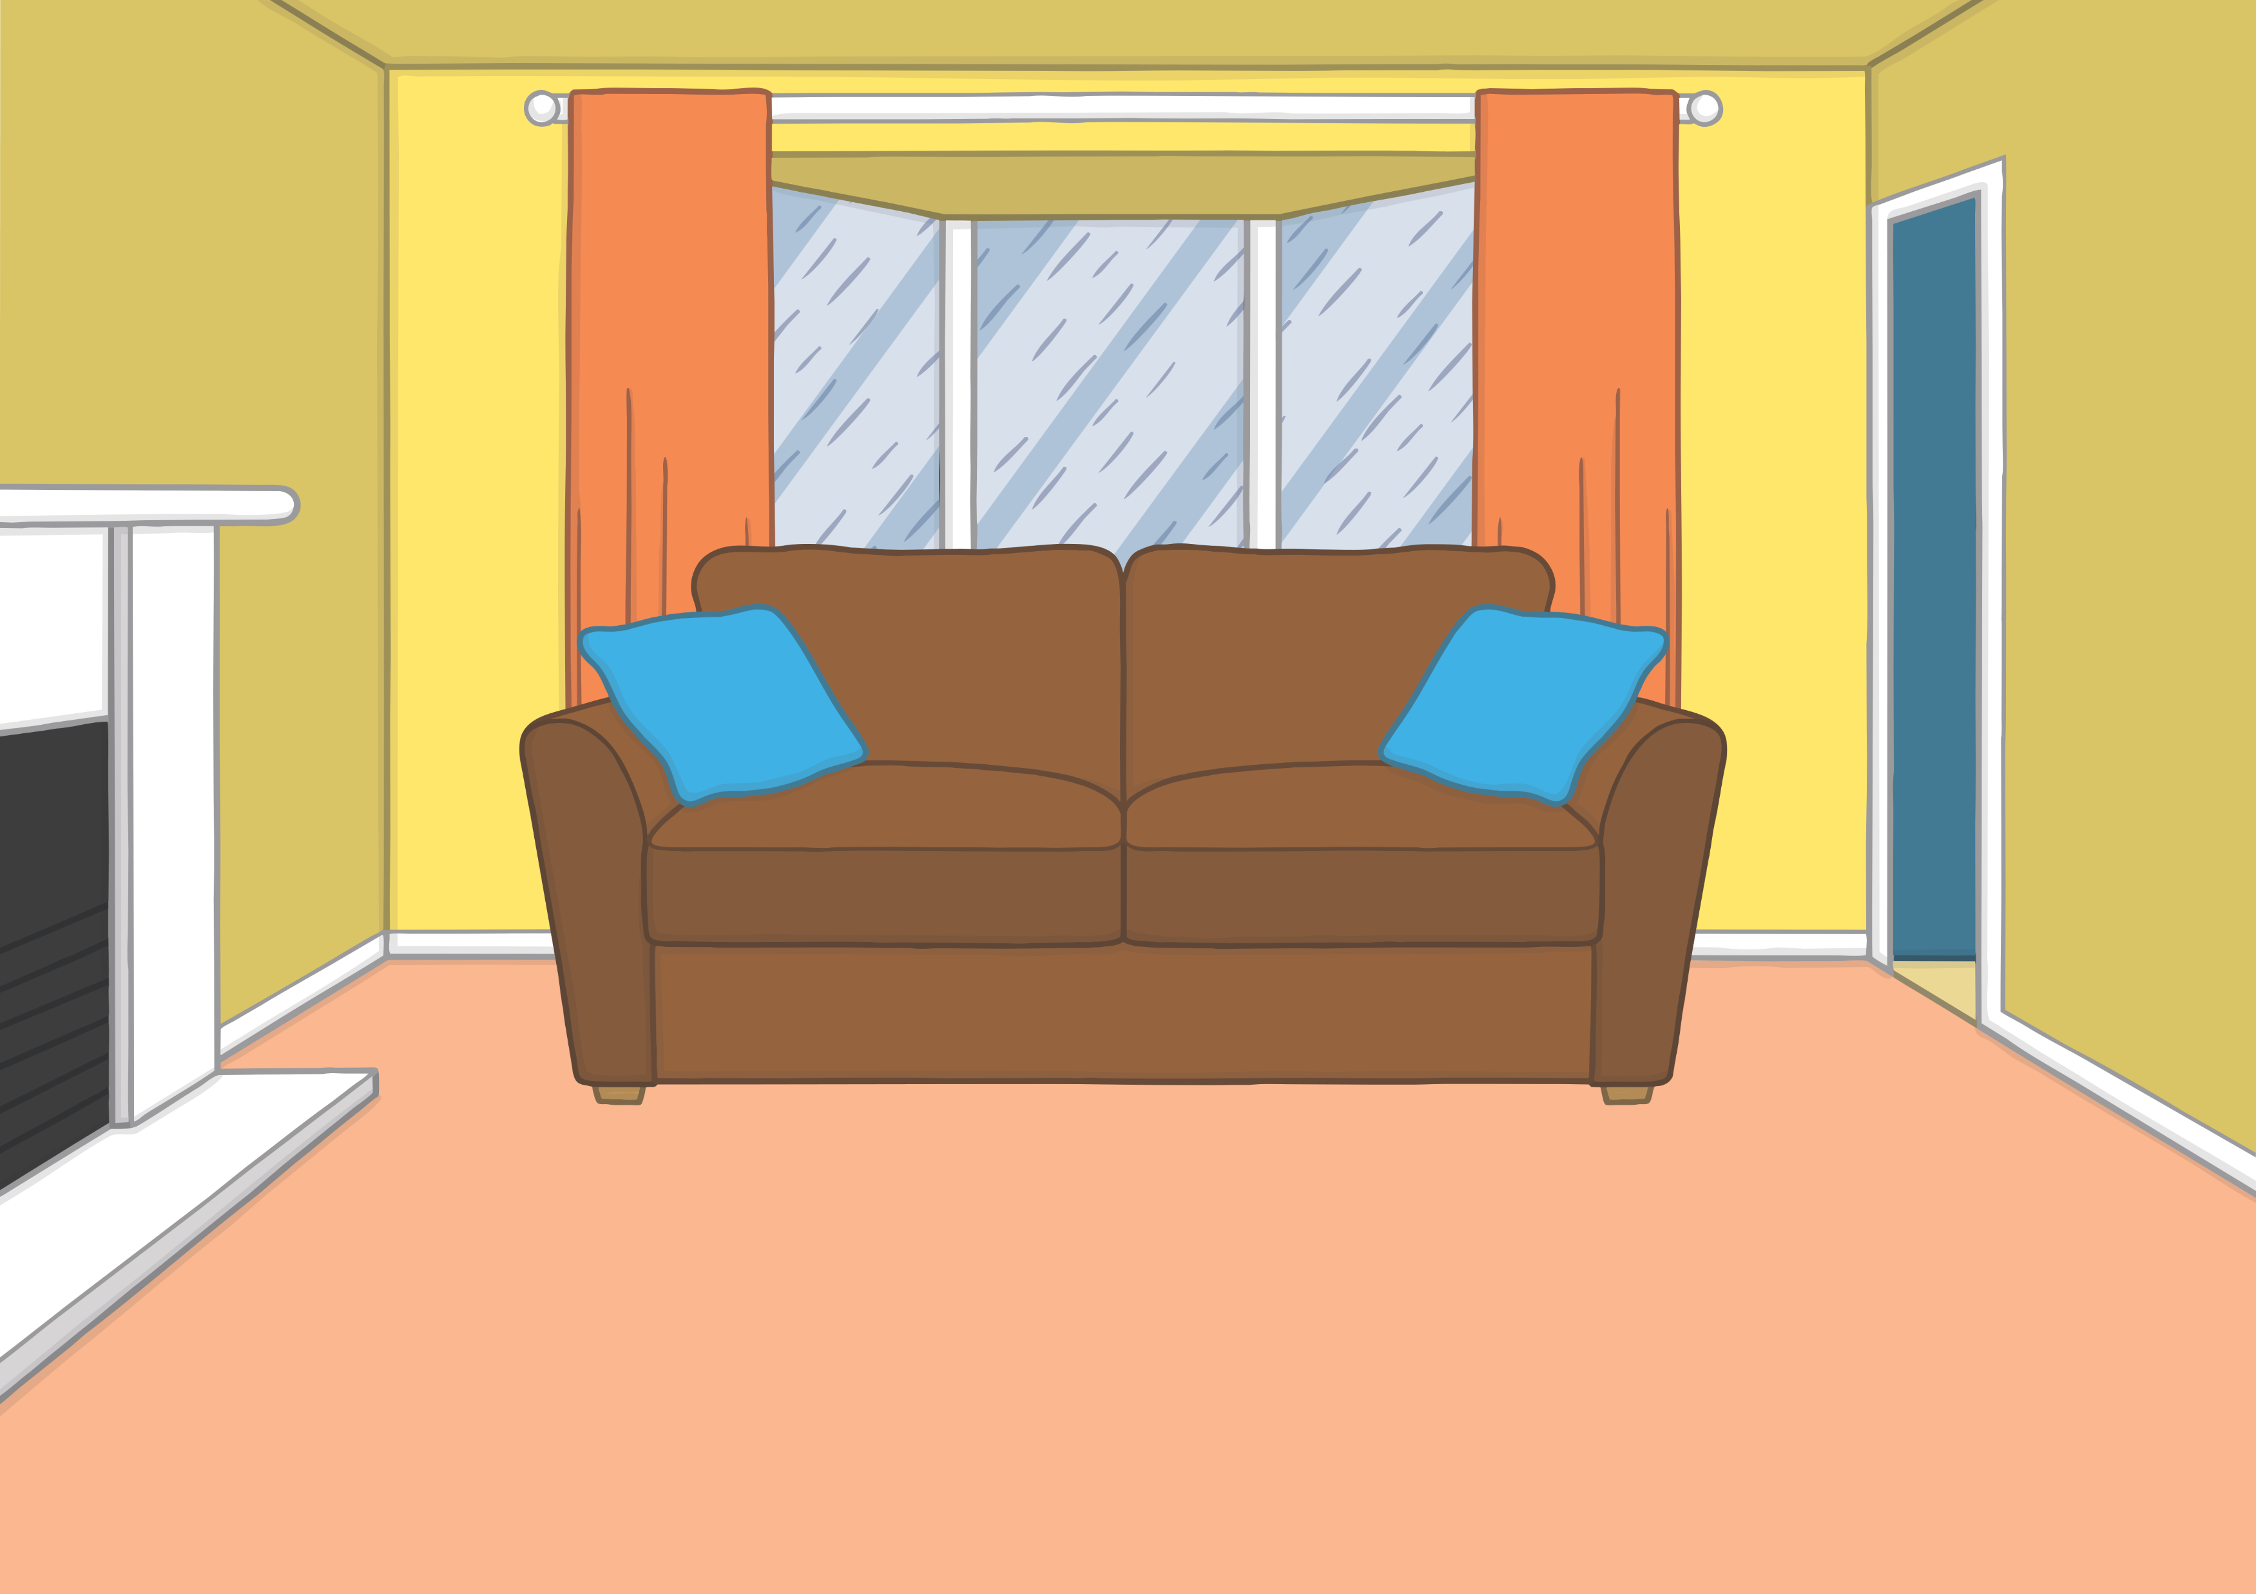
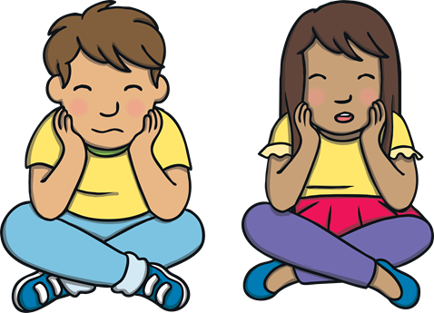
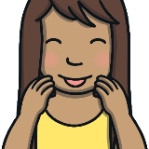
Apply
Show
“What a big storm,” said Kit and Sam.
Drip, drip went the rain.

Slide 15

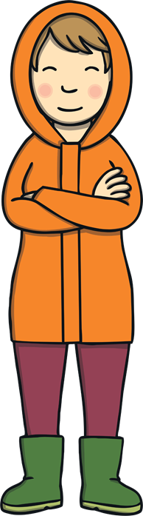

Apply
Show
“Let’s go and get some books on storms out,” said Kit. “I will come too,” said Mum.

Slide 16
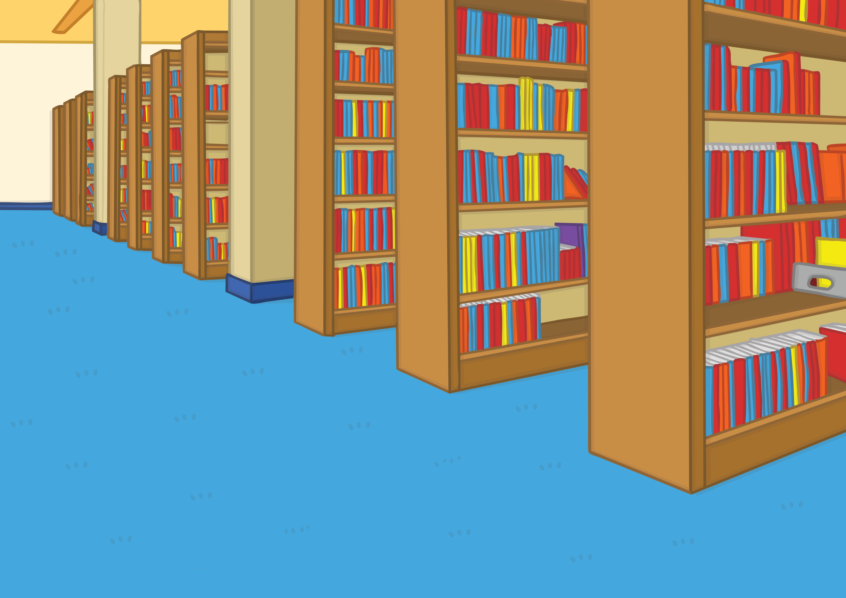
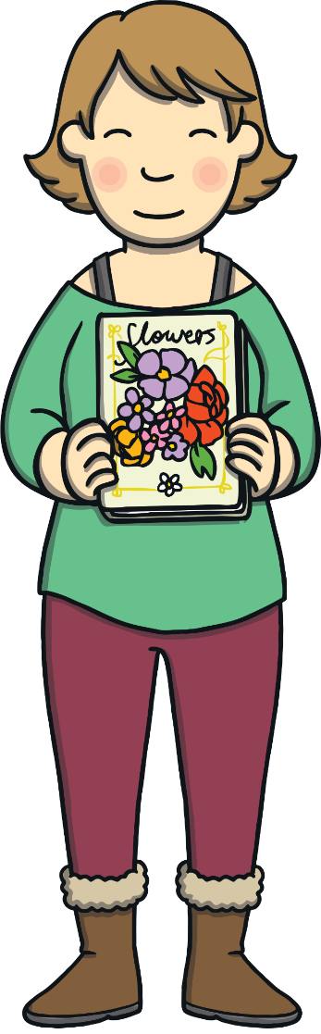
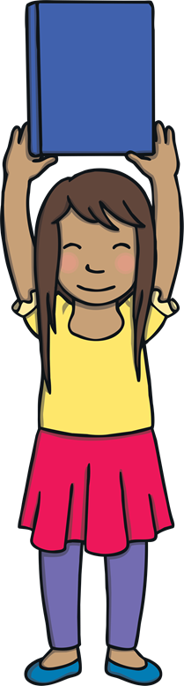

Apply
Show
Kit and Sam got books with storms out. Mum got books with flowers out.

Slide 17
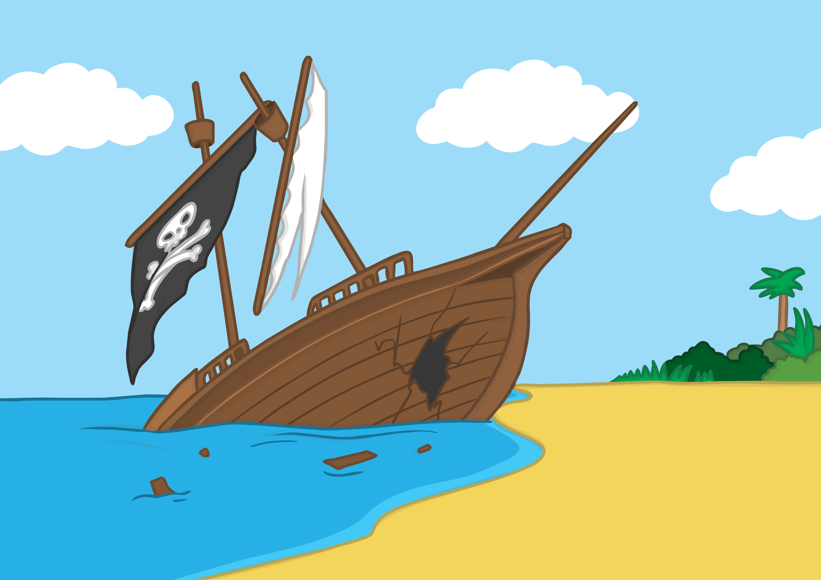
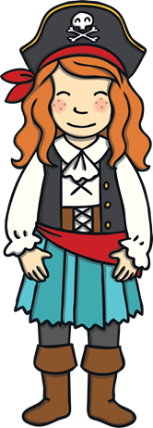
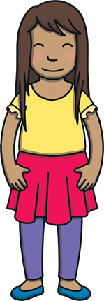

Apply
Show
Kit and Sam went on a little adventure and met Fran. Fran had a big ship that had sunk.

Slide 18


Apply
Show
“We will help you fix the ship,” said Sam.
“Then we can go for a trip in the ship,” said Fran.

Slide 19




Apply
Show
“That was the best adventure ever!” said Kit and Sam when they got back.

Slide 20
Teach
They finished looking at the pictures and writing, then closed the book. “I loved meeting Fran the Pirate,” said Sam.
“Me too,” said Kit. “So, can we go again next time there is a storm?!”

Slide 21


Today we have written a book containing consonants blends together.

