Slide 2
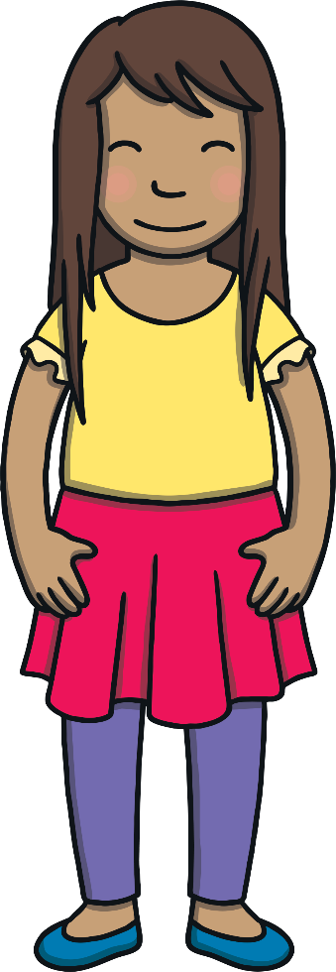
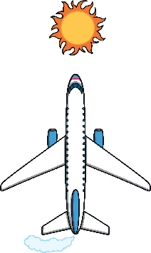
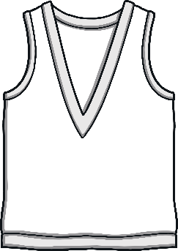


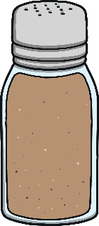
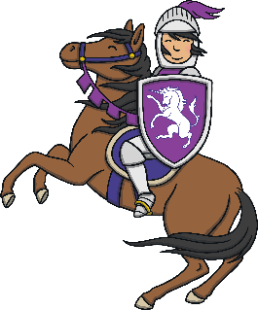
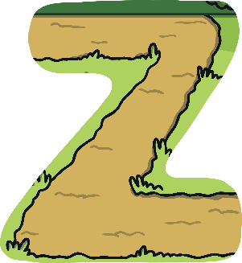


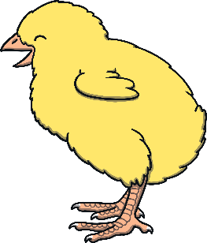

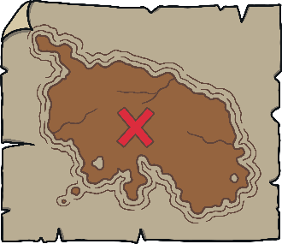
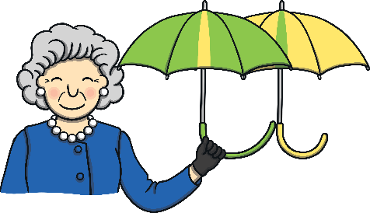
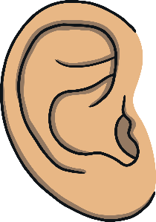
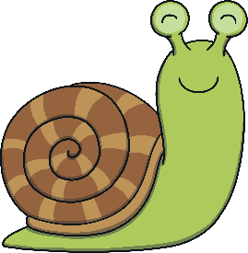


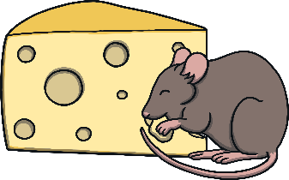
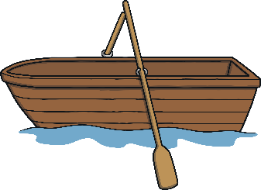
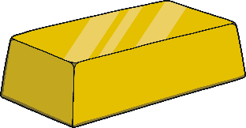


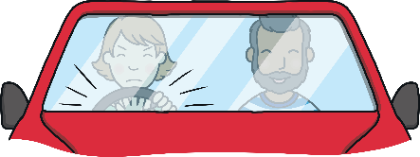

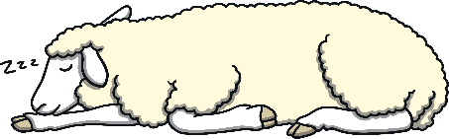
Revisit and Review
Revisit and Review
Let’s practise Sam’s Sounds and Tricky Words!
w
er
v
ure
air
qu
ng
j
ch
z
ar
x
ee
ow
ur
ai
sh
igh
th
y
or
oo
oa
ear
oi
there
out
do
one
were
when
what
so
little
have
come
said
like
some

Slide 3
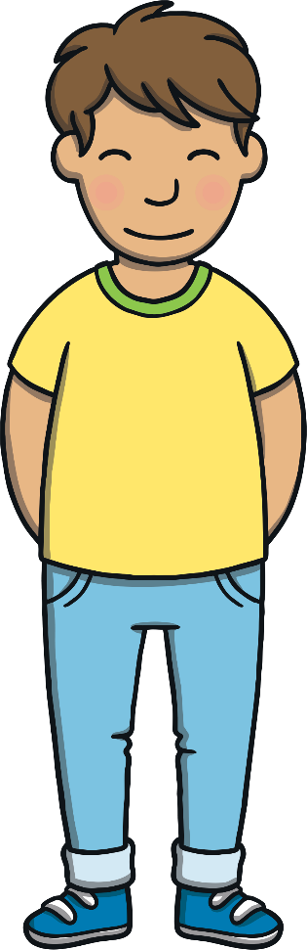
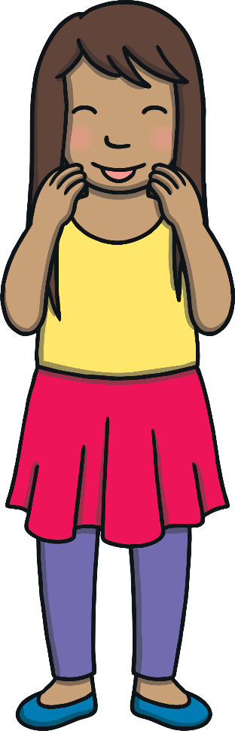
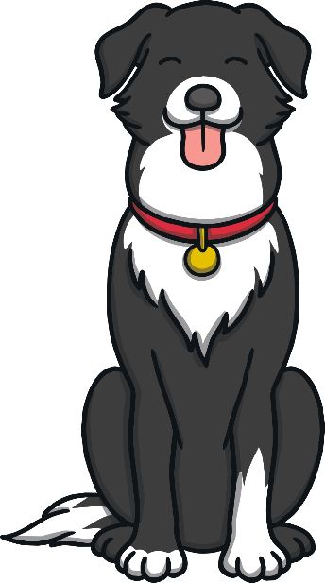
Teach
Today, we are practising reading words that contain
consonant blends.

Slide 4
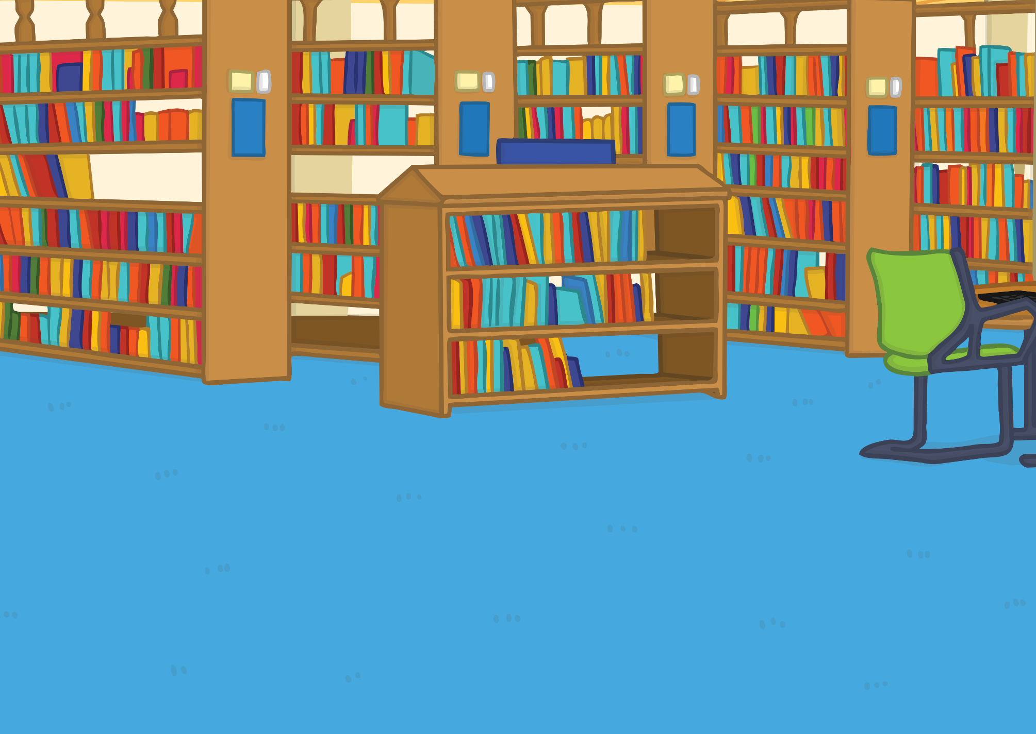
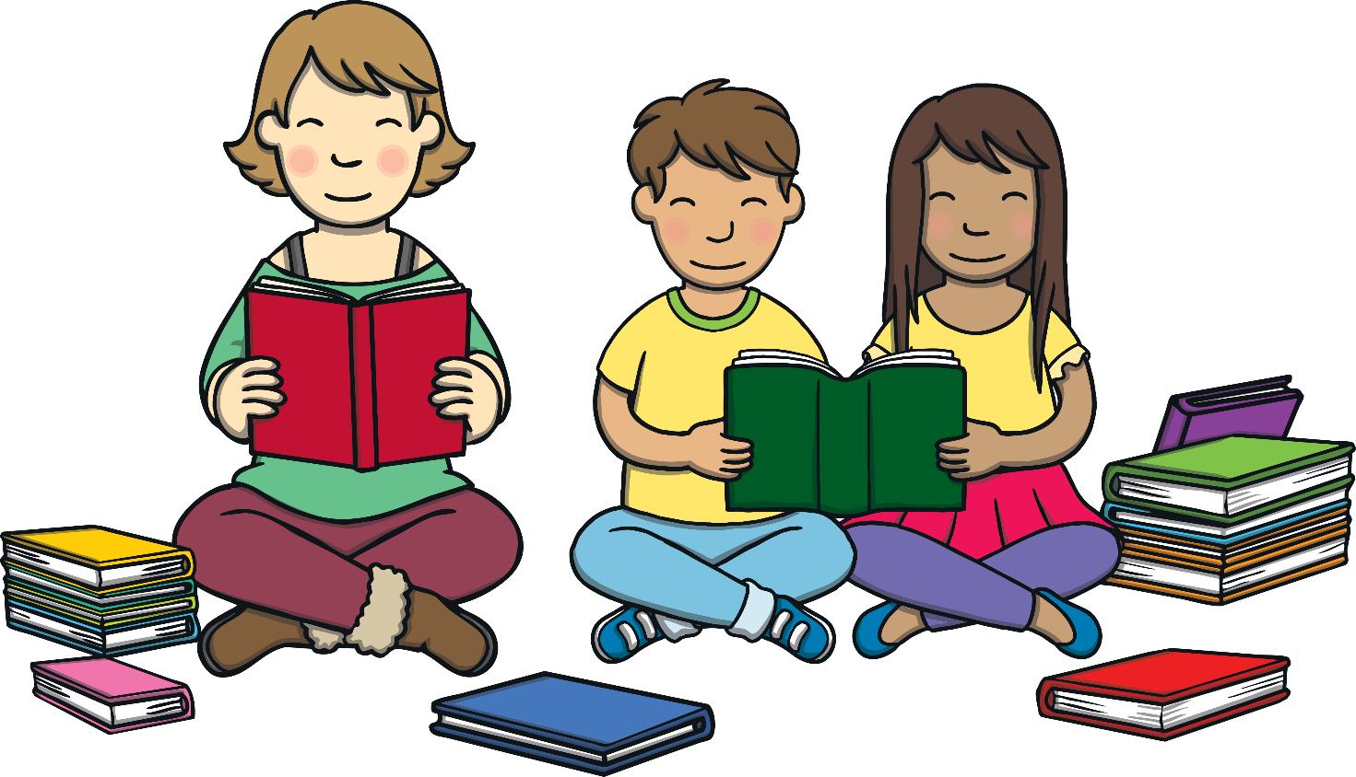
Teach
Kit, Sam and Mum were in the library reading some story books all about great storms at sea. “There are some very exciting stories in this book,” said Kit.

Slide 5
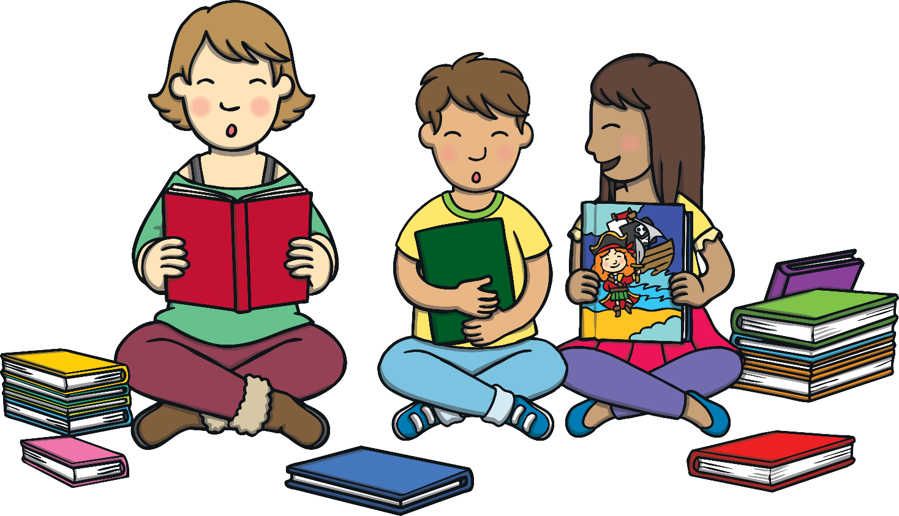
Teach
“Wow,” said Sam. “There is an interesting story here about a girl pirate who survived being shipwrecked by a storm. “She got to live on a fantastic island for a whole year!”

Slide 6
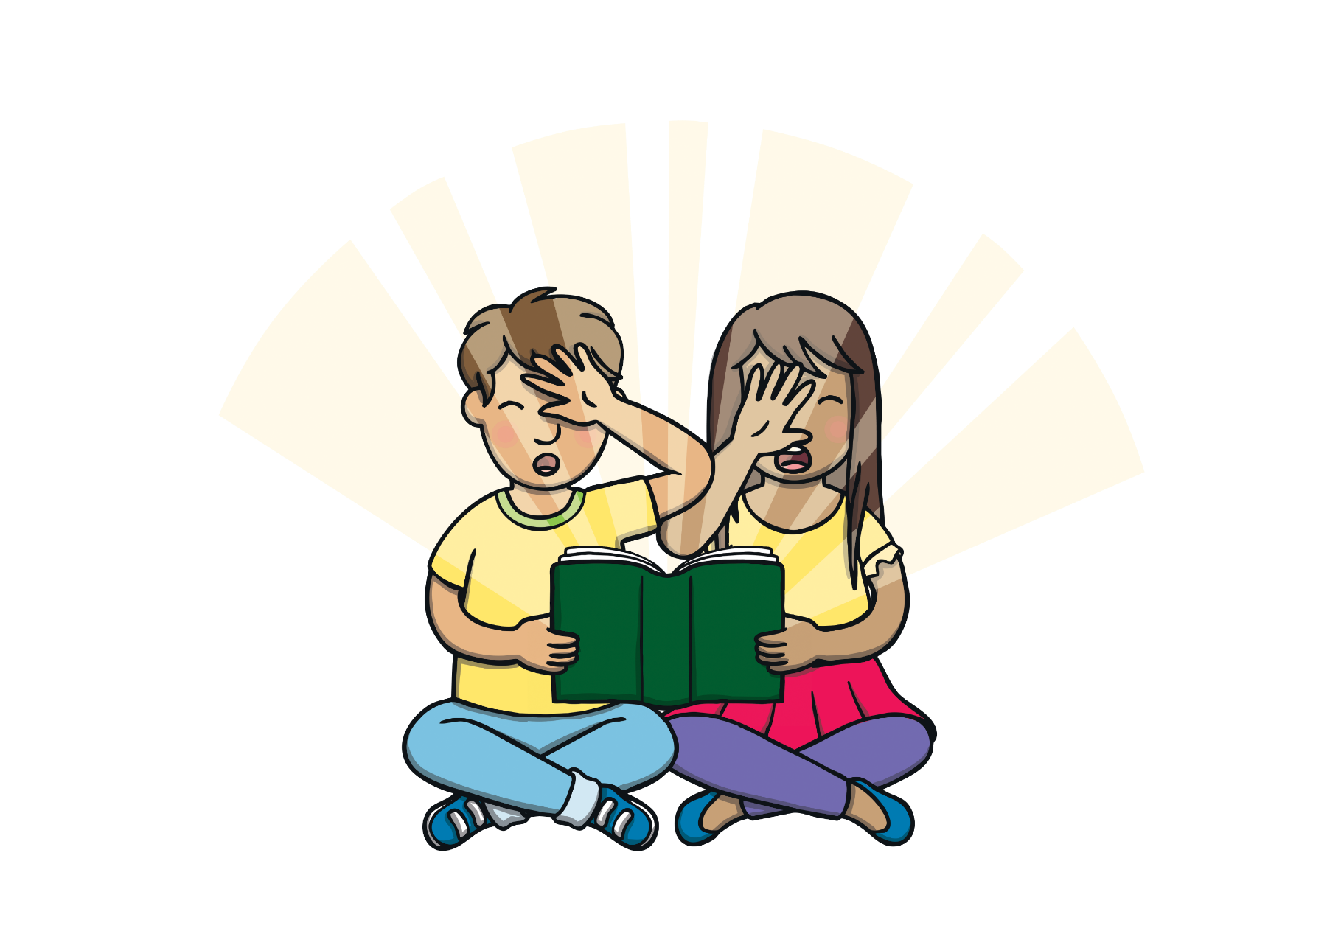

Teach
“I think I’d like to live on a pirate island,” said Kit.
“That gives me an idea,” whispered Sam. “Let’s get the magic book! It’s in my bag. Make sure Mum doesn’t see it.”

Slide 7


Teach
The Magic Book is taking Kit and Sam to Pirate Island. They can see letters on boats in the distance. Can you read the consonant blends as they sail past?

Slide 8
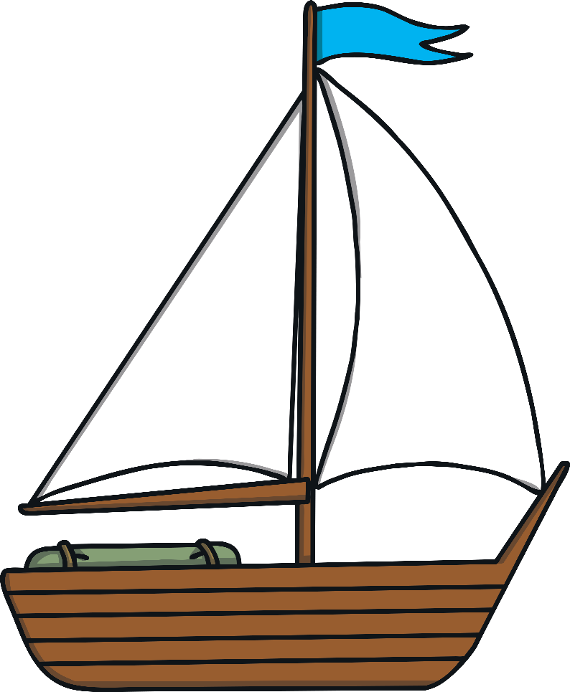
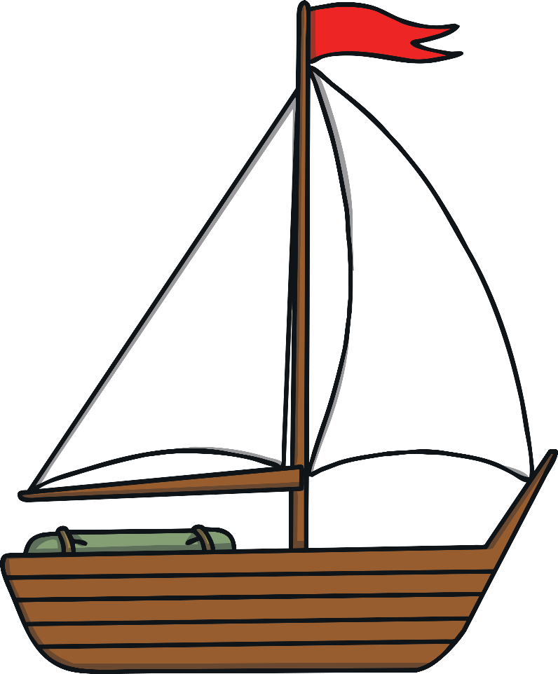
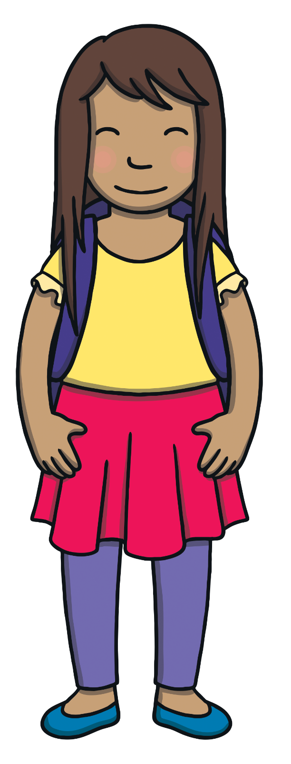
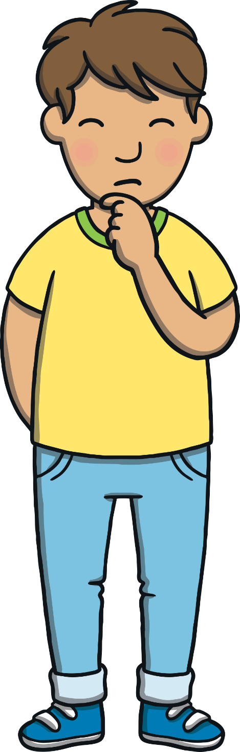
Practise
pl
lp
sl
st
cr
lt
cr
cr
cr
cr
nch
fl

Slide 9
Practise
Teach
Kit and Sam begin to wonder where the magic book might take them. Can you guess what they might see?

Slide 10
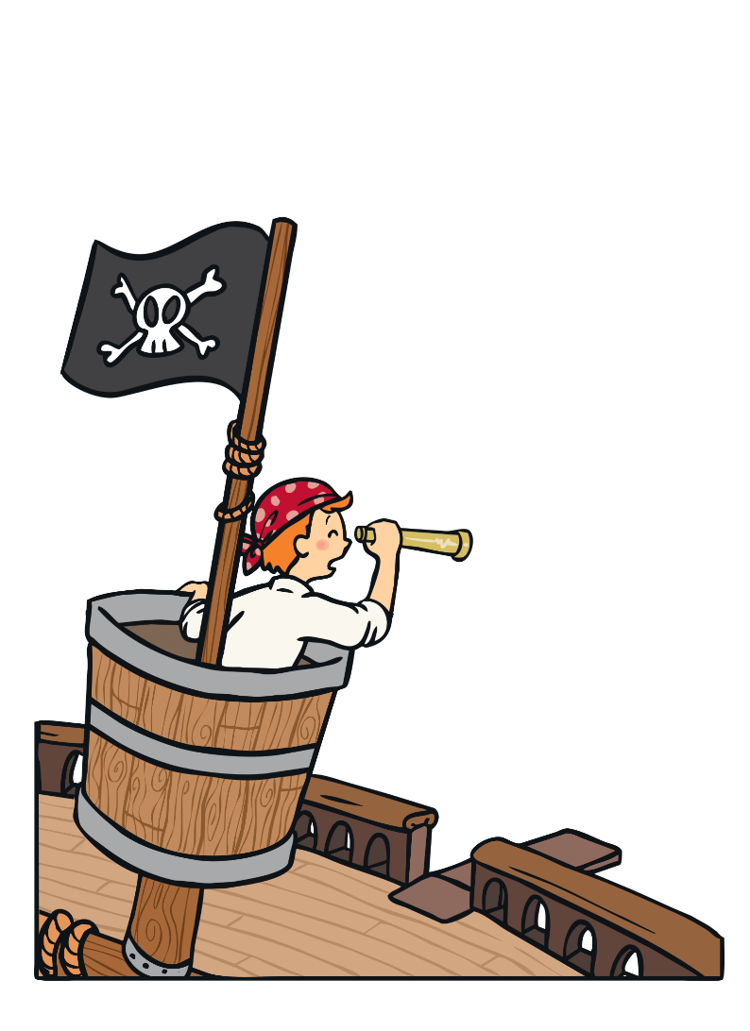
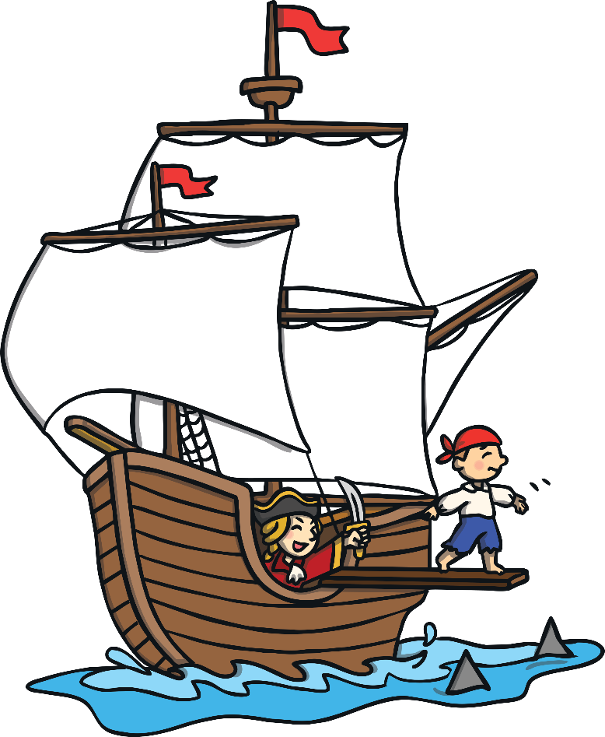

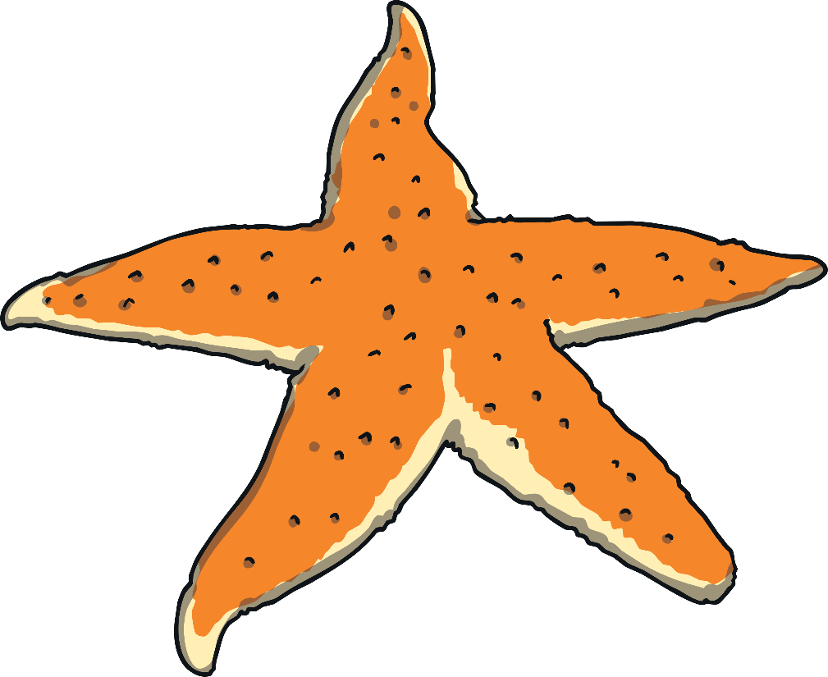
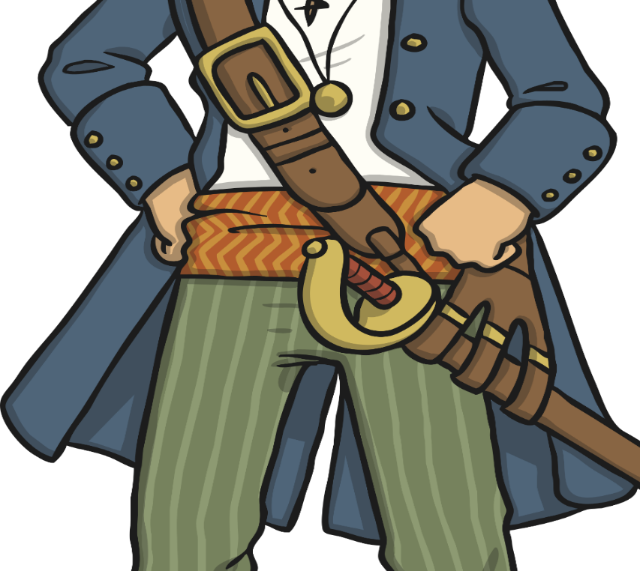
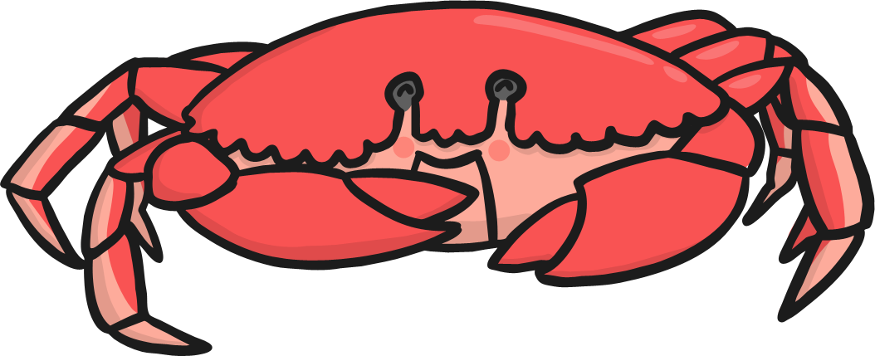
Practise
Teach
fl__
cr__
st __ __ __
___nk
__st
__lt

Slide 11
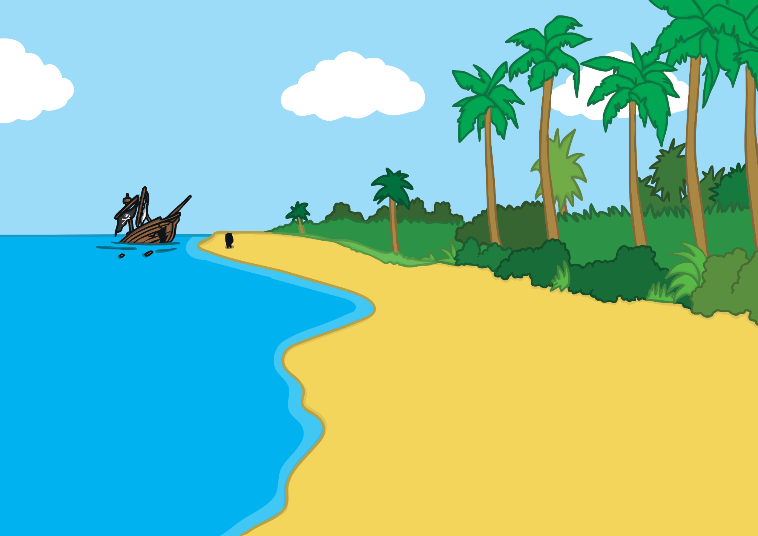
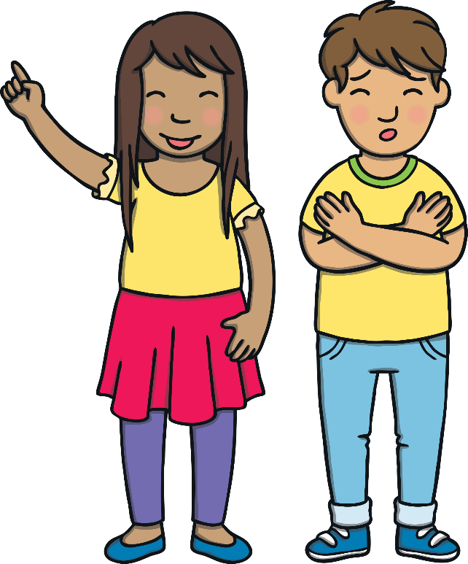
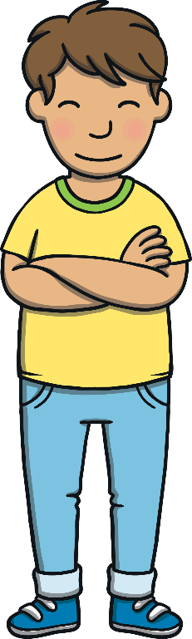
Apply
“What’s that over there?” said Sam, pointing into the distance. A girl pirate was standing on the beach next to something…
Kit and Sam arrived on a beautiful island. “This is good,” said Kit.

Slide 12
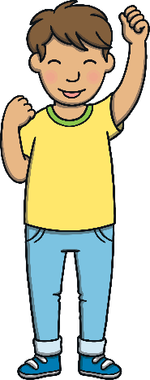
Apply
Sentence Time
What can Sam see in the distance?
Click ‘Show’ to see a suggested caption for the picture.
X
Click me for Kit’s teaching tips!

Slide 13
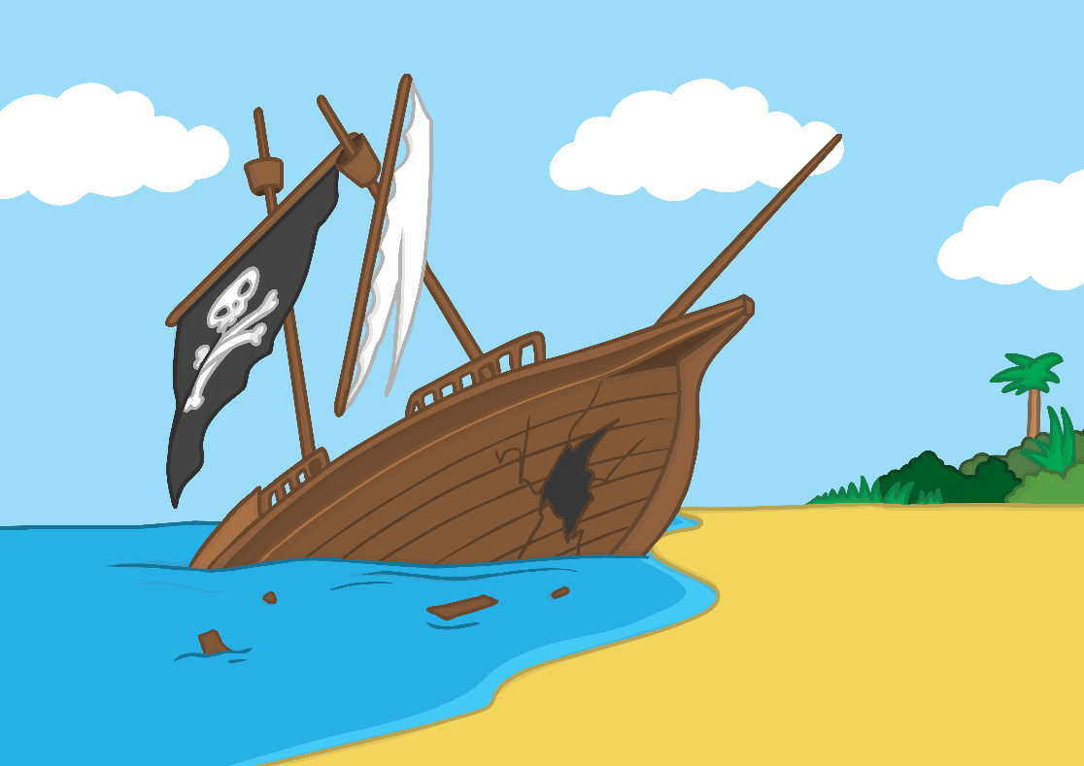
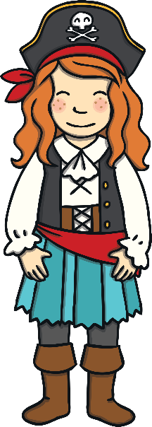

Apply
Her big ship sunk in the thunderstorm.
Sound Buttons On/Off
Show

Slide 14
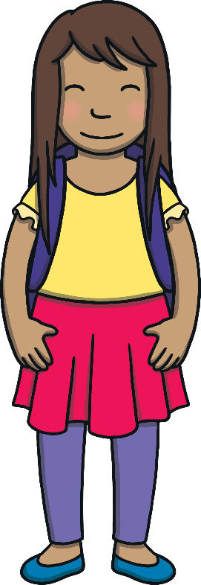
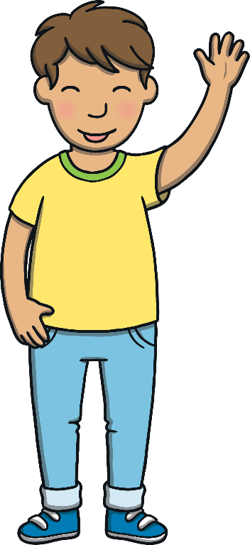
Apply
“Wow,” said Kit. “A real pirate! Let’s go and help her.” So Kit and Sam set off on a jolly walk across the island, excited about their next adventure!

Slide 15



Today, we have learnt… Consonant Blends
The adventure continues next lesson!

