Slide 1
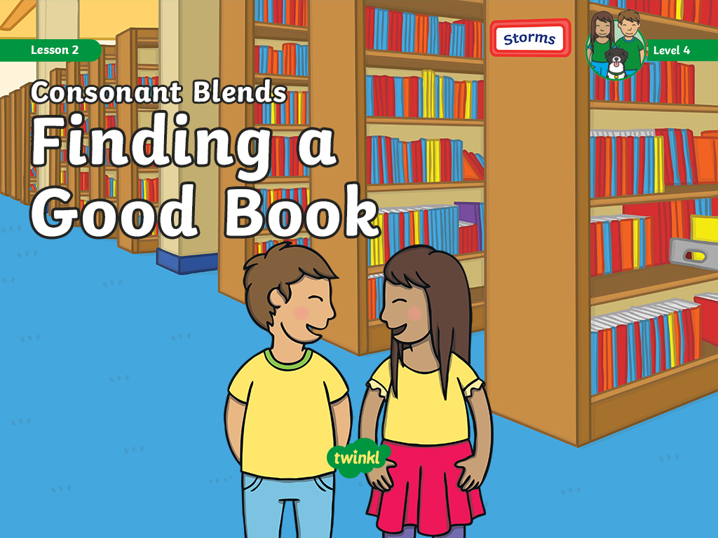

Slide 2
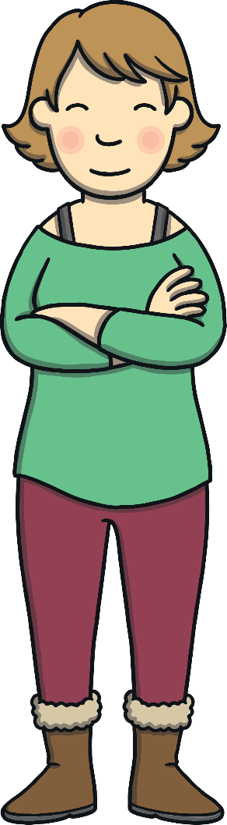
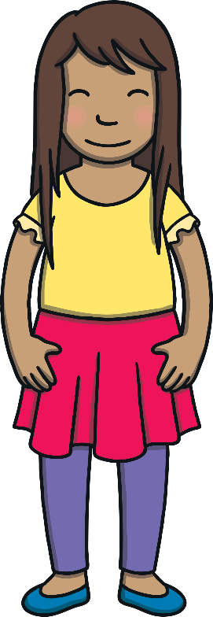
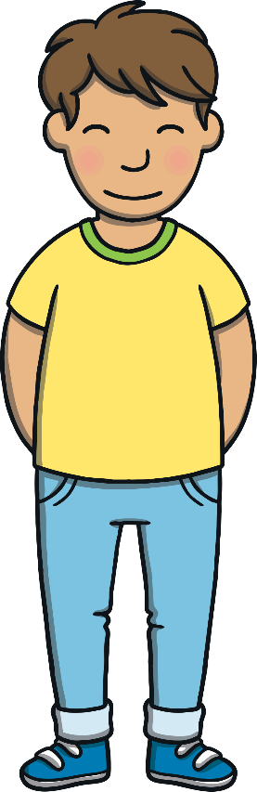
Today, we are practicing reading words that contain
consonant blends.
Teach

Slide 3
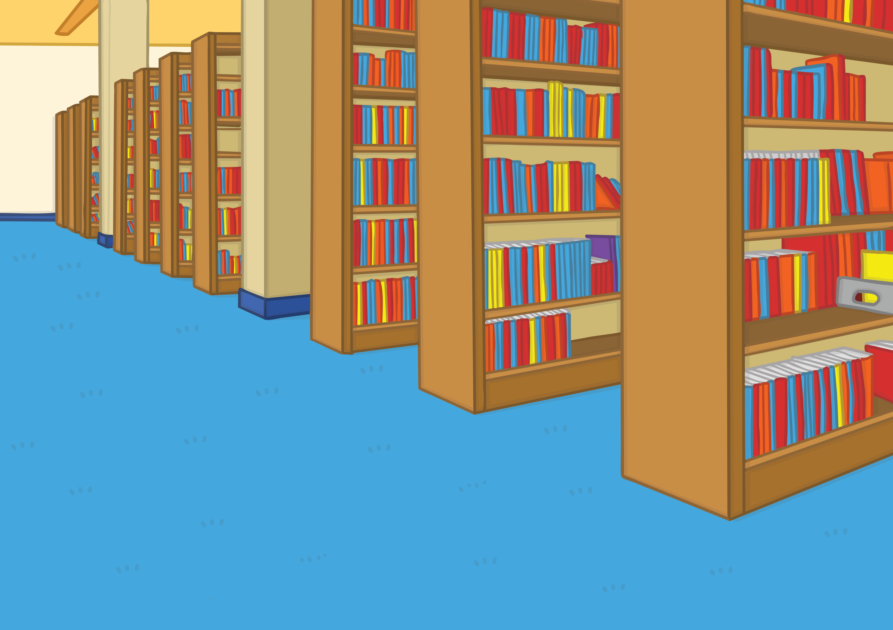
Teach
Kit, Sam and Mum had arrived at the library to take shelter from the storm. Kit and Sam were keen to read all about famous thunderstorms.

Slide 4

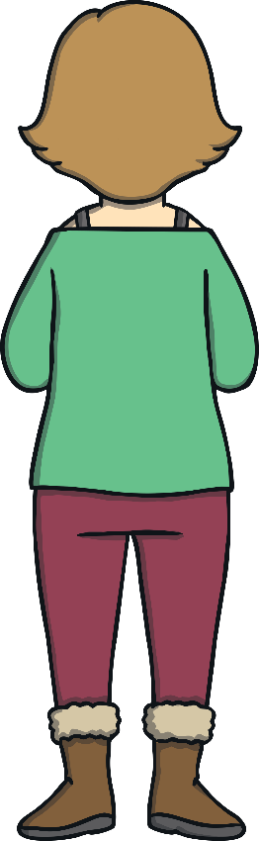
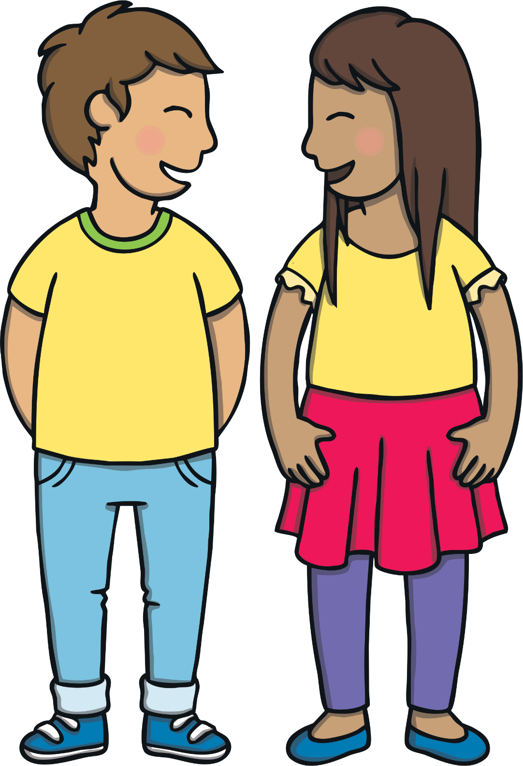
Teach
“Come on,” said Kit. “Let’s find the right part of the library and search for some exciting storm books.” Mum went to look at books on flowers.

Slide 5
Teach
Kit and Sam are trying to find the section of the library that has books all about storms. Can you help them to read the signs and find the right section?

Slide 6
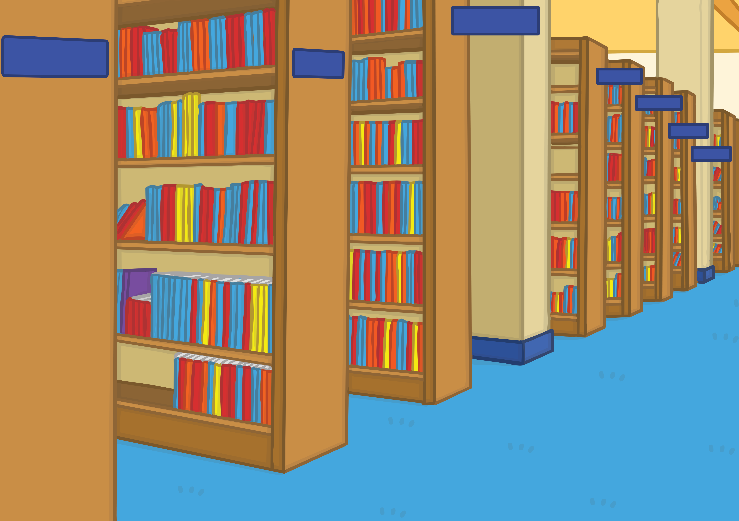
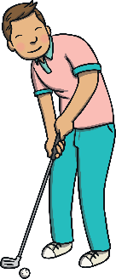
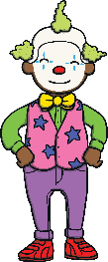


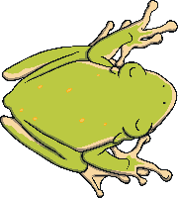
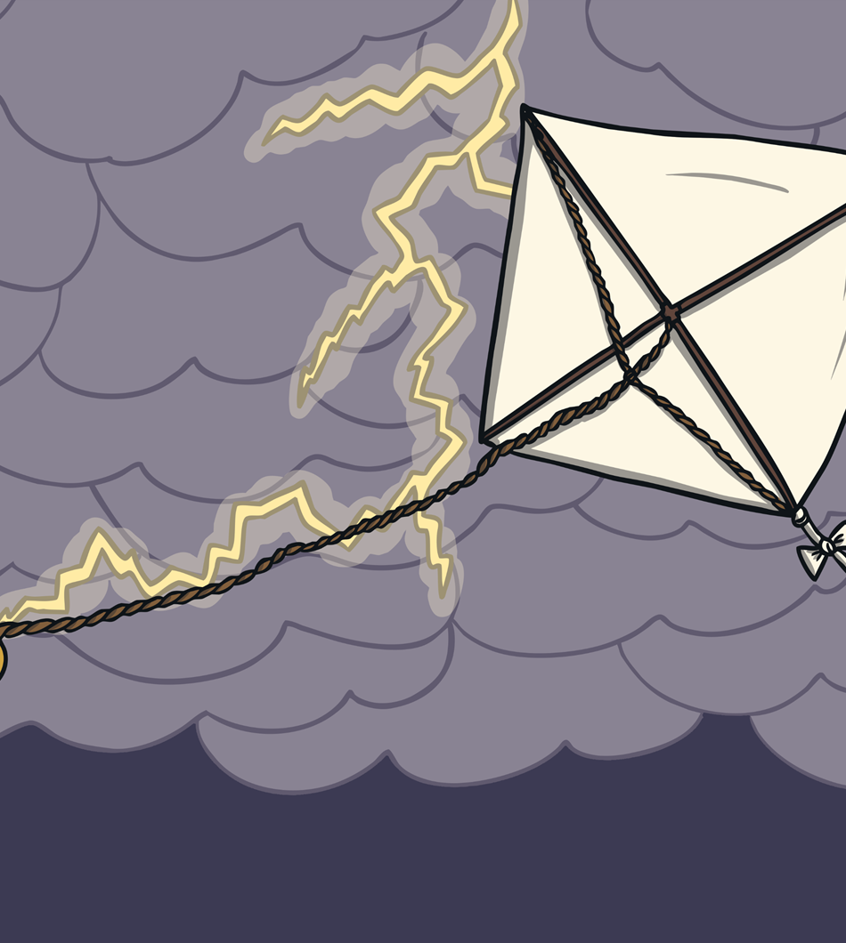
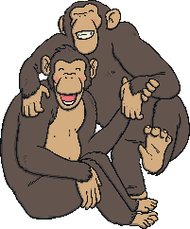
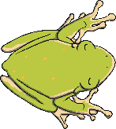

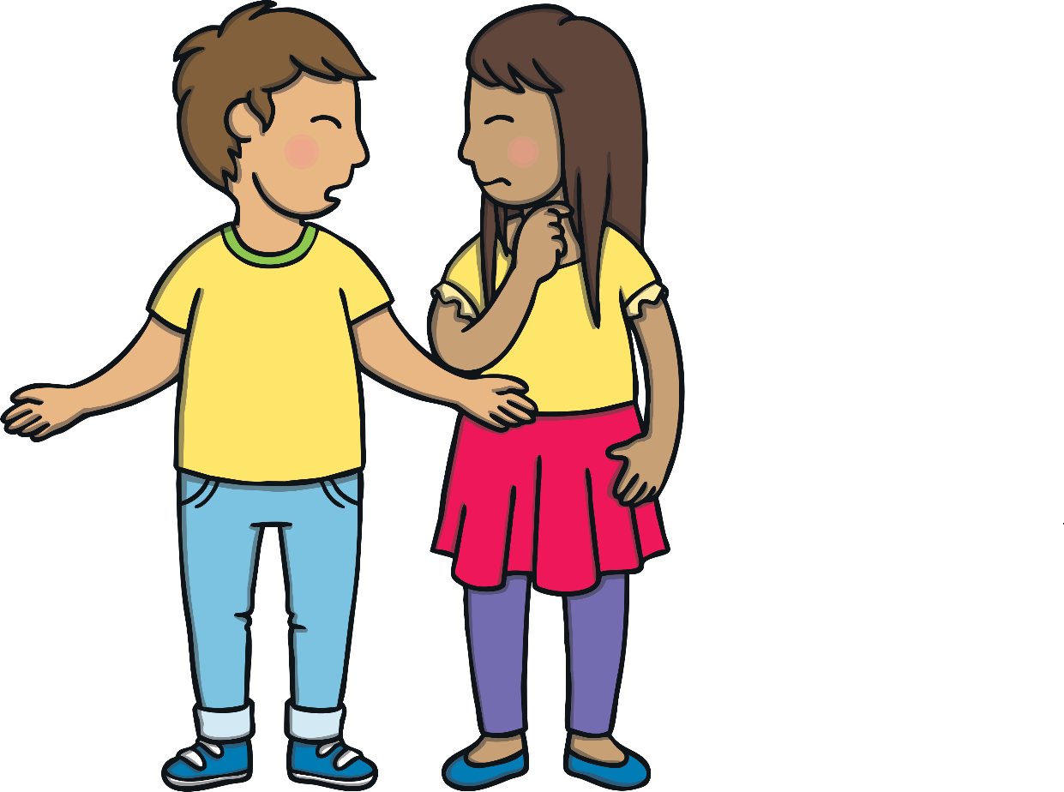
Teach
chimps
chimps

Slide 7
Teach
ponds
chimps
ponds

Slide 8
Teach
golf
chimps
ponds
golf

Slide 9
Teach
handstands
handstands
chimps
ponds
golf

Slide 10
Teach
frogs
chimps
handstands
frogs
ponds
golf

Slide 11
Teach
clowns
handstands
chimps
clowns
frogs
ponds
golf

Slide 12

Teach
storms
clowns
storms
chimps
handstands
frogs
ponds
golf

Slide 13
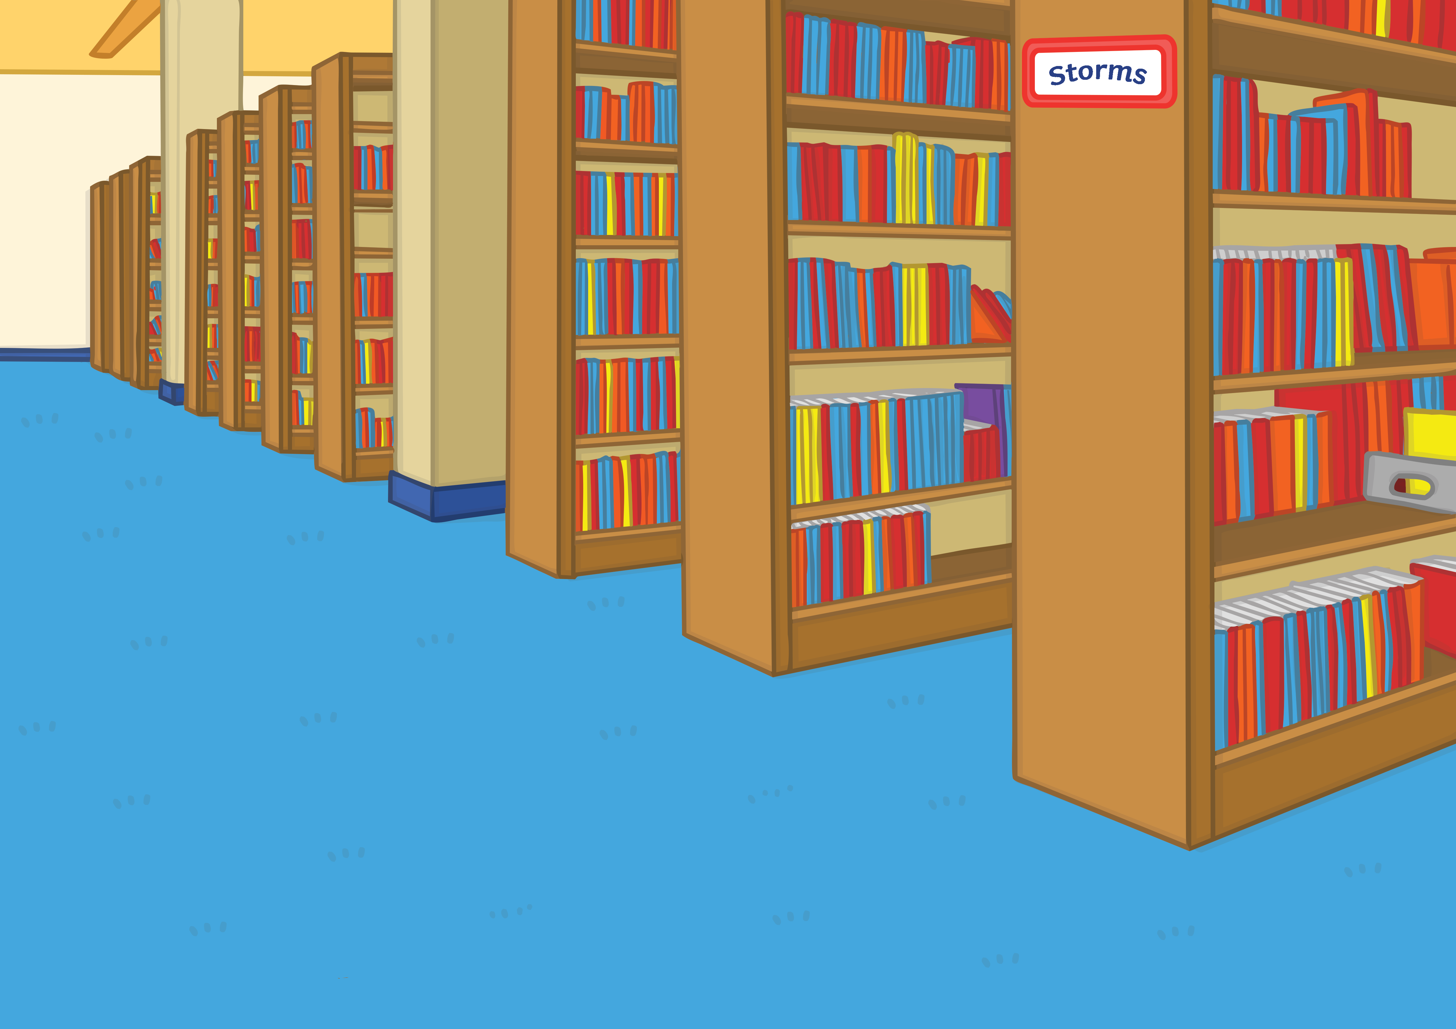
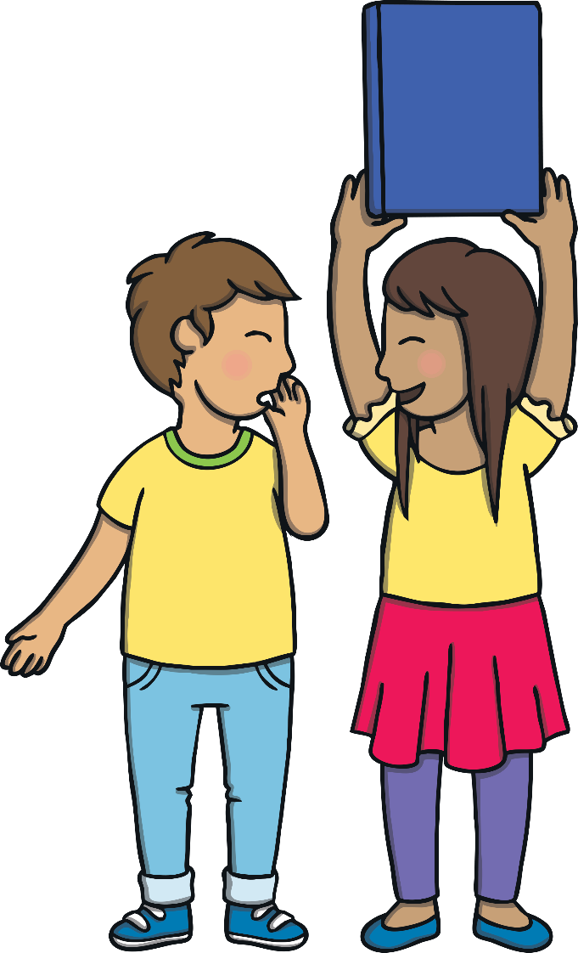
Apply
Finally Kit and Sam found the section on storms. “Quick, let’s find some good books to get out before Mum wants to go home,” whispered Sam. “Ha ha, I think we need this one,” said Sam, holding a book in the air.

Slide 14
Apply
Sentence Time
What was the book that Sam found? Read the caption then click ‘Show’ to reveal the title of the book!

Slide 15
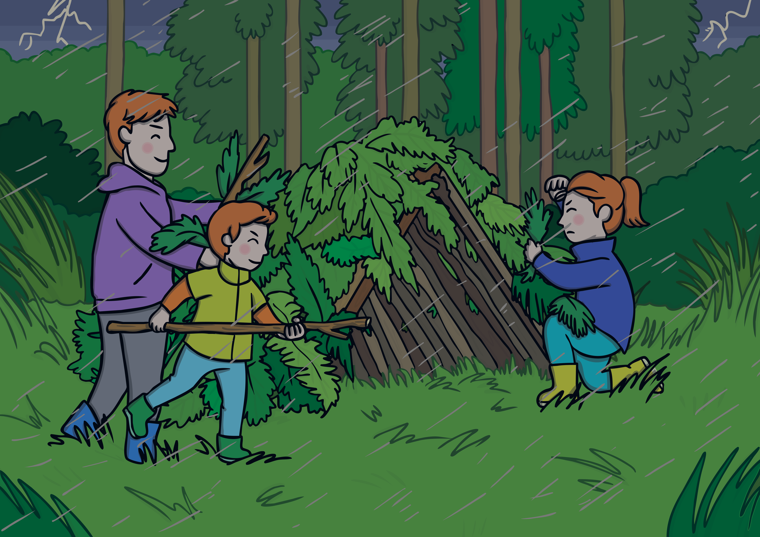

Apply
How to shelter from the wind and
rain when you are out in a storm.
Sound Buttons On/Off
Show

Slide 16
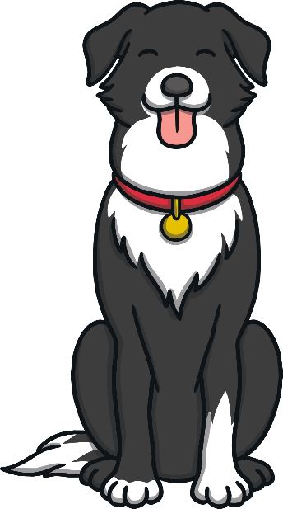
Today, we have practiced…
consonant blends
The adventure continues next lesson!

