Slide 1
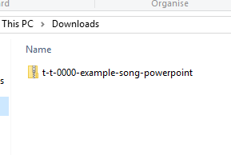
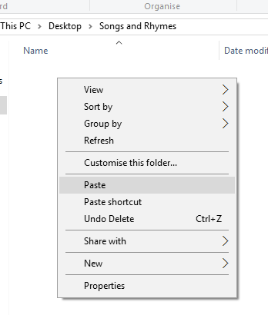


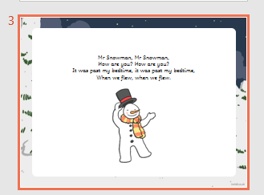
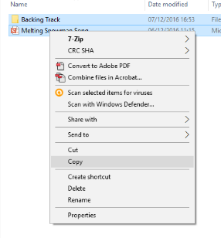
Guidance for Video/Audio in PowerPoints
1. Open the folder and copy all the files.
2. Paste the copied files into a new folder.
3. Open the PowerPoint file, enable editing and enter presentation mode (start the slide show).
Please note the embedded audio may not be compatible with early versions of PowerPoint.
You may wish to delete this slide before beginning the presentation.

Slide 3










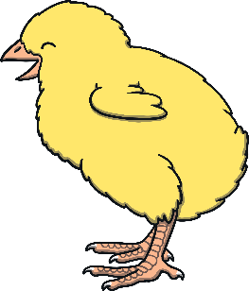

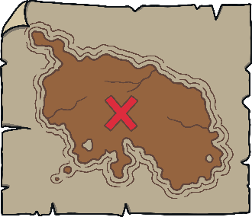










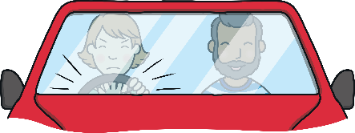


Revisit and Review
Let’s practise Sam’s Sounds and Tricky Words!
w
er
v
ure
air
qu
ng
j
ch
z
ar
x
ee
ow
ur
ai
sh
igh
th
y
or
oo
oa
ear
oi
there
one
were
so
little
have
come
said
like
some

Slide 4

Teach
This week, we meet our next tricky
words for reading:
do
when
out
what
Tricky words are words that can’t be sounded out. We just have to learn them off by heart!

Slide 5
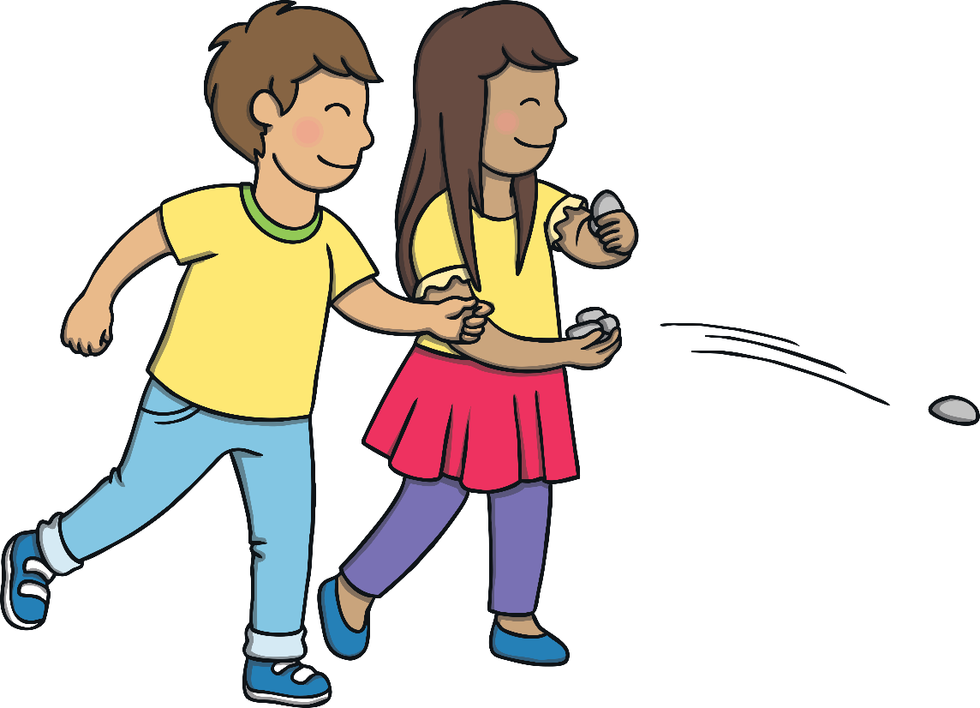
Teach
Ripple Patterns
Kit and Sam are in the park throwing stones into the pond. Read the tricky words that the ripples are making.

Slide 6
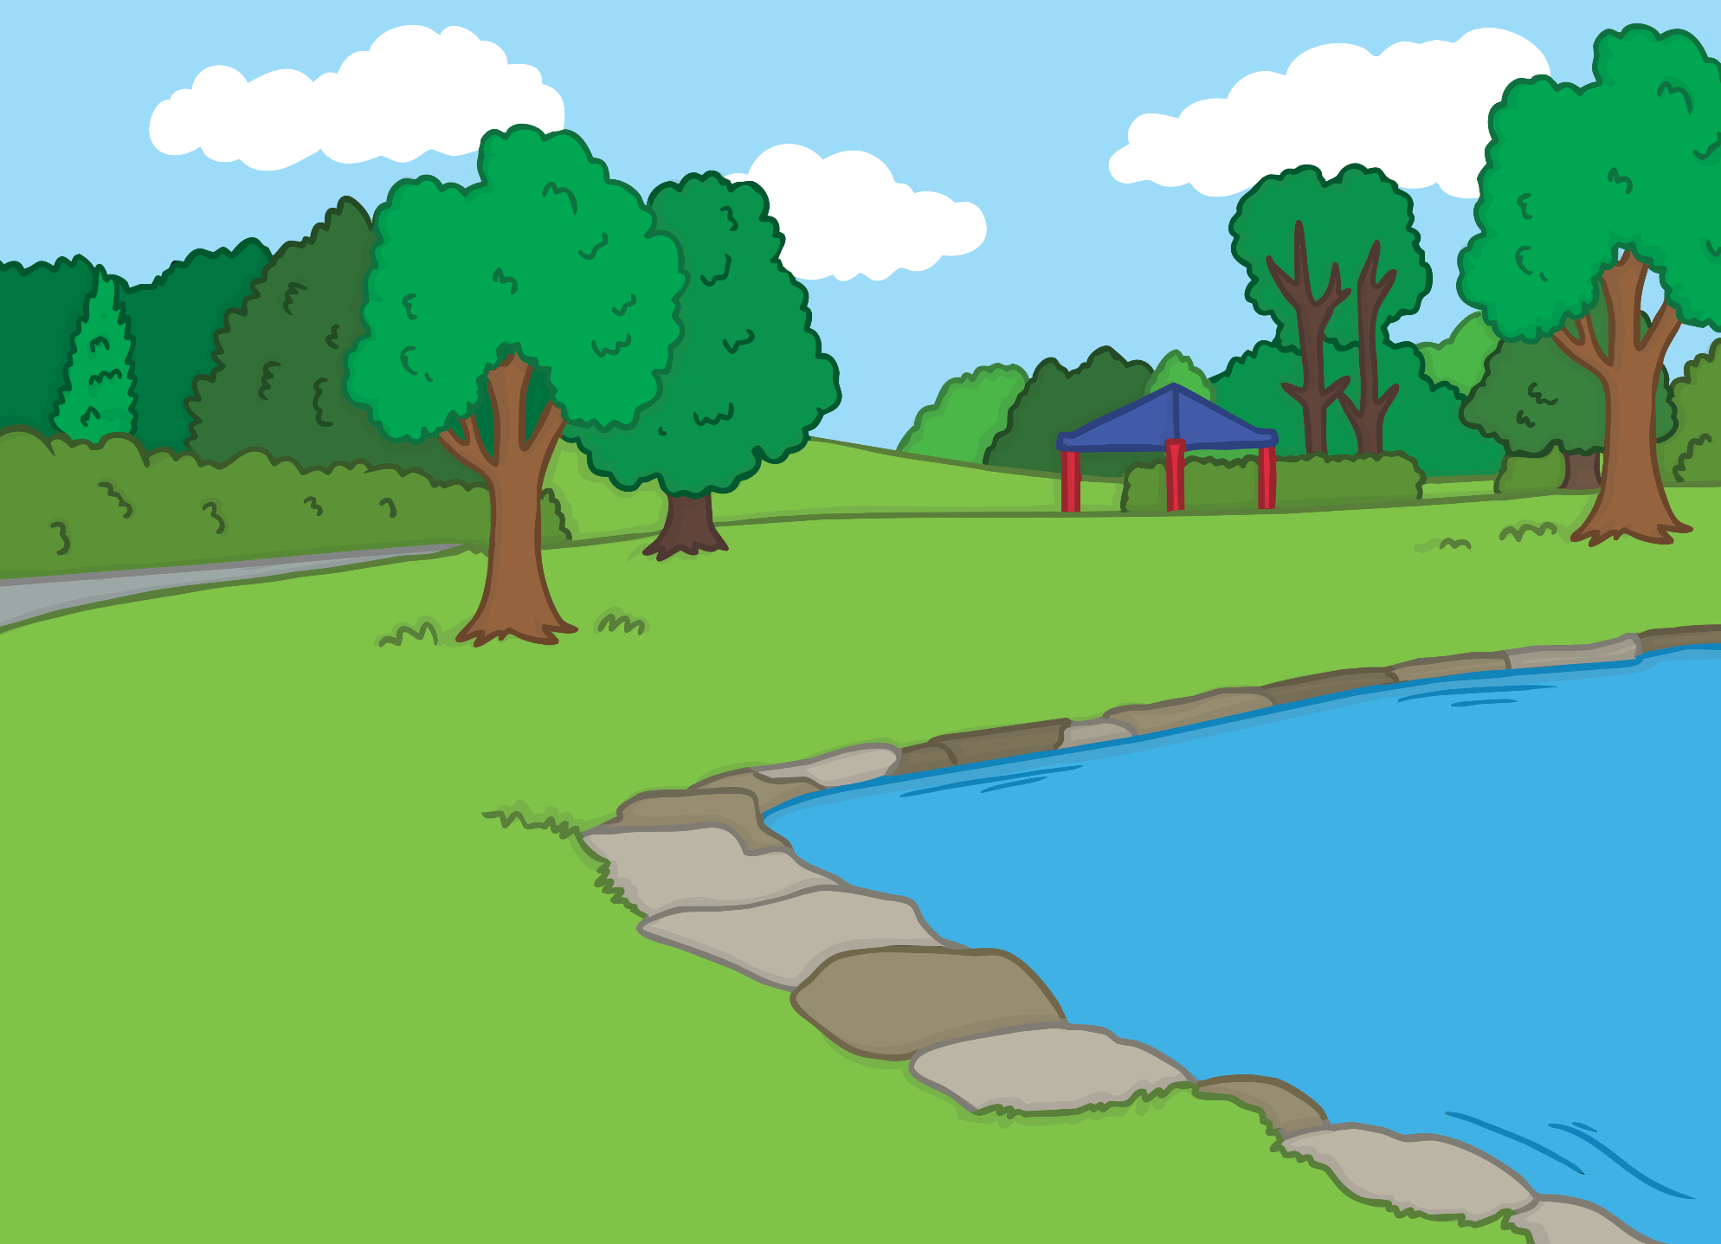

Teach
when
what
what
when
out
out
do
do

Slide 7

Teach
Today, we are practising reading words that contain
consonant blends.

Slide 8
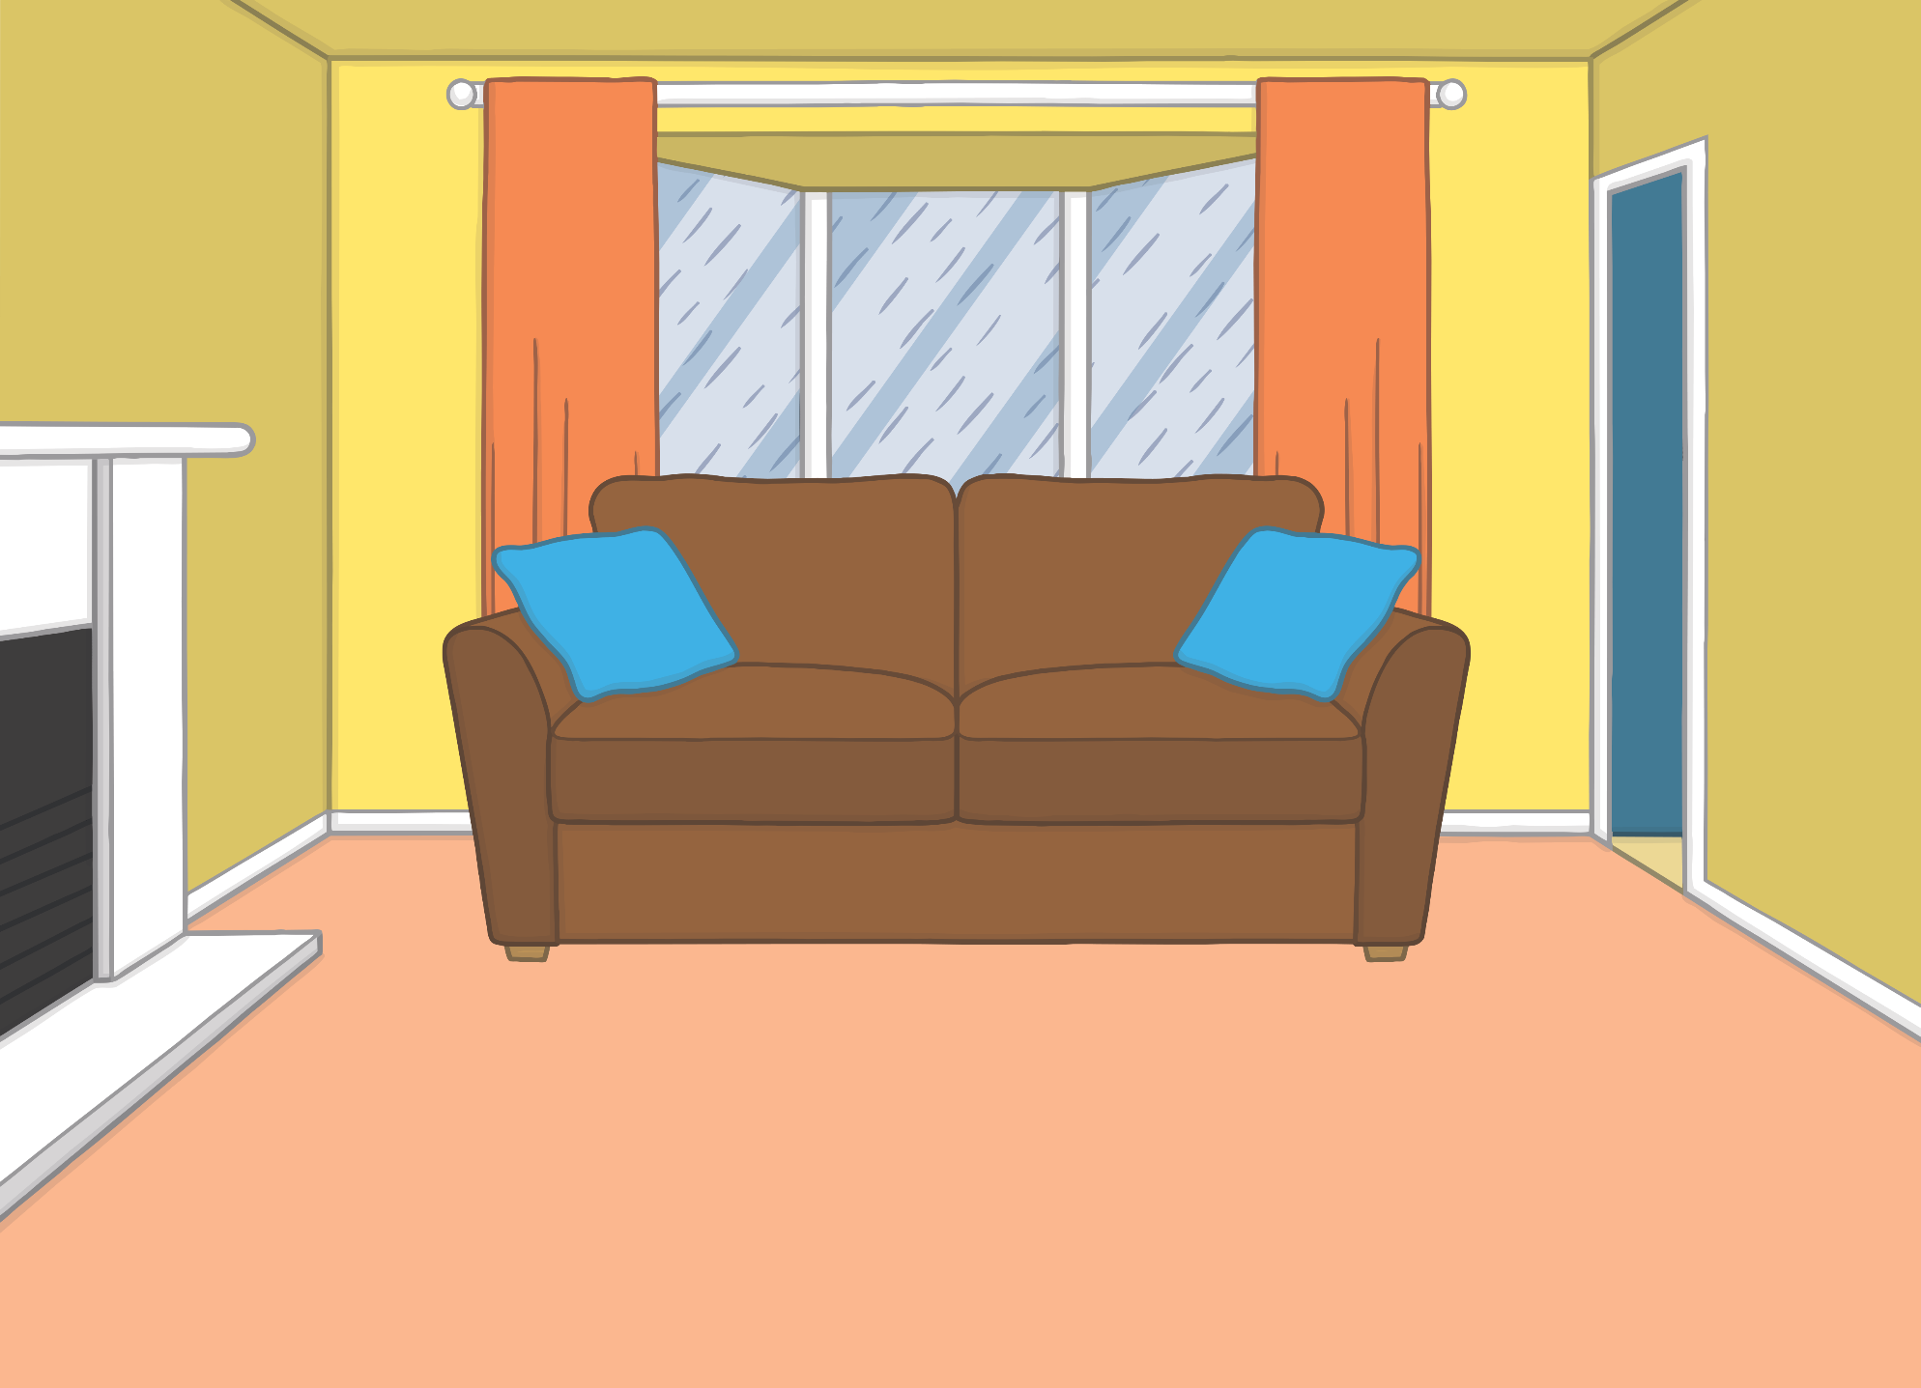


Teach
One rainy day, Kit and Sam were fed up. “Shall we go to the library to look at some books?” said Kit.
“That is a good idea!” said Sam.
“I will come too,” called Mum, from the other room.

Slide 9
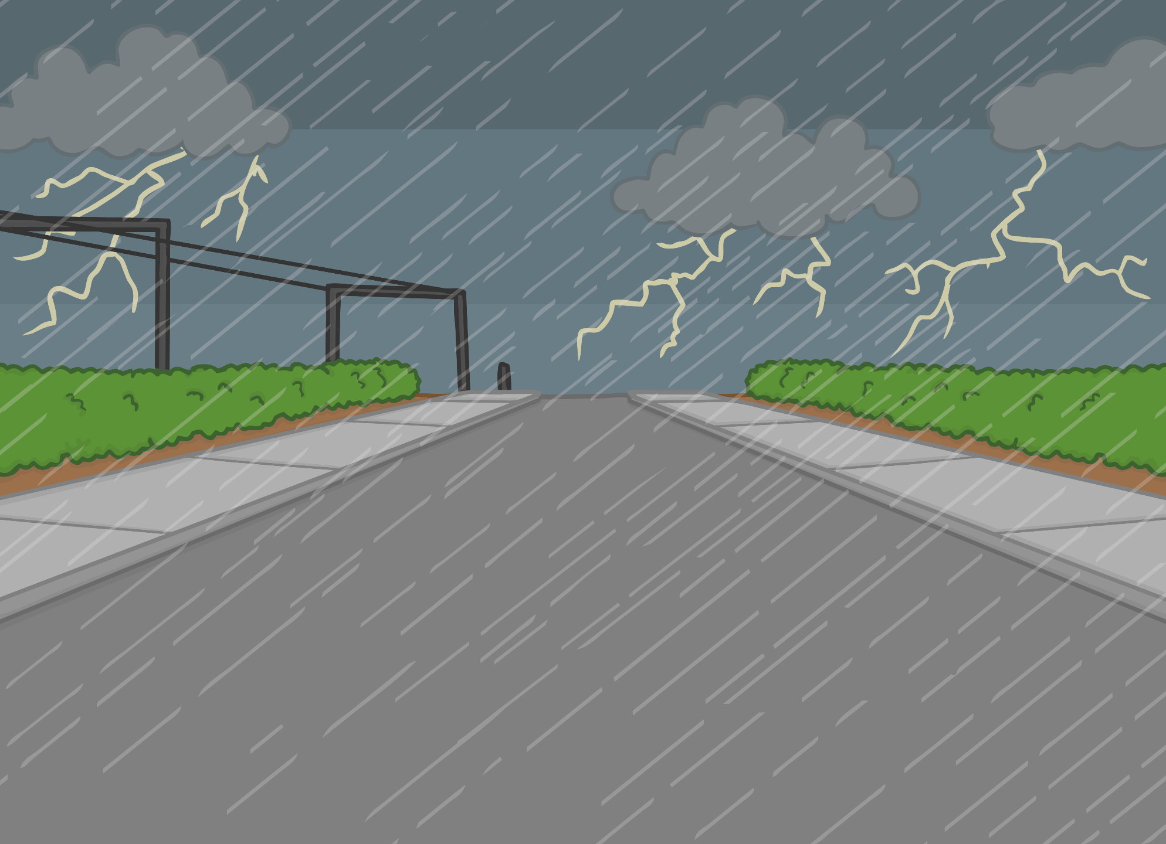
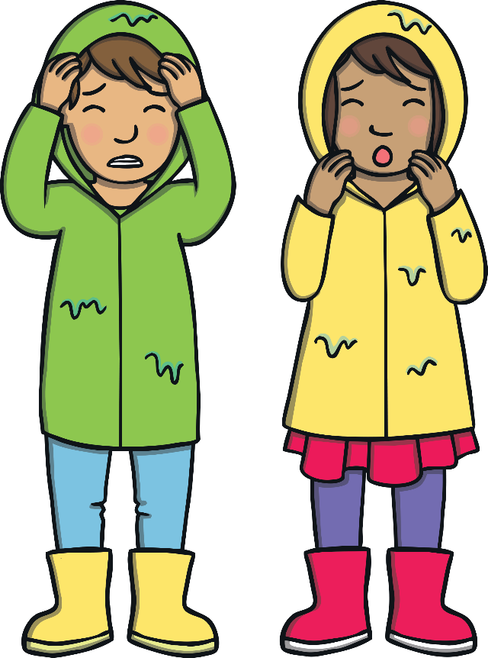
Teach
The library was a long walk from Kit and Sam’s house. On the way there, they heard a crack of thunder.
“Are you afraid of thunderstorms?” asked Sam.
“Yes,” said Kit, looking frightened.

Slide 10
Teach
Crash! went the thunder. Clap! went the lightning. Kit, Sam and Mum decided to find somewhere to take shelter from the storm.

Slide 11
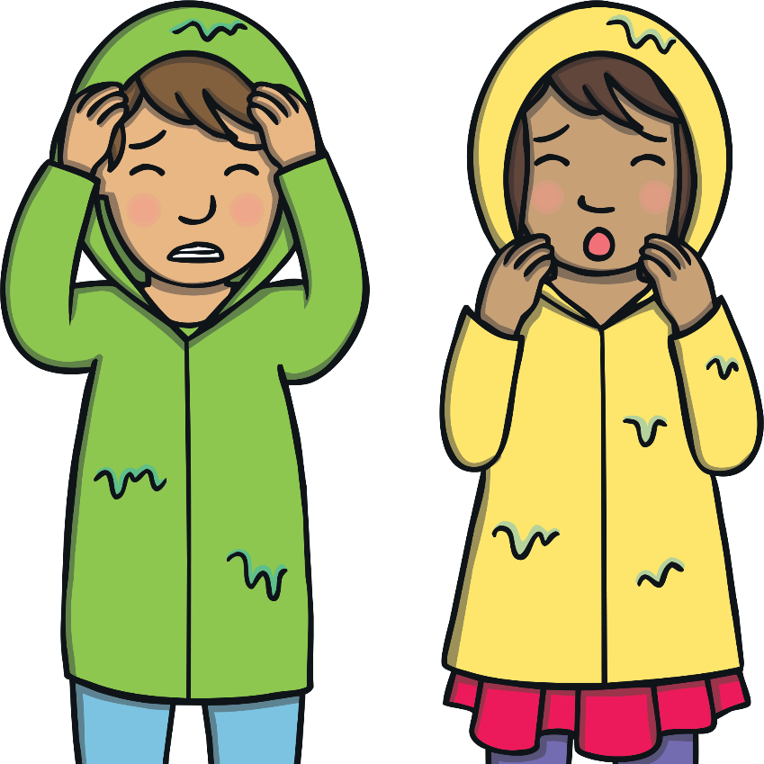

Teach
Kit and Sam are wondering about good places to take shelter along the way. What places might they find?
X
You can add challenge to this activity by asking the children to suggest a word that contains each blend.
Click me for Kit’s teaching tips!

Slide 12


Teach
street lamp

Slide 13

Teach
tree

Slide 14

Teach
train

Slide 15

Teach
flowers

Slide 16

Teach
junk

Slide 17

Teach
bench

Slide 18

Teach
bricks

Slide 19

Practise
Puddle Words
As they watch the rain splash down, Kit and Sam begin to see the raindrops make words in the puddles. Can you sound out the words to see what they have spotted?

Slide 20



Practise
sk
u
nk
Check

Slide 21

Practise
sw
i
m
Check

Slide 22

Practise
pl
u
m
Check

Slide 23
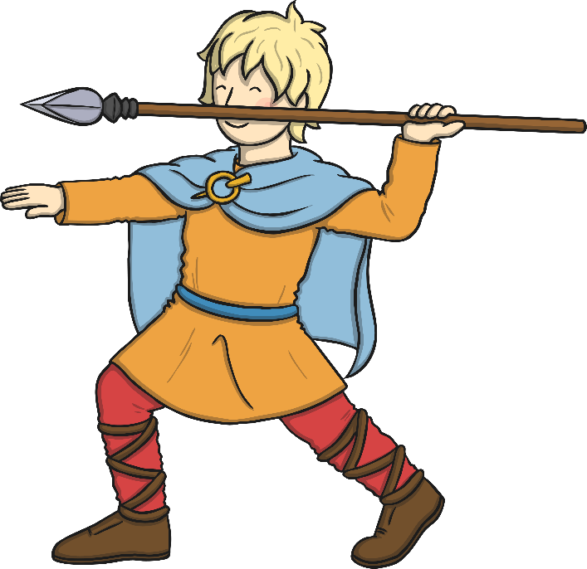
Practise
sp
ear
Check

Slide 24

Practise
fl
oa
t
Check

Slide 25

Practise
l
gr
ow
Check

Slide 26

Practise
st
o
p
Check

Slide 27
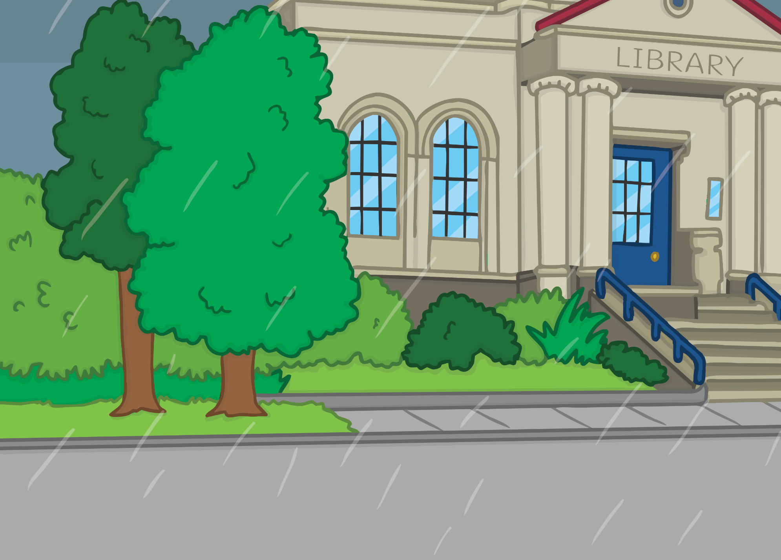

Apply
“Wow, what a long walk!” said Sam. Just then, there was another clap of thunder that made the children jump.
“Oh, what is that?” asked Kit.

Slide 28
Apply
Sentence Time
What can Kit see? Read the sentence then click ‘Show’ to reveal the answer!

Slide 29


Apply
The lightning struck the roof!
Sound Buttons On/Off
Show

Slide 30




Apply
They arrived at the library and ran inside to get out of the storm. “I’m in the mood for a book all about big storms,” said Sam.
“Ha ha, I think we have had enough storms for one day,” laughed Mum.

Slide 31
Today, we have practiced…
consonant blends

