Slide 1
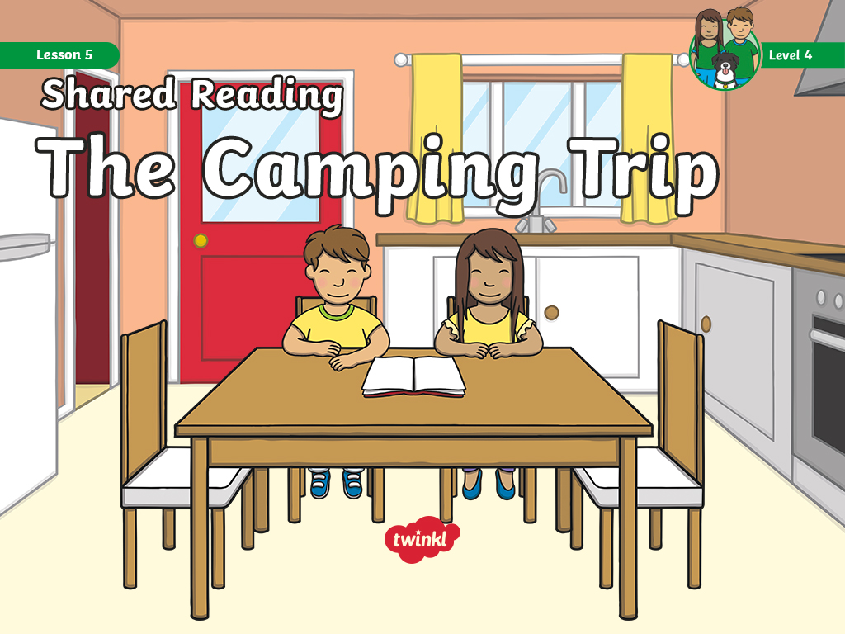

Slide 2

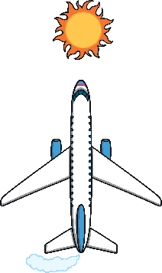
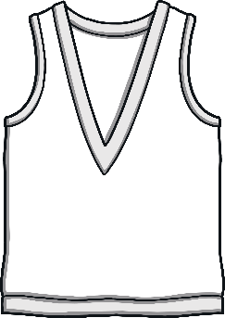


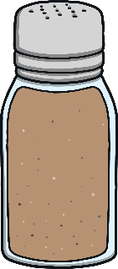
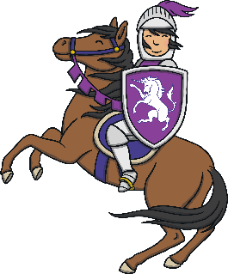



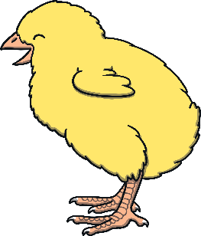

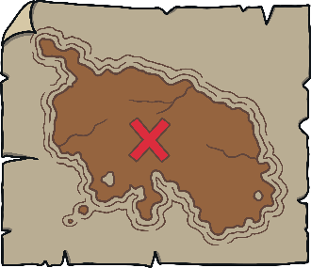
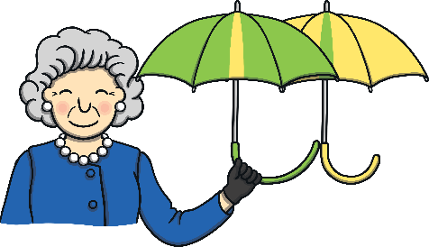
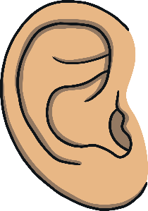
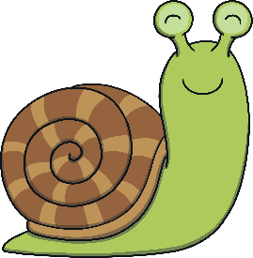
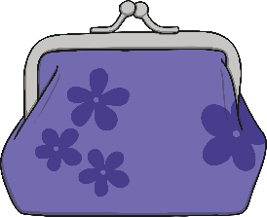
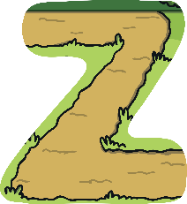

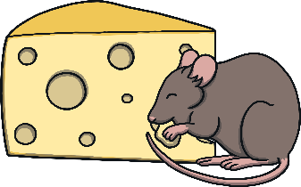


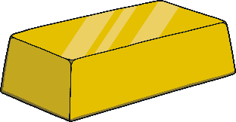



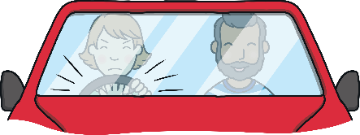

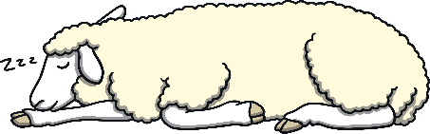
Revisit and Review
Let’s practise Sam’s Sounds and Tricky Words!
w
er
v
ure
air
qu
ng
j
ch
z
ar
x
ee
ow
zz
ur
ai
sh
igh
th
y
or
oo
oa
ear
th
oo
oi
were
one
there
some
come
have
said
like
so
little

Slide 3
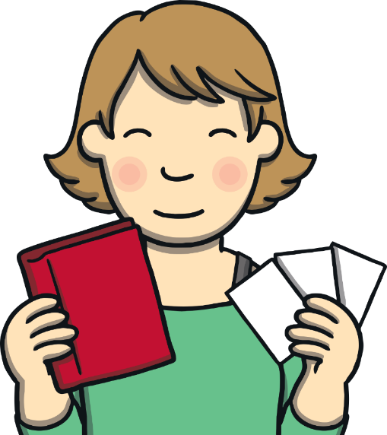
Teach
Today, we are reading a book that contains consonant blends.

Slide 4
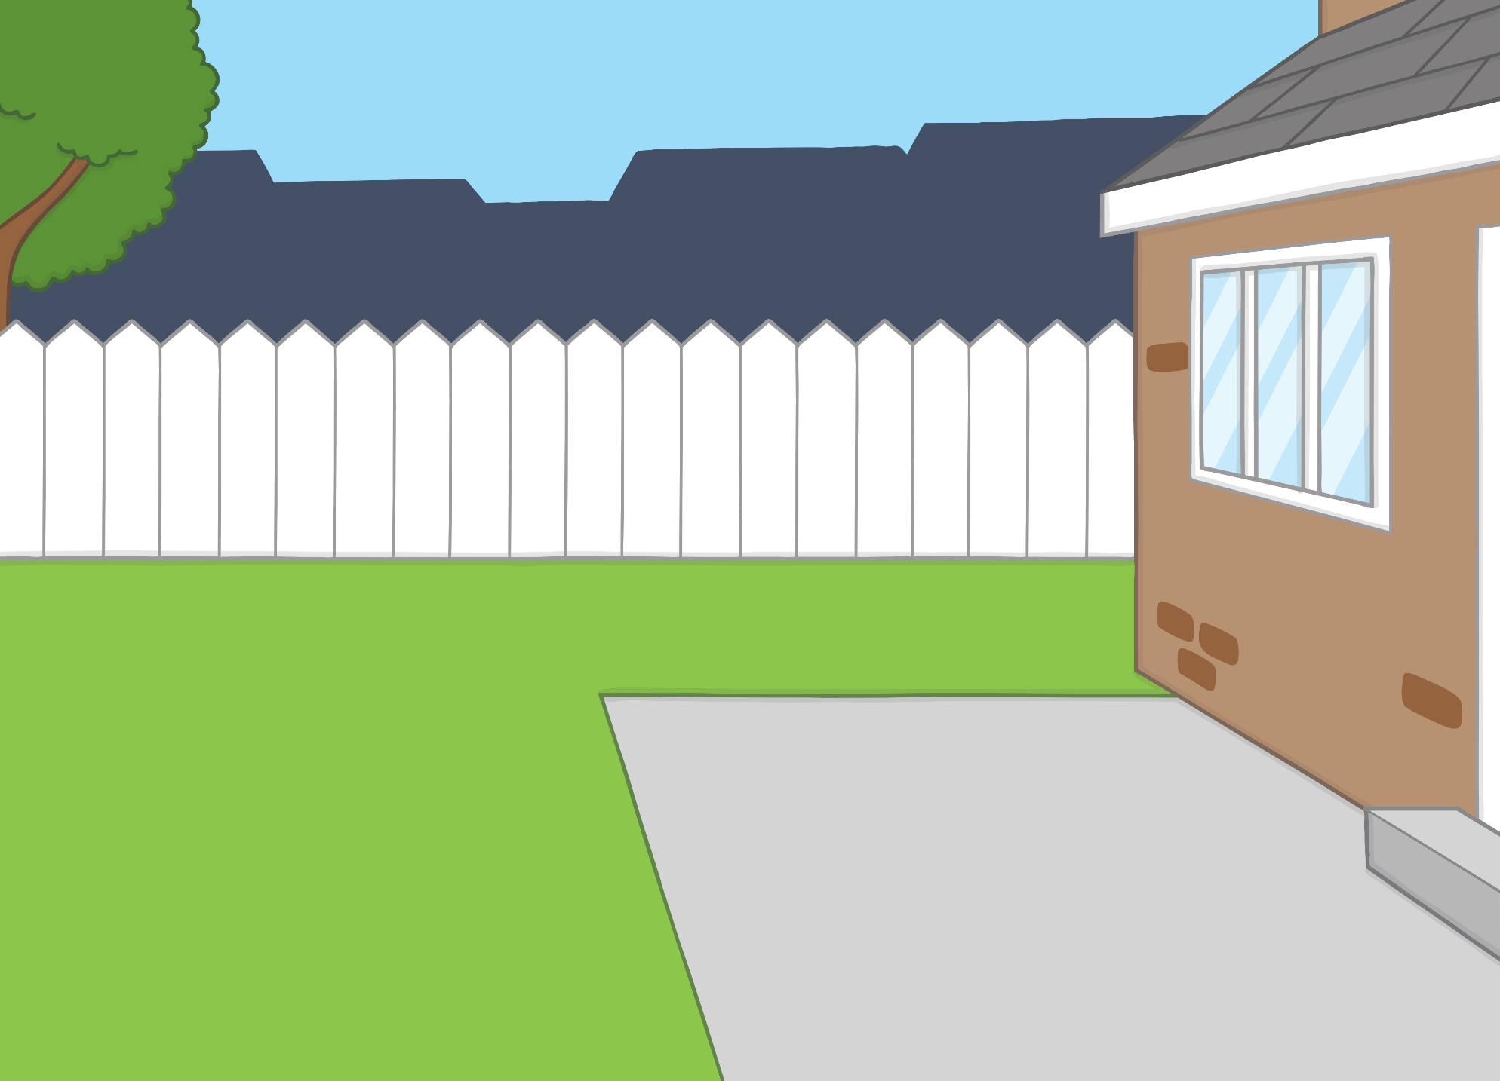

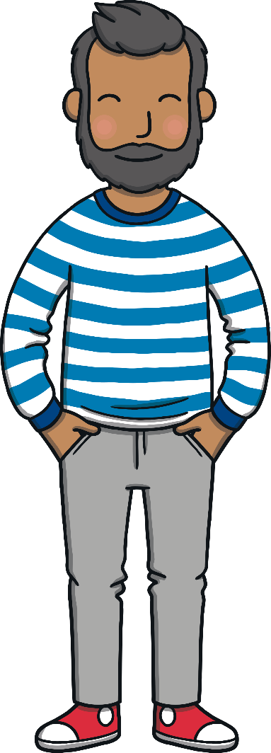
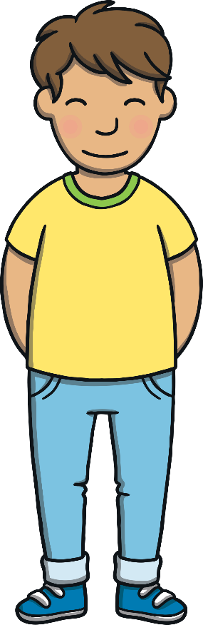


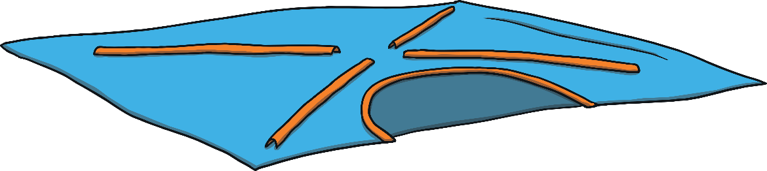
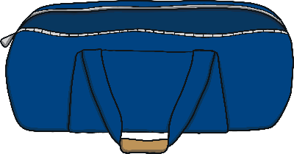
Teach
The family were back from their camping trip. “We had a great time,” said Kit and Sam.
“Yes,” said Dad, “but now we have to put away all the gear.”

Slide 5


Teach
They all helped to put the tent, lamp and sleeping bags away. “Phew!” said Mum. “Time for a nice cup of tea,
I think.”

Slide 6
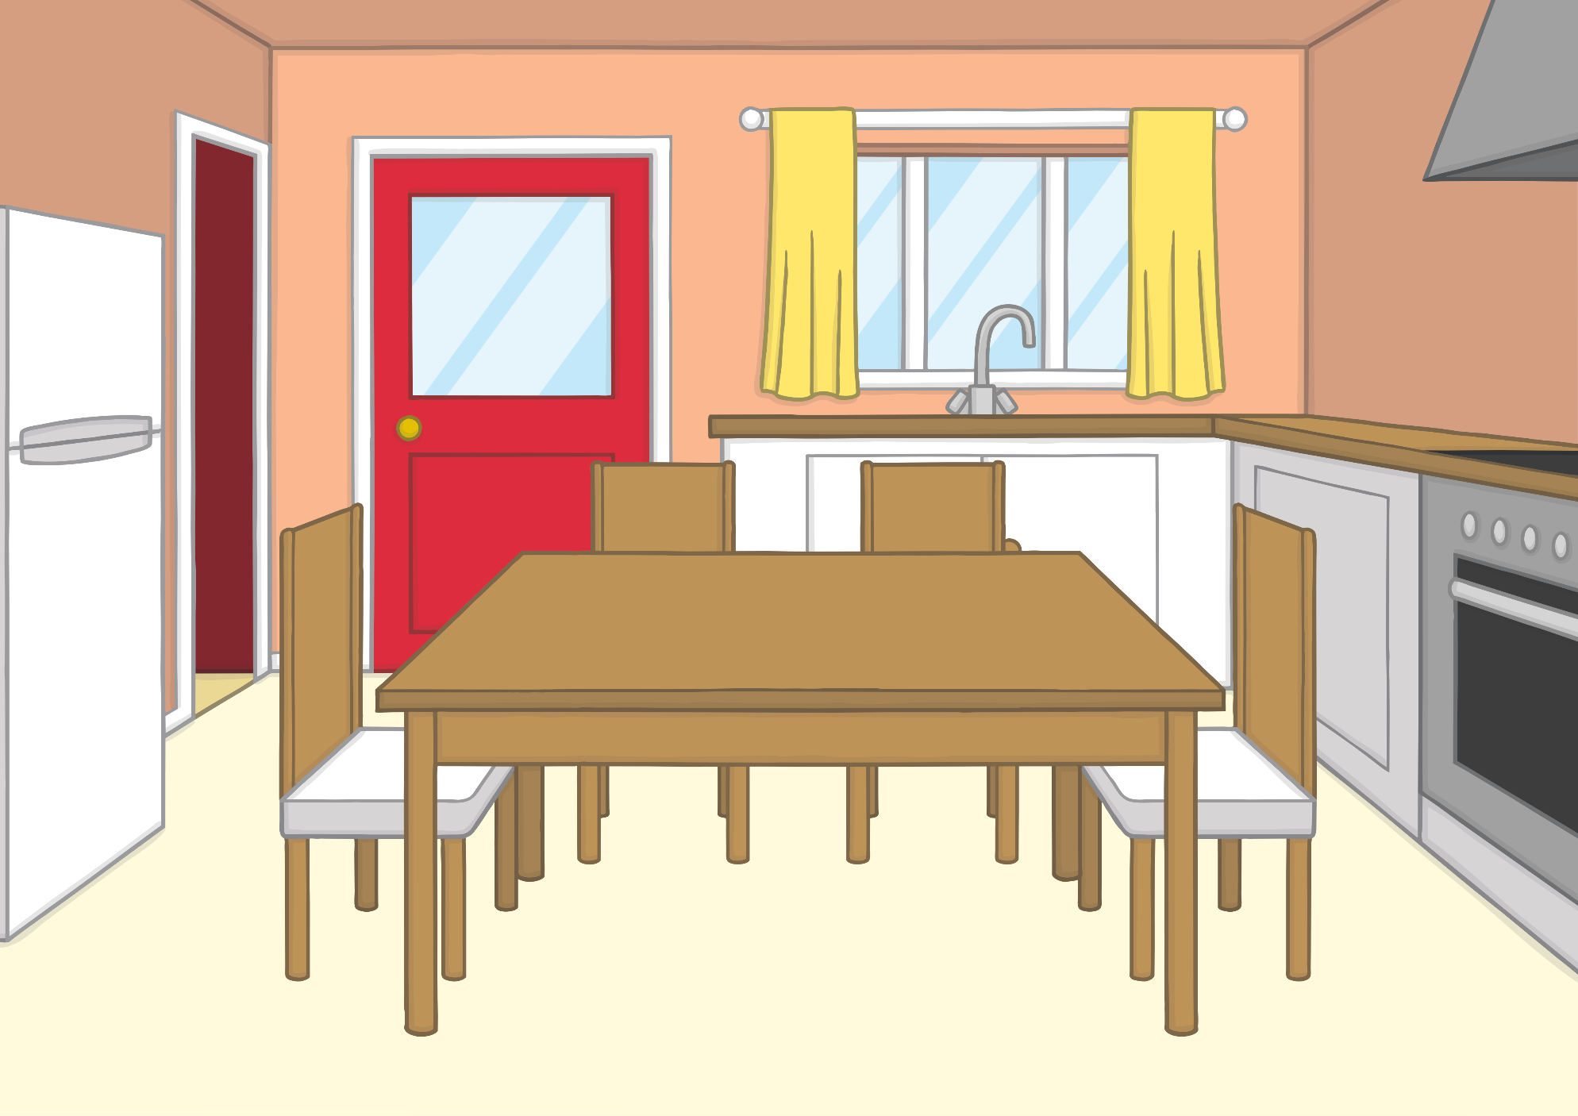

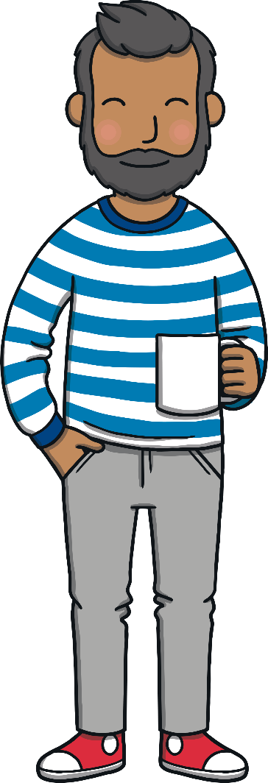
Teach
Dad made tea while Mum showed Kit and Sam some photos from the trip. “Would you like to help me put these into an album?” she asked.

Slide 7

Camping Captions
Practise
Can you match the sentences that Mum has written to
the correct photo?

Slide 8
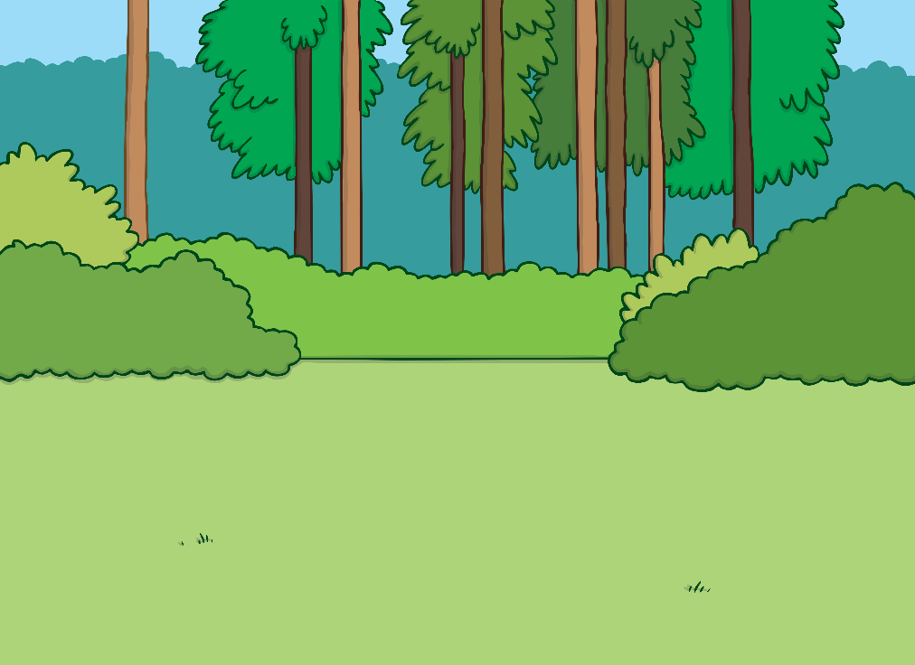
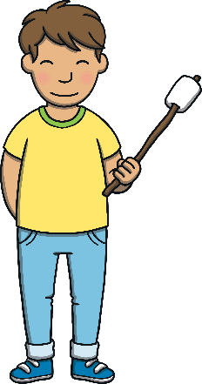


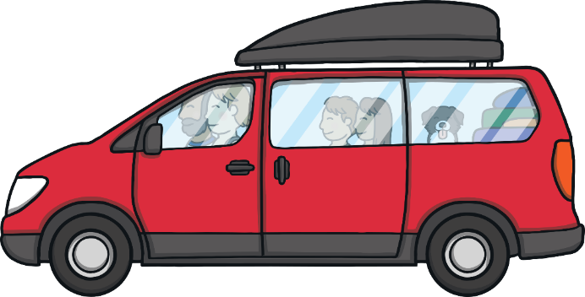

Practise
We went in the car.

Slide 9
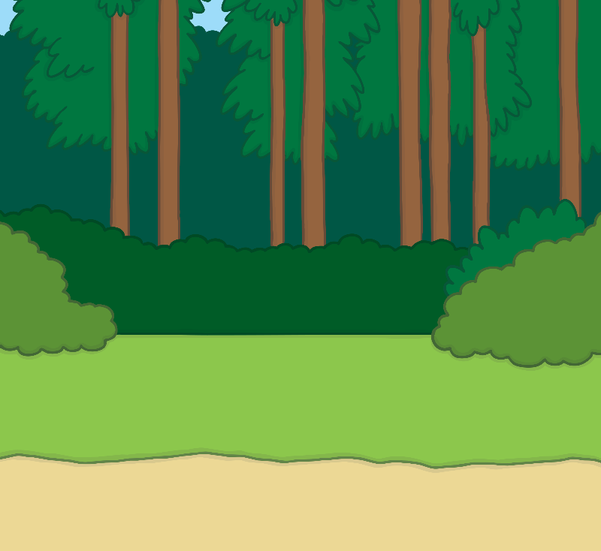



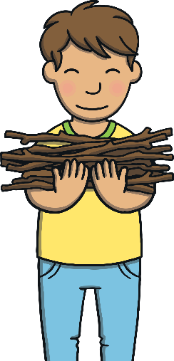


Practise
Dad put up the tent.

Slide 10
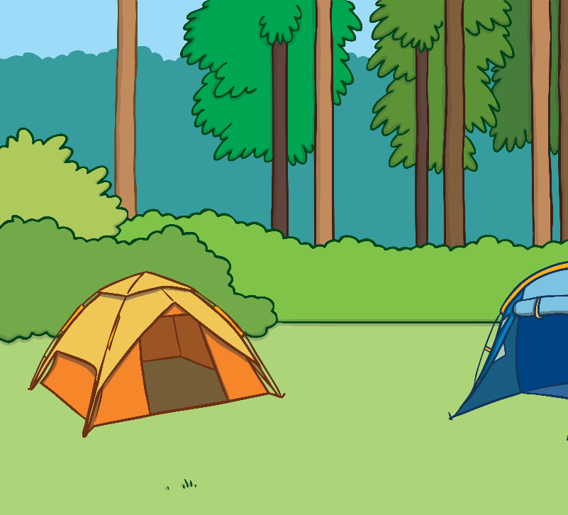


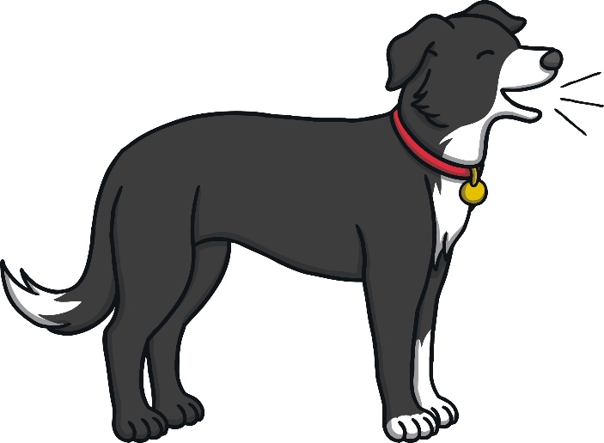
Practise
Mum hung the lamp.

Slide 11

Practise
Sam and Kit got the sticks.

Slide 12


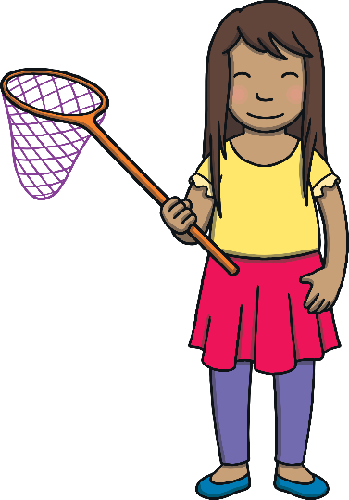
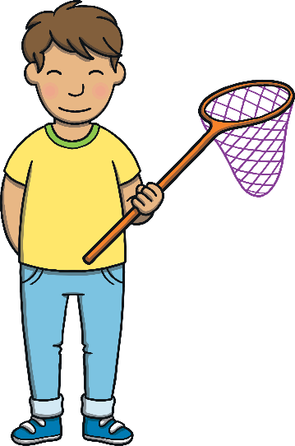





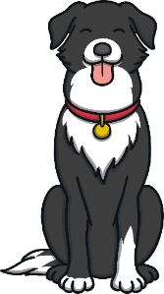
Practise
We went hunting in rock pools.

Slide 13
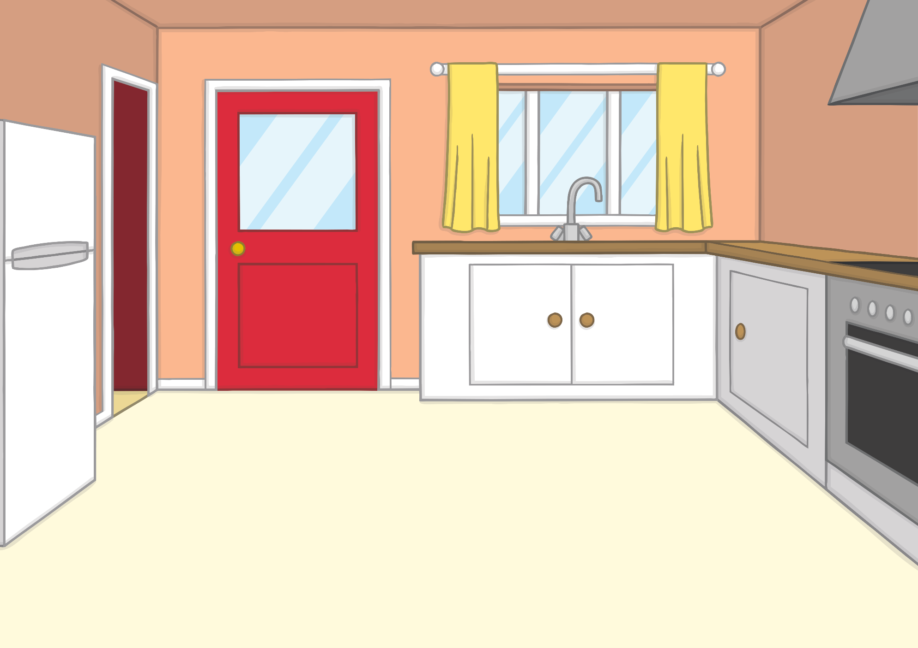

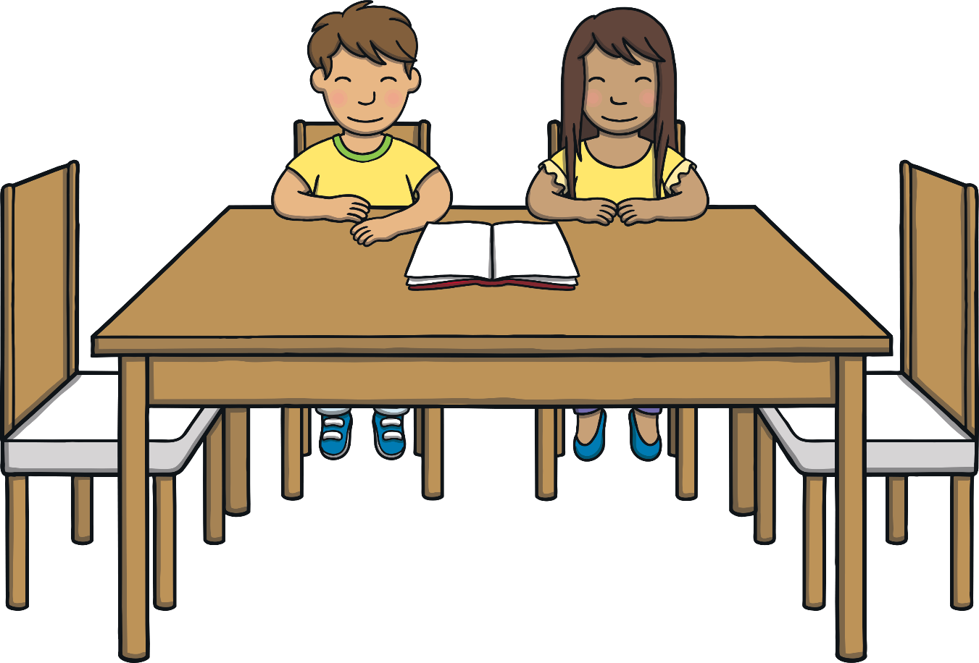
Teach
“OK,” said Mum. “We know what we’re going to write for each photo.”
“Let’s get sticking!” said Dad, as he put a glue stick on to the table.

Slide 14
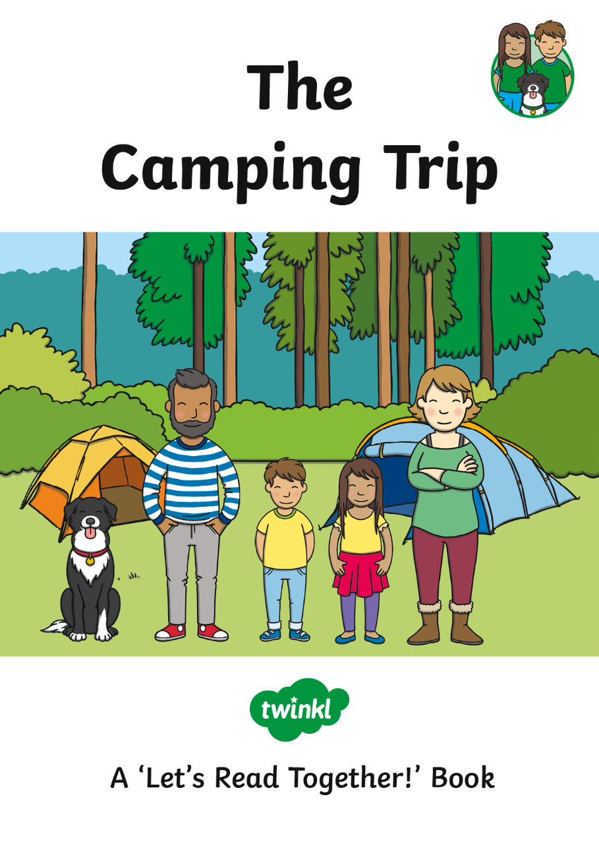
Apply

Slide 15




Apply
Sound Buttons On/Off
“We are going on a camping trip,” said Mum and Dad.

Slide 16





Apply
Sound Buttons On/Off
It was hard to put the tent up but they did it!

Slide 17




Apply
Sound Buttons On/Off
“Let us get lots of sticks for the camp,” said Kit.

Slide 18



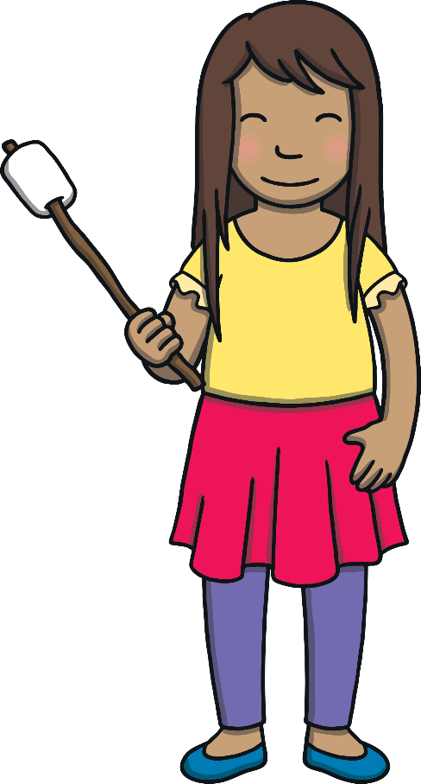
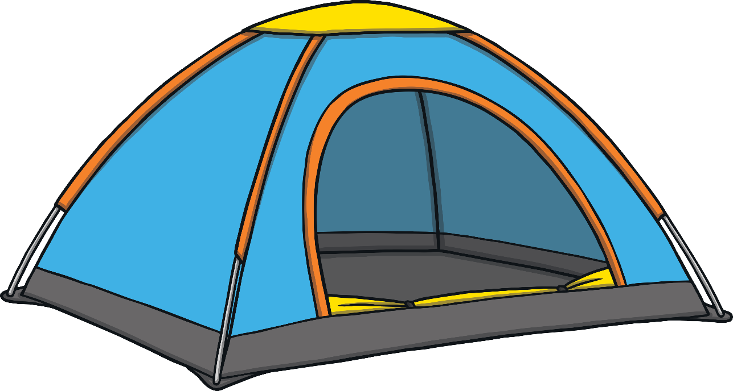

Apply
Sound Buttons On/Off
“Come and toast some sweets,” said Mum.

Slide 19


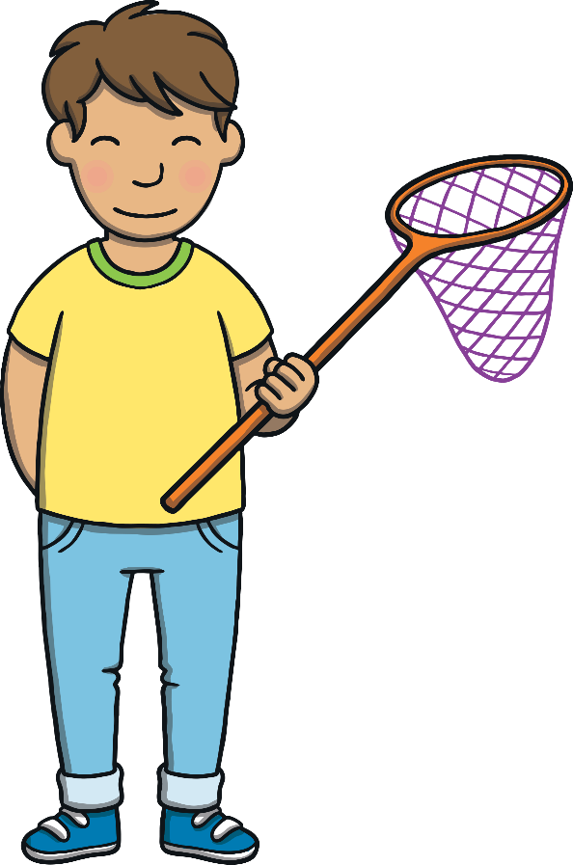
Apply
Sound Buttons On/Off
“We can hunt for little bugs in the rock pools,” said Sam.

Slide 20





Apply
Sound Buttons On/Off
It had been the best camping weekend ever!

Slide 21

Apply
They finished looking at the pictures and closed the book. “I loved camping,” said Sam.
“Me too,” said Kit. “Can we go again next weekend?!”

Slide 22



Today, we have read a book containing consonant blends together.

