Slide 1
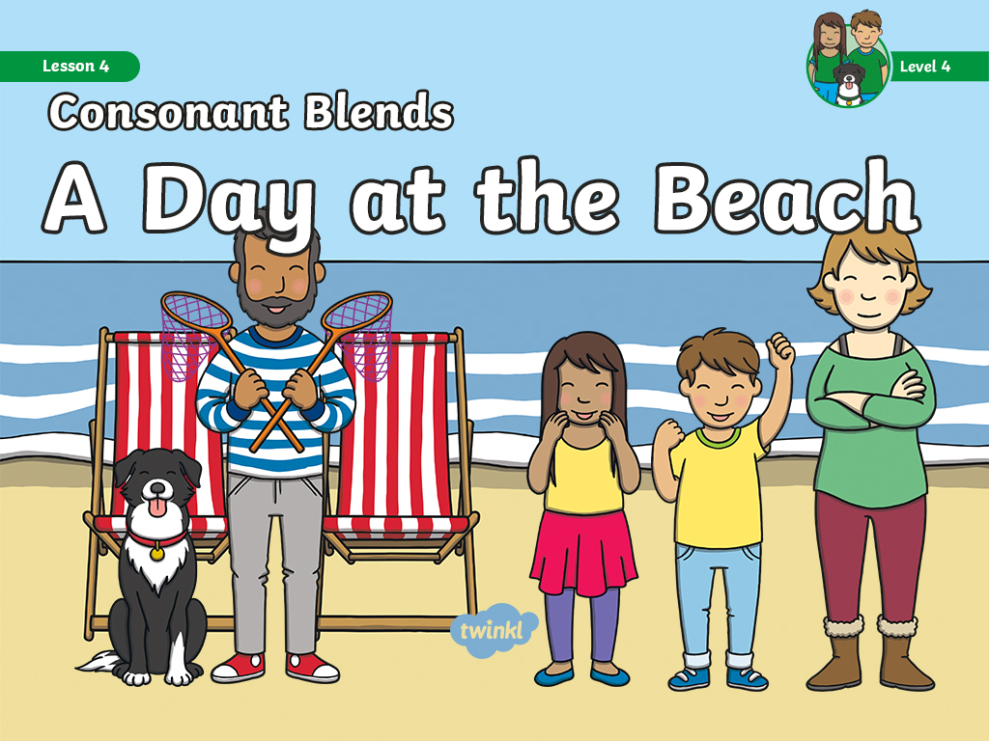

Slide 2


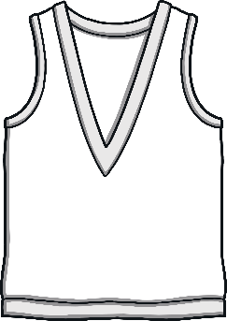
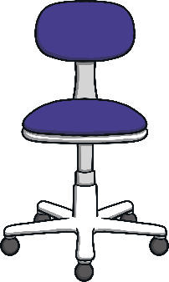


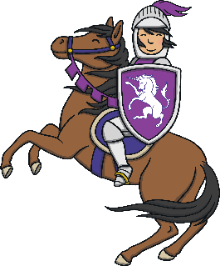



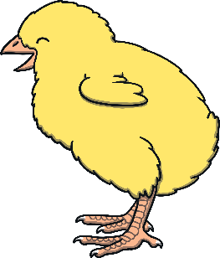

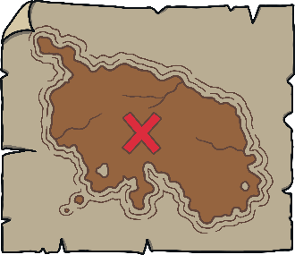
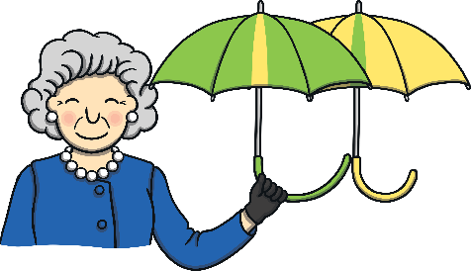
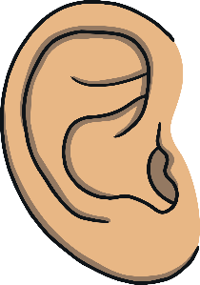
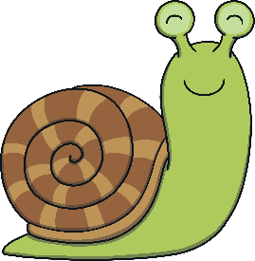


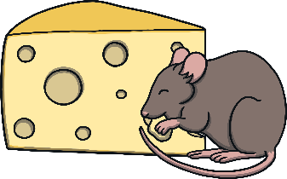
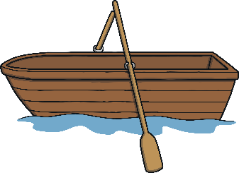
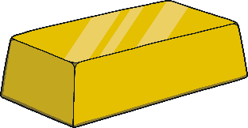


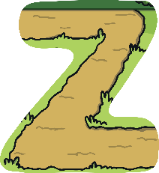
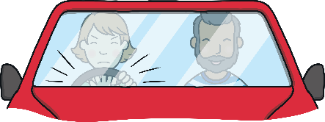

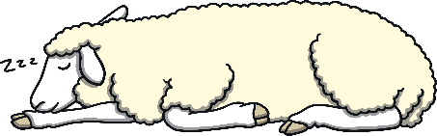
Revisit and Review
Let’s practise Sam’s Sounds and Tricky Words!
w
er
v
ure
air
qu
ng
j
ch
z
ar
x
ee
ow
ur
ai
sh
igh
th
y
or
oo
oa
ear
oi
zz
there
one
were
so
little
have
come
said
like
some

Slide 3
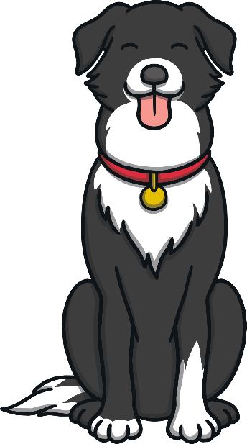
Teach
Today, we are practicing reading words that contain
consonant blends.

Slide 4
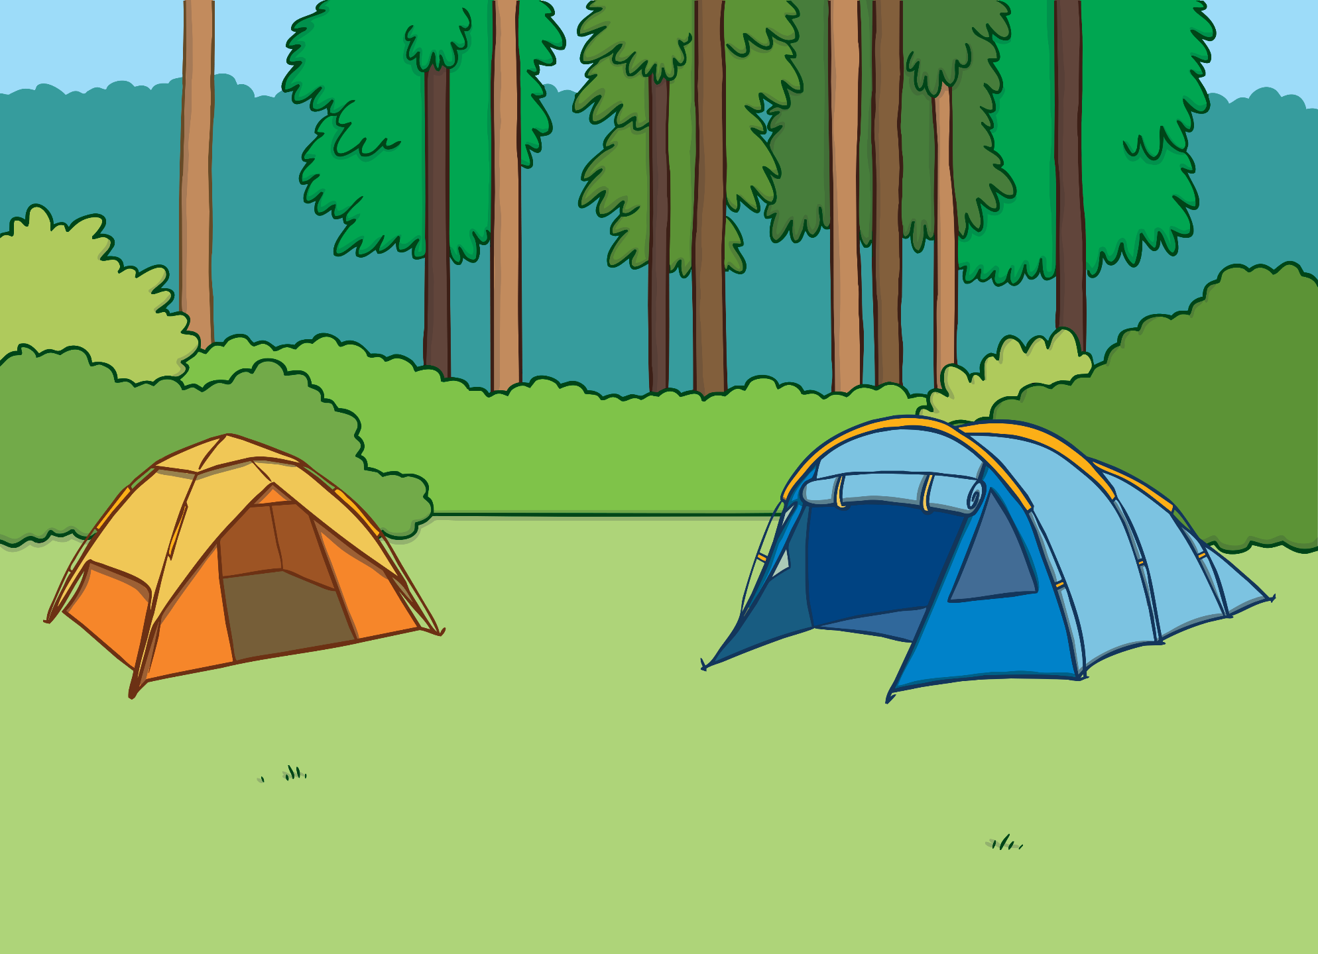
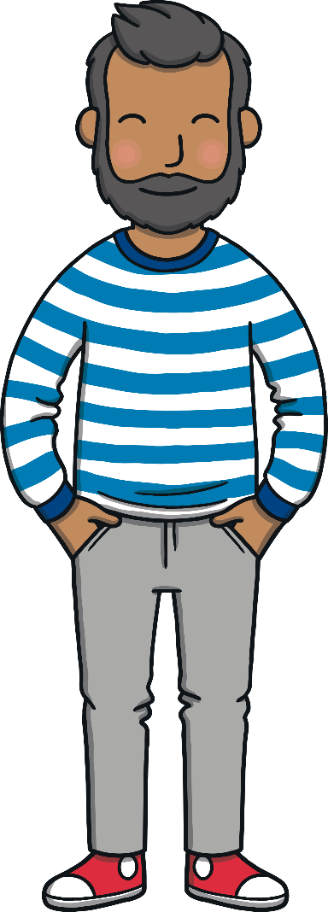

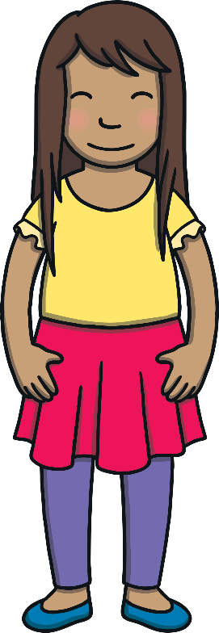
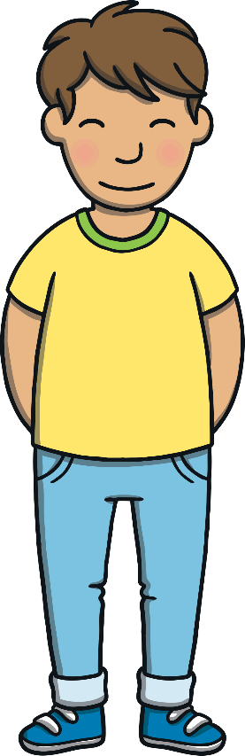

Teach
The family had spent their first night in the tent.
“I had a great sleep,” said Sam, yawning.
“Me too,” said Kit, “What are we doing today?”

Slide 5
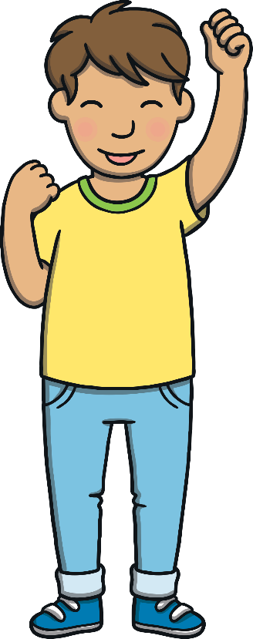
Teach
“We are not too far from the beach,” said Mum. “Dad and I thought that we could go there for the day.”
“Yippee!” said Kit and Sam.

Slide 6
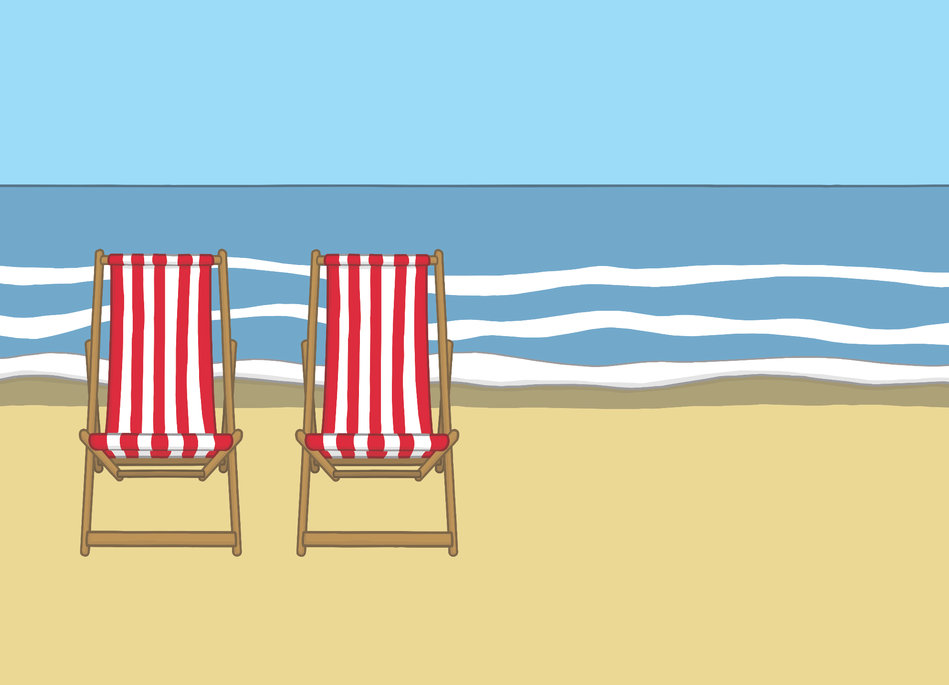
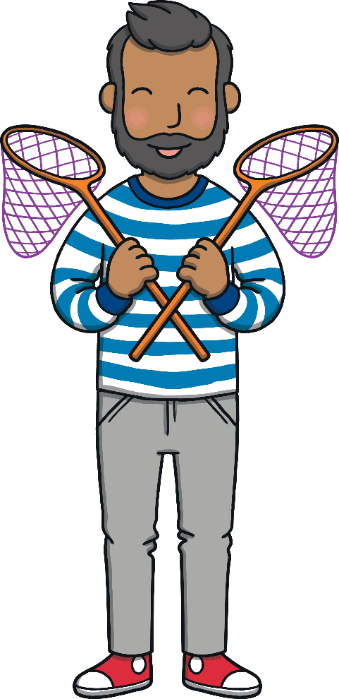
Teach
They arrived at the beach. “Take these fishing nets,” said Dad. “Why don’t you see what you can find in the rock pools?”

Slide 7
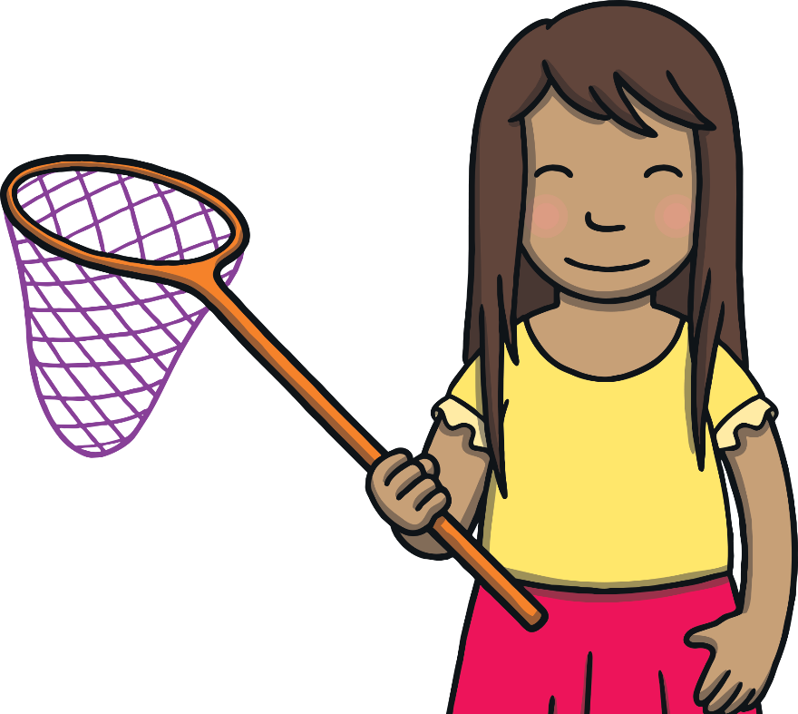
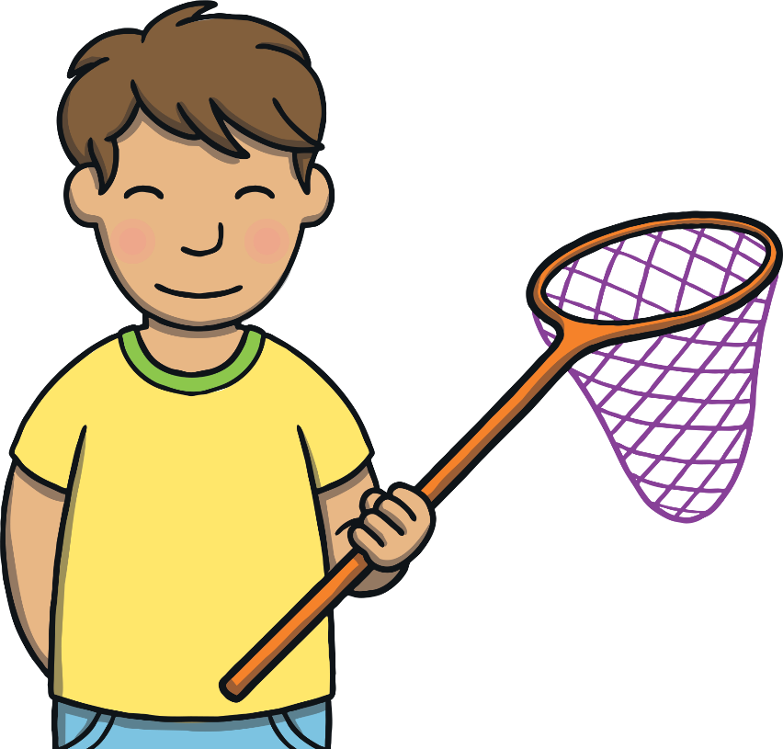

Teach
Kit and Sam are fishing in rock pools.
What consonant blends can you spot hiding
in the pool?
X
You can add challenge to this activity by asking the children to suggest a word that contains each blend.
Click me for Kit’s teaching tips!

Slide 8
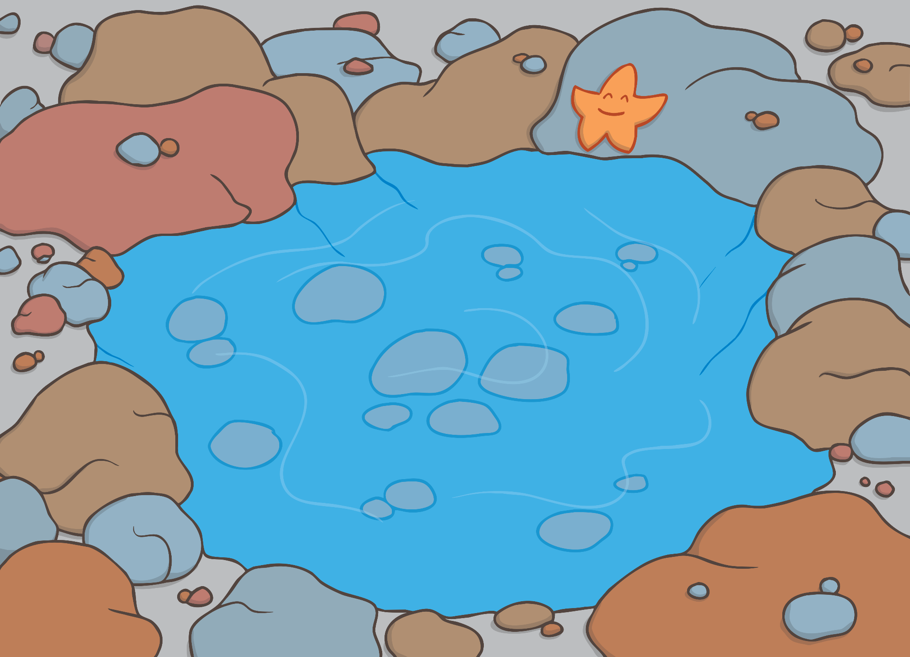
Teach
xt
fr
st
pl
mp
sp
ft
nt
br
lt
cr
nd

Slide 9
Fishing for Blends
Practise
Kit and Sam are fishing consonant blends out of the rock pool – can you match each blend with the picture that contains that blend and write the word?
X
This is a great whiteboard activity!
Click me for Kit’s teaching tips!

Slide 10
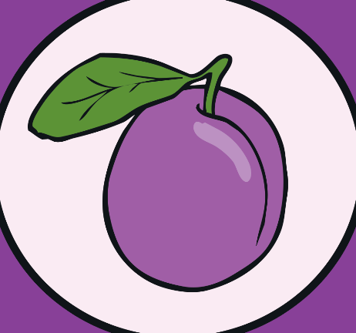
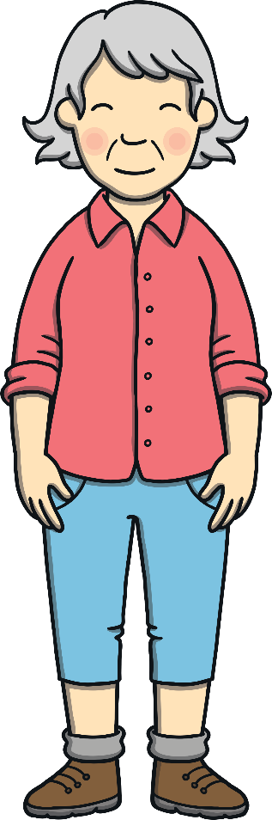
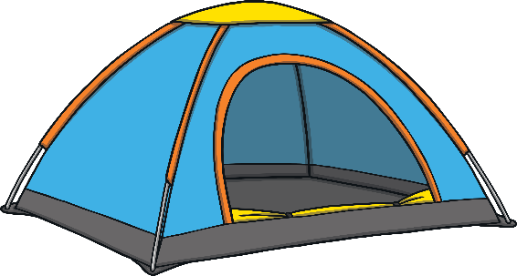

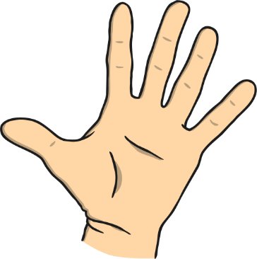

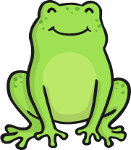
Teach
st

Slide 11
Teach
pl

Slide 12
Teach
fr

Slide 13
Teach
gr

Slide 14
Teach
nt

Slide 15
Teach
nd

Slide 16
Teach
mp

Slide 17

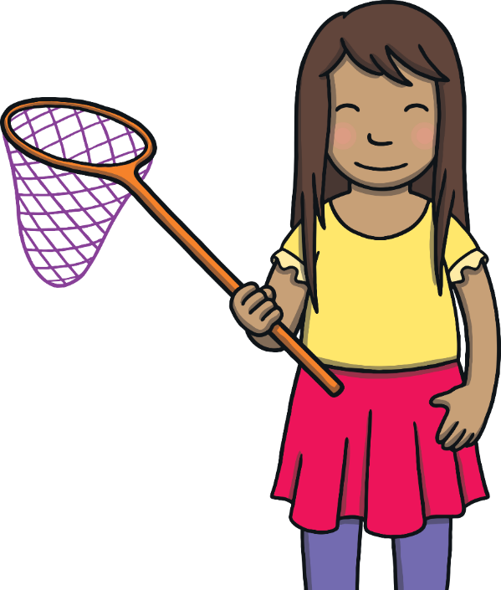
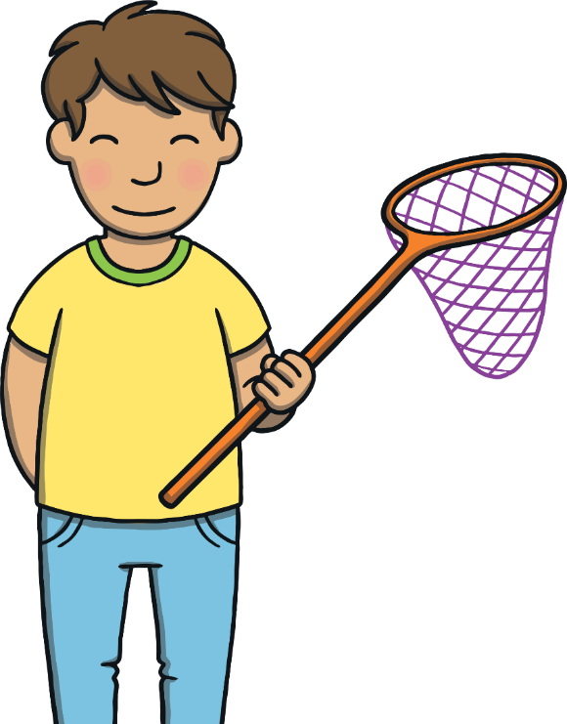
Teach
“Look what we found in the rock pools!” said Kit and Sam, showing Mum and Dad lots of tiny creatures.
“Have you had fun?” asked Mum.

Slide 18
Teach
“Look what we found in the rock pools!” said Kit and Sam, showing Mum and Dad lots of tiny creatures.
“Have you had fun?” asked Mum.

Slide 19
Apply
Sentence Time
What do Kit and Sam say to Mum and Dad? Look at the picture and write a sentence to match.

Slide 20

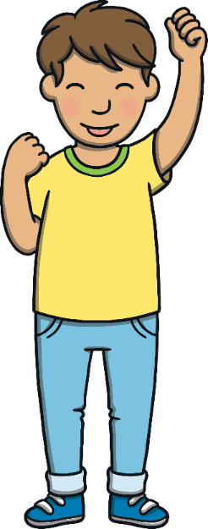

Apply
They cannot wait for the next
camping trip!
Show

Slide 21

Apply
“It’s been the best weekend!” said Sam, as they got ready to go.
“Agreed!” said Kit. “We didn’t even need any magic this time either!”

Slide 22
Today, we have practiced…
consonant blends

