Slide 2
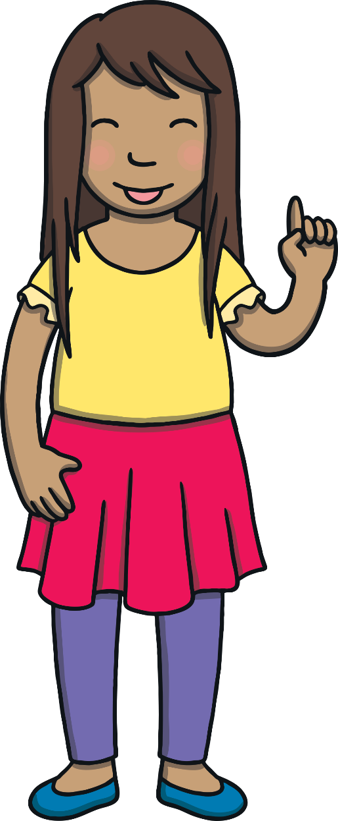
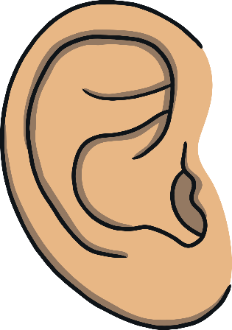

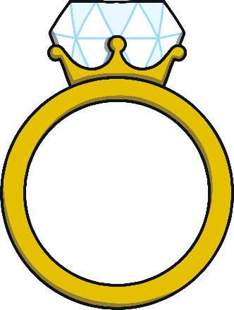
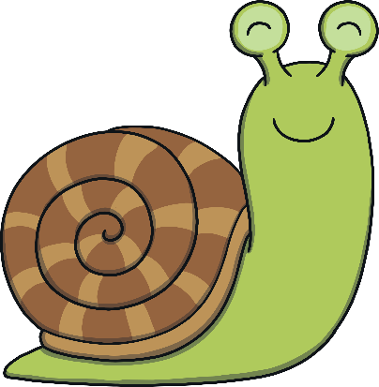
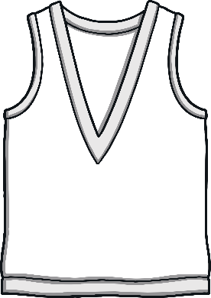
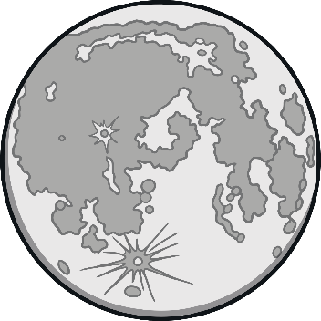

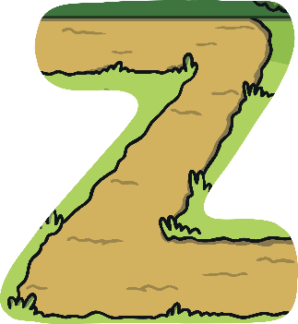
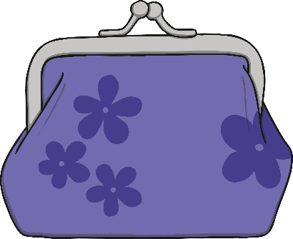
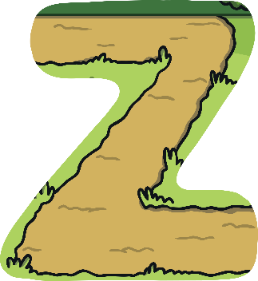
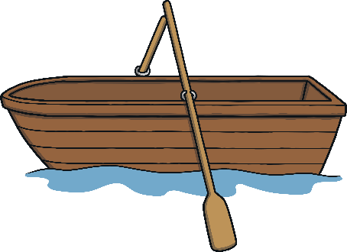
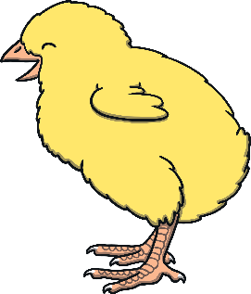
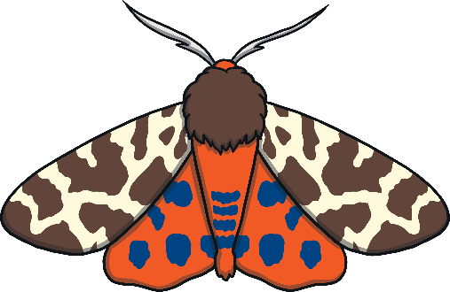


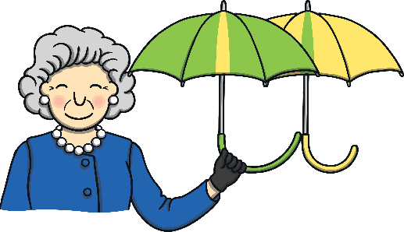
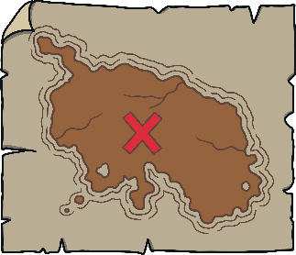
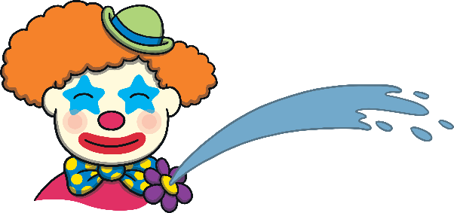
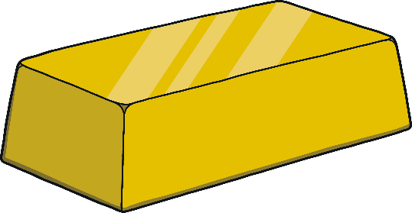
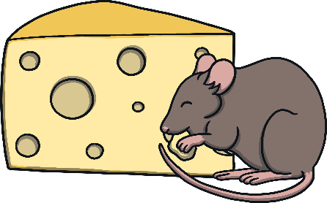
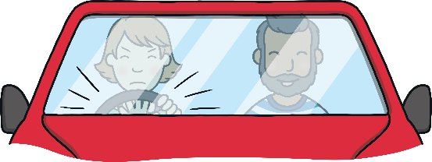

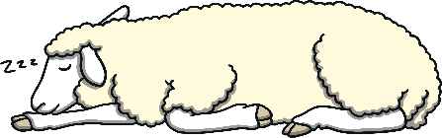
Revisit and Review
Let’s practise Sam’s Sounds and Tricky Words!
ng
ear
ai
ar
z
oo
v
ee
ure
oi
zz
th
oa
qu
ow
ur
oo
ch
x
th
w
sh
or
some
were
there
little
one
come
have
said
like
so

Slide 3

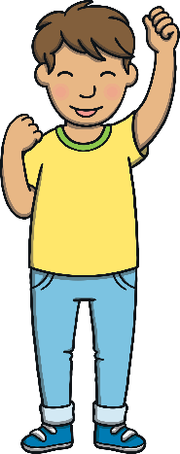
Teach
This week, we are learning to spell the tricky words they, are and all.
Watch the magic pencil write the words.
Can you join in?
X
It can help to spell out tricky words using the letter names to remind children that tricky words can’t be sounded out.
Click me for Kit’s teaching tips!

Slide 4


Teach
they
Play

Slide 5
Teach
are
Play

Slide 6
Teach
all
Play

Slide 7
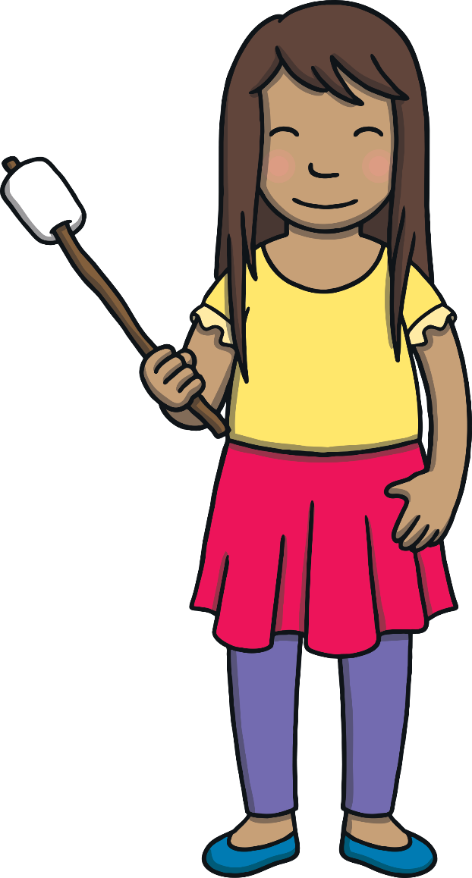

Teach
Today, we are practising writing words that contain
consonant blends.

Slide 8
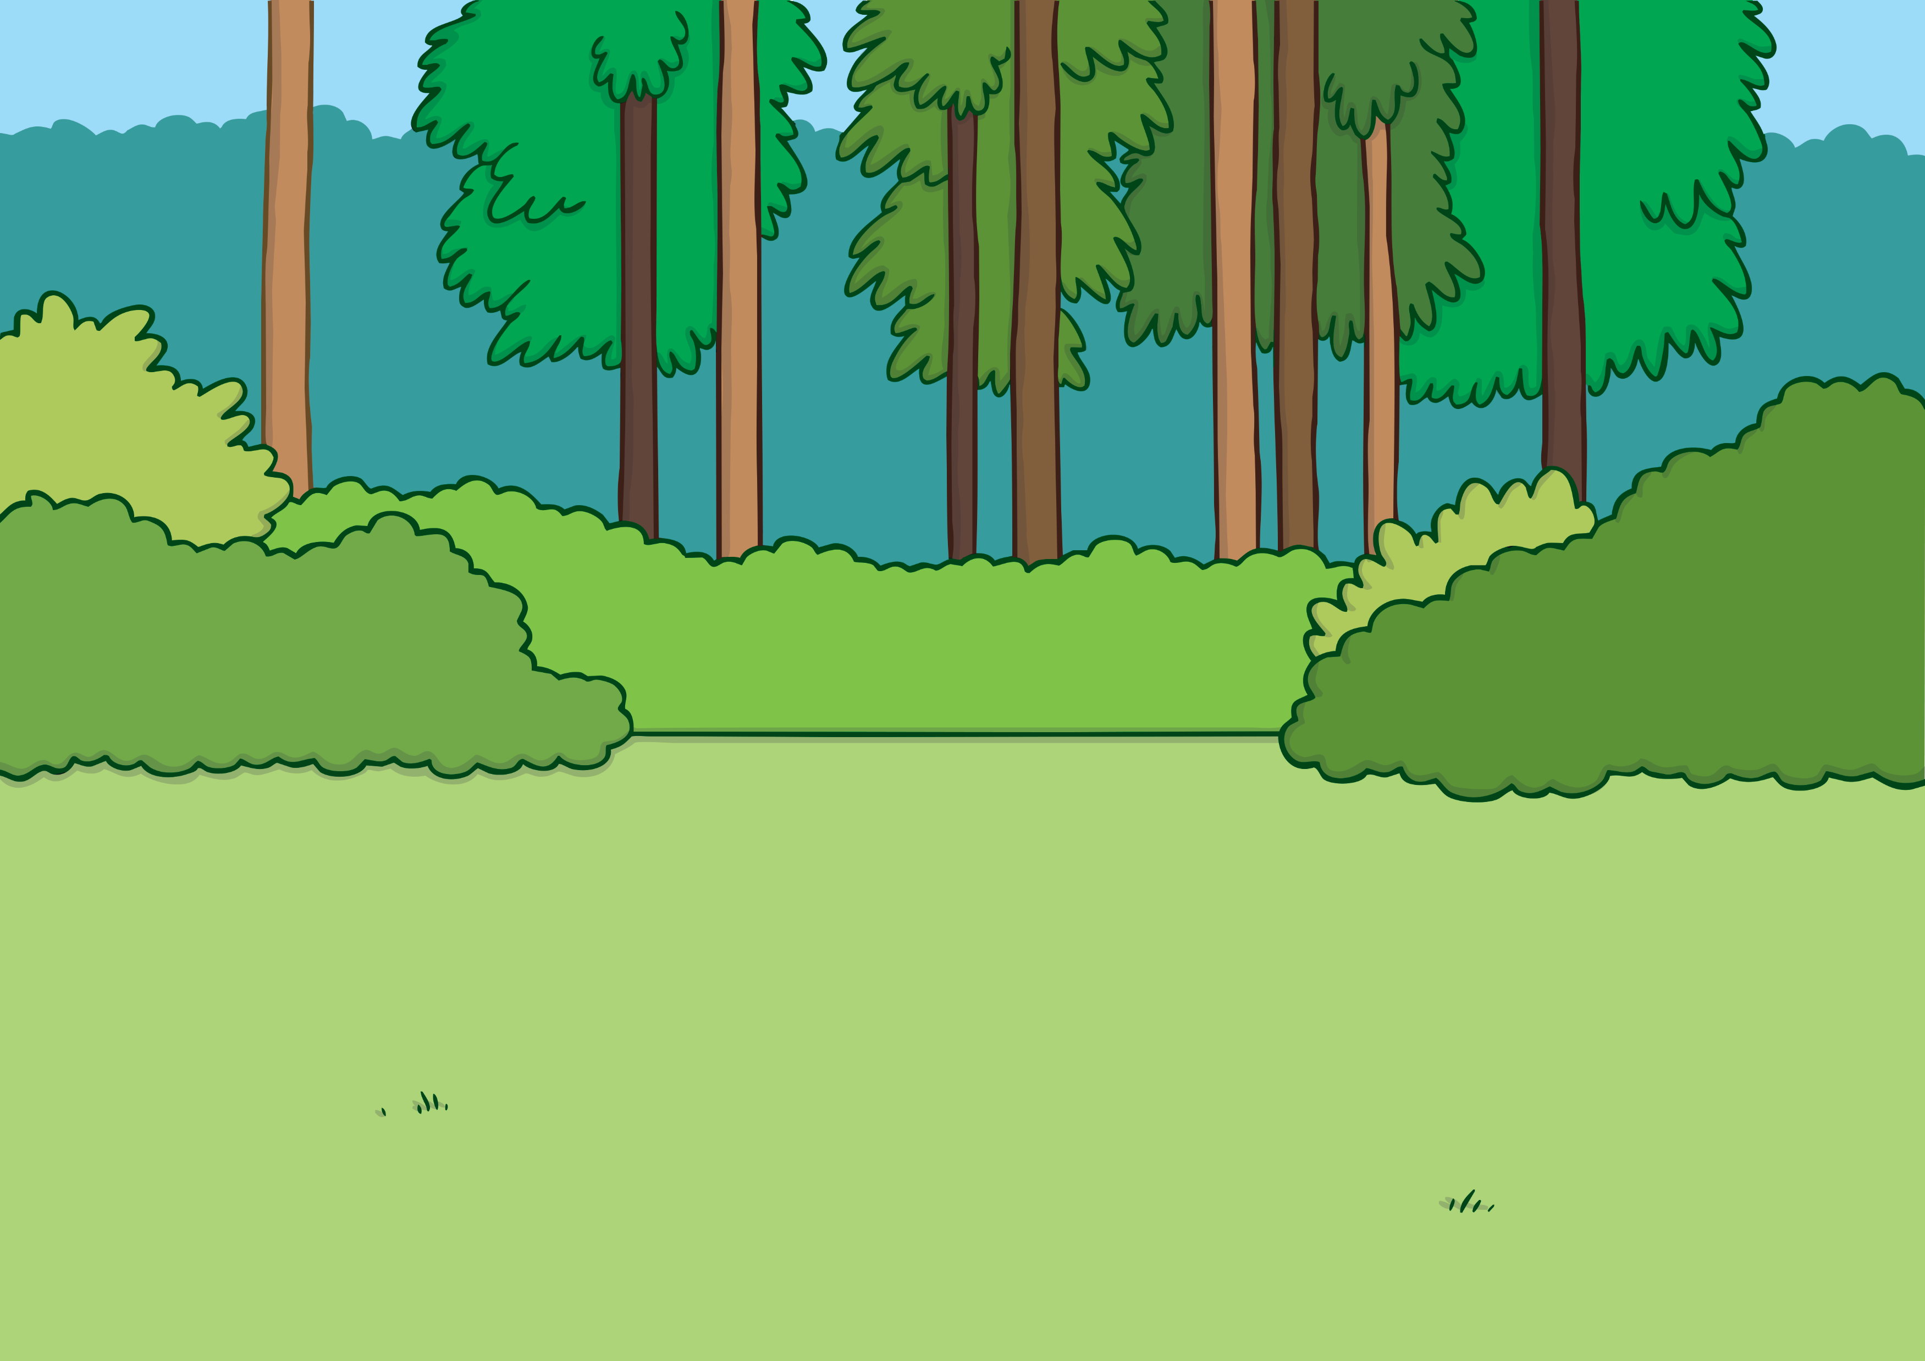
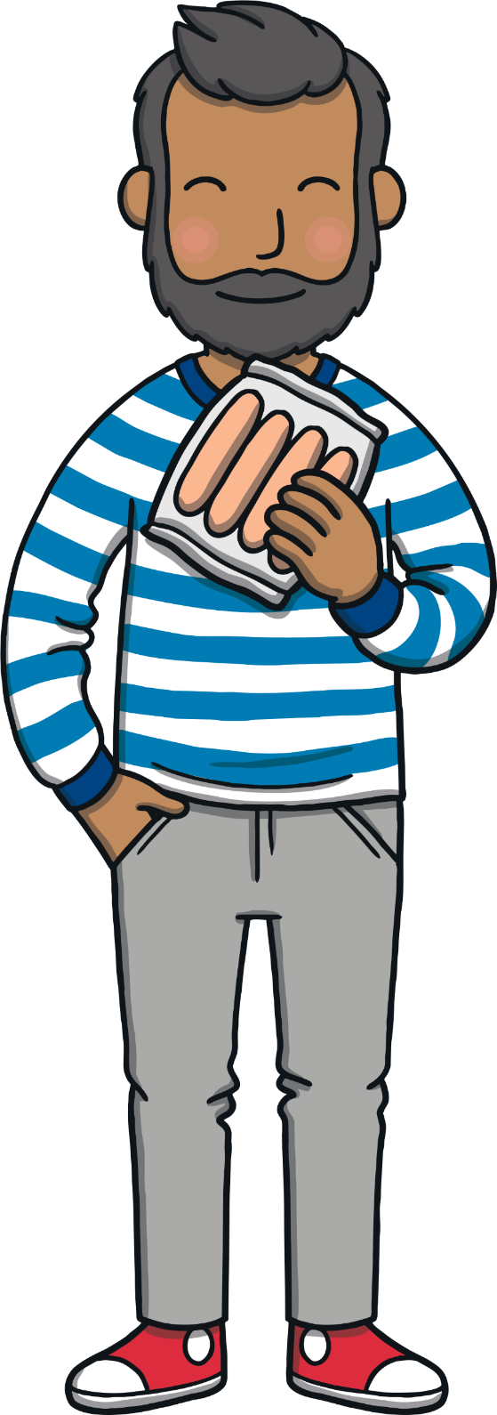
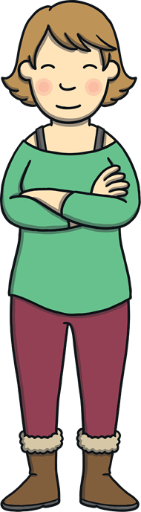
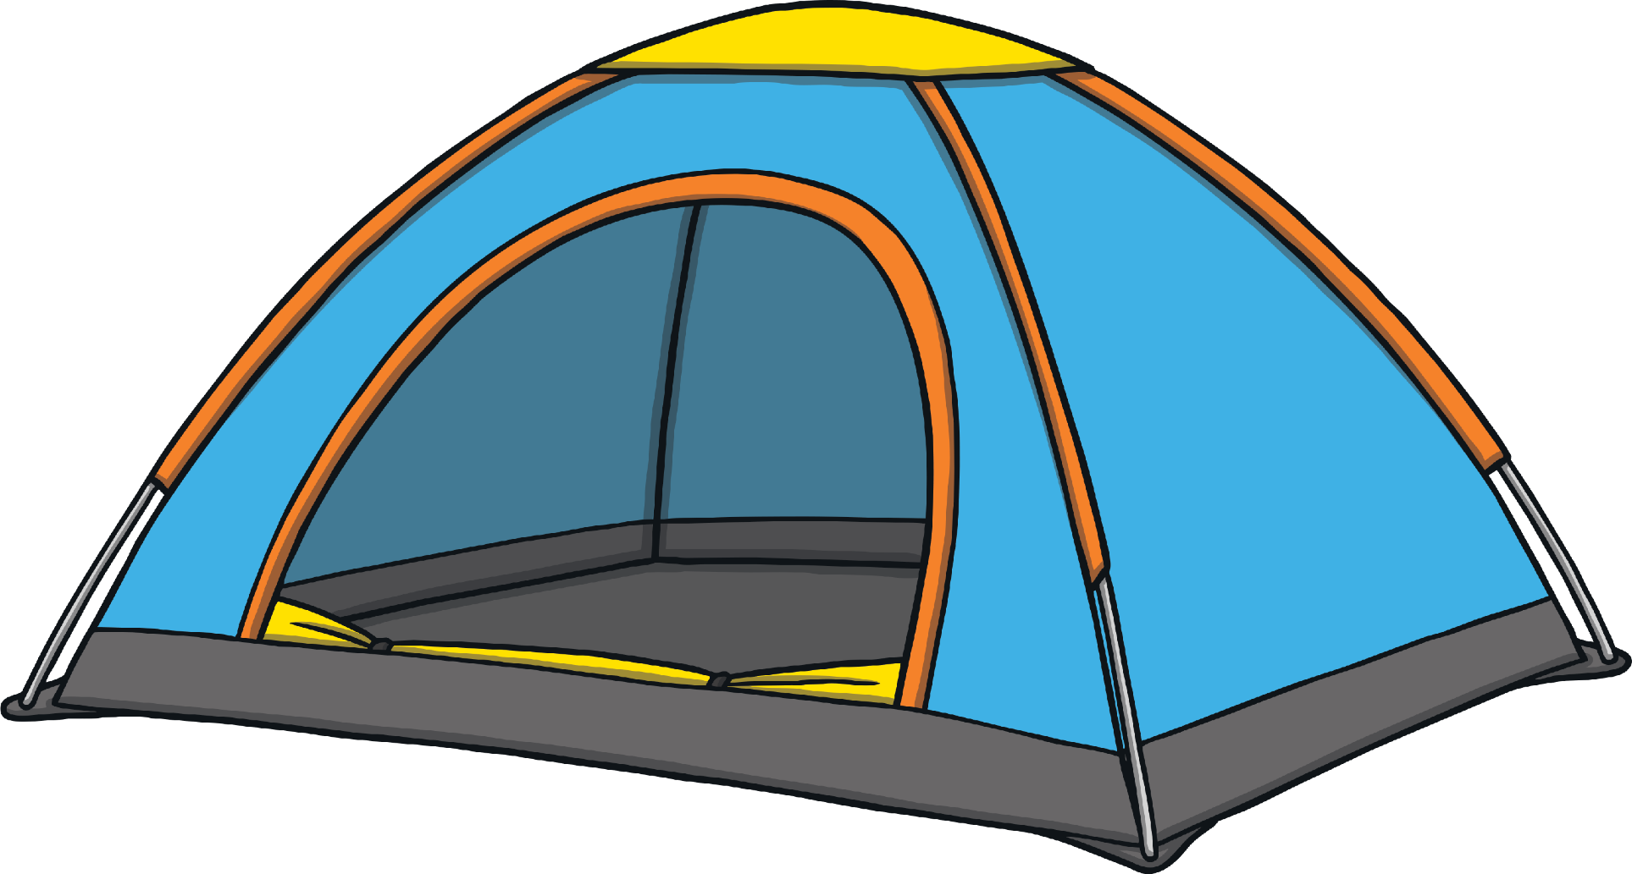
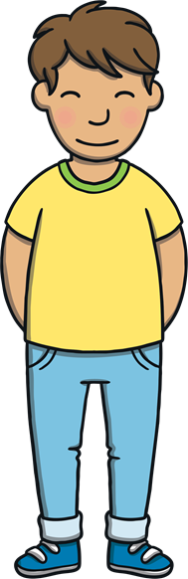
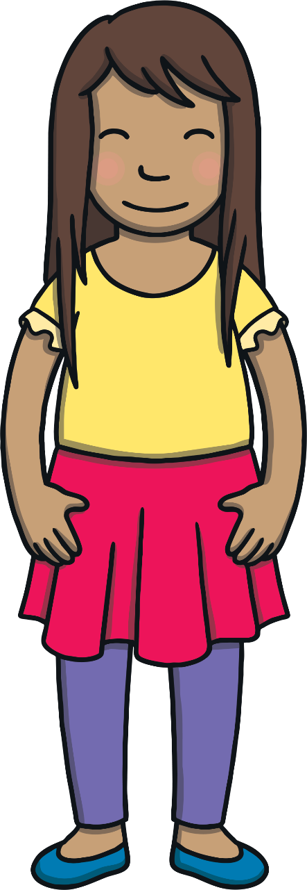
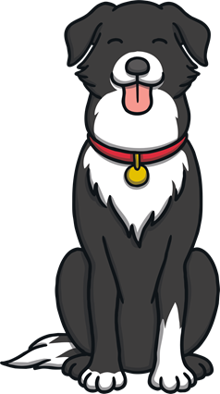
Teach
The family had put the tent up. “Now children, we need to make a campfire to cook our food on,” said Dad, pulling out a packet of sausages.

Slide 9
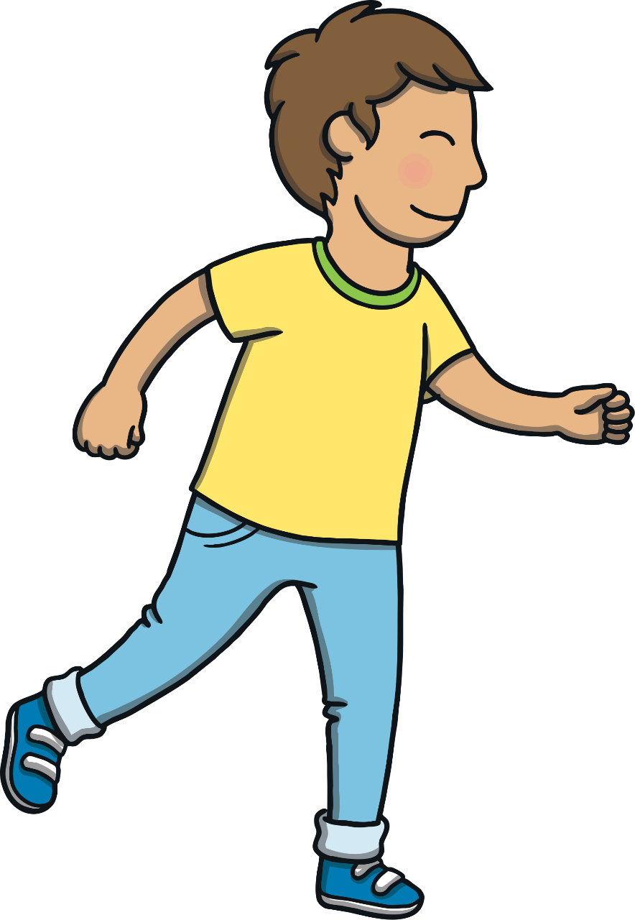
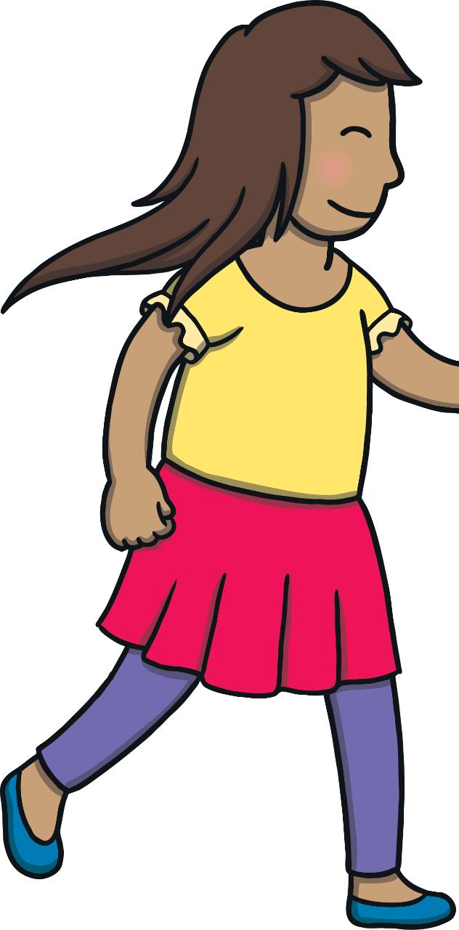
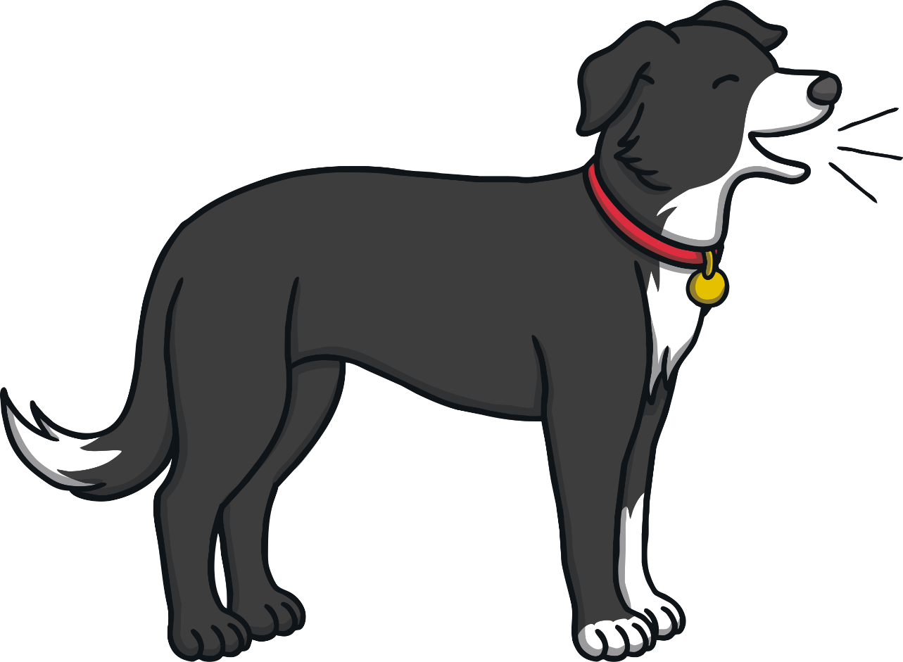
Teach
“We will go and get some wood,” said Sam.
“Great idea,” said Mum, as Kit and Sam ran off. “Get some big sticks and some small ones too.”

Slide 10
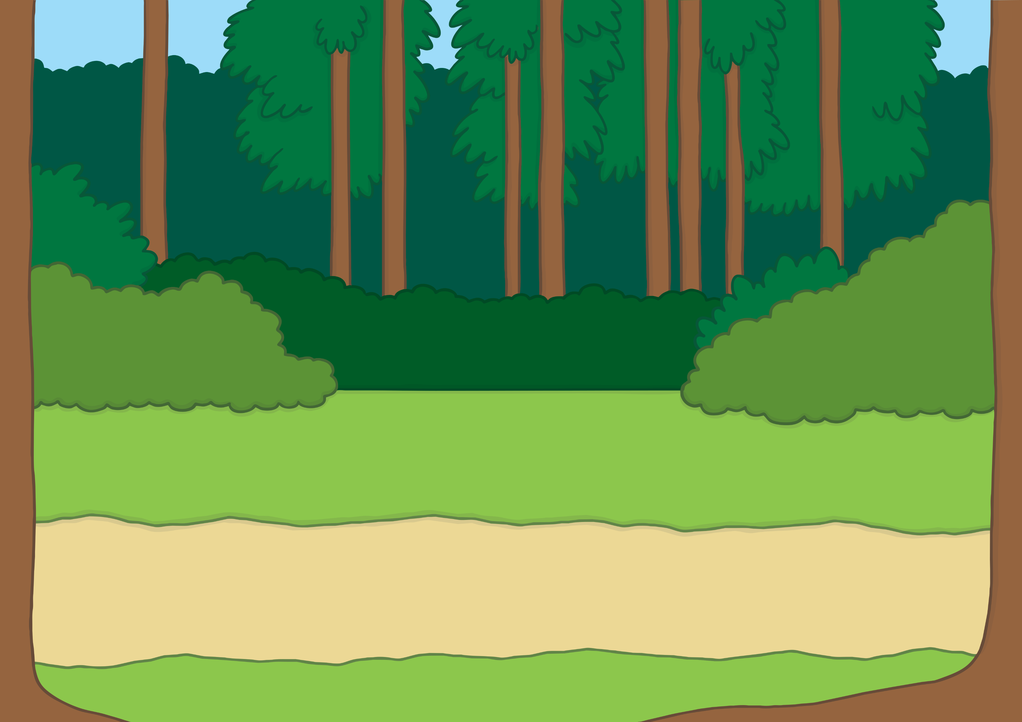
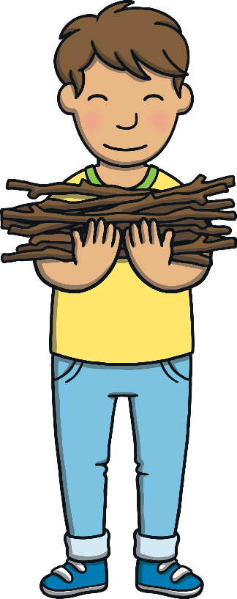
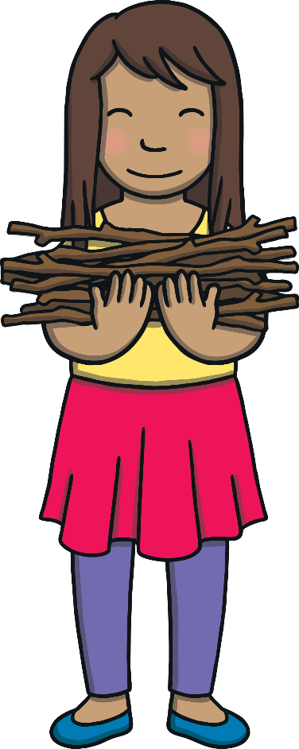

Teach
“I bet I can get more sticks than you can, Kit!”
laughed Sam.
“I bet you can’t!” replied Kit. They both started to
gath er as many as they could.

Slide 11

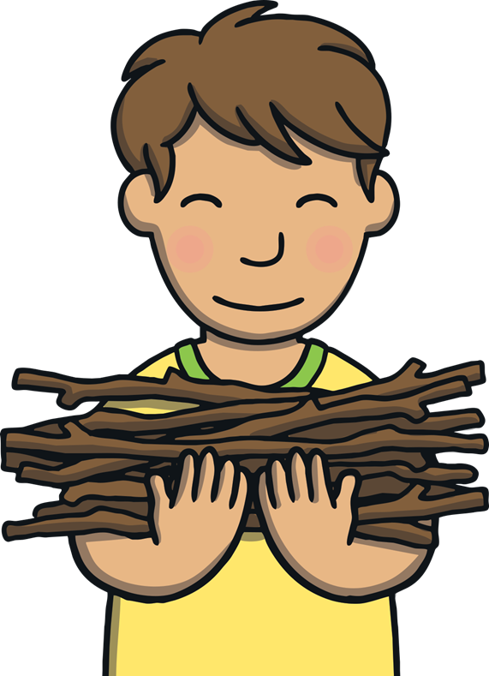
Teach
Kit and Sam are picking up sticks for the campfire.
Can you read the consonant blends on each stick?

Slide 12


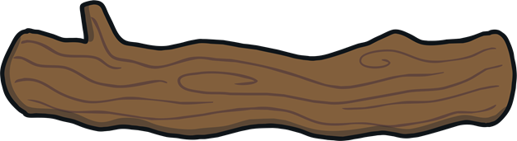


Teach
mp
nd
lp
sw
sm
st
cr
bl
lt
nt

Slide 13
Consonant Blend Sticks
Practise
Kit and Sam are trying to think of words that contain the blend on their sticks. Can you help?

Slide 14

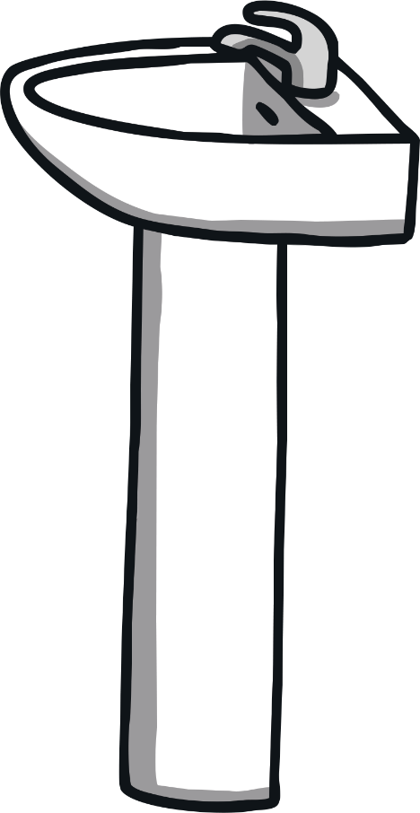
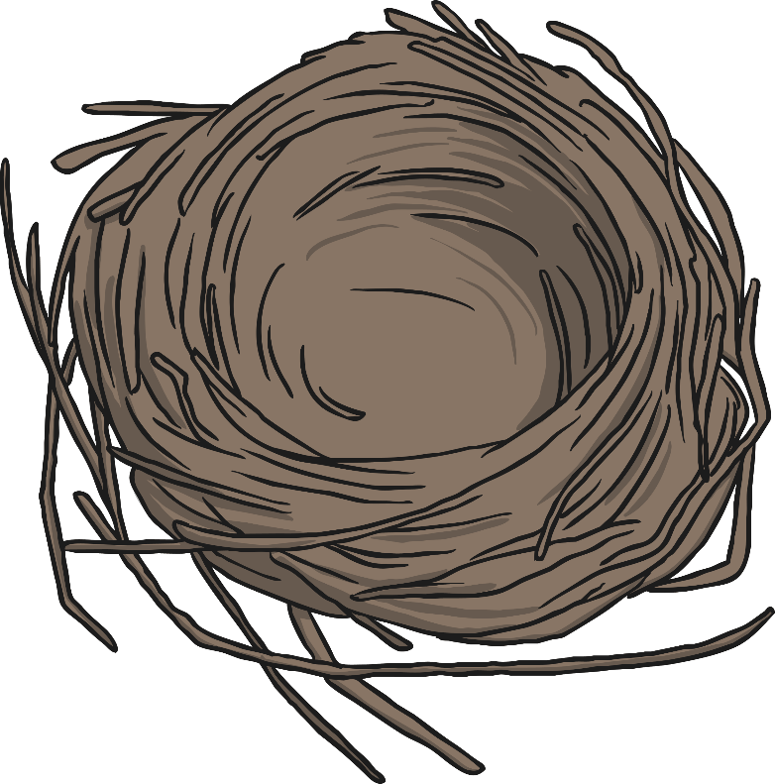
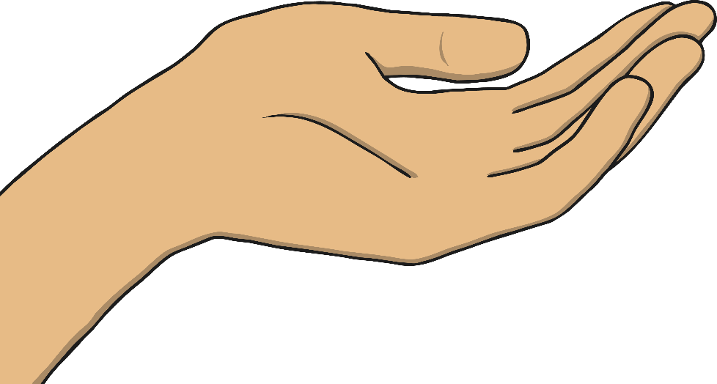
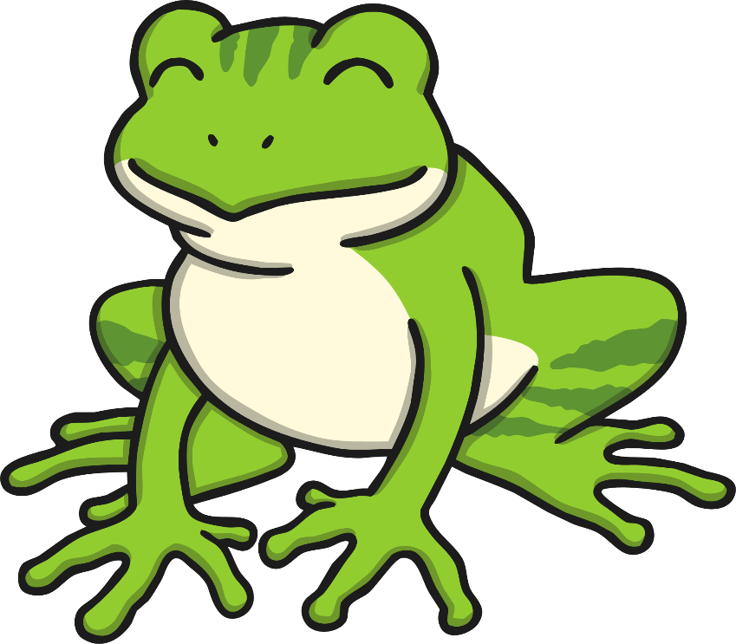
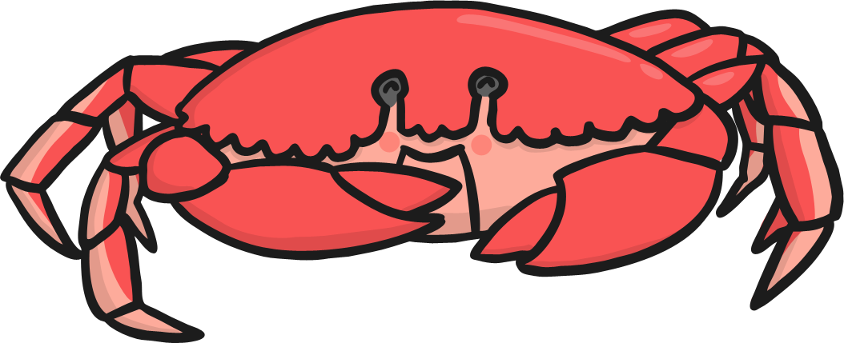

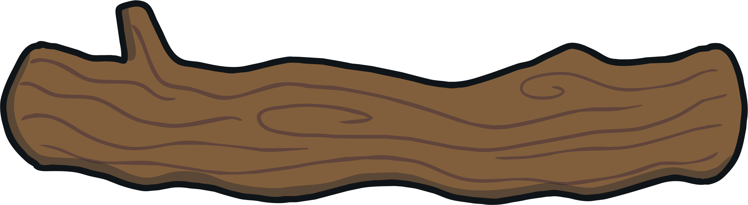
Practise
st
lt
nd
nk
st
fr
cr

Slide 15

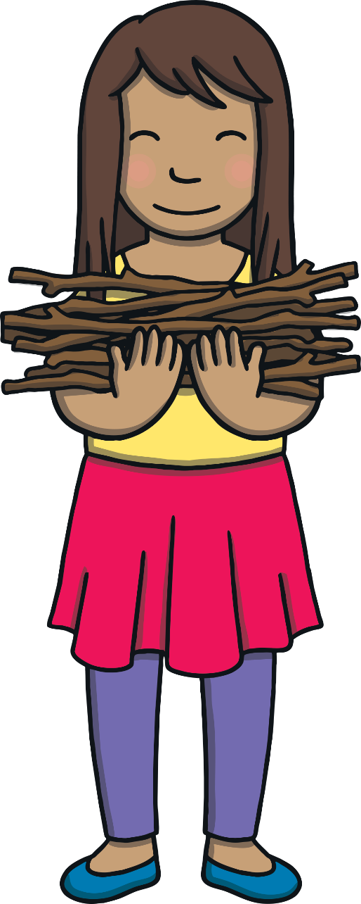
Apply
Kit and Sam ran back with the sticks. “Great work,” said Mum. “Now, let’s get this fire started.”
“I have an extra treat for us tonight,” said Dad.

Slide 16
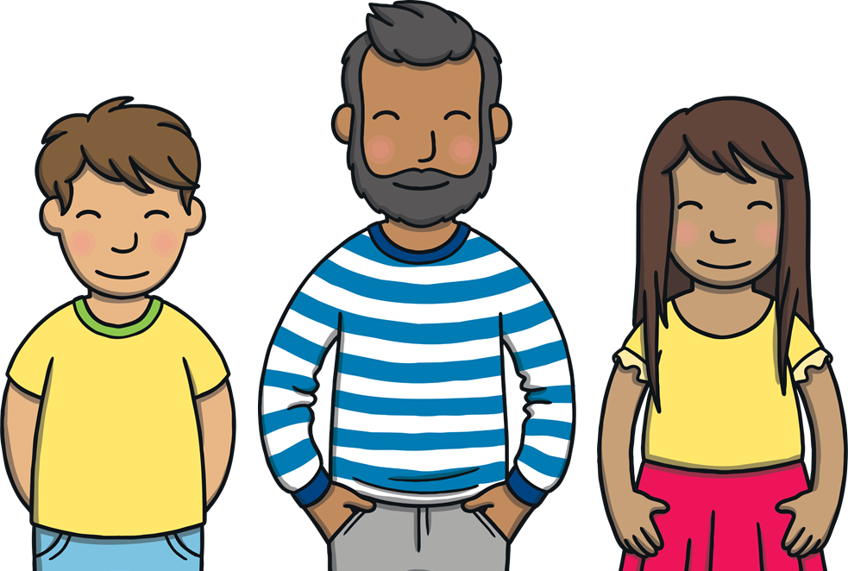
Sentence Time
Apply
What treat does Dad have for Kit and Sam?
Look at the picture and write a sentence to match.
X
Click ‘Show Suggestion’ to see a suggested sentence for the picture.
Click me for Kit’s teaching tips!

Slide 17

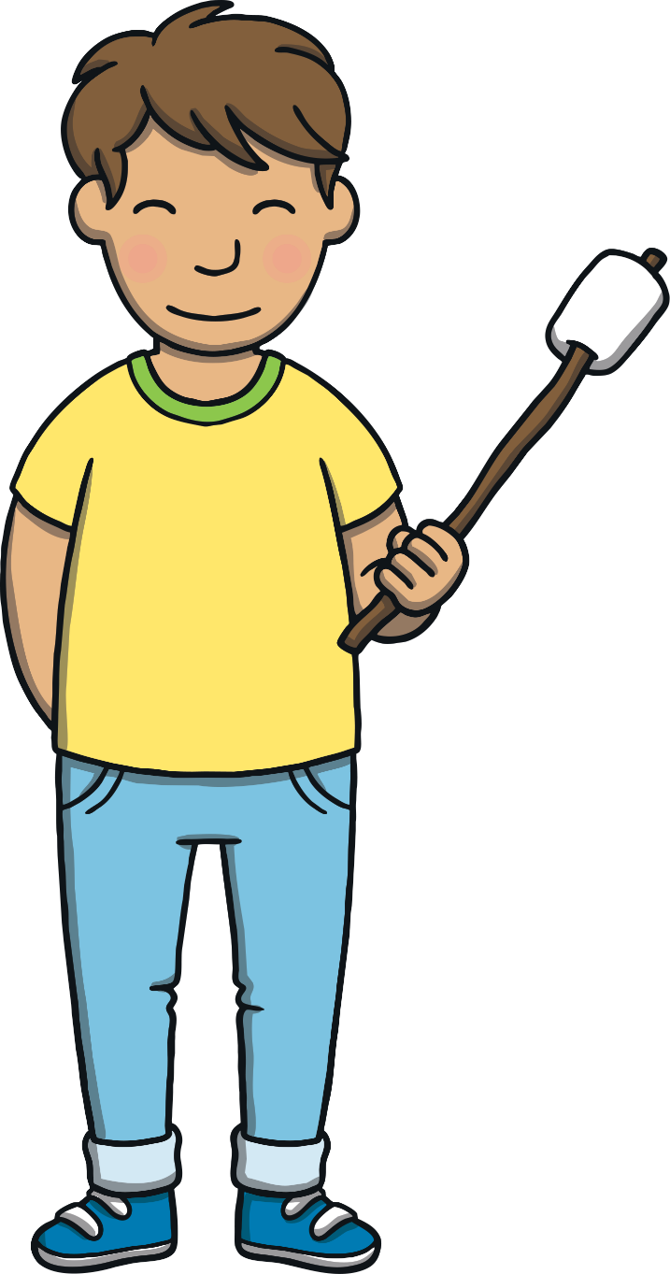



Apply
We can all toast and melt
camp sweets.
Show

Slide 18
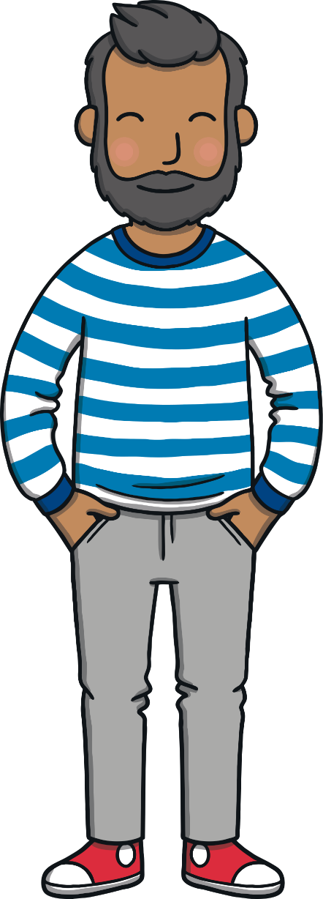




Apply
“This has been a great first day at the campsite!”
said Kit.
“It has!” agreed Sam. “So… Mum and Dad, what are we going to do tomorrow?”

Slide 19
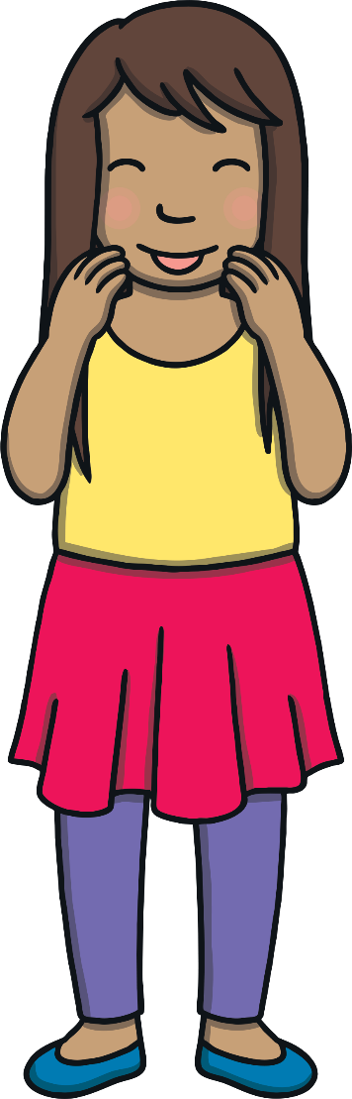

Today, we have practised…
Consonant Blends
The adventure continues next lesson!

