Slide 2
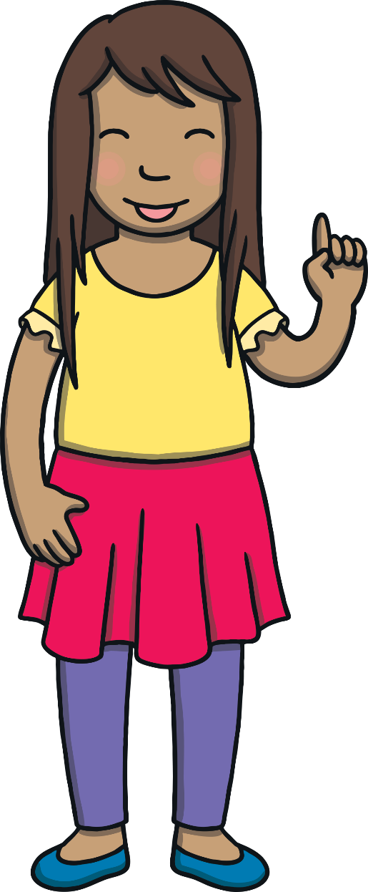



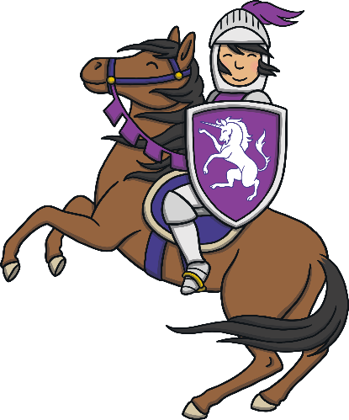





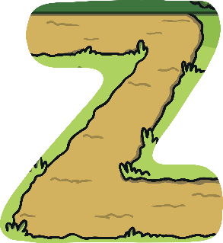
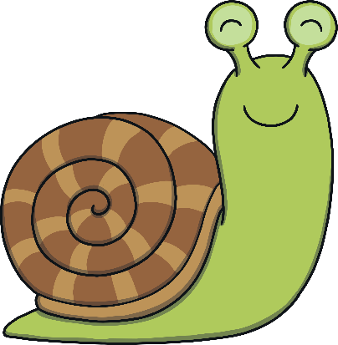
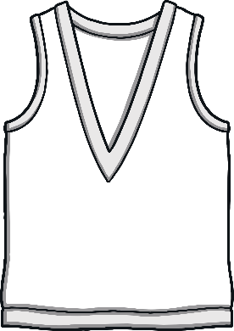


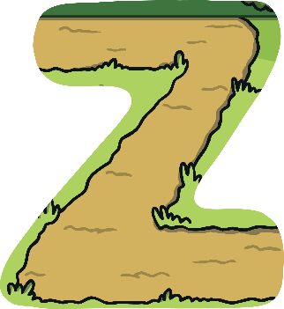


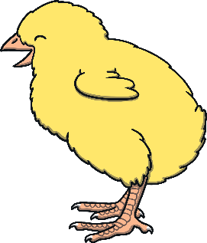


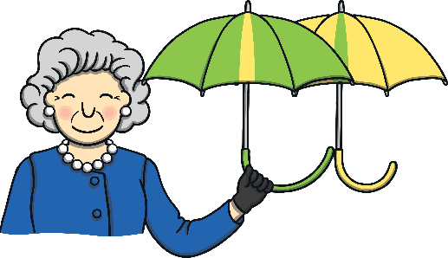
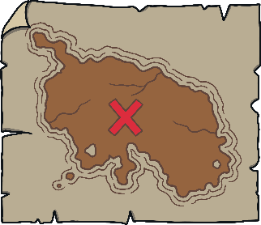


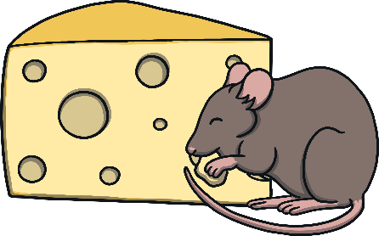
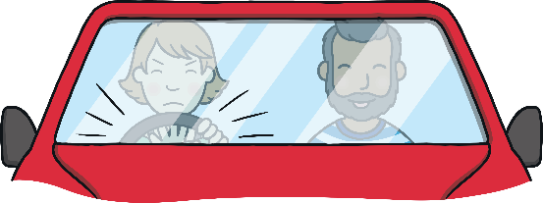

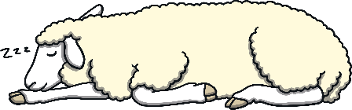
Revisit and Review
Let’s practise Sam’s Sounds and Tricky Words!
ng
ear
ai
ar
z
oo
v
ee
ure
oi
y
j
oa
qu
ur
ow
th
oo
er
ch
air
x
igh
th
w
zz
sh
or
were
one
little
so
have
come
said
like
there
some

Slide 3

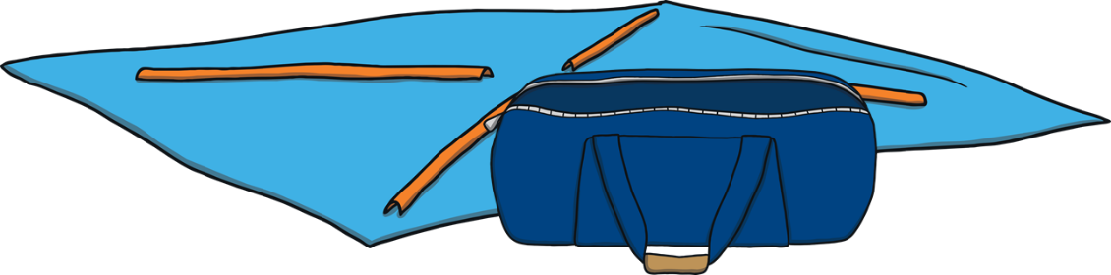
Teach
Today, we are practising reading words that contain
consonant blends.

Slide 4
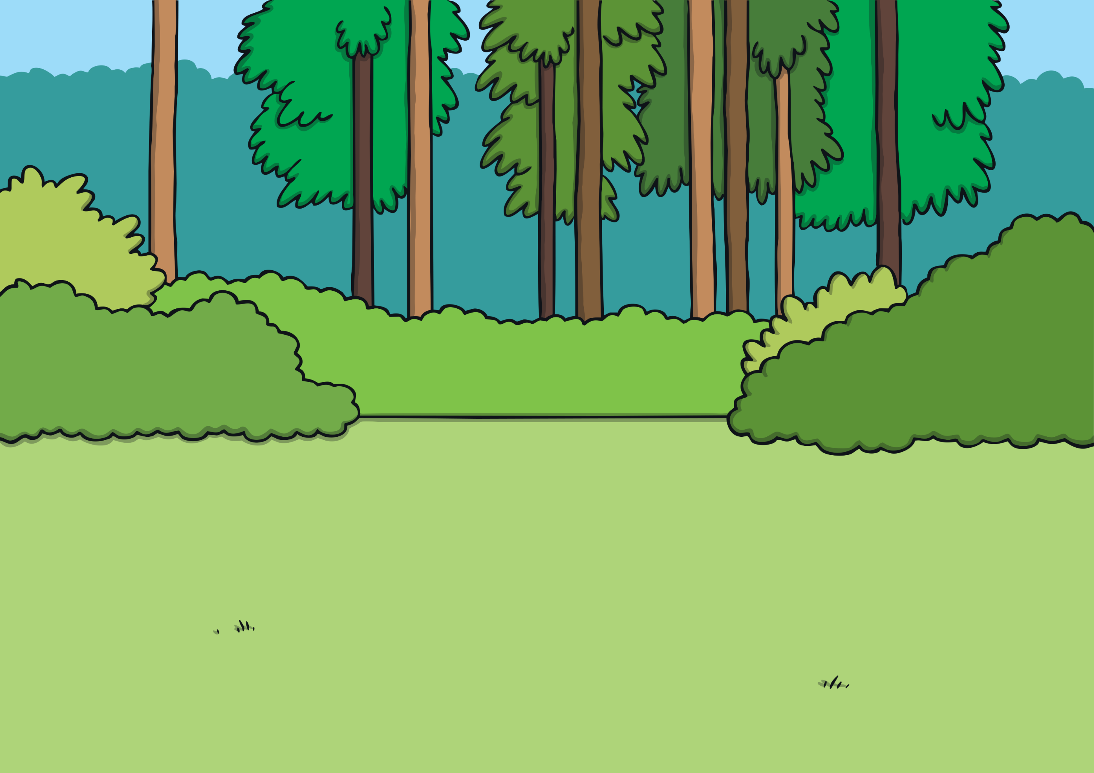
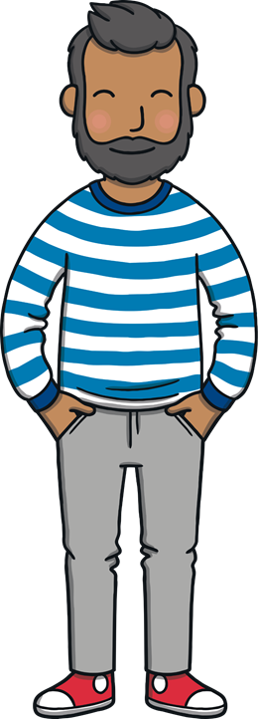



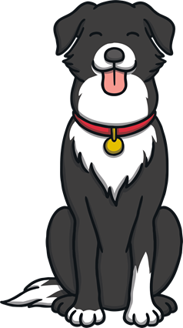
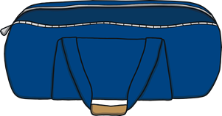
Teach
The family were spending the weekend at a campsite. Kit and Sam couldn’t wait to put the tent up and get inside!

Slide 5
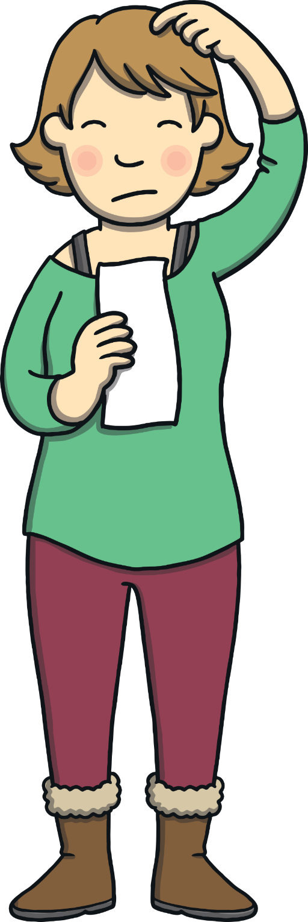

Teach
Mum and Dad got out the instructions. They both looked puzzled.
“Hmm…”said Dad, “this tent looks complicated.”

Slide 6
Teach
“I am sure we will work it out,” said Mum. “OK, I will read out the instructions and you can all start to get the right bits out of the bag.”

Slide 7


Teach
Mum has a list of instructions to put the tent up. What do Kit and Sam need to get out of the bag? Click on the correct item.
X
This activity can be done practically, using real objects.
Click me for Kit’s teaching tips!

Slide 8
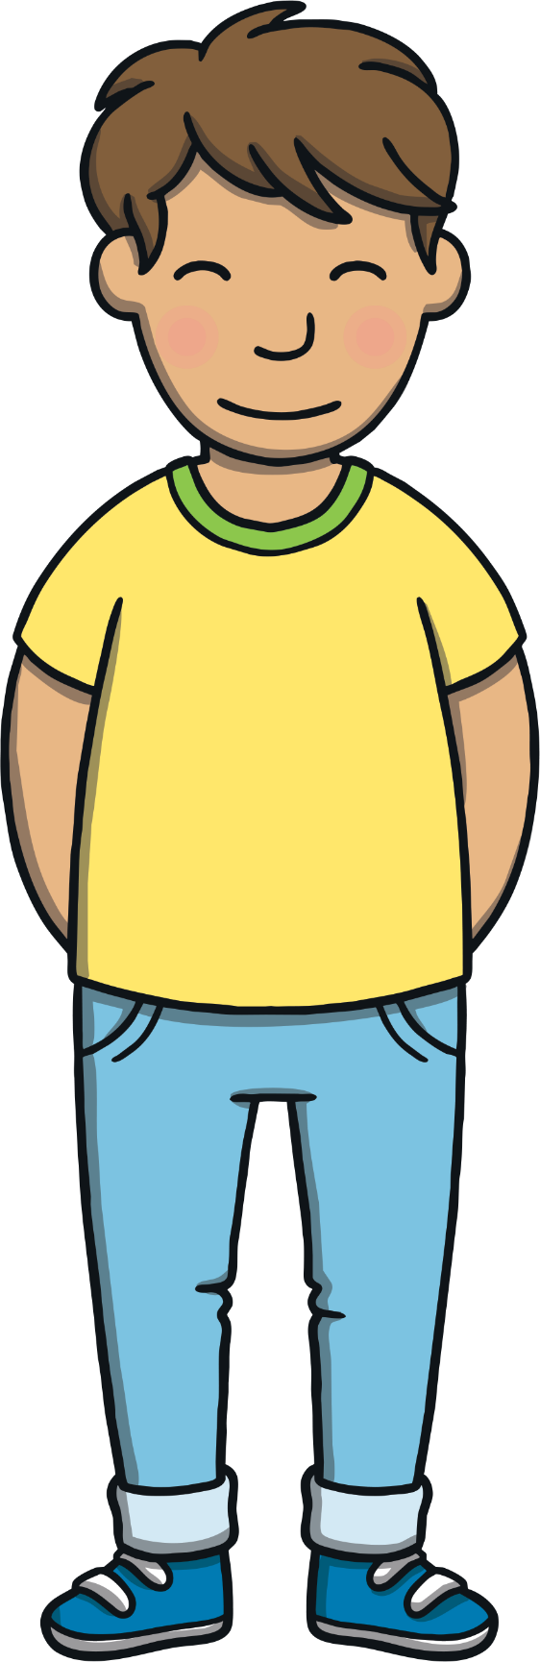

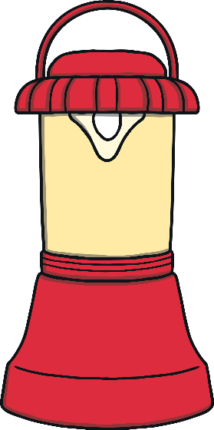

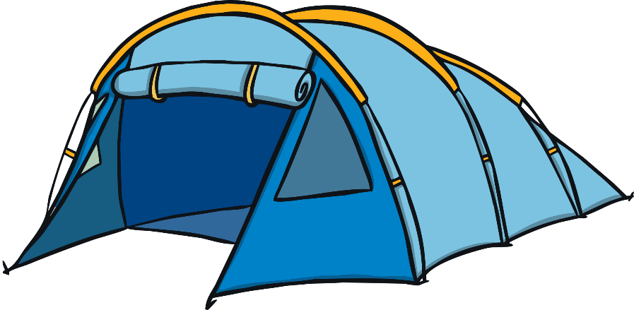
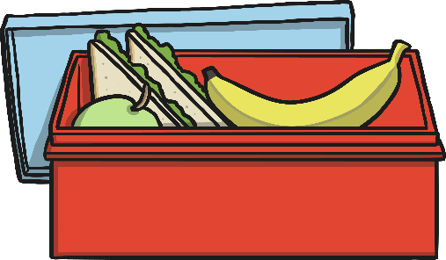

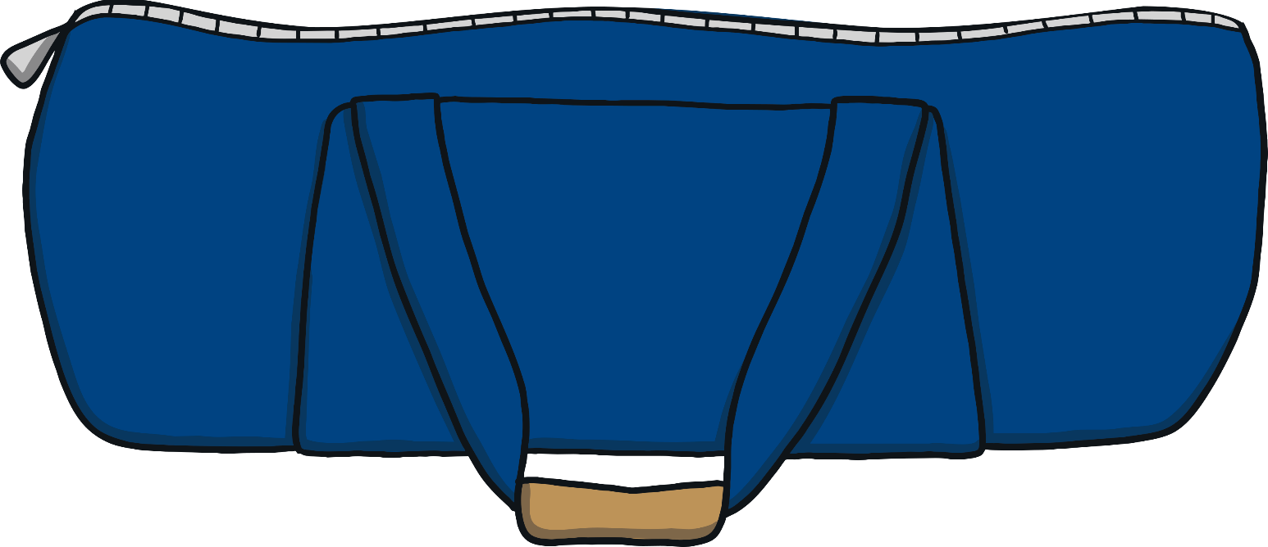
Teach
lunch
tent
stick
lamp
flag
next

Slide 9

Putting up the Tent
Practise
Dad is telling Kit and Sam which part of the tent they need to put up next. Can you help to put up the tent?

Slide 10
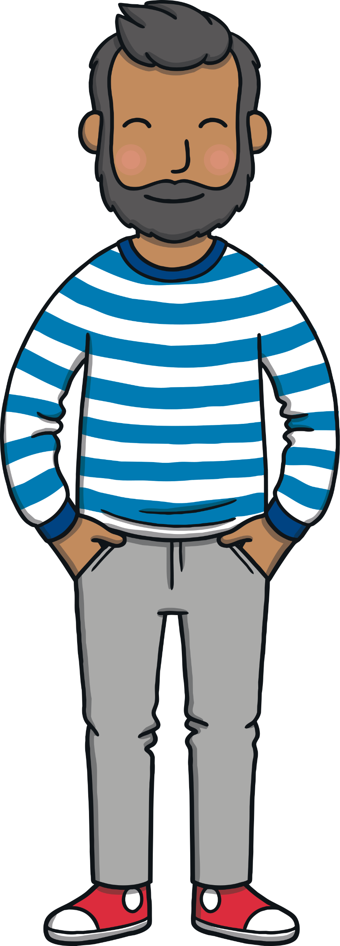

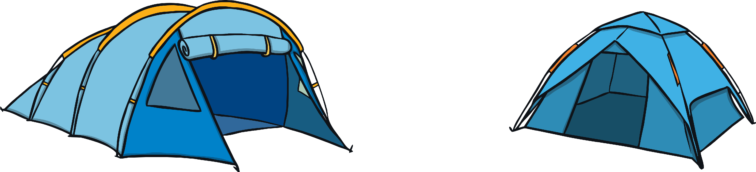

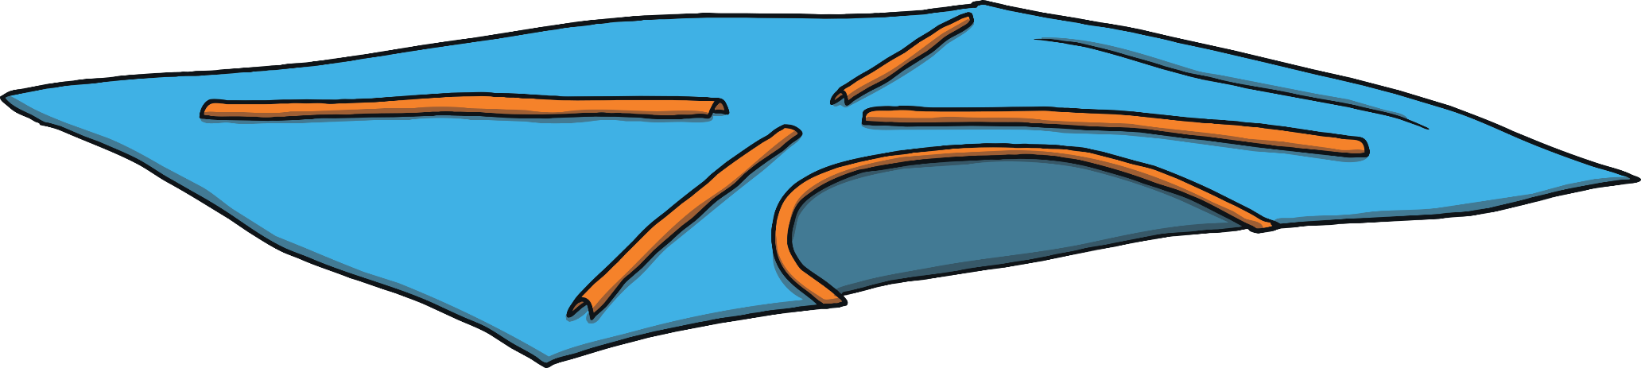
Practise
Get the sticks.
Lift the tent.
Stick on the flag.
Hang up the lamp.

Slide 11

Apply
Finally, the tent was up. “It looks so cosy in there,” said Sam.
“Guess what I want to do now?” said Kit.
“What, Kit?” asked Mum.

Slide 12
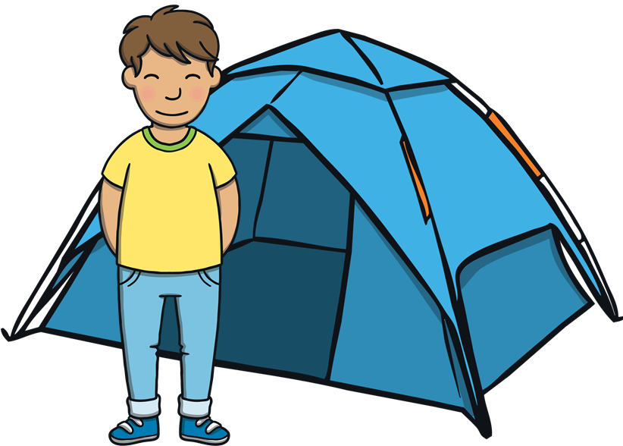
Sentence Time
Apply
What does Kit want to do? Read the sentence then click ‘Show’ to reveal the answer!

Slide 13
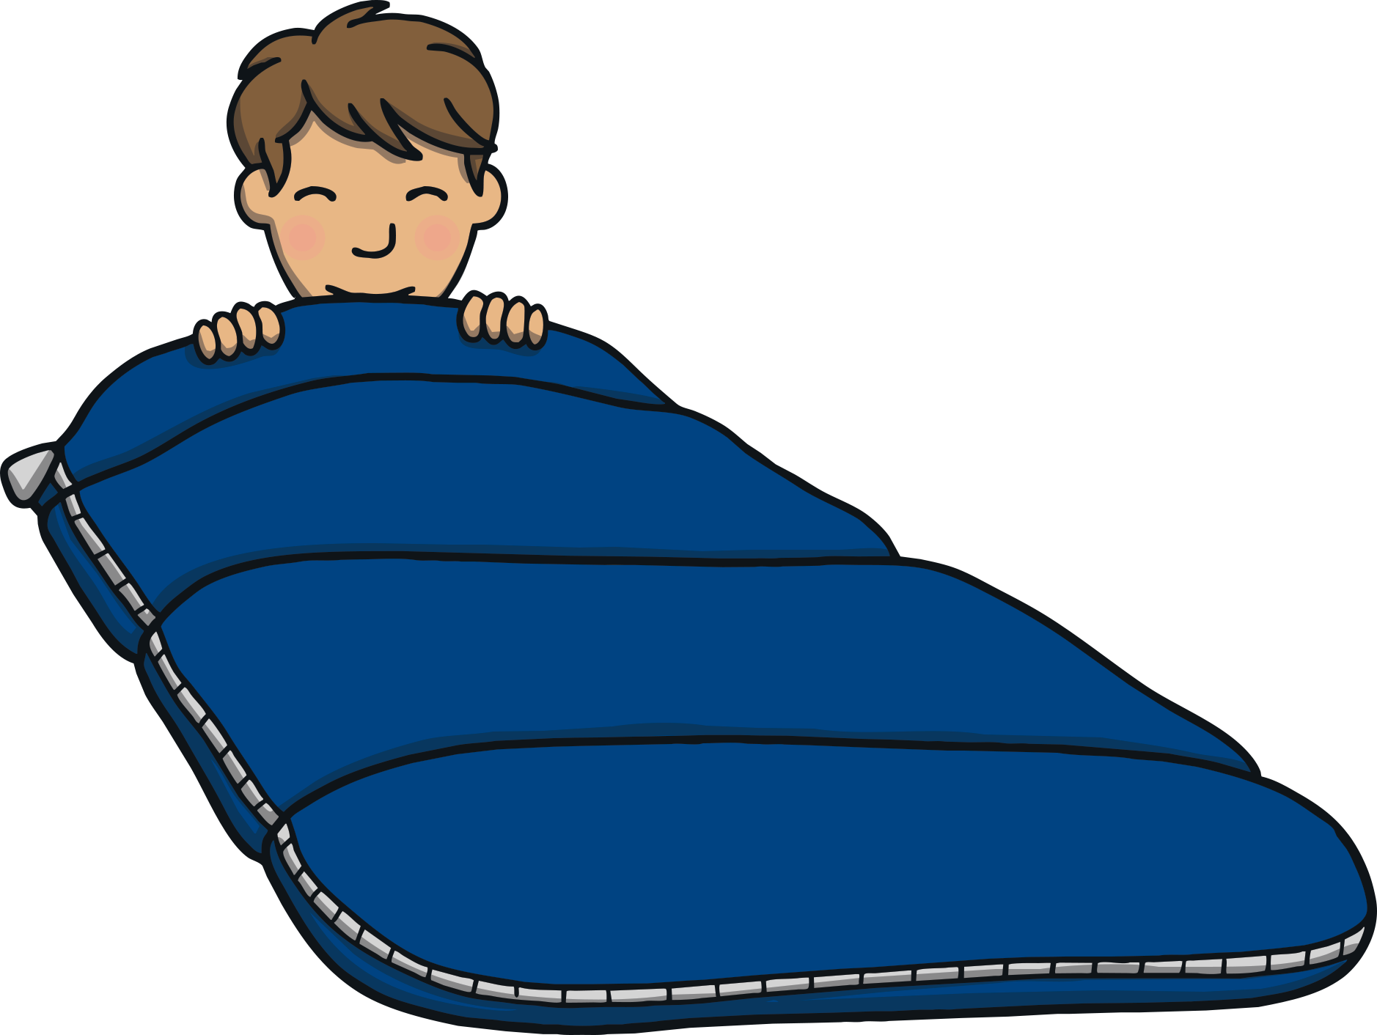

Practise
Can I jump into my soft
bed and have a little sleep?
Sound Buttons On/Off
Show

Slide 14
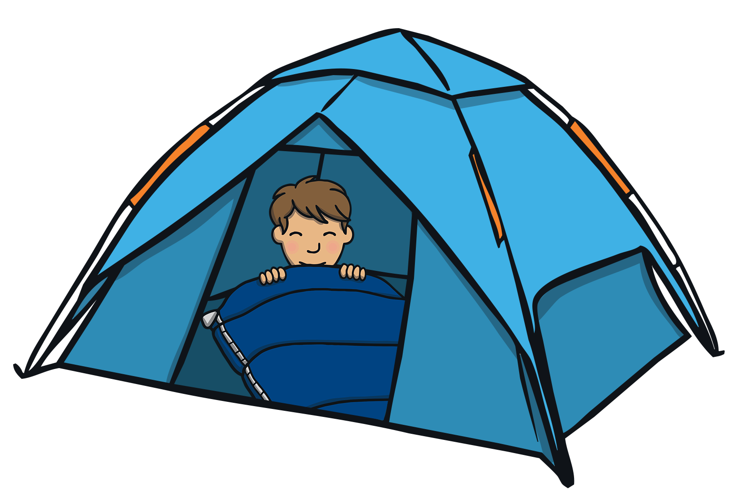

Apply
“Oh, Kit, you are funny,” laughed Mum. “It’s only
four o’clock!”
“Yes,” said Dad, “we can have lots more fun before bedtime, kids…”

Slide 15


Today, we have practised…
Consonant Blends
The adventure continues next lesson!

