Slide 2

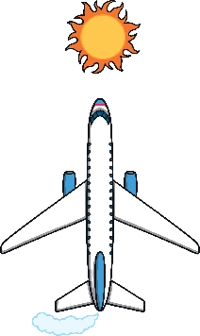
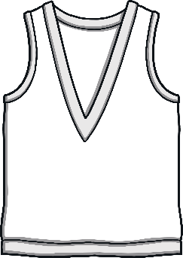



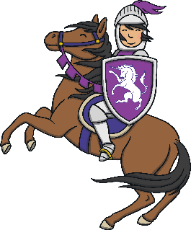
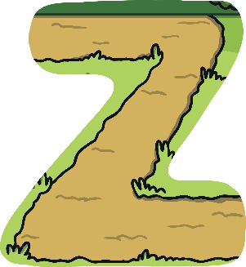


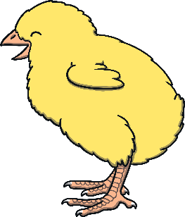

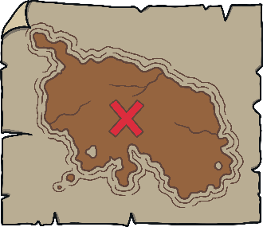
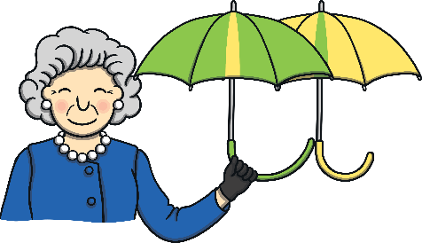
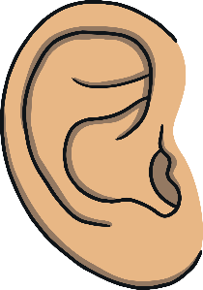
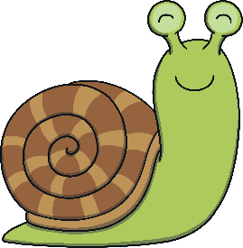


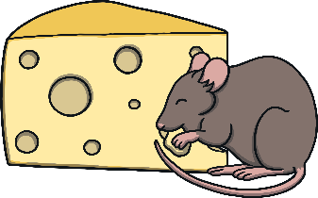




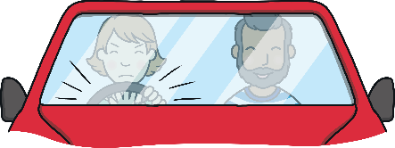

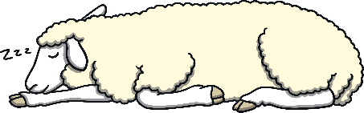
Revisit and Review
Let’s practise Sam’s Sounds and Tricky Words!
w
er
v
ure
air
qu
ng
j
ch
z
ar
x
ee
ow
ur
ai
sh
igh
th
y
or
oo
oa
ear
oi
so
have
come
said
like
some

Slide 3
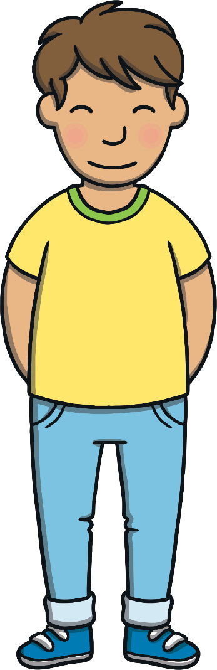
Teach
This week, we meet our next tricky
words for reading:
were
there
little
one
Tricky words are words that can’t be sounded out. We just have to learn them off by heart!

Slide 4


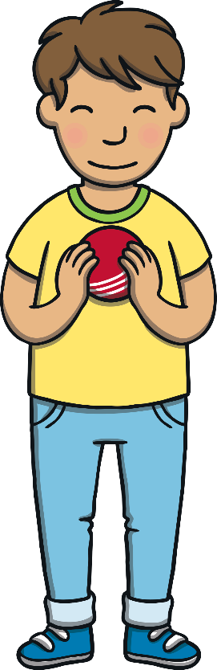
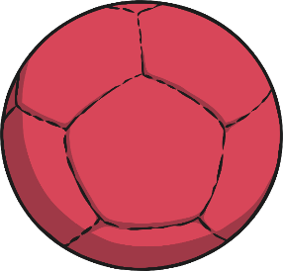


Teach
Throw and Catch
Kit and Sam are playing catch in the garden. Read the tricky words on the balls as they throw them.
little
one
there
were

Slide 5
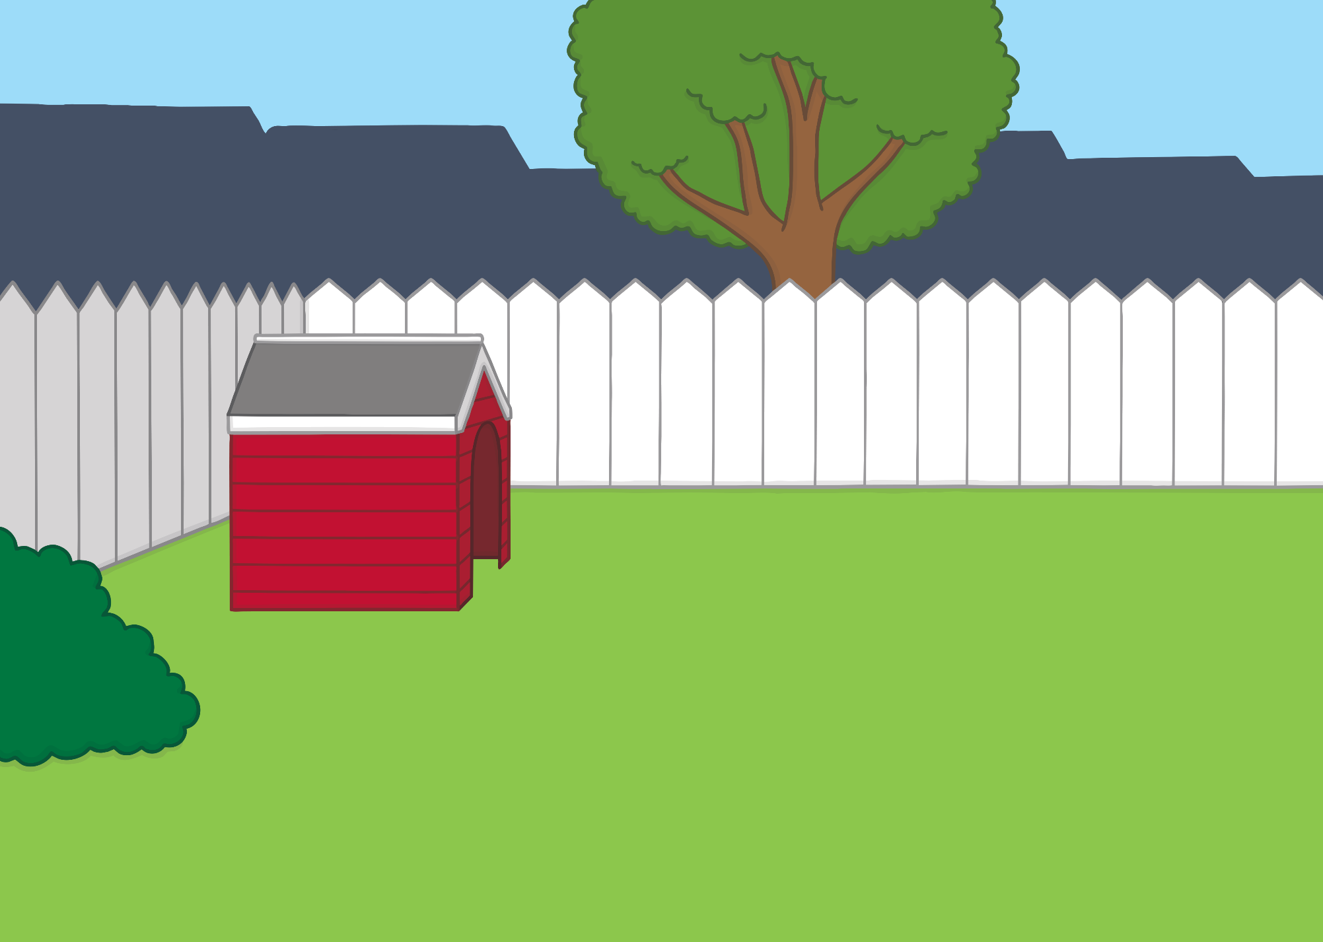

Teach
were
little
little
were
one
there
there
one

Slide 6

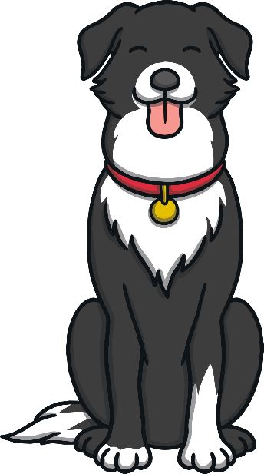
Teach
Today, we are practising reading words that contain
consonant blends.

Slide 7
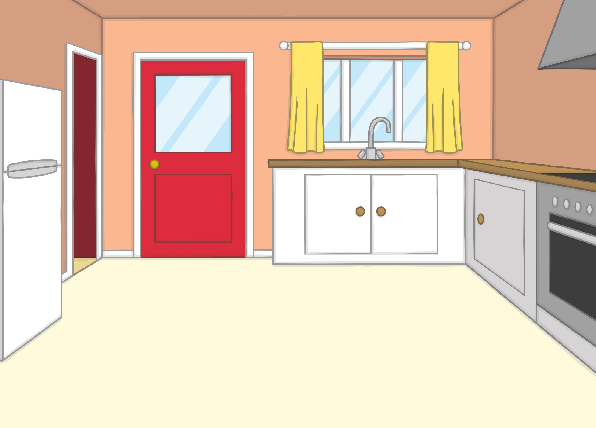
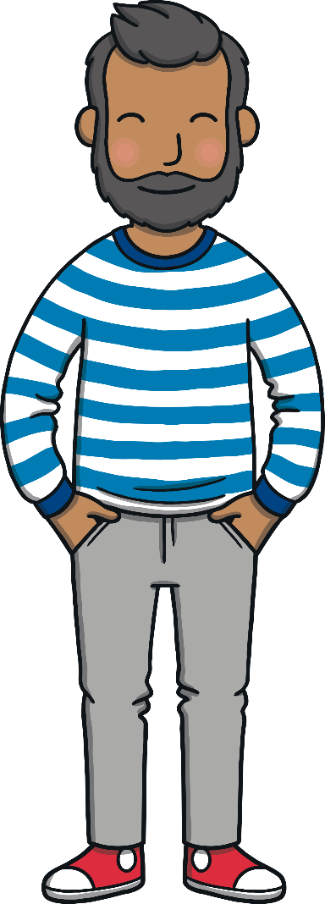


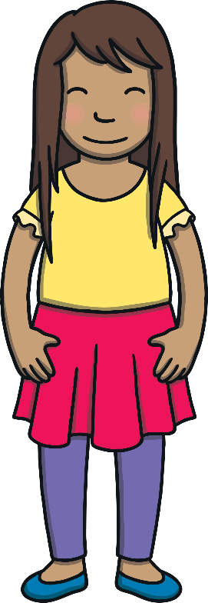
Teach
One Saturday, Mum and Dad came into the kitchen
with some news for Kit and Sam. They were all going
on a camping trip!

Slide 8
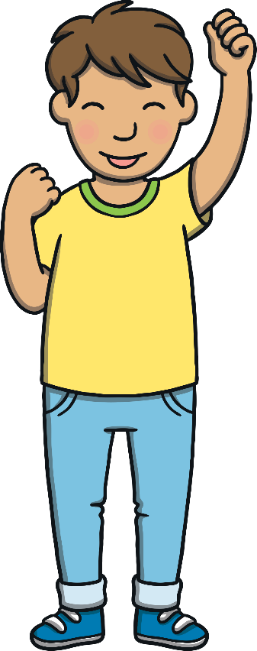

Teach
The campsite was in the woods. It was a long drive away from home but it was near to the beach! Kit and Sam were so excited.

Slide 9
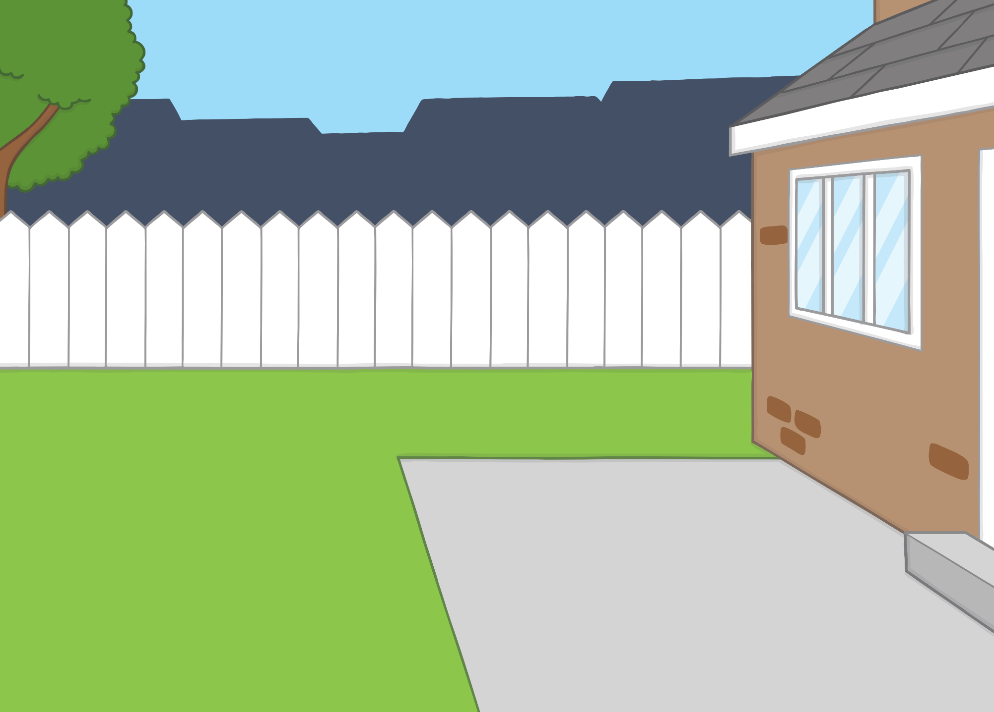
Teach
They all went out into the garden to gath er the camping equipment and get ready to pack it into the car. “OK, what do we need to take?” said Mum.

Slide 10



Teach
Mum and Dad have written a list of things they need to pack. Can you help Kit and Sam choose the right items to go into the bag?
X
Consonant blends include both initial and final consonant blends.
Click me for Kit’s teaching tips!

Slide 11
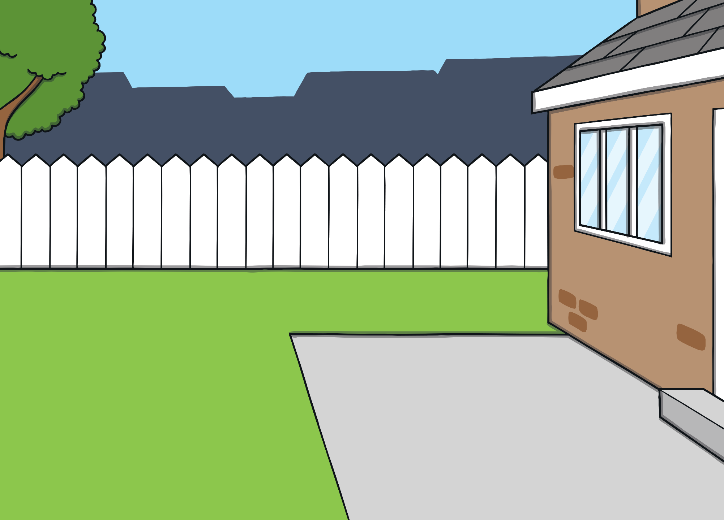


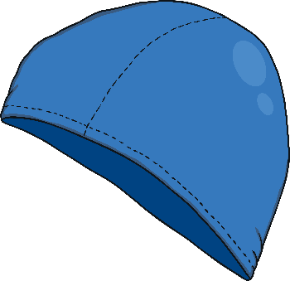
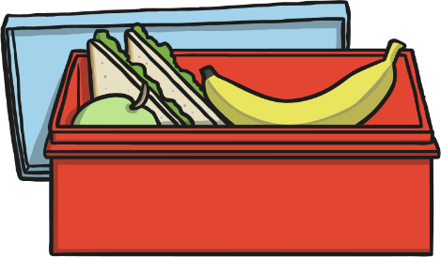
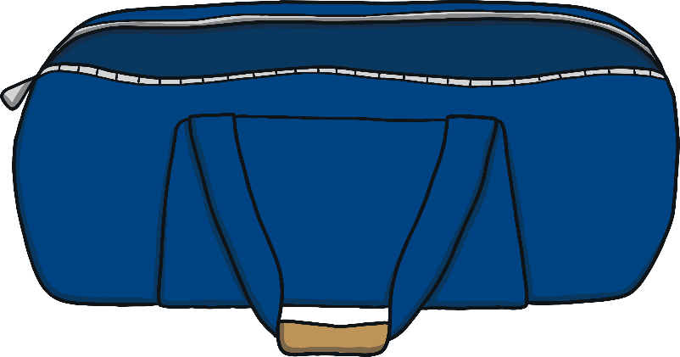
Teach
tent
spoon
lamp
camp food
swim hat
brush

Slide 12
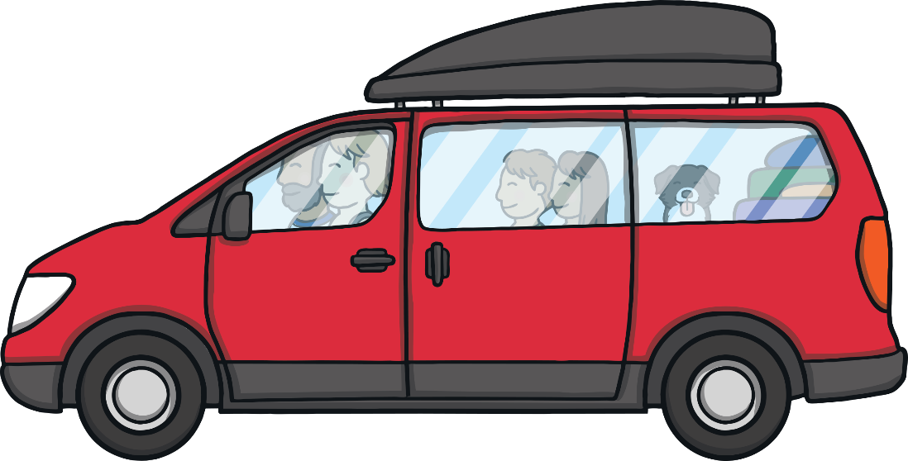
Practise
Consonant Blend I Spy
The family are in the car. Kit and Sam play I Spy on the way. Listen to Kit and Sam sounding out the words. Can you guess what they have spotted?

Slide 13


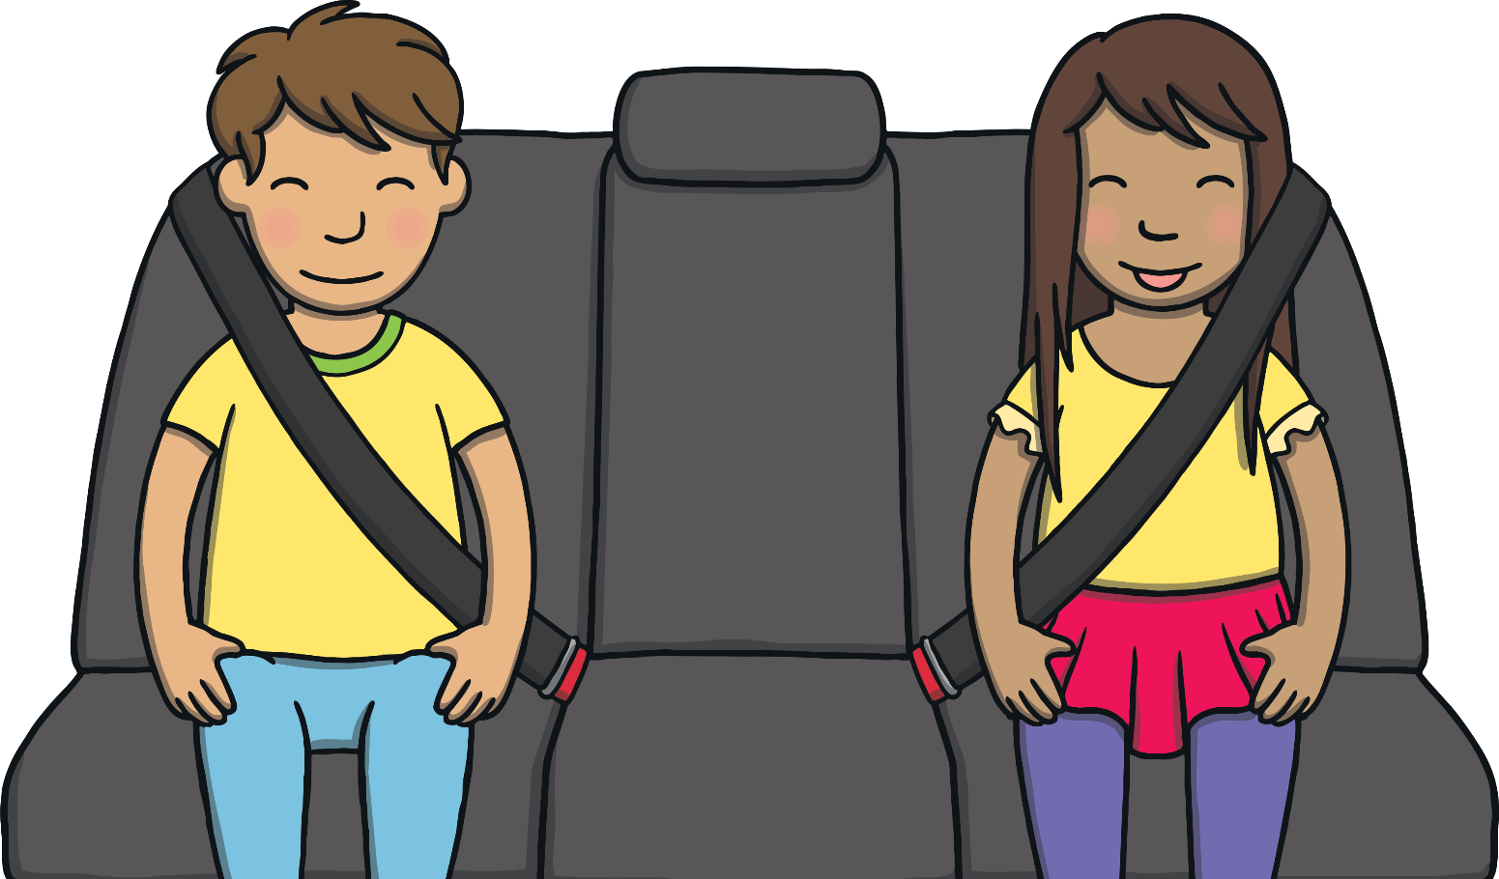

Practise
g
a
fl
Check

Slide 14
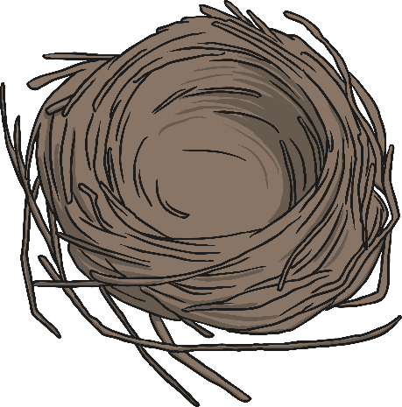
Practise
st
e
n
Check

Slide 15
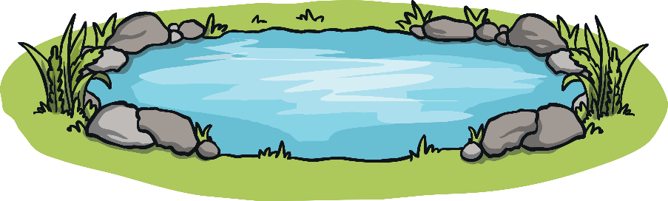
Practise
nd
o
p
Check

Slide 16
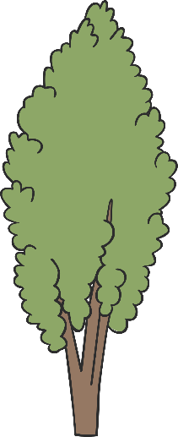
Practise
r
t
ee
Check

Slide 17

Practise
b
ch
e
n
Check

Slide 18

Practise
g
o
fr
Check

Slide 19
Apply
Sentence Time
What can Dad see? Read the sentence then click ‘Show’ to reveal the answer!

Slide 20
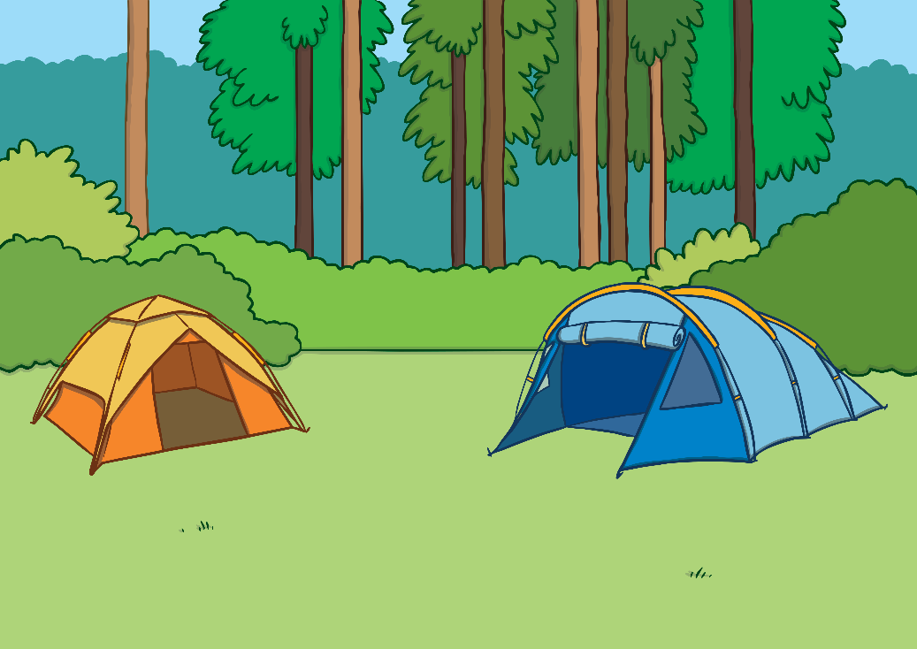
Apply
“There is the little camp and there are lots of tents!”
Sound Buttons On/Off
Show

Slide 21

Apply
They arrived at the campsite and unpacked the car. “Can we help to put the tent up?” asked Kit and Sam. “Of course!” said Mum and Dad.

Slide 22
Today, we have practised…
Consonant Blends
The adventure continues next lesson!

