Slide 2
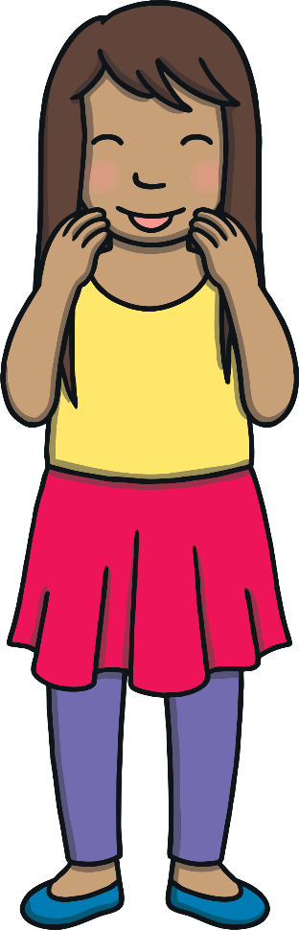
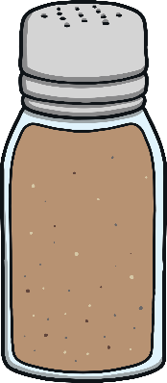

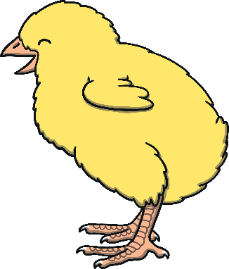
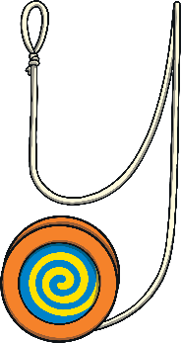
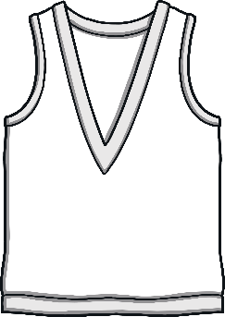
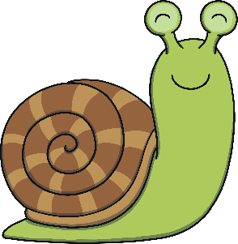
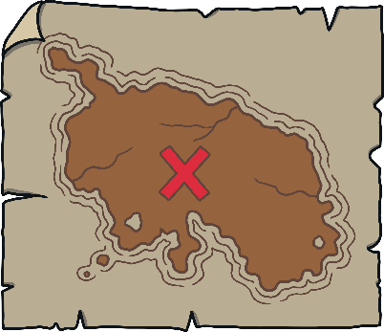
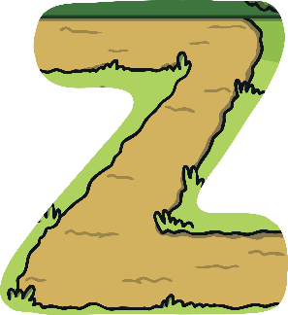
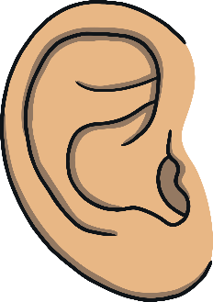
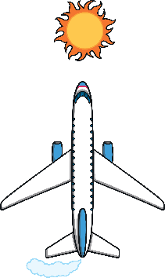
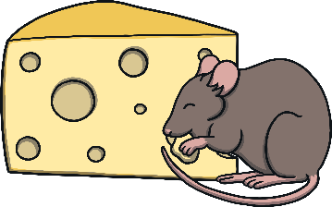

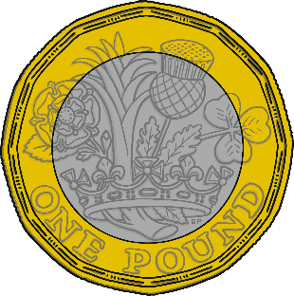


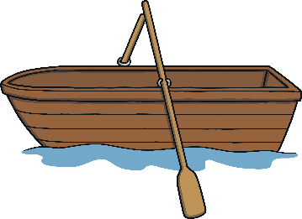
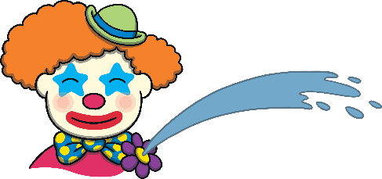
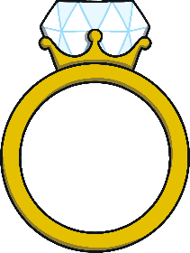
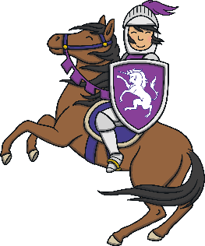
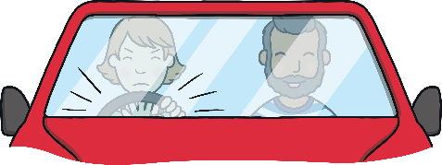


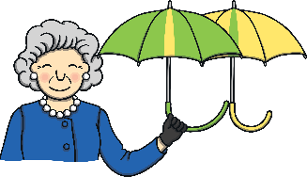
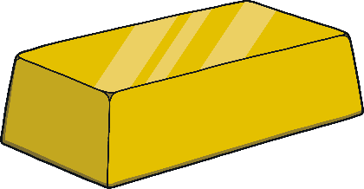
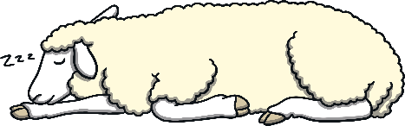
Revisit and Review
Let’s practise Sam’s Sounds and Tricky Words!
er
y
j
ch
z
ee
air
ai
ear
ng
oi
oa
qu
th
ur
oo
x
v
ar
igh
ow
or
ure
w
sh
some
so
like
have
come
said

Slide 3
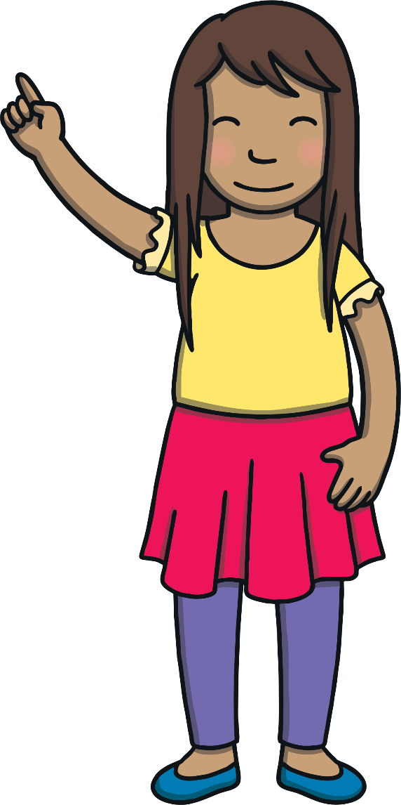
Today, we are learning to read words that contain
initial consonant blends.

Slide 4
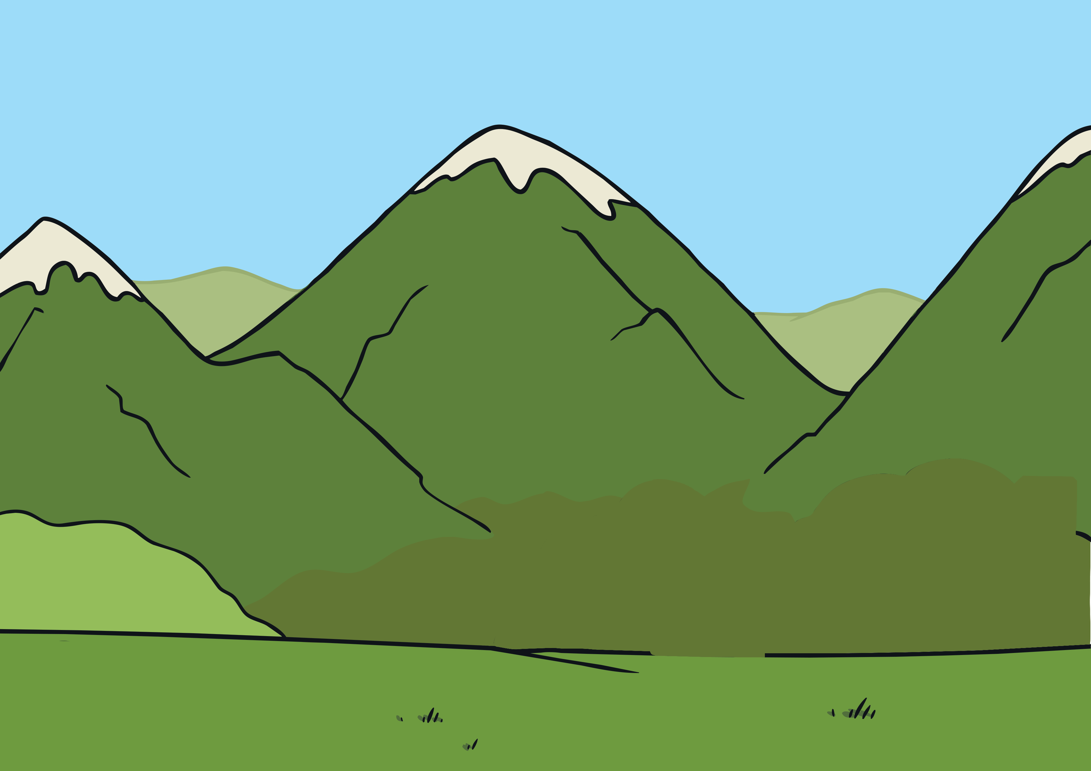
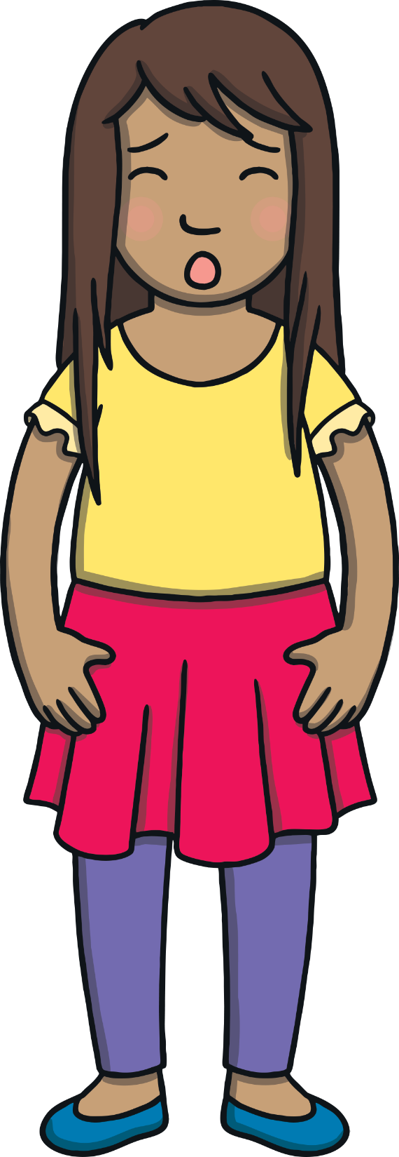

Teach
The magic map was taking Kit and Sam to the top of the highest mountain in the world – Mount Everest! Kit and Sam were scared.

Slide 5


Teach
“We are at the top of Mount Everest!” called Sam, over the noise of the wind. “Yes,” said Kit, “we didn’t mean to get this close to other mountains!”

Slide 6
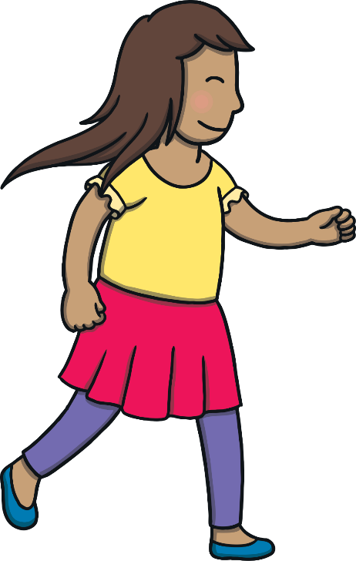
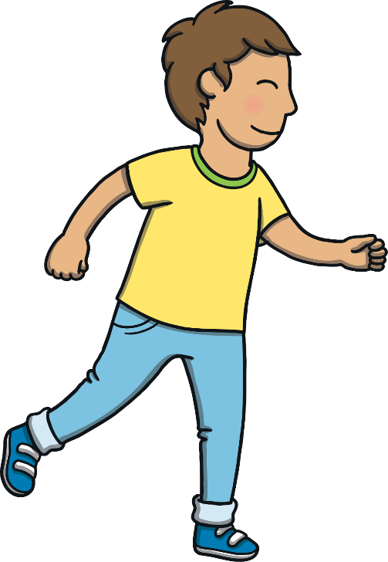
Teach
“I think we should head down the mountain,” said Sam. “It’s fr…fr…freezing up here!”
“Good plan,” shouted Kit. “Let’s follow this track.”

Slide 7
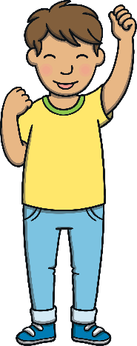
Teach
Kit and Sam are following the track down the mountain. Can you write down the names of things that they see on the way?
Hint
They all begin with an initial consonant blend!
X
This activity can be done on whiteboards, either individually or in pairs.
Click me for Kit’s teaching tips!

Slide 8
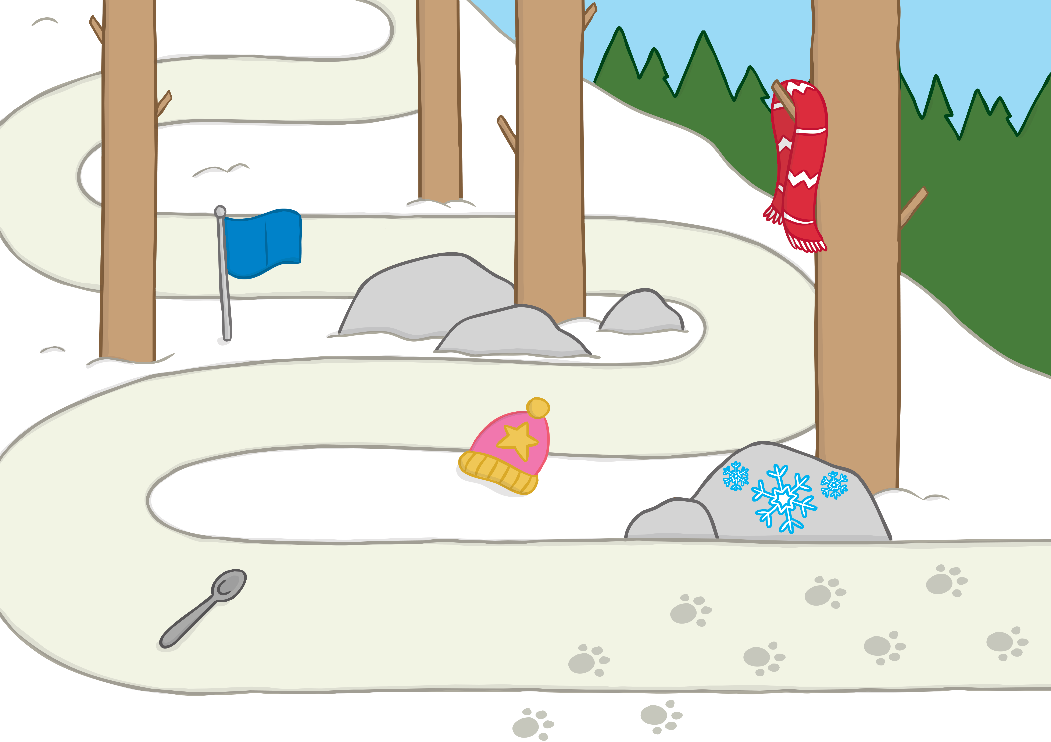
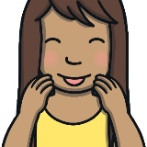
Teach
scarf
flag
frost
star
spoon
Answer

Slide 9
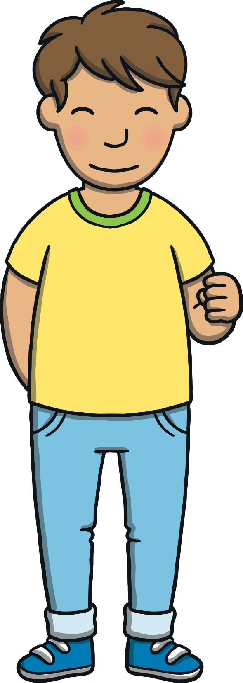
Practise
Climbing Pole Phoneme Frames
Kit and Sam see climbers’ poles on their way down the mountain. Put letters inside the climbing pole phoneme frames to match the pictures.

Slide 10
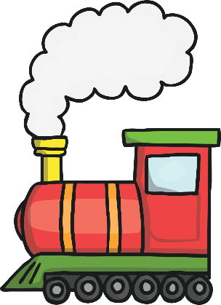
Practise
u
r
i
n
ai
c
t

Slide 11
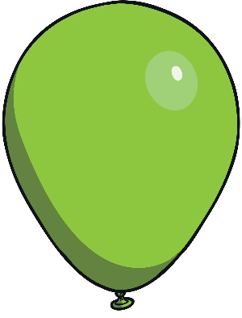
Practise
r
p
n
ee
g
o
b

Slide 12
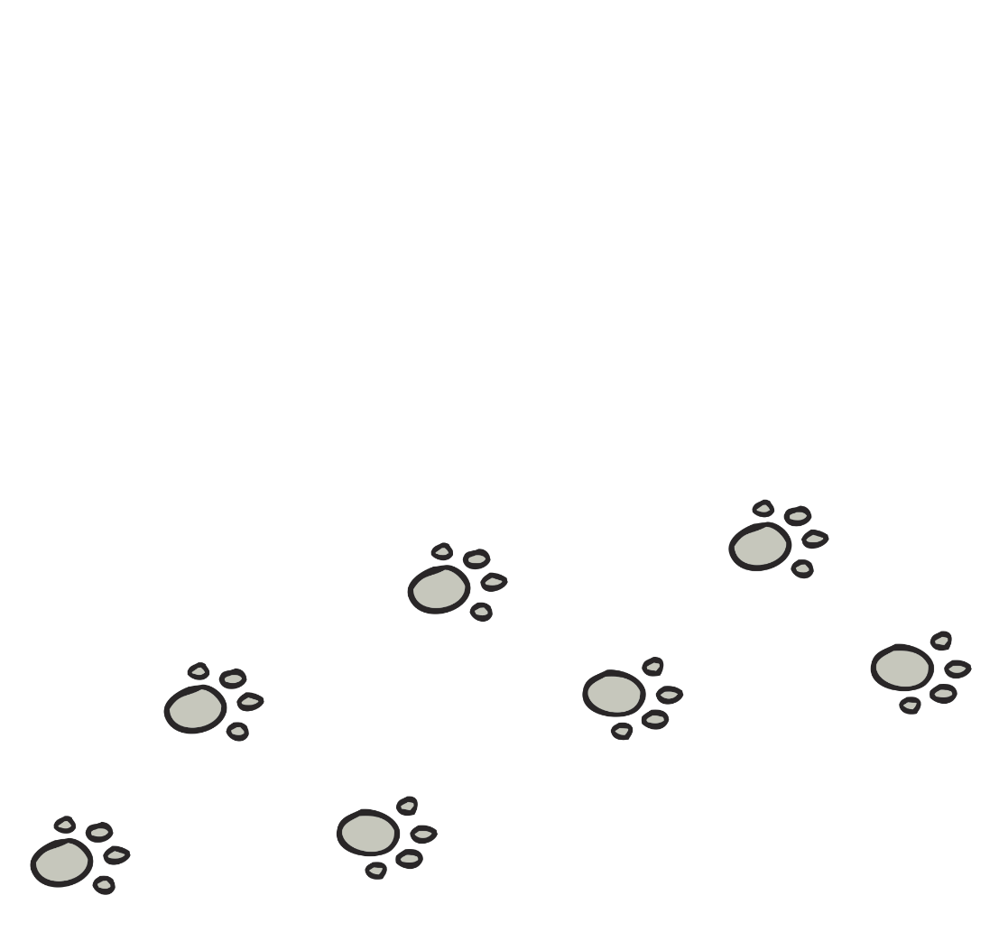
Practise
a
ck
t
m
r
c
b

Slide 13
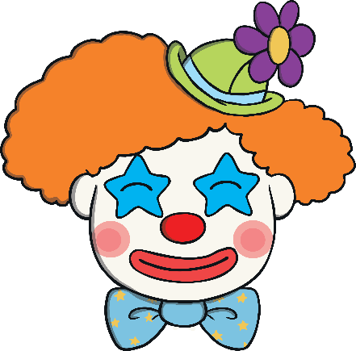
Practise
y
r
n
t
c
ow
l

Slide 14

Practise
r
o
u
i
sh
e
b

Slide 15
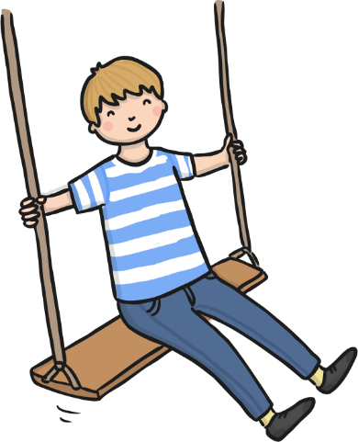
Practise
w
s
u
ng
i
o
b

Slide 16

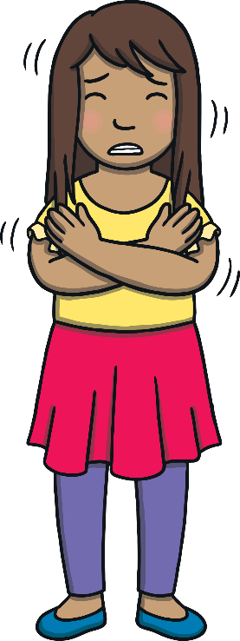
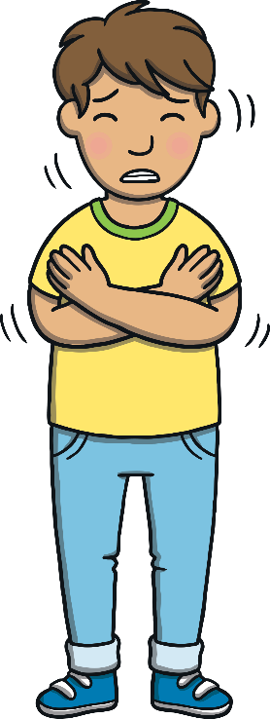
Apply
“Even following these climbing poles isn’t helping!” yelled Kit.
“I’m so cold! I think we had better ask the magic map for help,” shouted Sam.

Slide 17
Sentence Time
Apply
What does Sam say to the magic map? Look at the picture and write a sentence to match.

Slide 18
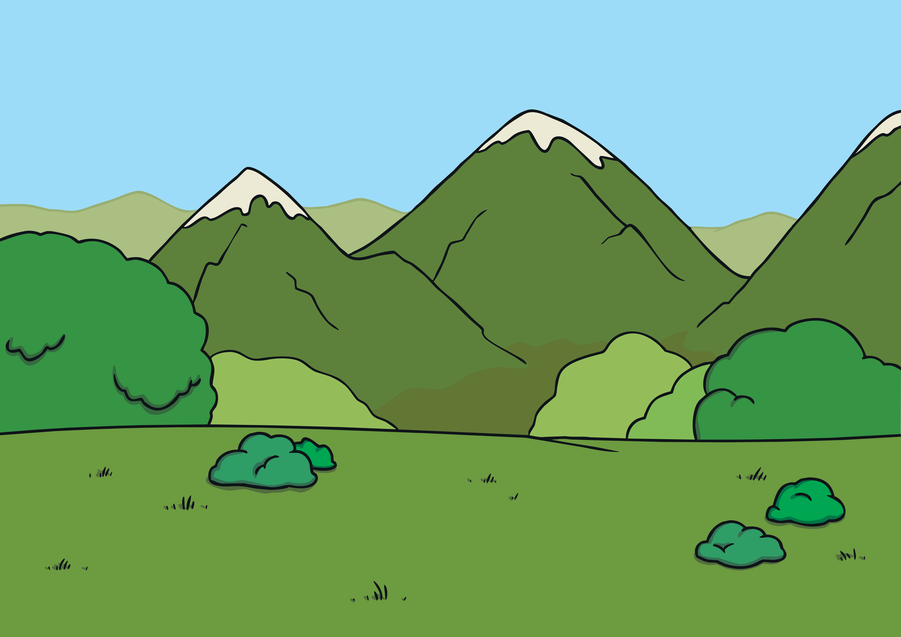
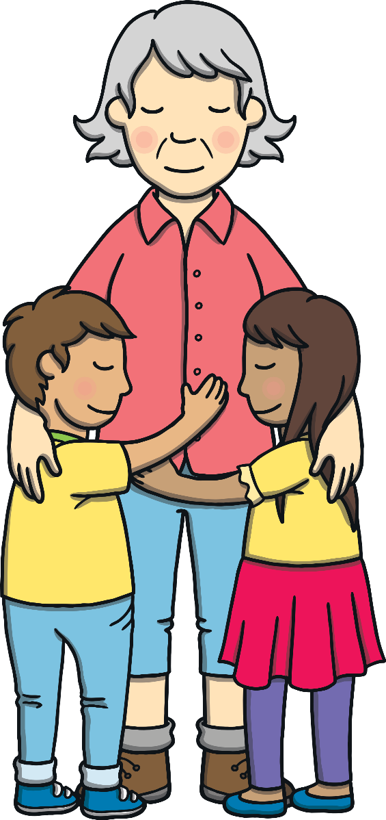
Apply
It was a fun trip but can we go back to Gran now?
Sound Buttons On/Off
Show

Slide 19
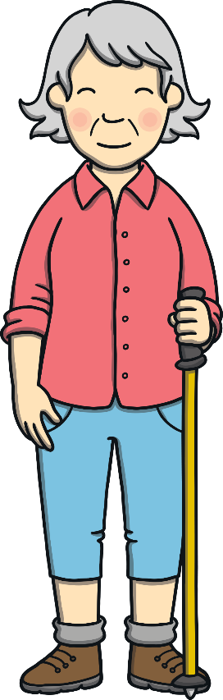
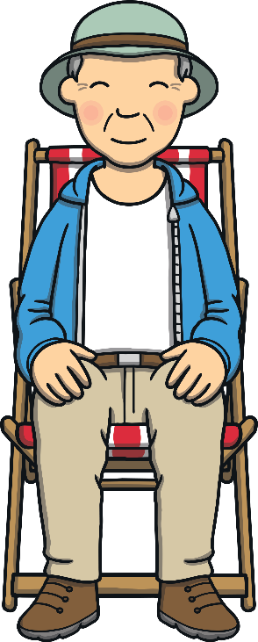
Kit and Sam found themselves back with Gran and Grandad. Gran opened one eye. “Welcome back,” she said. “You need to be careful how you use that…”

Slide 20
Today, we have learned…
Initial
Consonant Blends.
The adventure continues next lesson!

