Slide 2

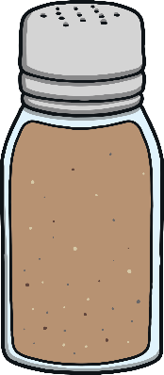

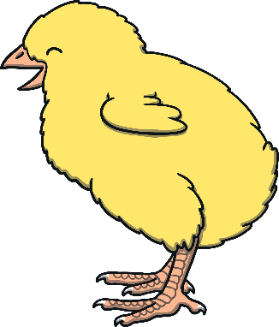

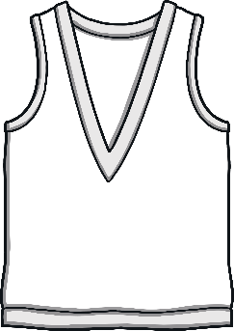
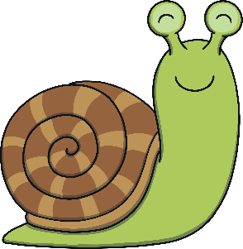
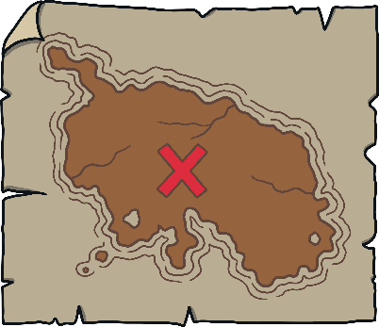
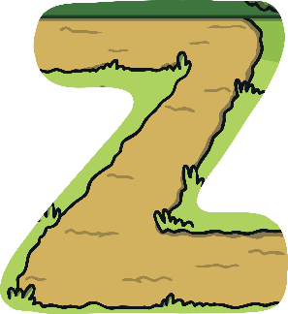
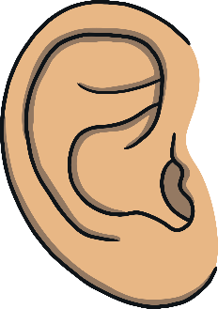
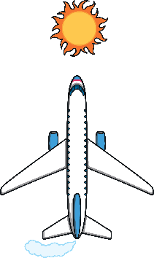
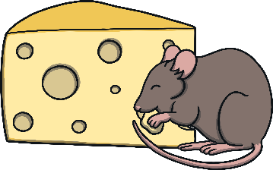




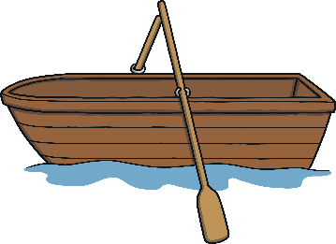


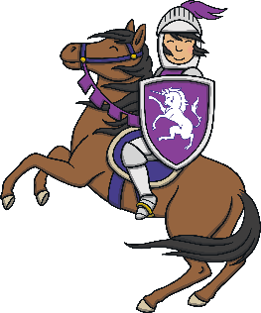
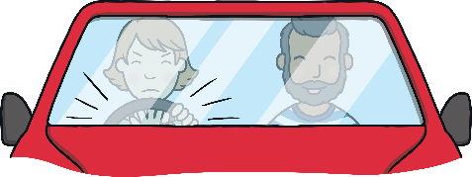


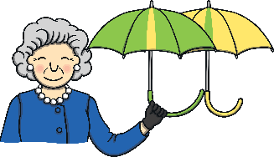

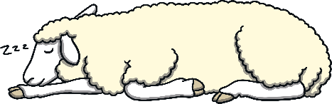
Revisit and Review
Let’s practise Sam’s Sounds and Tricky Words!
er
y
j
ch
z
ee
air
ai
ear
ng
oi
oa
qu
th
ur
oo
x
v
ar
igh
ow
or
ure
w
sh
so
have
come
said
like
some

Slide 3

Today, we are learning to read words that contain
initial consonant blends.

Slide 4
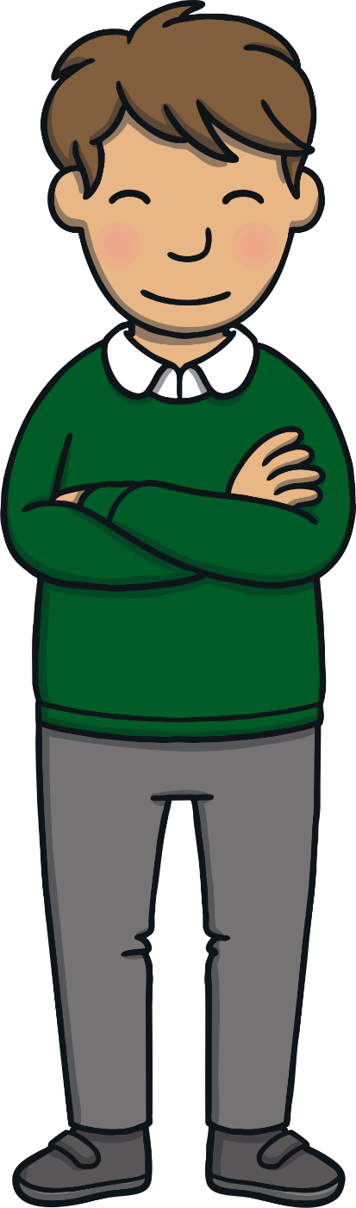
Teach
This week, we are learning to spell the tricky words was and you..
Watch the magic pencil write the words. Can you join in?

Slide 5

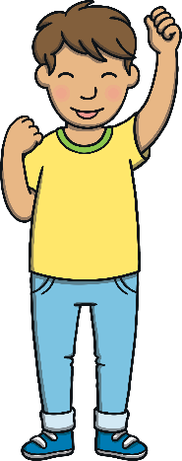

Teach
was
X
It can help to spell out tricky words using the letter names to remind children that tricky words can’t be sounded out.
Click me for Kit’s teaching tips!
Play

Slide 6
Teach
you
X
It can help to spell out tricky words using the letter names to remind children that tricky words can’t be sounded out.
Play

Slide 7
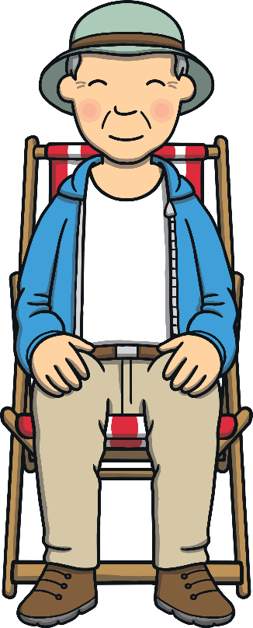
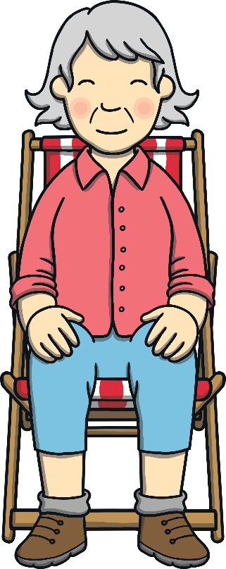
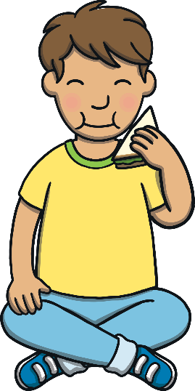
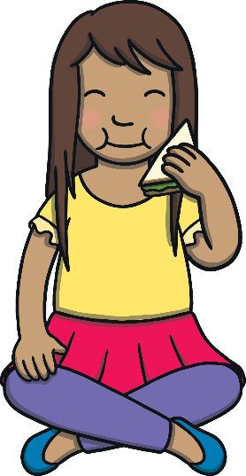
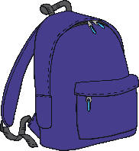
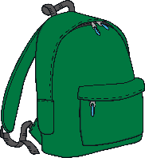
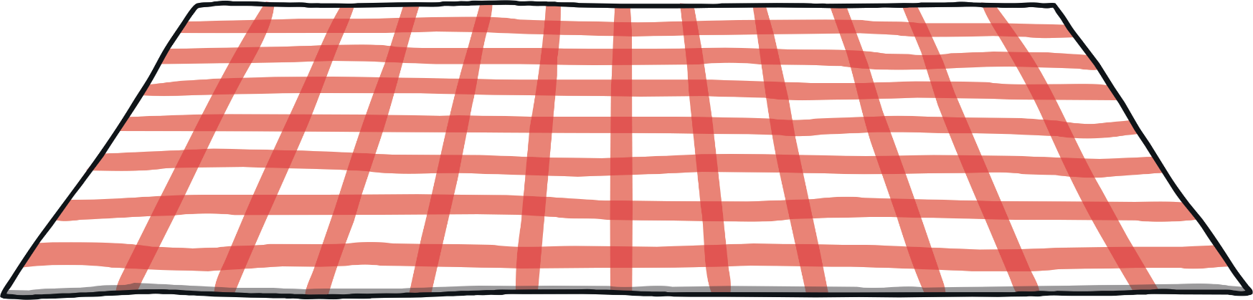
Teach
Kit, Sam, Gran and Grandad had stopped for a picnic lunch. The walk had made them hungry and they all happily tucked into their sandwiches.

Slide 8


Teach
After lunch, Gran and Grandad dozed in the sun.
“I love being in the mountains,” said Kit.
“Me too,” said Sam. “I wonder if there are other mountains?”

Slide 9

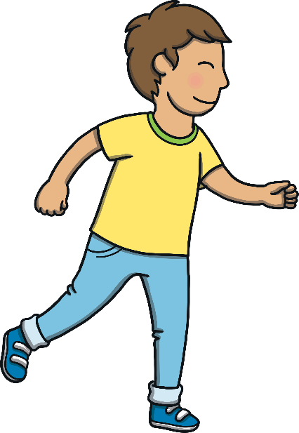

Teach
“I know how we can find out!” said Kit. “Guess what I have in my rucksack!”
“The magic map!” said Sam, with excitement.

Slide 10


Magic Map
Teach
The magic map is showing objects that begin with initial consonant blends. Can you work out which blend belongs at the start of each word?

Slide 11

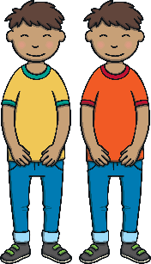



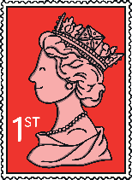


Teach
__ack
__ins
__ush
__ink
__isp
__amp
__een
__own

Slide 12

What’s on the mountain?
Practise
Can you move the snowballs to make a word to match the picture on the mountain?
Hint:
They all contain initial consonant blends.

Slide 13


Practise
d
a
r
o
m
u
i
p

Slide 14

Practise
l
n
r
g
m
u
i
s

Slide 15
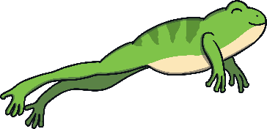
Practise
r
t
u
g
d
o
i
f

Slide 16
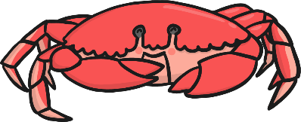
Practise
c
l
r
o
b
a
y
e

Slide 17
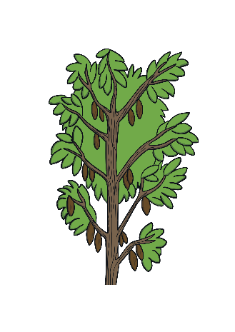
Practise
r
b
e
c
e
n
t
p

Slide 18

Practise
t
b
a
c
r
i
s
o

Slide 19
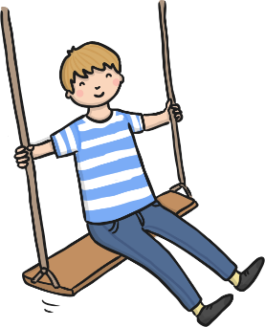
Practise
f
s
a
w
o
n
e
p
g
i

Slide 20

Practise
f
p
a
s
a
o
n
e
r
o

Slide 21

Apply
“Let’s ask the map which mountain is the highest in the world!” said Sam.
“Good plan,” said Kit. “Magic map, can you show us?”

Slide 22

Sentence Time
Apply
What answer does the magic map give? Look at the picture and write a sentence to match.
X
Click ‘Show’ to see a suggested caption for the picture.
Click me for Kit’s teaching tips!

Slide 23
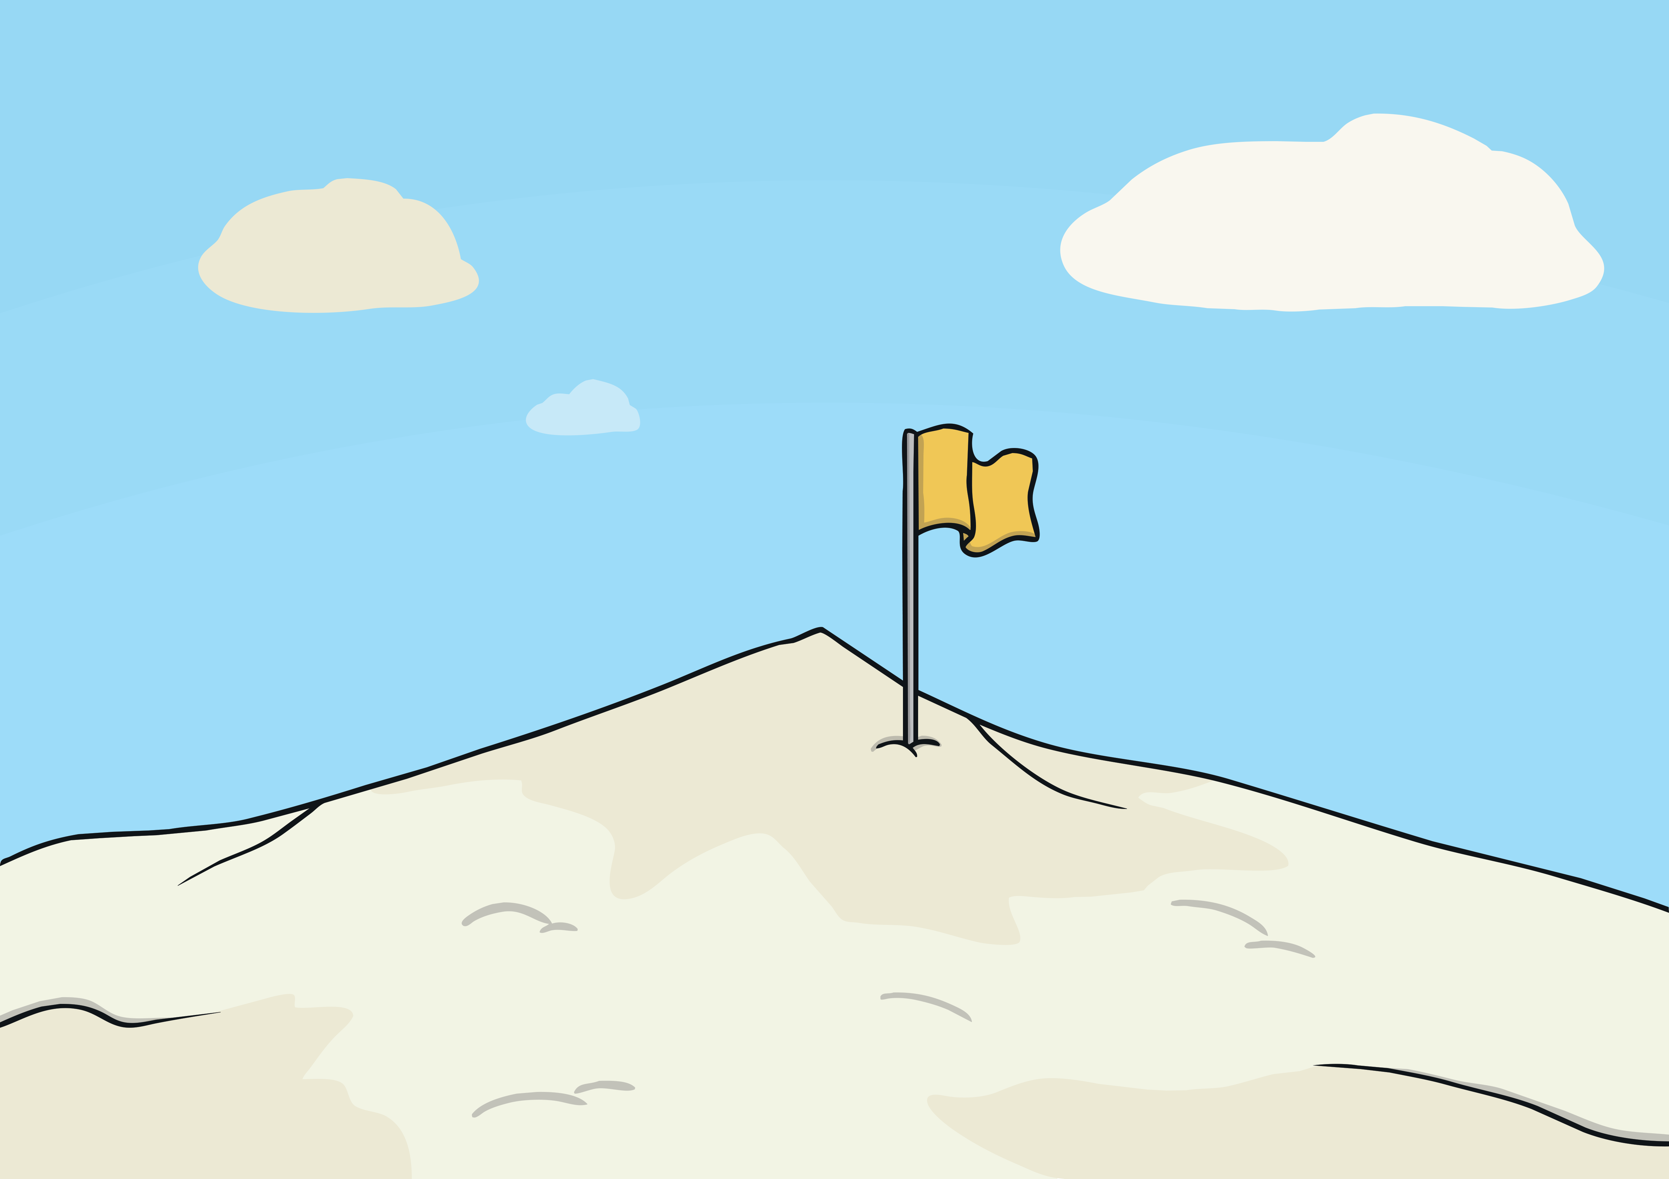
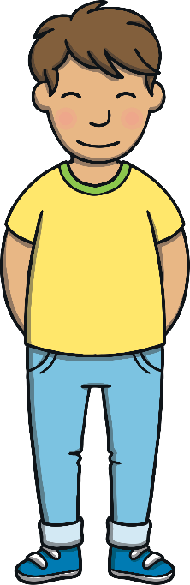


Apply
You can go on a trip to
stand on Everest.
Sound Buttons On/Off
Show

Slide 24
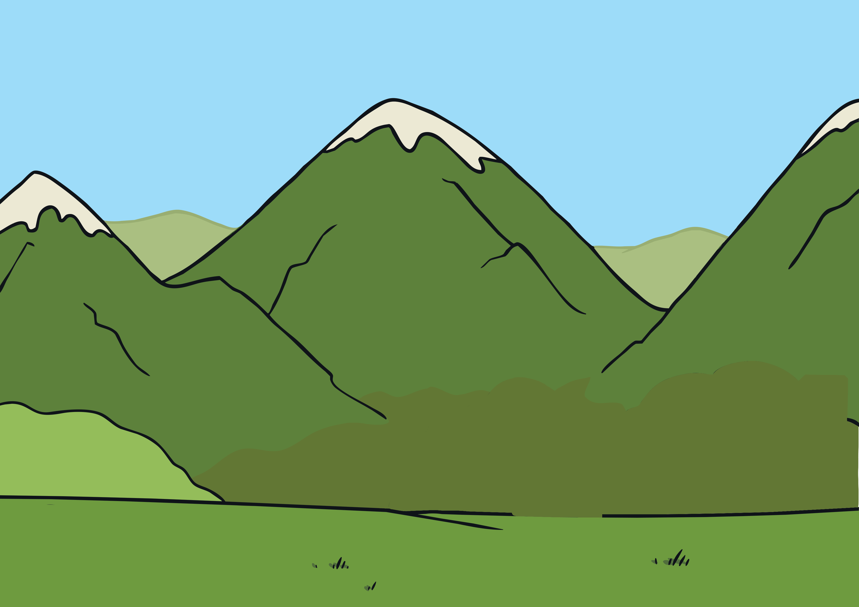
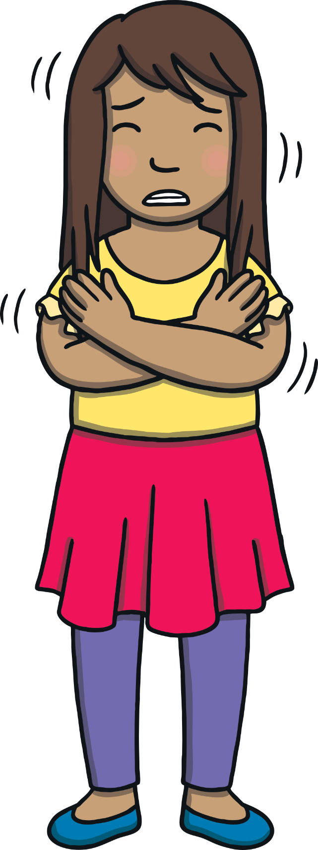
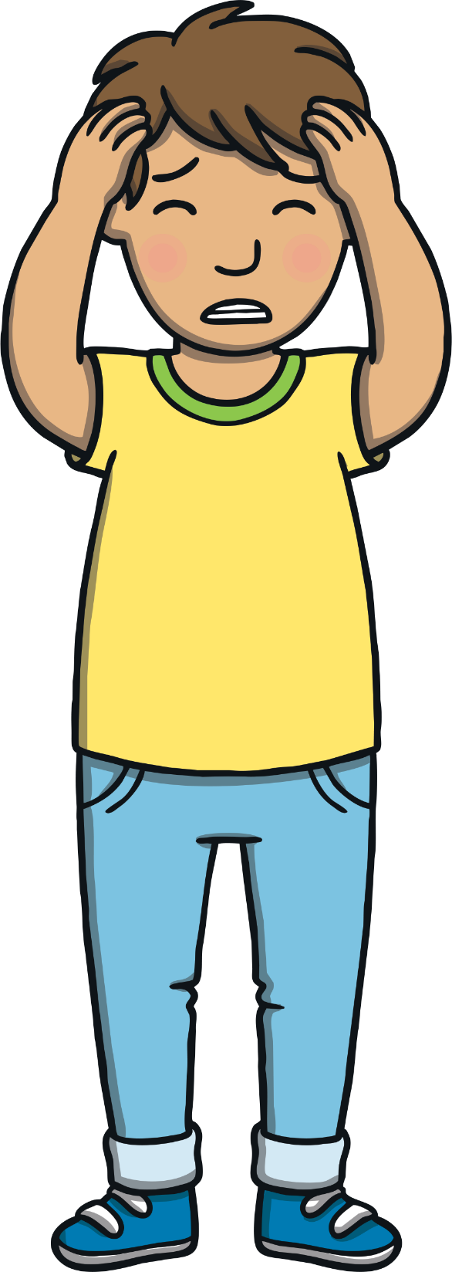
Apply
“So, Everest is the highest mountain in the world,” said Kit. The trees around them started to fade.
“But we don’t want to go there!” shouted Sam.

Slide 25
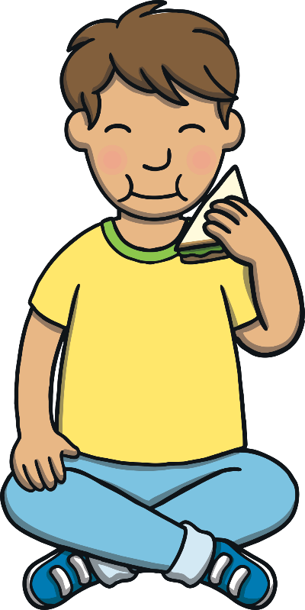
Today, we have learnt…
Initial Consonant Blends
The adventure continues next lesson!

