Slide 1
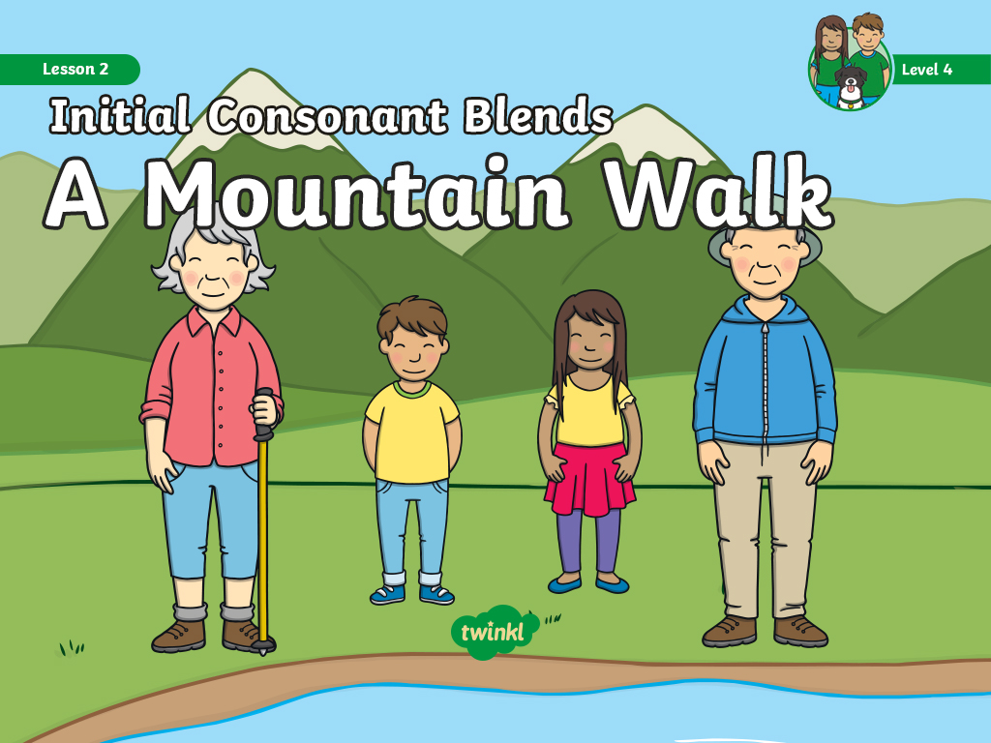

Slide 2
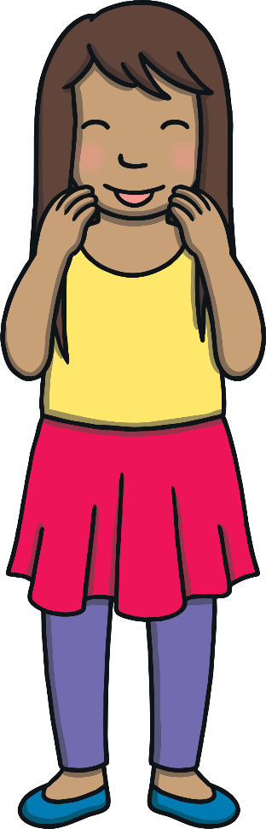
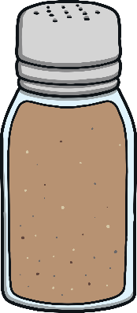

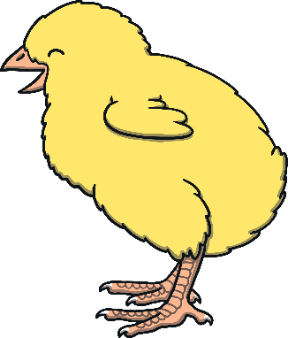
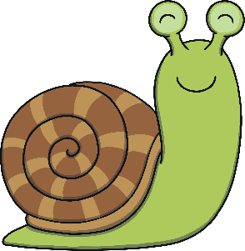

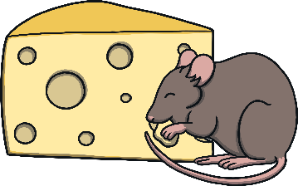




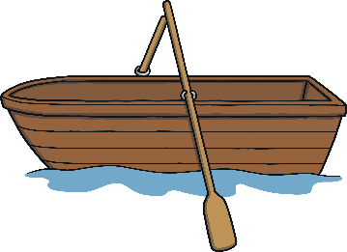
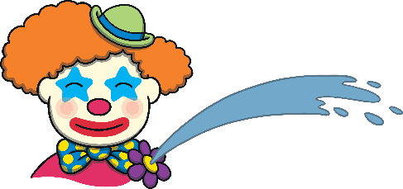

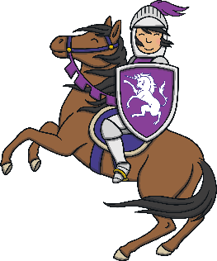

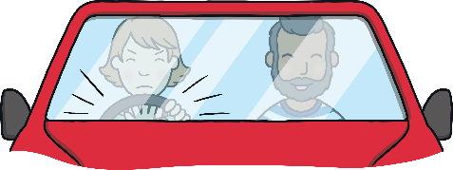
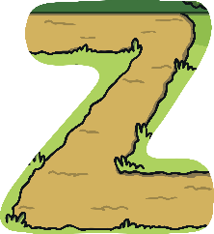


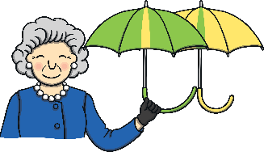

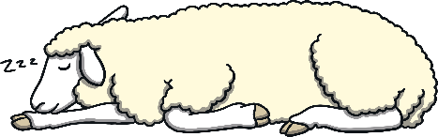
Revisit and Review
Let’s practise Sam’s Sounds and Tricky Words!
er
ch
ee
air
ai
ear
ng
oi
oa
qu
th
ur
oo
ar
igh
ow
or
zz
ure
th
oo
sh
some
so
like
have
come
said

Slide 3
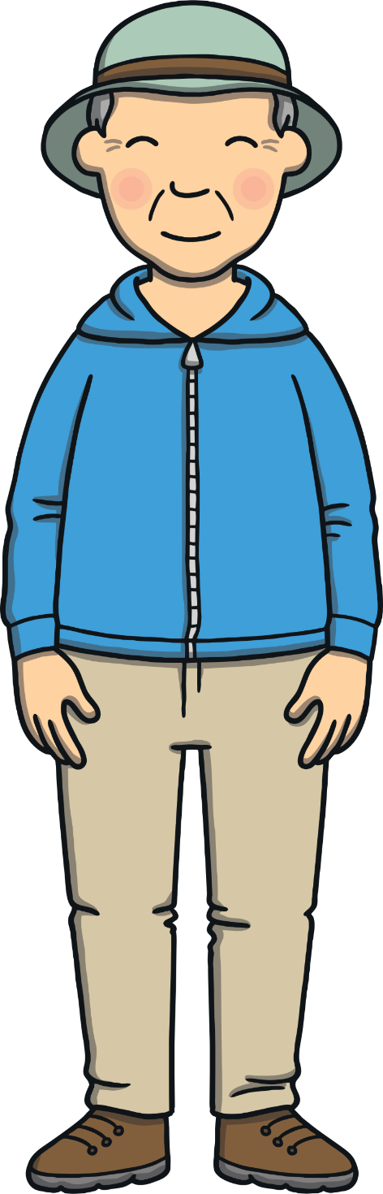
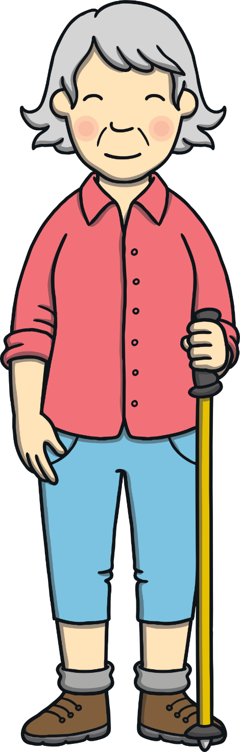
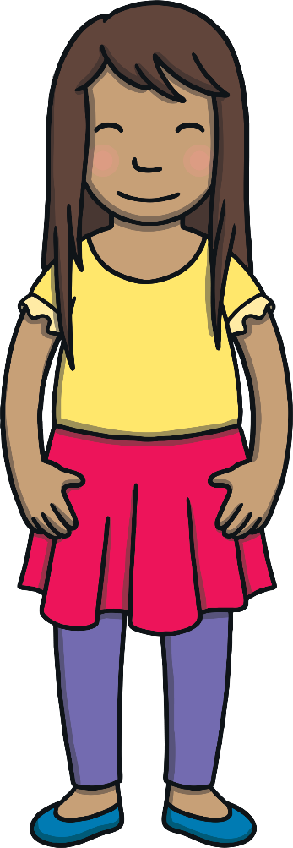
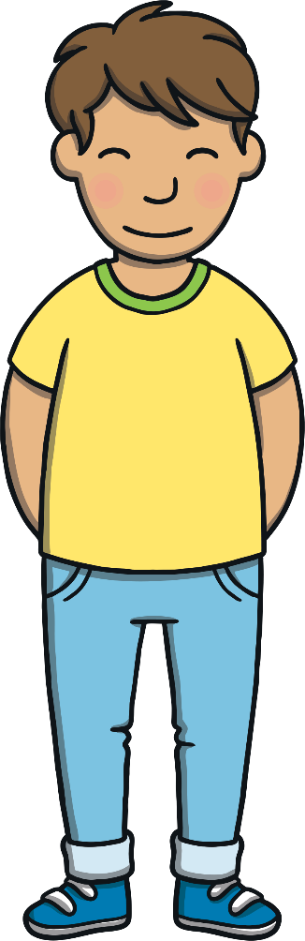
Teach
We are learning to read words that contain initial consonant blends.

Slide 4
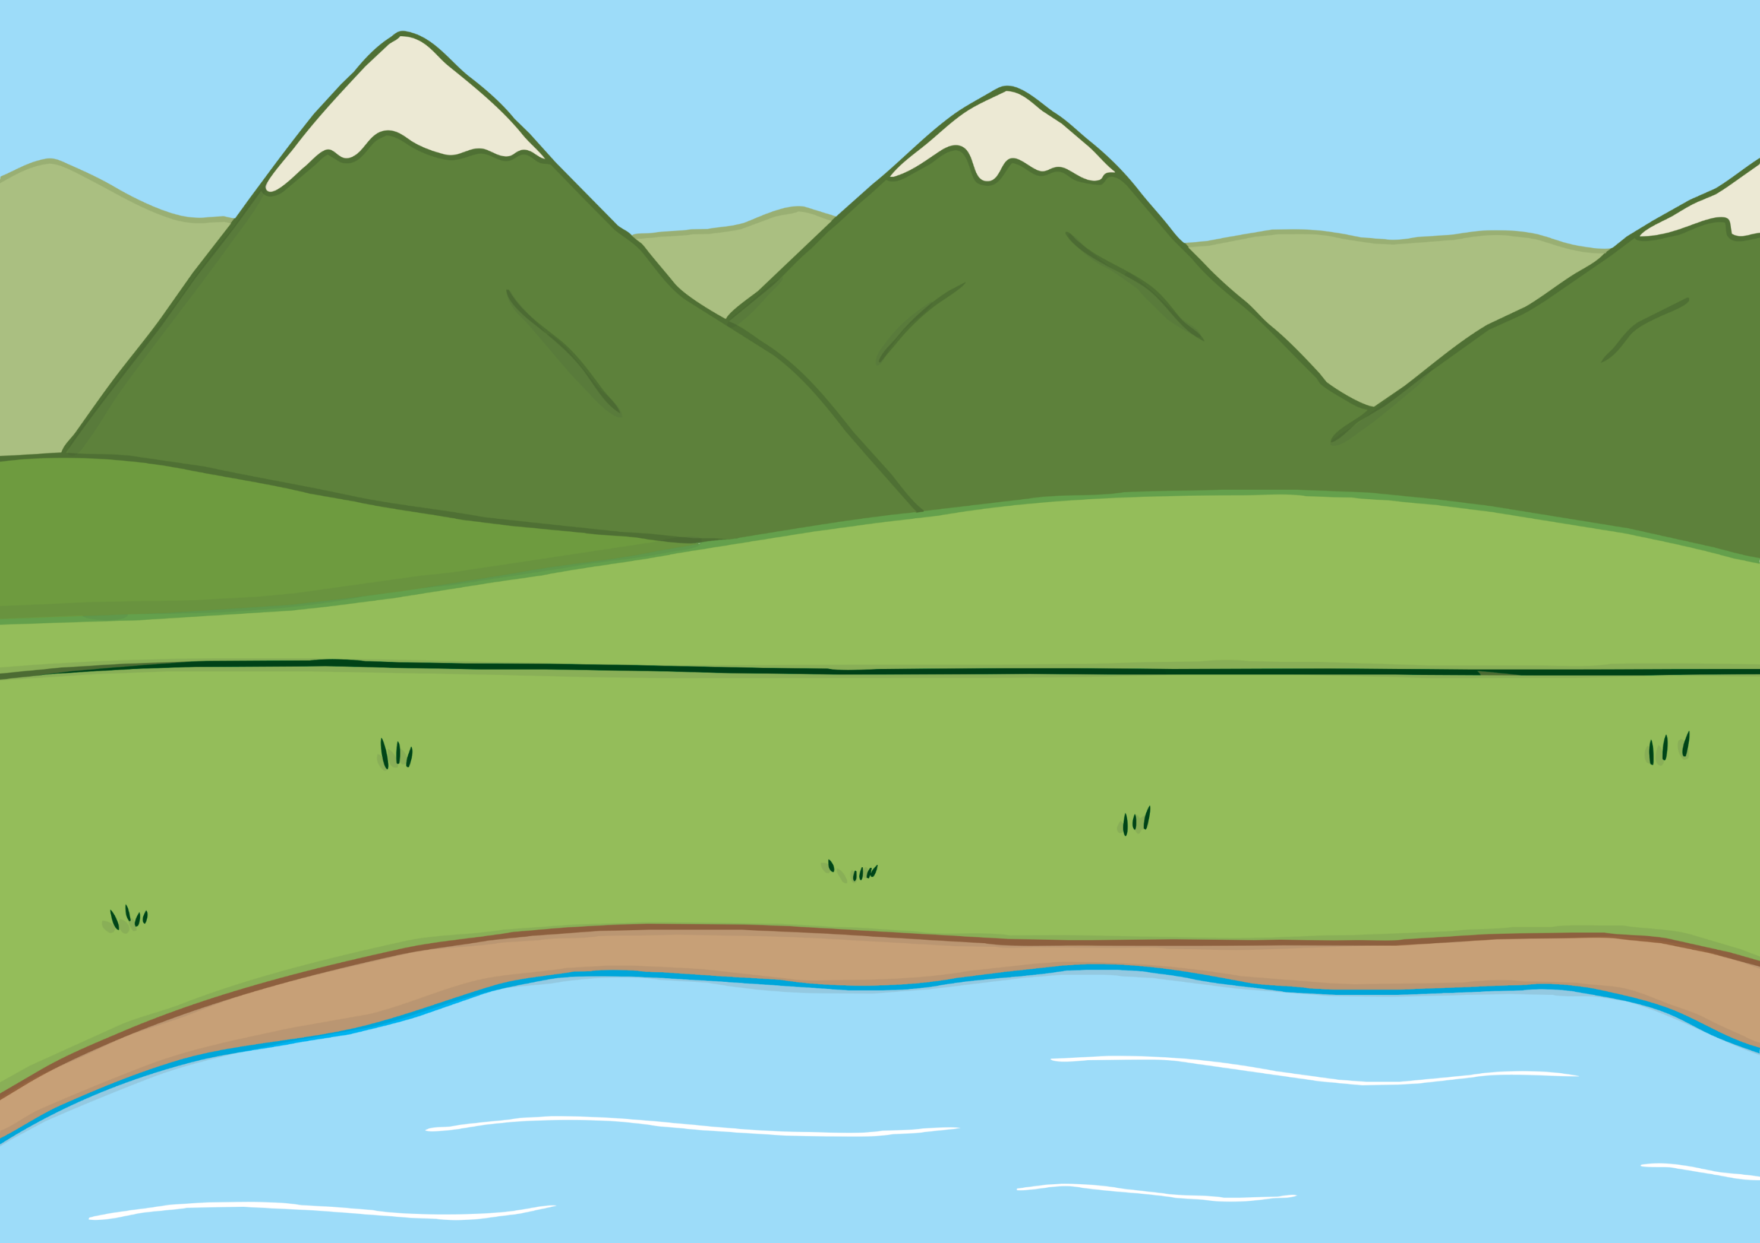
Teach
Kit and Sam were visiting the mountains near Gran and Grandad’s house.
“Let’s set off for our walk,” said Grandad.

Slide 5
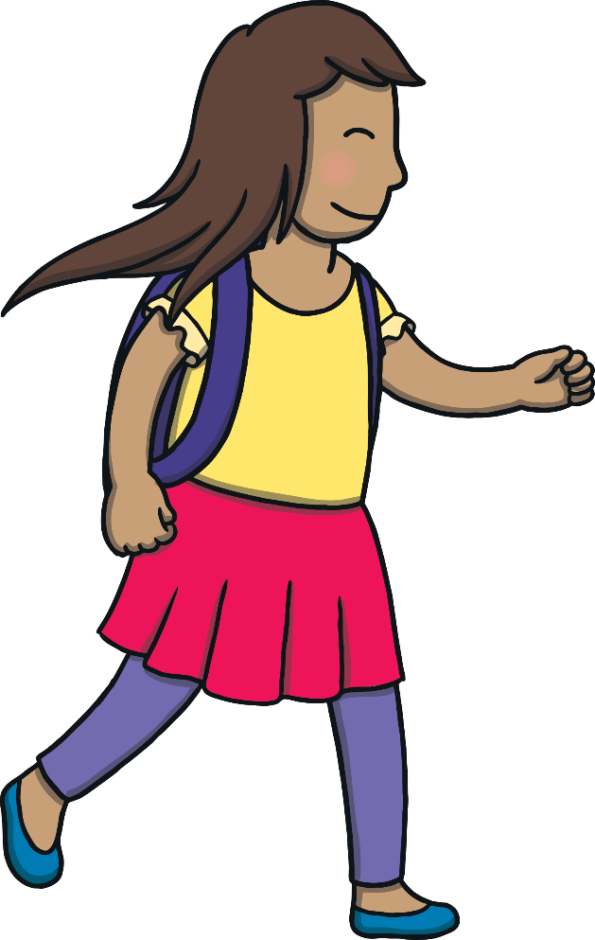
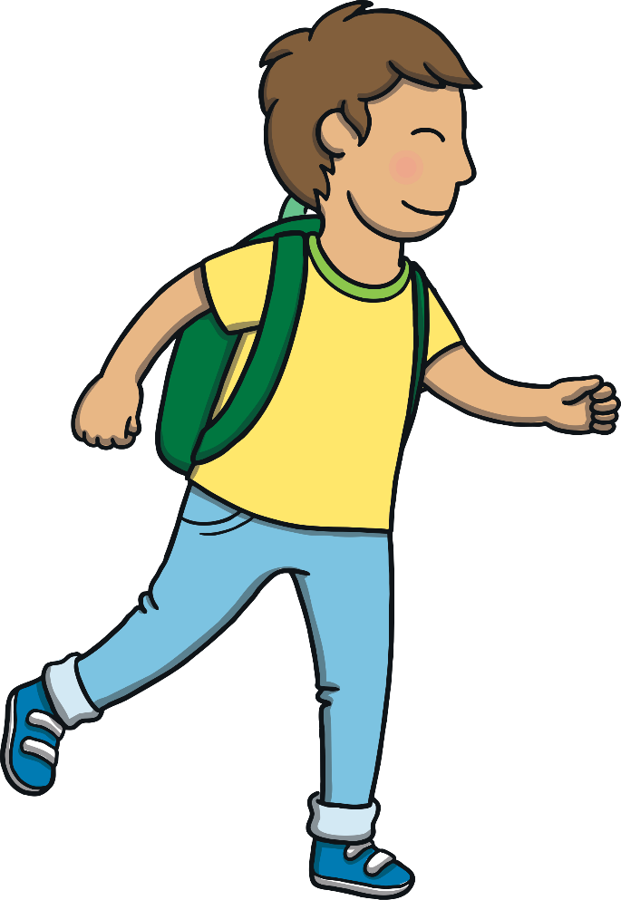
Teach
The family set off down a woodland trail, which snaked through the trees. “Mind your step,” said Gran, as Kit and Sam ran ahead. “Don’t trip!”

Slide 6
Teach
“I’m going to look for things to collect in my rucksack,” said Sam.
“Me too!” said Kit. “Let’s see what we can find.”

Slide 7
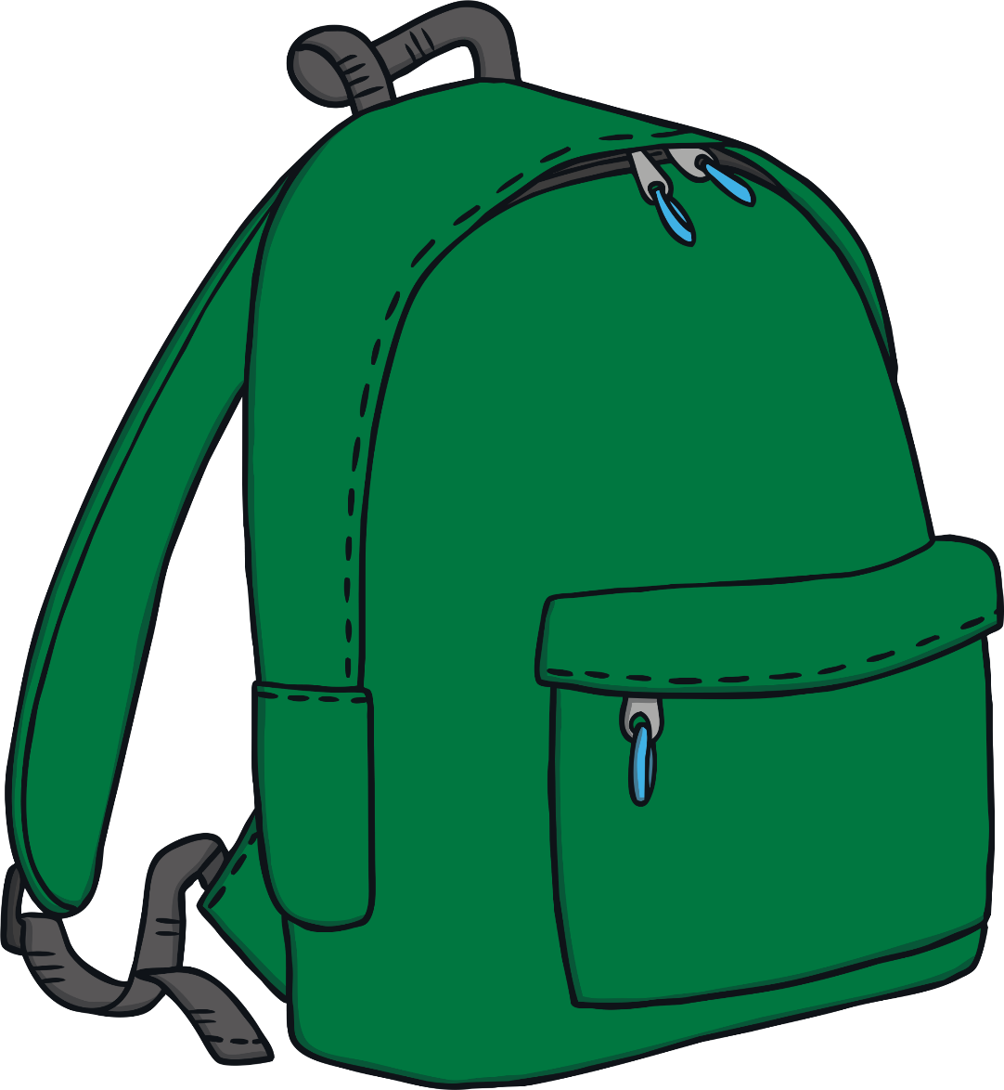
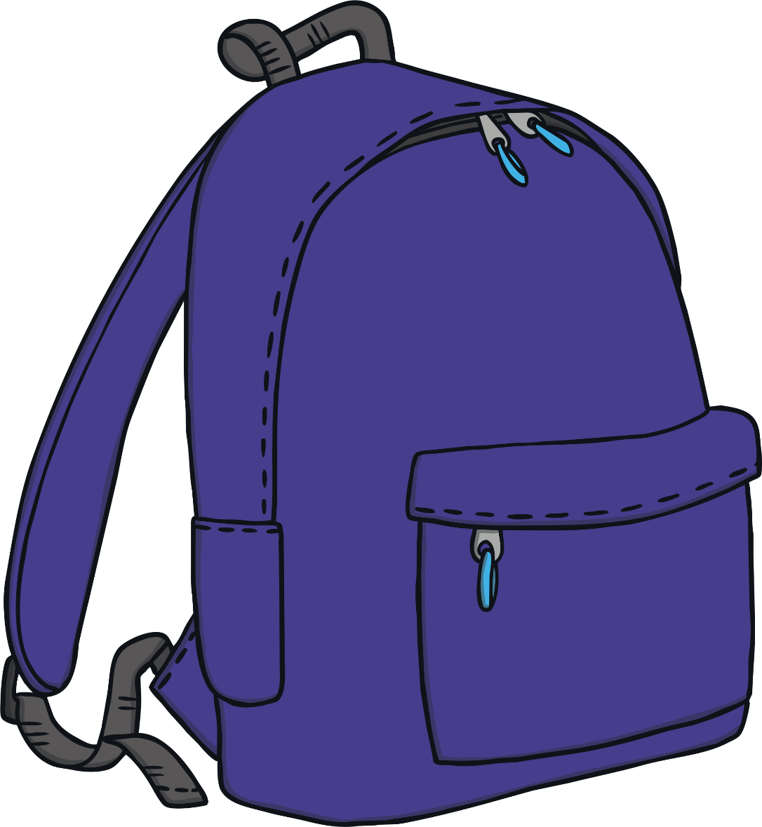
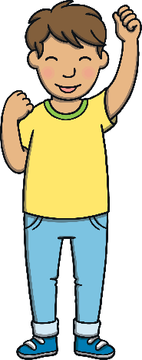
Teach
Kit and Sam want to collect objects that begin with initial consonant blends. Look at the objects and click those that can go into Kit and Sam’s rucksacks.
X
This activity can be done practically using real objects or pictures.
Click me for Kit’s teaching tips!

Slide 8
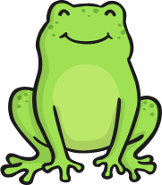

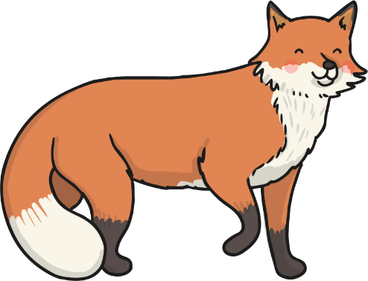


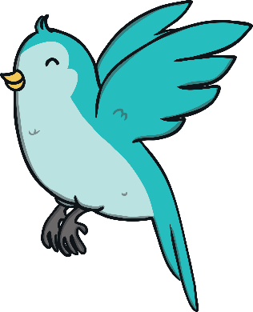

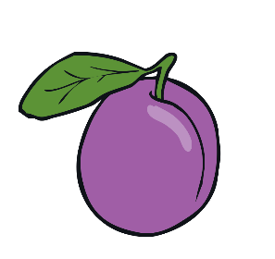
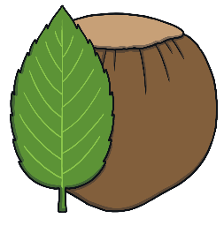
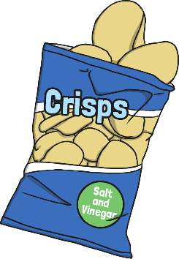
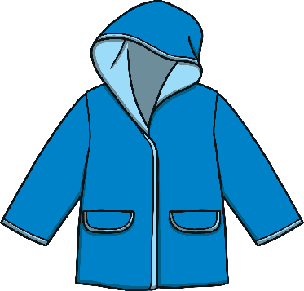
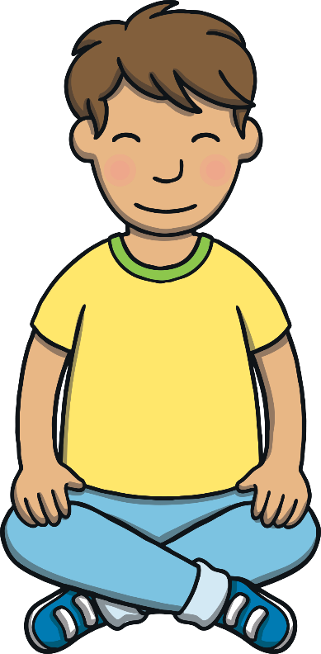
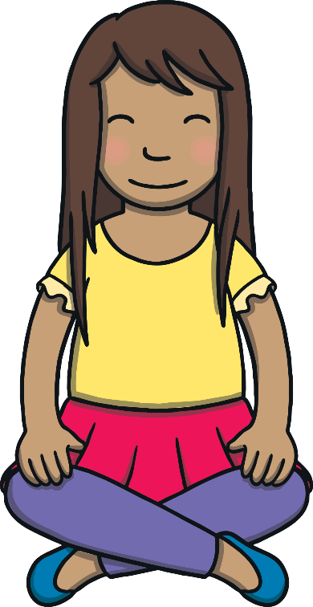



Teach

Slide 9


Initial Blend Collectors
Practise
Kit and Sam are showing Gran and Grandad the objects that they have collected. Read the labels and match them to the correct object.
flag

Slide 10
Practise
stick
spoon
flag
grass
plum
flower
frog

Slide 11

Practise
stick
spoon
flag
grass
plum
flower
frog

Slide 12
Practise
stick
spoon
flag
grass
plum
flower
frog

Slide 13

Practise
stick
spoon
flag
grass
plum
flower
frog

Slide 14

Practise
stick
spoon
flag
grass
plum
flower
frog

Slide 15

Practise
stick
spoon
flag
grass
plum
flower
frog

Slide 16

Practise
stick
spoon
flag
grass
plum
flower
frog

Slide 17
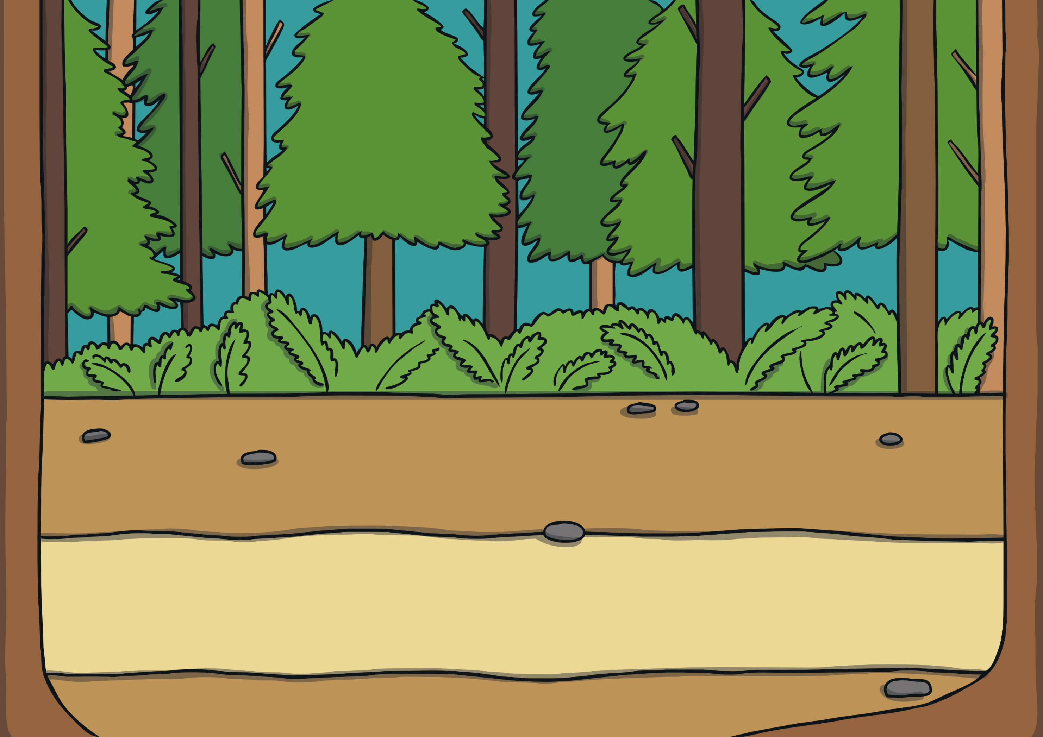
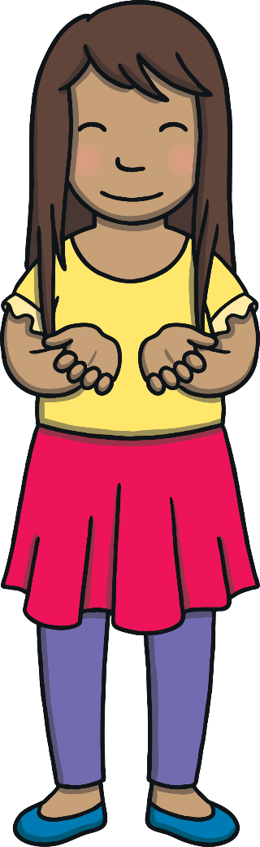
Apply
“Erm… I’m not sure you can put a frog in your rucksack, Sam,” laughed Gran.
“Come on kids,” said Grandad, “I know what to do with him!”

Slide 18

Sentence Time
Practise
What is Grandad thinking? Read the sentence then click ‘Show’ to reveal the answer!

Slide 19
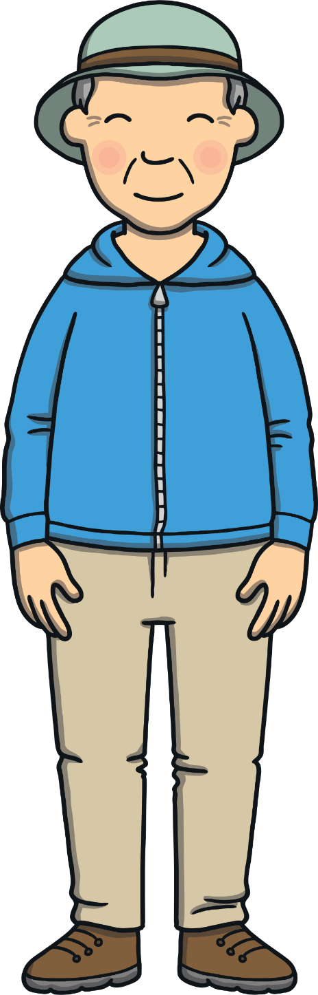




Apply
The frog will like to have a swim in the fresh pond.
Sound Buttons On/Off
Show

Slide 20






Apply
“There you go little frog,” laughed Sam. “He looks much happier now!”
“He does,” agreed Gran. “Now, let’s find somewhere to have our picnic.”

Slide 21


Today, we have learnt… Initial Consonant Blends
The adventure continues next lesson!

