Slide 2
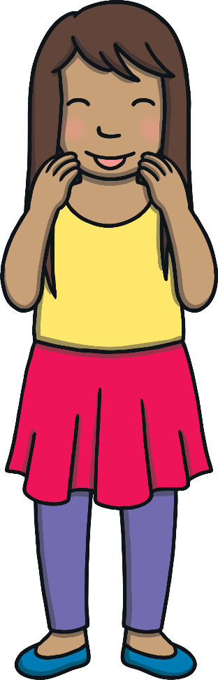


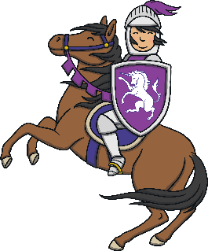


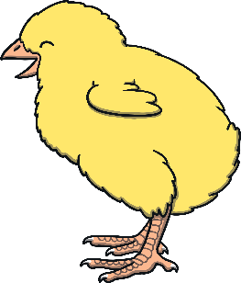

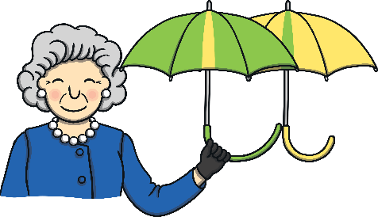
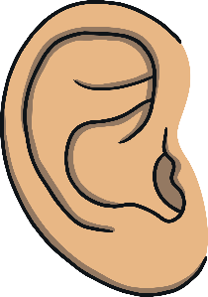
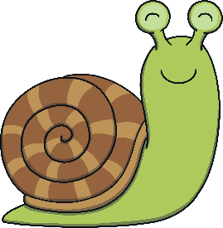


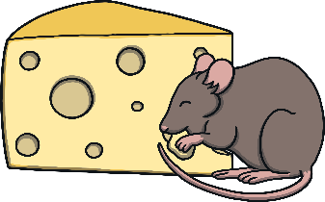

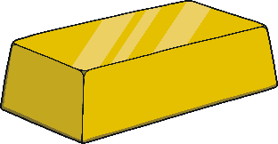

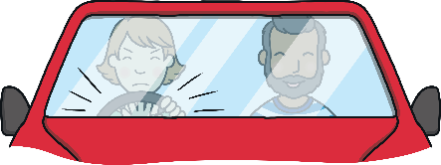

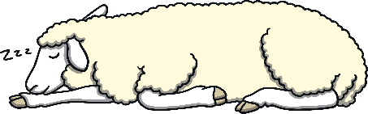
Revisit and Review
Let’s practise Sam’s Sounds and Tricky Words!
er
ure
air
qu
ng
ch
ar
ee
ow
ur
ai
sh
igh
th
or
oo
oa
ear
oi
so
said

Slide 3
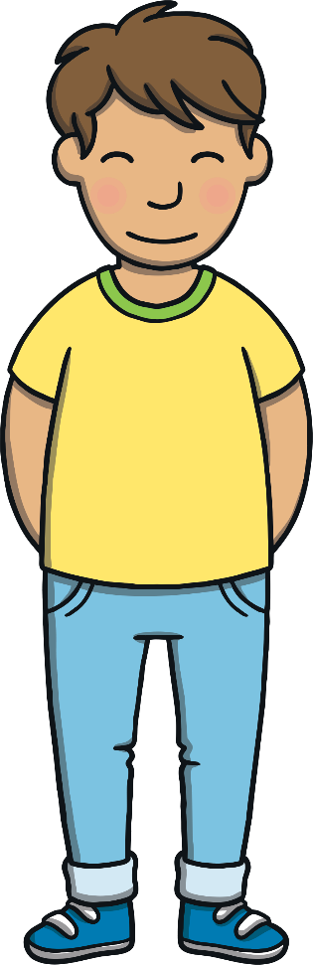
Teach
This week, we meet our next tricky words:
have
like
some
come
Remember, tricky words are words that can’t be sounded out. We just have to learn them off by heart!

Slide 4
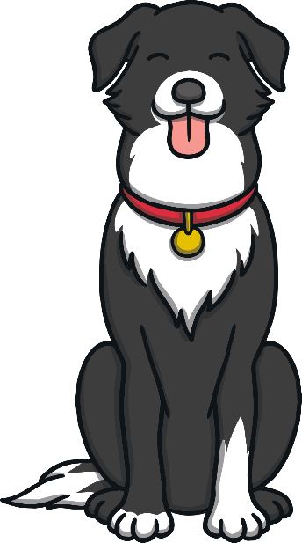
Teach
Today, we are learning initial consonant blends.

Slide 5
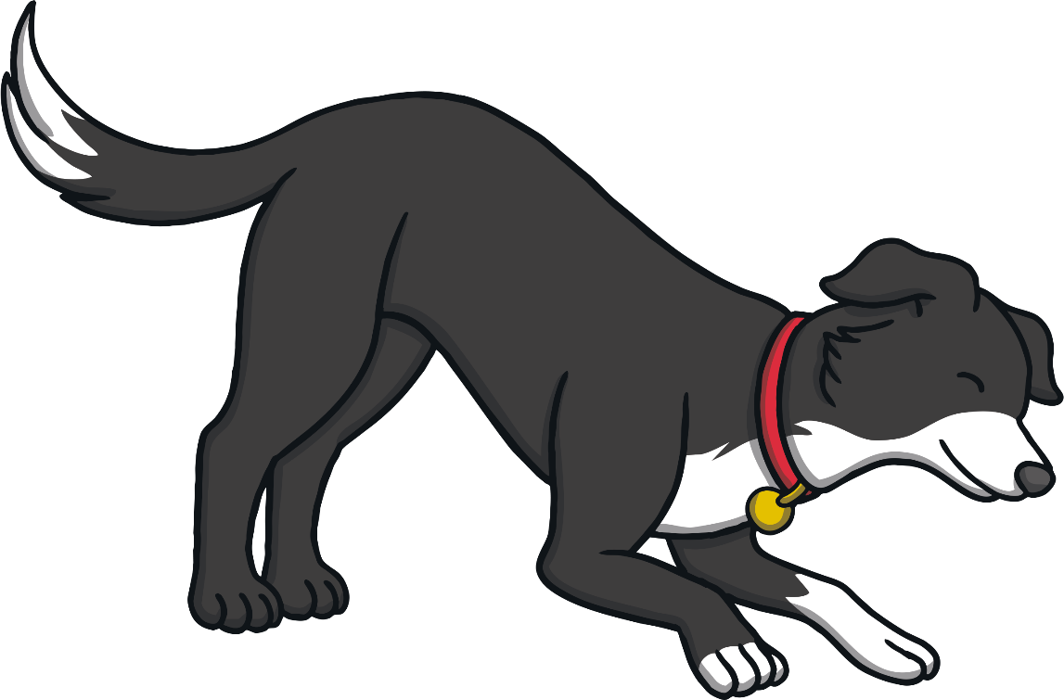
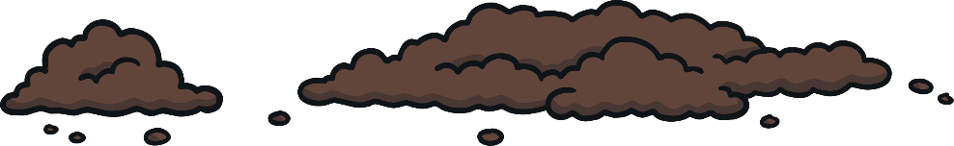
Teach
Ben’s Bones
Ben has been digging in the garden. Shout out the tricky word on each bone that he digs up!

Slide 6
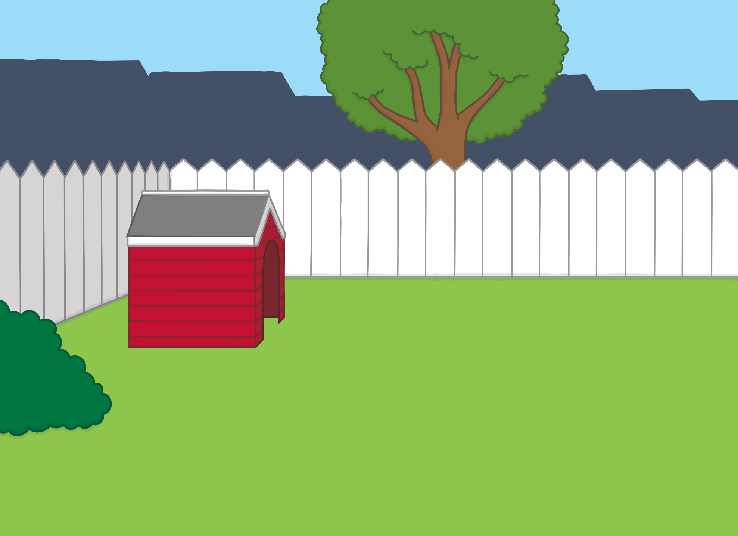

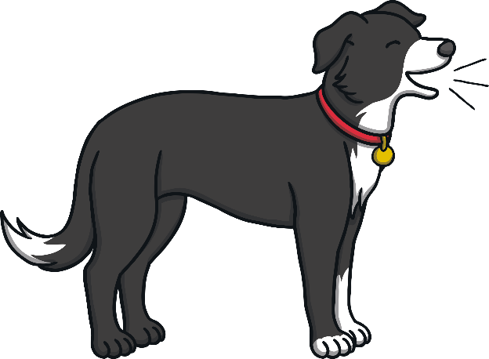


Teach
have

Slide 7

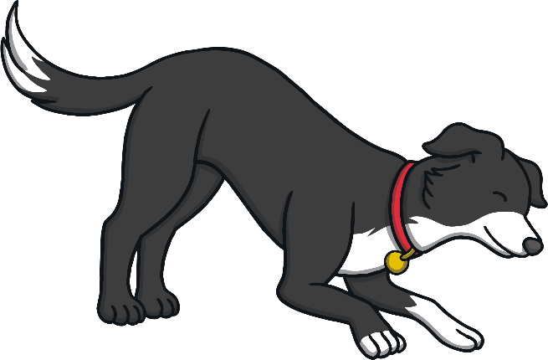

Teach
like

Slide 8
Teach
some

Slide 9
Teach
come

Slide 10
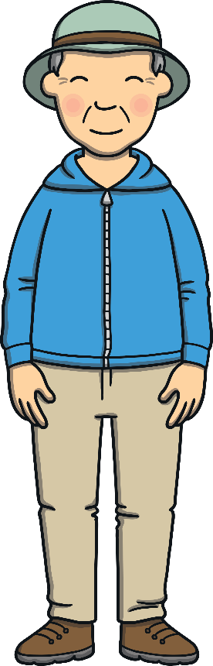
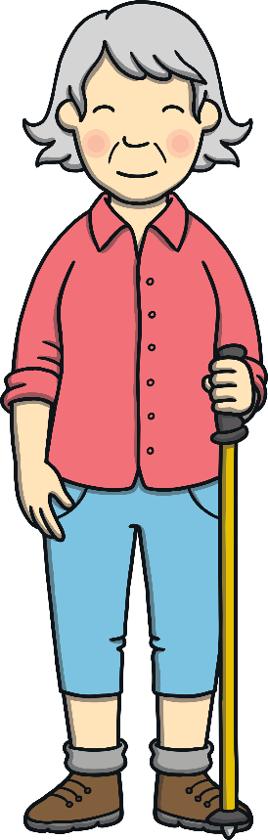

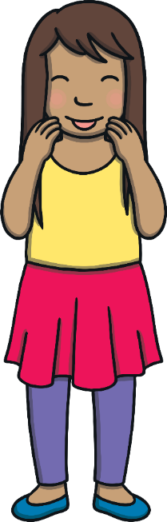
Teach
Today, we are learning to read words that contain
initial consonant blends.

Slide 11
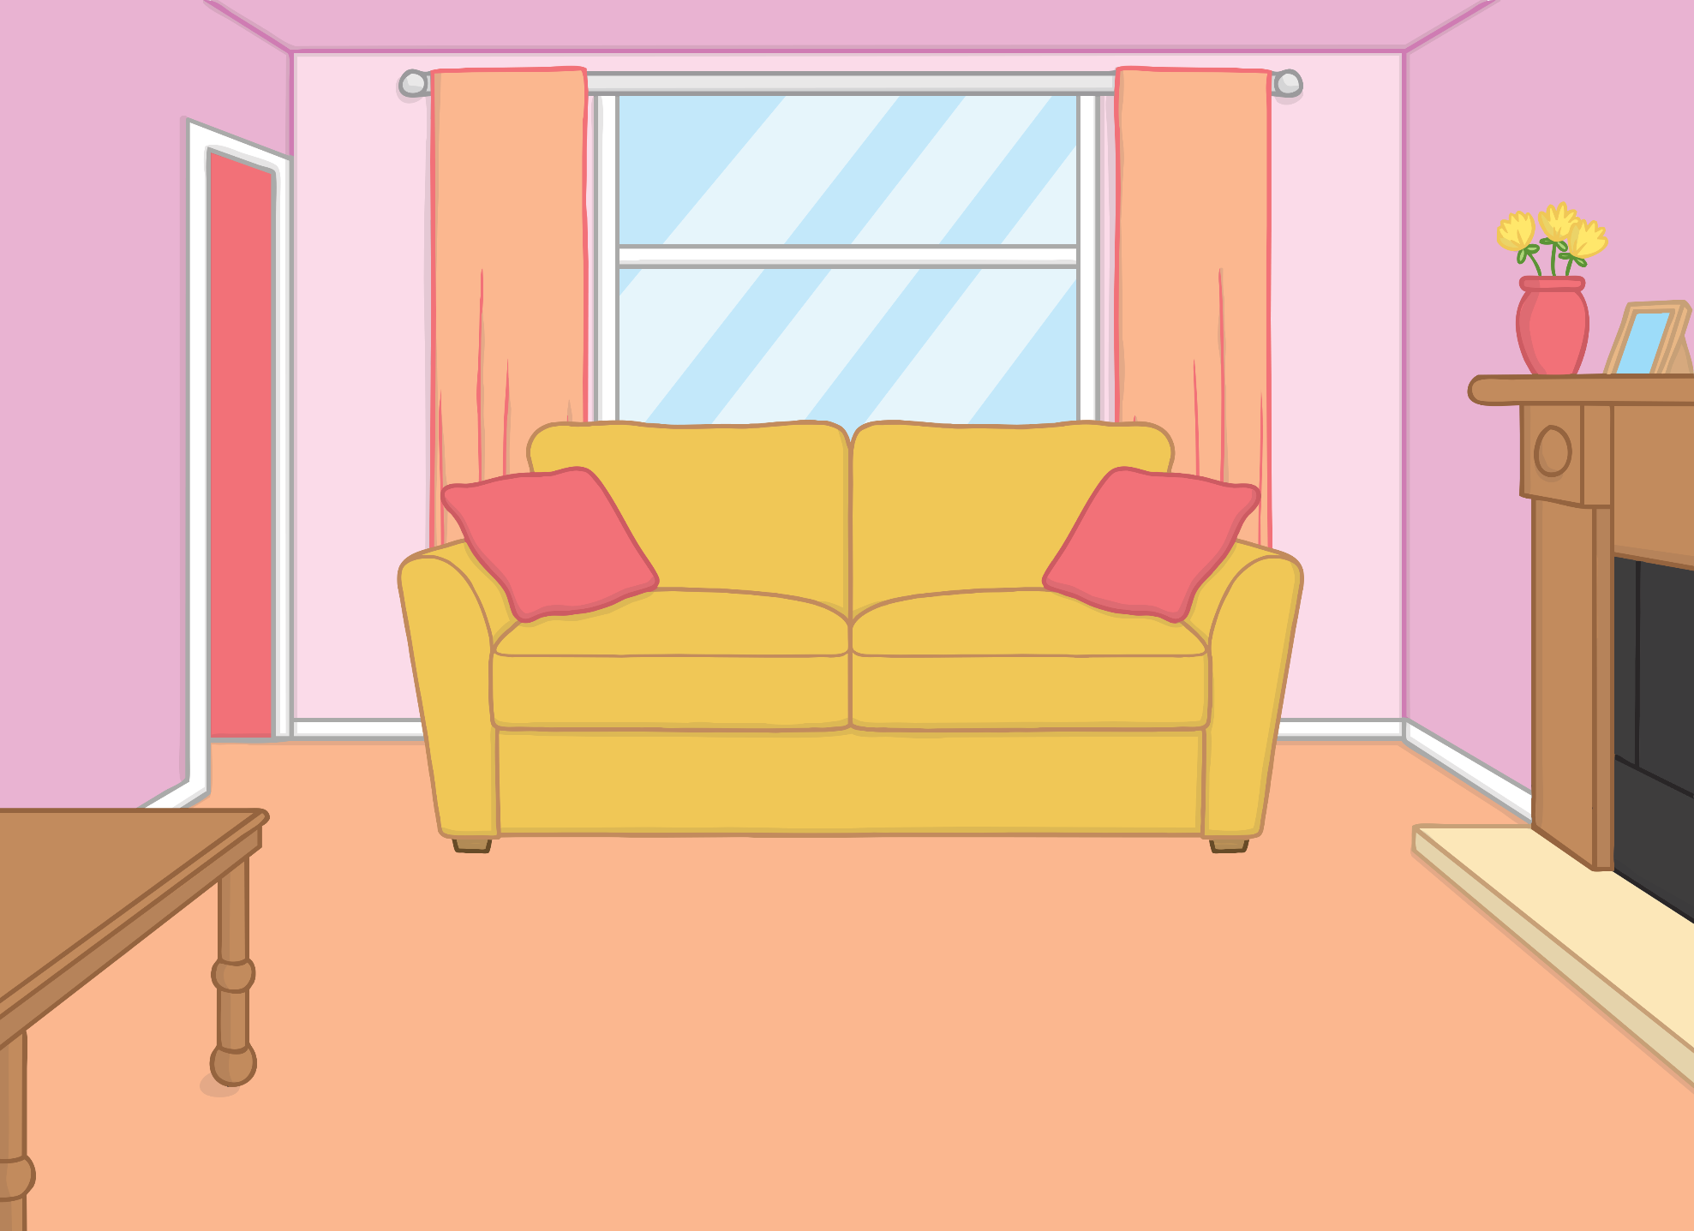
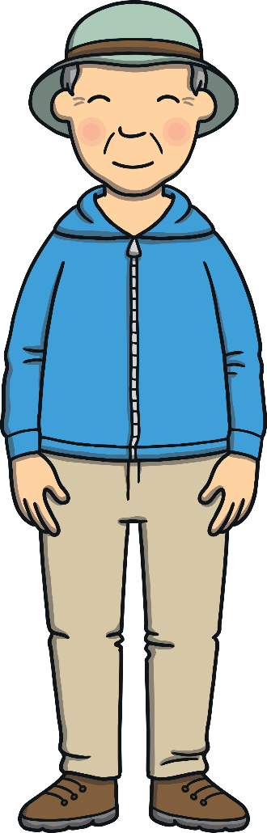

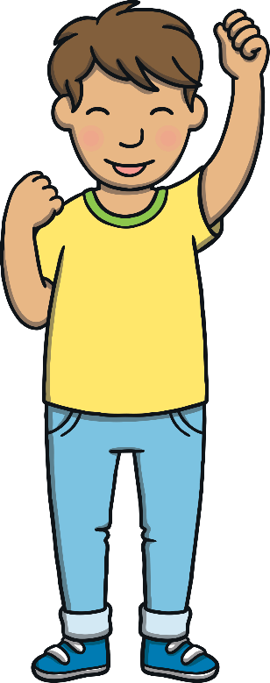
Teach
Kit and Sam were staying with Gran and Grandad. They were all going out on a train trip to the mountains. Kit and Sam were very excited!

Slide 12
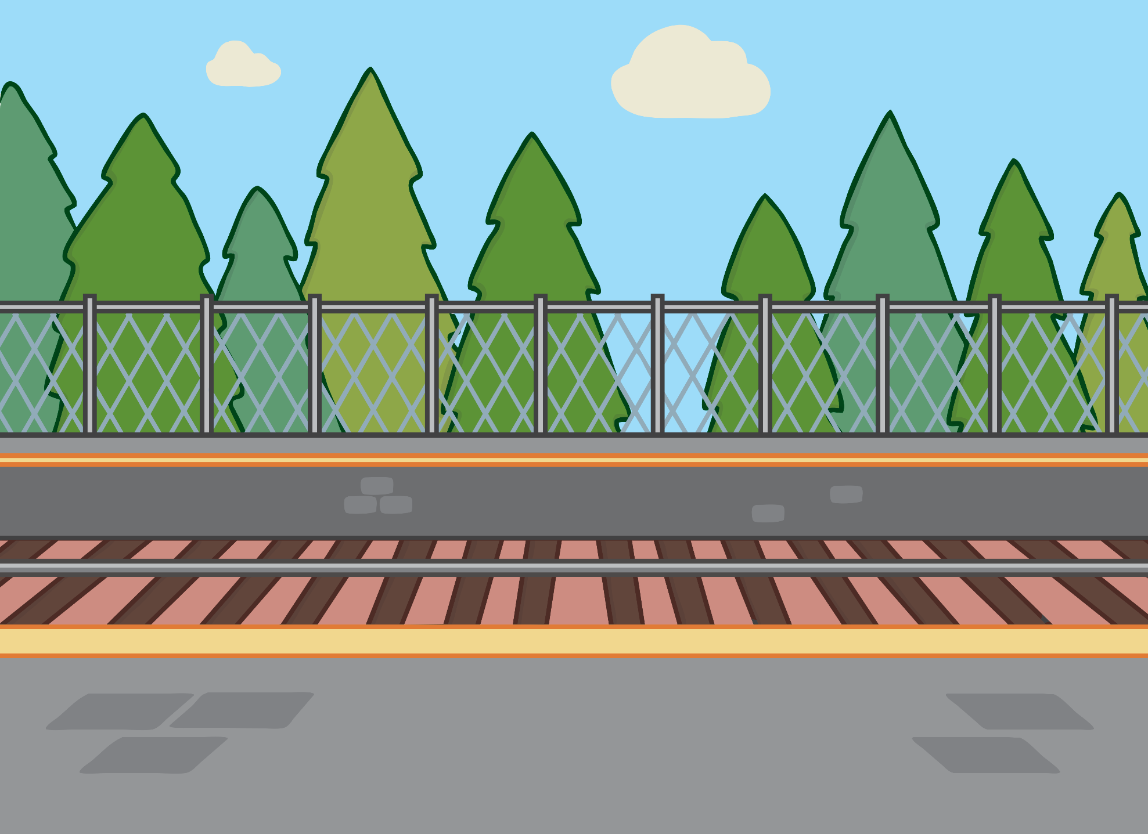
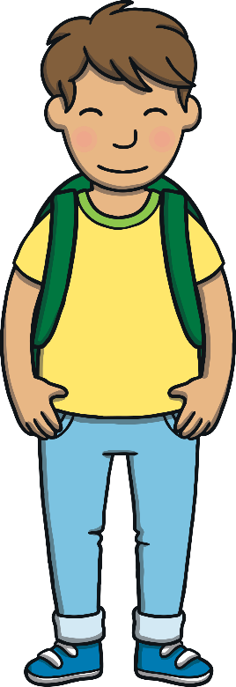
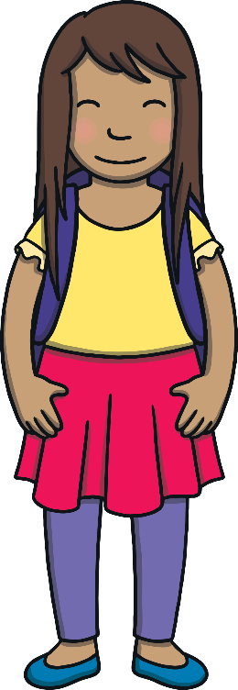
Teach
“You will love to see the mountains,” said Gran. “They are very high.” Soon the train arrived and they all got on board.

Slide 13
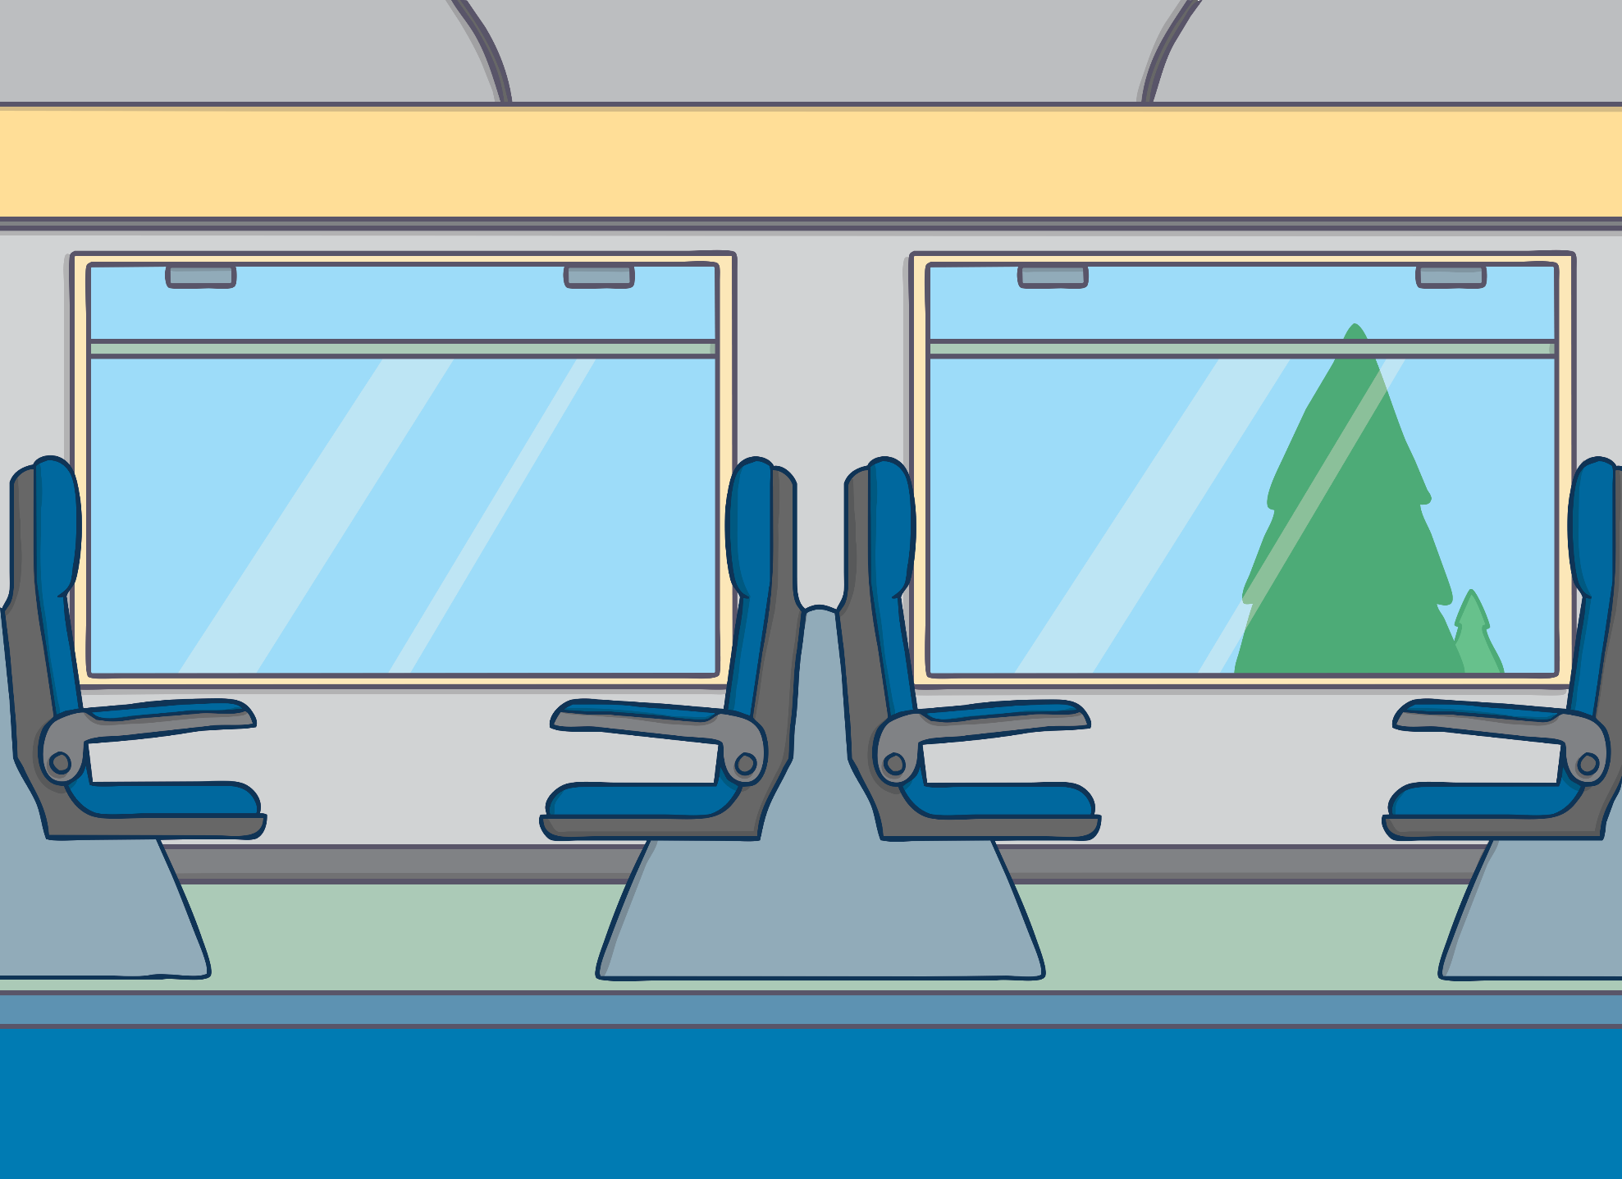
Teach
Kit and Sam looked out of the window as the train chuffed along. “I can see a tree,” said Kit. “What can you see, Sam?”

Slide 14
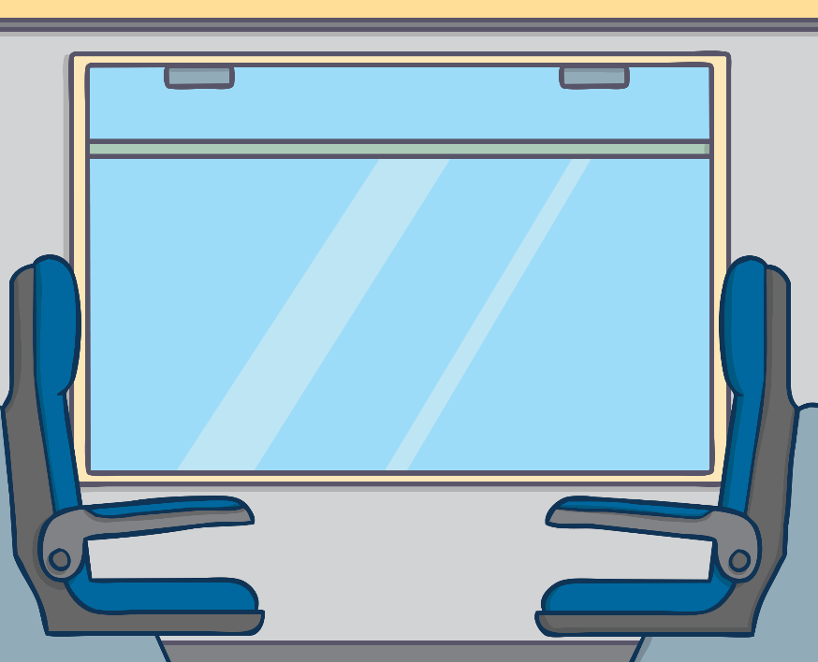

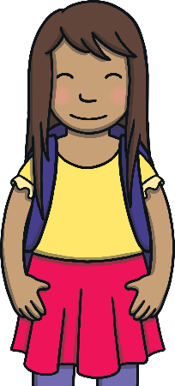

Teach
Kit and Sam see lots of things on the train trip. They all begin with an initial consonant blend. Shout out the name of the things Kit and Sam see as they go past.
X
Initial consonant blends differ from digraphs because in a blend, both letter sounds can be heard.
Click me for Kit’s teaching tips!

Slide 15

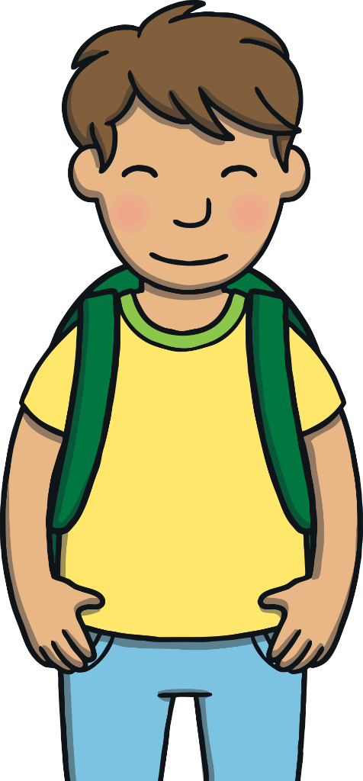


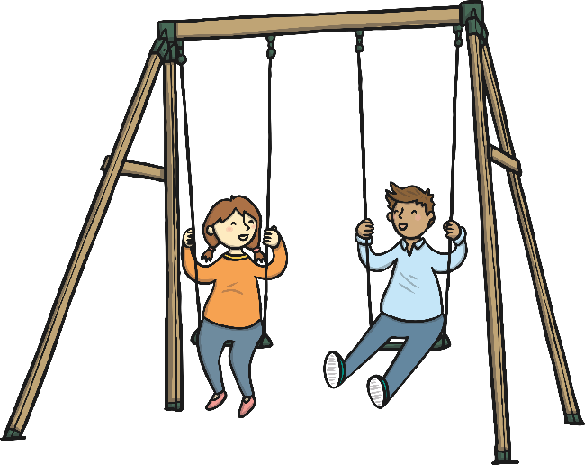
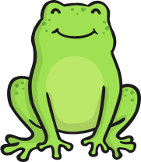



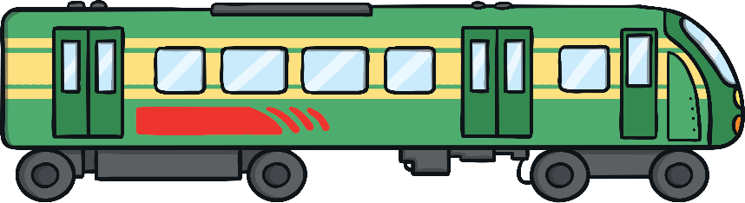
Teach

Slide 16
Practise
Train Spotters
Gran and Grandad have given Kit and Sam spotter sheets to keep them busy on the journey. Read the words on the sheet and click on the matching picture.
tree
swing
flag
star
grass
clown
train
frog

Slide 17
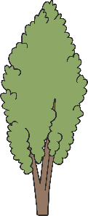





Practise
tree
swing
flag
star
grass
clown
train
frog

Slide 18
Apply
“Now I can see mountains!” shouted Sam. “It looks like we are here,” said Grandad, reaching for their bags. “I am so happy,” said Kit.

Slide 19

Apply
Sentence Time
Why is Kit so happy? Read the caption then click ‘Show’ to reveal the answer!
X
Click ‘Sound Buttons On/Off’ to select whether you want to show sound buttons under the sentence.
Click me for Kit’s teaching tips!

Slide 20


Apply
He is glad to see that the train has come to a stop.
Sound Buttons On/Off
Show

Slide 21
Apply
“Wow!” said Kit and Sam as they looked around. The mountains were huge and beautiful.
“OK, rucksacks on and off we go!” said Gran.

Slide 22
Today, we have learnt…
Initial Consonant Blends
The adventure continues next lesson!

