Slide 1
Spelling Week 1/ Lesson 1
ABC spelling List A to practise for next week.
LO: Revise
Strategies at the point of writing.
- If you are unsure of the spelling of a word, put a wiggly line under it in the sentence to signal that this needs checking by the teacher, or by yourself using a dictionary during proofreading time.
- Make sure that you are continuing with writing and not checking the correct version of the spelling at this point. This is important so that the flow of writing is not unnecessarily slowed.
- Don't make more than three attempts at a word.

Slide 2
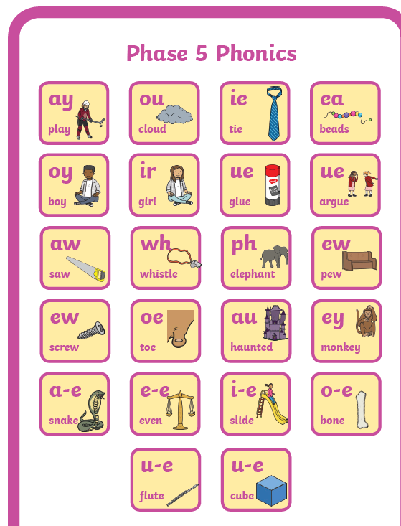
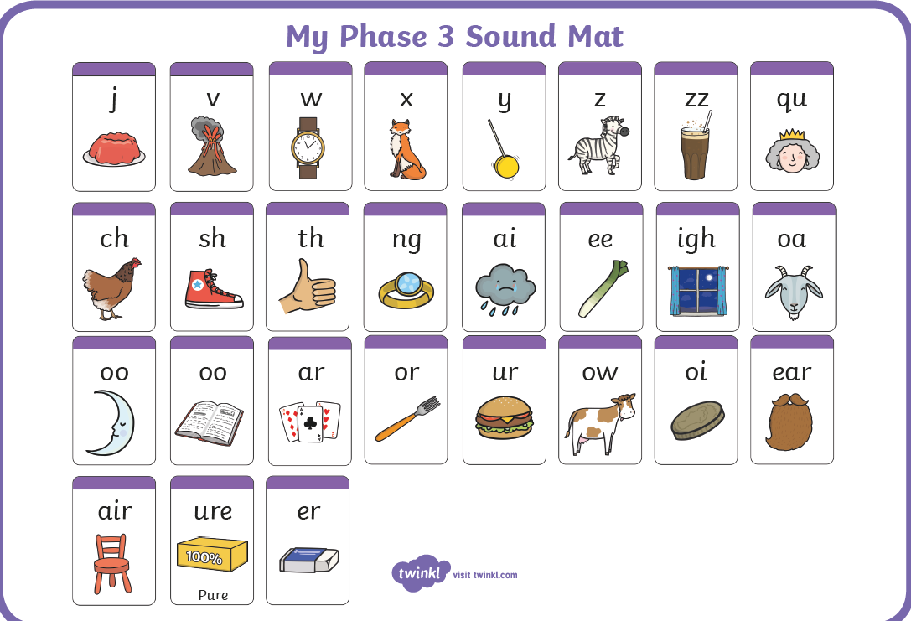
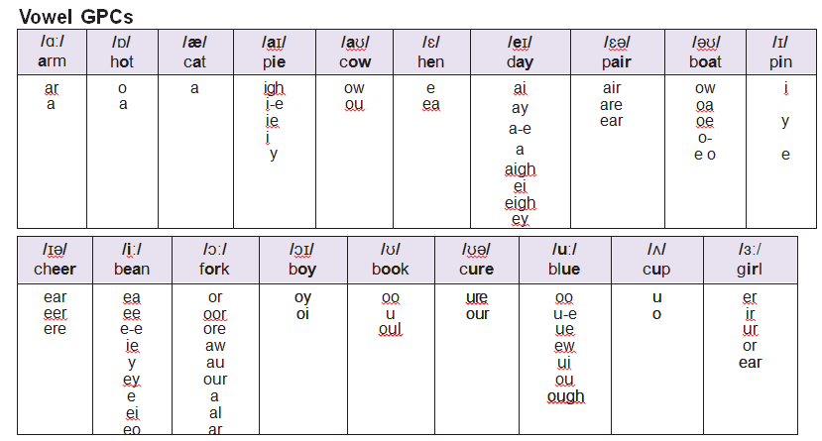
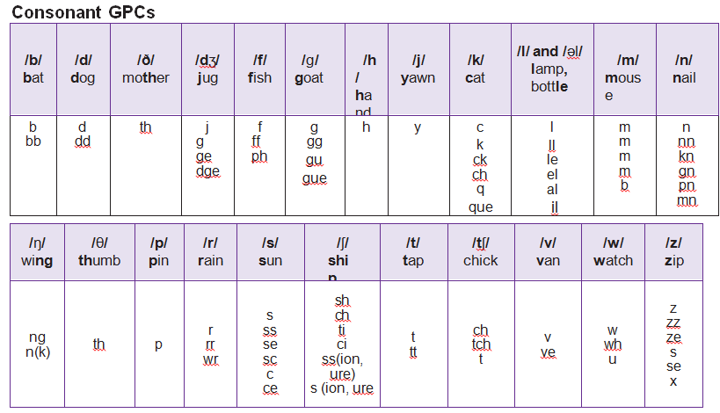
Revision of phonemes

Slide 3
Revision of spelling rules learnt last half term.
/ʒə/ending in sure and /ea/for ‘e’
measure
treasure
pleasure
enclosure
closure
breakfast
already
instead
weather
pleasant
apostrophefor possession
Lucy's
Tom's
girl's
boy's
woman's
Alice’s
Agnes’
Julius’
dog's
cat’s
How can you practise spelling?
Underlining and looking at tricky bits.
look, cover, write, check
saying it in a funny way: like "Wed - nes - day"
drawing a picture in the word
drawing a jigsaw piece around the words
rainbow writing
writing the word out using fancy fonts
pyramid words

Slide 4
Spelling Week 1/ Lesson 2
LO: to revise homophones
Recap: what is a homophone?
KS2 English- Homophones with Johnny & Inel - BBC Teach
https://www.youtube.com/watch?v=l0VpP7VxtYg&feature=share
Homophone
'same'
'sound'

Slide 5
What homophones do you know?
(same pronunciation but different meaning)

Slide 6

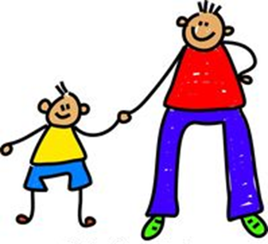
homophones
piece
peace
main
mane
fair
fare
son
sun
break
brake
Fun ways of remembering spellings of homophone pairs, such as:
There is a piece of pie in the word piece.
Draw a picture:
near homophones and homophone
not
knot
accept
except
male
mail
won
one
advice
advise
son
sun

Slide 7
Spelling Week 1/ Lesson 3
LO: Revise Year 2 prefixes and suffixes
What are prefixes- - BBC Bitesize
Prefixes are a group of letters that change the meaning of a word when they are added to the start. Most prefixes mean a similar thing when they're added to different words.
un usually means not. For example, unhappy, unlocked, unfair
dis and mis usually have negative meanings. For example, disagree, disobey, misbehave, mislead
re usually means again or back. For example, redo, reappear, redecorate
sub usually means under. For example, subheading or submarine
​

Slide 8
What are suffixes- - BBC Bitesize
Suffixes
A suffix is a letter or group of letters that goes on the end of a word and changes the word's meaning.
Sometimes they also change the original word's spelling. When adding a suffix you might have to double the last letter. For example when adding 'ed' to 'drop' you also double the p so it becomes 'dropped'.
Some suffixes have specific uses. Adding ‘ing’ can change a noun into a verb eg 'garden' to 'gardening'. While ‘ed’ can put a verb in the past tense eg 'jump' to 'jumped'.
​
How to use the suffix –ly - BBC Bitesize
Adding the suffix -ly
Suffixes are letters that can be added to the end of words to change their meaning.
Adding the suffix -ly, turns an adjective into an adverb
'nice' becomes 'nicely'.
If the word ends with 'y', the 'y' becomes an 'i', and then add -ly
'happy' becomes 'happily'.
If the word ends with 'le', drop the 'le' and add -ly
'terrible' becomes 'terribly'

Slide 9
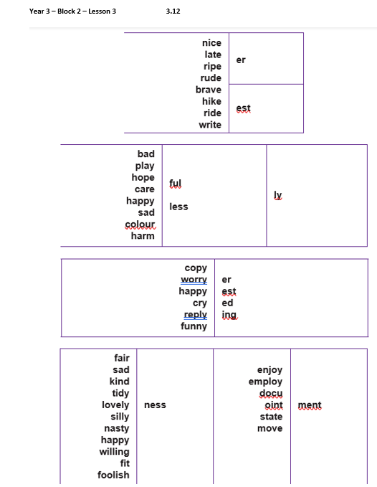
Create a word from the 3.12 document and read it out for someone at home. Both of you should write the word down.
Together check the spelling and then change over.
Play a game on SpellingFrame with prefixes and suffixes.
3.12.docx
SpellingFrame

Slide 10
Spelling Week 2/ Lesson 1
Spelling test on ABC spelling
New words to give out:
prefixes ‘mis-’ and ‘re-’
reappear
retry
rebuild
rewrite
replay
redo
misbehave
misremember
misread
mishear
Words to go home Week 2 prefixes mis and re.docx
Plus: ABC spelling List B to practise for next week (if they've passed list A).

Slide 11
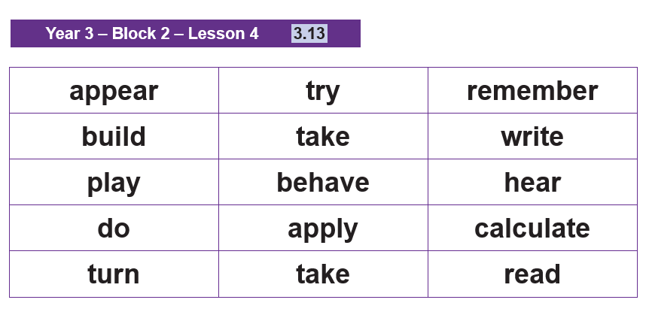
Spelling Week 2/ Lesson 2
LO: Teach: Prefixes ‘mis-’ and ‘re-’
3.13.docx
In pairs, create words with ‘mis-’ and ‘re-’ from 3.13 document.
What do you think ‘mis-’ and ‘re-’ might mean?
Write a root word of your choice down in your spelling jotter. Then write the same root word with the added
prefix too. Explain the difference in meaning.

Slide 12
Spelling Week 2/ Lesson 3
LO: Practise: Prefixes ‘mis-’ and ‘re-’
In the previous lesson, you created words with the 'mis' and 're' prefixes.
Today you are putting those words into sentences.
Write then sentences down with your partner.

Slide 13
LO: Apply: Prefixes ‘mis-’ and ‘re-’
Where could you add the prefixes ‘mis-’ or ‘re-’
to make these sentences mean the opposite?
The boy behaved as he played his video.
He heard what his teacher had said.

Slide 14
Spelling Week 3/ Lesson 1
LO: Spelling test on previous week’s words and ABC words.
(plus giving new words out)
The /I/ sound spelt ‘y’
gym
cygnet
myth
pyramid
mystery
Egypt
symbol
mystic
dynasty
synonym
Plus: ABC spelling List C to practise for next week (if they've passed list A and B).
Words to go home Week 3 the i sound spelt y.docx

Slide 15
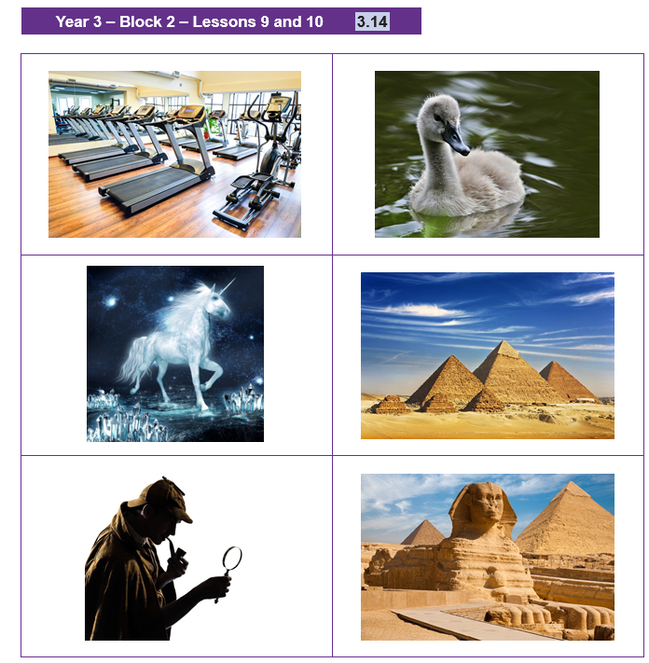
Spelling Week 3/ Lesson 2
3.14.docx
LO: Teach: The /ɪ/ sound spelt ‘y’
Identify the words as a class.
(Answers:
gym, cygnet, myth, pyramid, mystery, Egypt)

Slide 16
Spelling Week 3/ Lesson 2
Try to sound out the words and write them on your white board so that you can read them.
What do you notice about all these words?
Practise writing the words in their spelling jotter, you could also draw a picture if it helps remembering the spelling.
Next, cover up the words and write the words from memory.

Slide 17
Spelling Week 3/ Lesson 3
LO: Practise/ Apply: The /ɪ/ sound spelt ‘y’
Create a sentence based on one of the images and write it.
Check the spelling.
Do this for at least five words.

Slide 18
Spelling Week 3/ Lesson 3
Dictation:
Can you write the sentences correctly as ​your teacher reads them?
Dictation week 3.docx
The mystery of how pyramids were built has been solved.
It was a myth that the symbol of the dynasty was a cygnet.
If you misbehave in the gym, you’ll have to redo your homework.

Slide 19
Spelling Week 4/ Lesson 1
LO: Spelling test on previous week’s words and ABC words.
(plus giving new words out)
There's no other list to give out this week than the ABC spelling List D to practise for next week (if they've passed list A, B and C).

Slide 20
Spelling Week 4/ Lesson 2
LO: Learn: Strategies for learning words: words from statutory word list for Years 3 and 4
Revise the strategy Look, say, cover, write, check.
In this lesson, the children practise the ABC list that they are on.
Pupils will use Look, say, cover, write, check to learn the spelling of the words on their list.

Slide 21
Spelling Week 4/ Lesson 2
LO: Assess: Words from statutory spelling lists: pair testing
Pupils to test each other in pairs.
They should use the word lists that they practised yesterday.

Slide 22
Spelling Week 4/ Lesson 3
LO: proofreading
What is proofreading and why is it important?
Pupils to find the errors in the attached document
and write them out correctly with their partner on white boards.
Correct-the-spelling--grammar-and-punctuation-week4 lesson 3.docx
Pupils could check their English books for misspelt words and
could practise those misspelt words in their spelling jotters
using one of the strategies that they have for learning spellings.

Slide 23
Spelling Week 5/ Lesson 1
LO: Spelling test on the ABC words.
(plus giving new words out)
words ending in the /g/ sound
spelt ‘-gue’ and the /k/ sound spelt ‘que’
antique
unique
fatigue
catalogue
tongue
vague
mosque
cheque
Plus: ABC spelling List E to practise for next week (if they've passed list A, B, C and D).
Words to go home Week 5 g and k sound.docx

Slide 24
Spelling Week 5/ Lesson 2
LO: Teach: words ending in the /g/ sound
spelt ‘-gue’ and the /k/ sound spelt ‘que’
(French in origin)
fatigue
catalogue
What do you notice about the /g/ sound?

Slide 25
Spelling Week 5/ Lesson 2
Divide the polysyllabic words into syllables and draw a box for each syllable on the board.
Syllabify the words and write each syllable in the boxes.
Which syllables are tricky? How will you remember these?
fatigue catalogue

Slide 26
Spelling Week 5/ Lesson 2
Now do the same with:
antique unique.
Divide the polysyllabic words into syllables and draw a box for each syllable on the board. Syllabify the words and write each syllable in the boxes.
Which syllables are tricky? How will you remember these?
'Quickwrite' one word of each pattern for one minute.
fatigue catalogue
Practise your spelling list for next week:
words ending in the /g/ sound
spelt ‘-gue’ and the /k/ sound spelt ‘que’
antique
unique
fatigue
catalogue
tongue
vague
mosque
cheque

Slide 27
Spelling Week 5/ Lesson 3
Practise your spelling list for next week and your ABC spelling list.
words ending in the /g/ sound
spelt ‘-gue’ and the /k/ sound spelt ‘que’
antique
unique
fatigue
catalogue
tongue
vague
mosque
cheque
Dictation:
Can you write the sentences correctly as ​your teacher reads them?
Dictation week 5.docx
The antique shop had a unique catalogue.
I felt fatigue at the mosque.
My tongue had a paper cut from the cheque.

Slide 28
Spelling Week 6/ Lesson 1
LO: Spelling test on previous week’s words and ABC words.
(plus giving new words out)
There's no other list to give out this week than the ABC spelling List F to practise for next week (if they've passed list A, B, C, D and E).

Slide 29
Spelling Week 6/ Lesson 2
LO: apostrophe for contractions
Last half term we looked at apostrophe for posession; e.g.:
Tom's hat Thomas' pen
How to use apostrophes in contractions - BBC Bitesize

Slide 30
Spelling Week 6/ Lesson 2
Contractions
You can use apostrophes to show that you have omitted (left out) some letters when you are joining words together.
For example, you can join the words ‘you’ and ‘are’ together. You + are = you're. The apostrophe takes the place of the removed letters. In this example, the letter a.
Sometimes, however, you need to rearrange the letters a bit when you contract the words. For example: will + not = won't.
Using contractions like these makes your writing easier to read and more friendly.

Slide 31
Spelling Week 6/ Lesson 2
Contractions slides.ppt
Pupils to Quickwrite the contractions.
Ensure that the correct handwriting style is used.

Slide 32
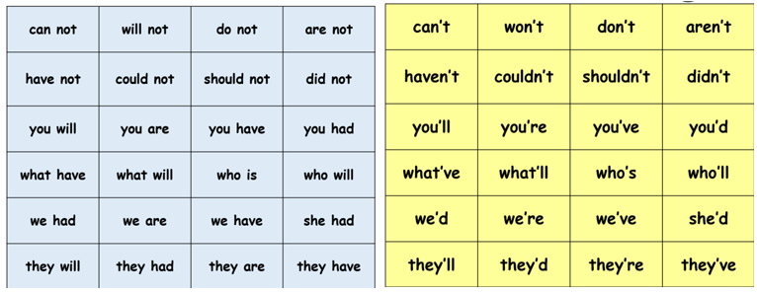
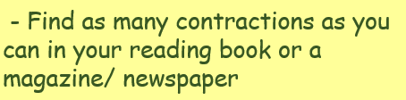
Spelling Week 6/ Lesson 3
LO: apostrophe for contractions
(27) Contractions! - English Grammar Practice - Scratch Garden - YouTube
Children to play contractions matching pairs (children can cut the cards up and play the game or match them and write the pairs in the spelling jotters).
Week 6 lesson 3 contractions matching pairs game.docx

Slide 34
Attachments
3.12.docx
Words to go home Week 2 prefixes mis and re.docx
3.13.docx
Words to go home Week 3 the i sound spelt y.docx
3.14.docx
Dictation week 3.docx
Correct-the-spelling--grammar-and-punctuation-week4 lesson 3.docx
Words to go home Week 5 g and k sound.docx
Dictation week 5.docx
Contractions slides.ppt
Week 6 lesson 3 contractions matching pairs game.docx

