Slide 1
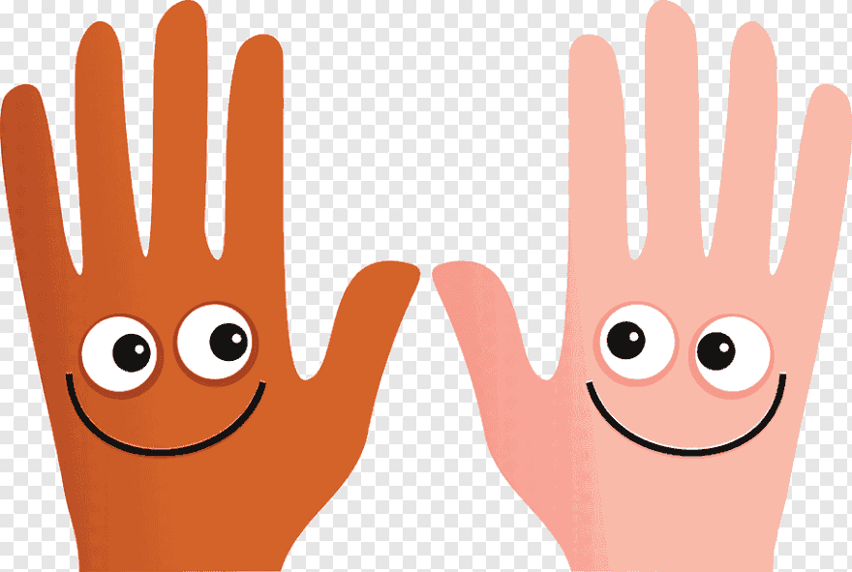
35 Fine Motor Skills Activities To Do At Home
Hardwick and Cambourne Community Primary School
June 2020

Slide 2
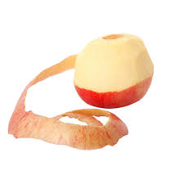
Here are a few ideas that you can do at home to keep up your fingers busy!
Will you be able to complete all 35 challenges?
Peel an orange.
Peel an apple or a potato with a potato peeler.
Pegging out the washing.
Spraying plants with a water sprayer. Use your writing hand and your non writing hand.
Thread Cheerio's onto a piece of strong or spaghetti.
Spoon rice, beans or pasta from one bowl to another. Don’t drop any! Use your writing and non-writing hand. Can you time it and beat your record?

Slide 3
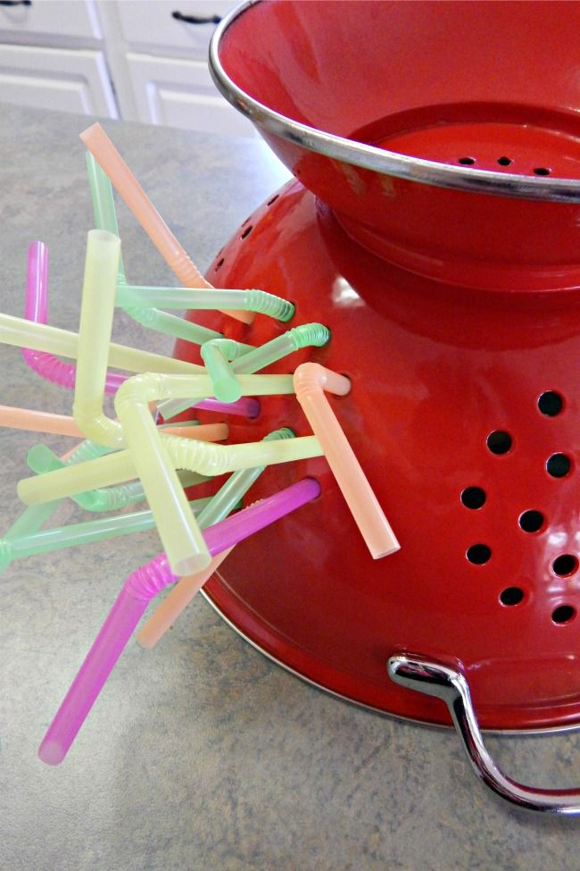

Threat cut straws onto a pipe cleaner, piece of string or spaghetti.
Make a pasta necklace threading pasta onto a piece of string.
Thread beads onto string, a pipe cleaner or piece of spaghetti.
Thread straws through a colander.
Learn to tie your shoe laces! Practice makes perfect ☺
Pick seeds out of a piece of fruit or a vegetable e.g. butternut squash or a watermelon.

Slide 4
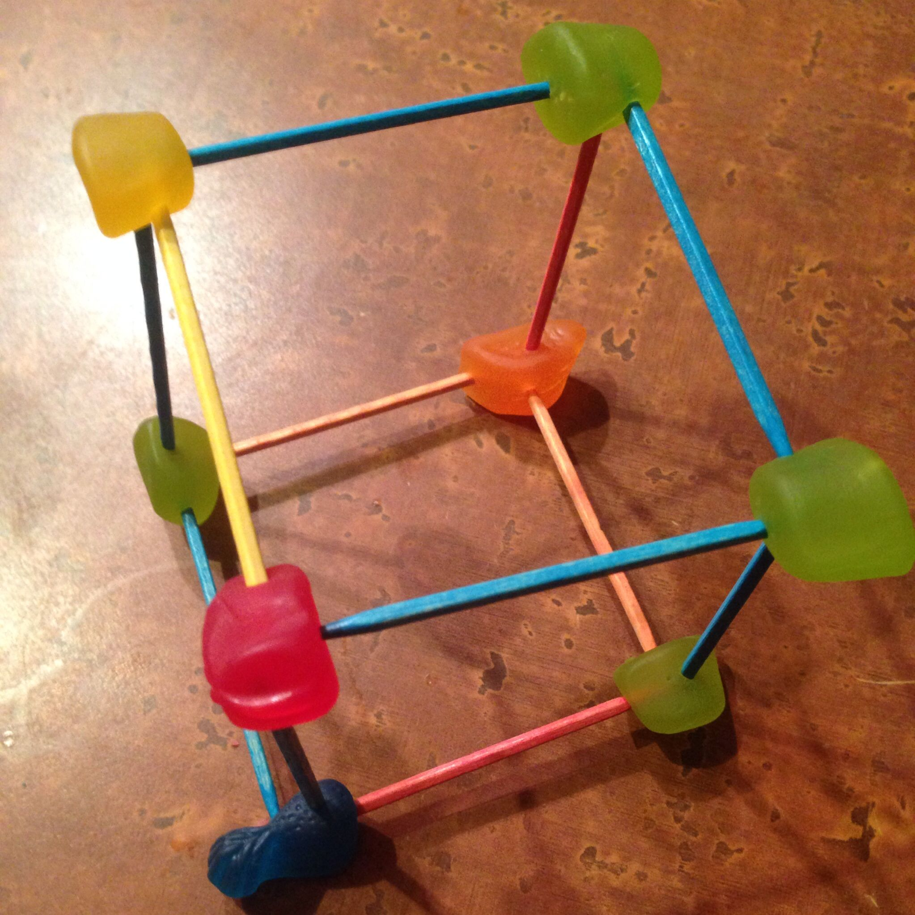
Make a picture using seeds and pasta.
Make a collage using small scrunched up pieces of tissue paper, toilet roll, kitchen roll or old magazines.
Make 3D shapes using toothpicks and fruit or sweets.
Take half a sheet of newspaper and scrunch it up only using one hand. Try with your writing hand and your non writing hand. Don’t use your body to help you!
Tear up sheets of newspaper, but don’t forget to clear up the mess!
Put elastic bands or pipe cleaners around an empty kitchen roll. Can you make it into a rainbow?

Slide 5
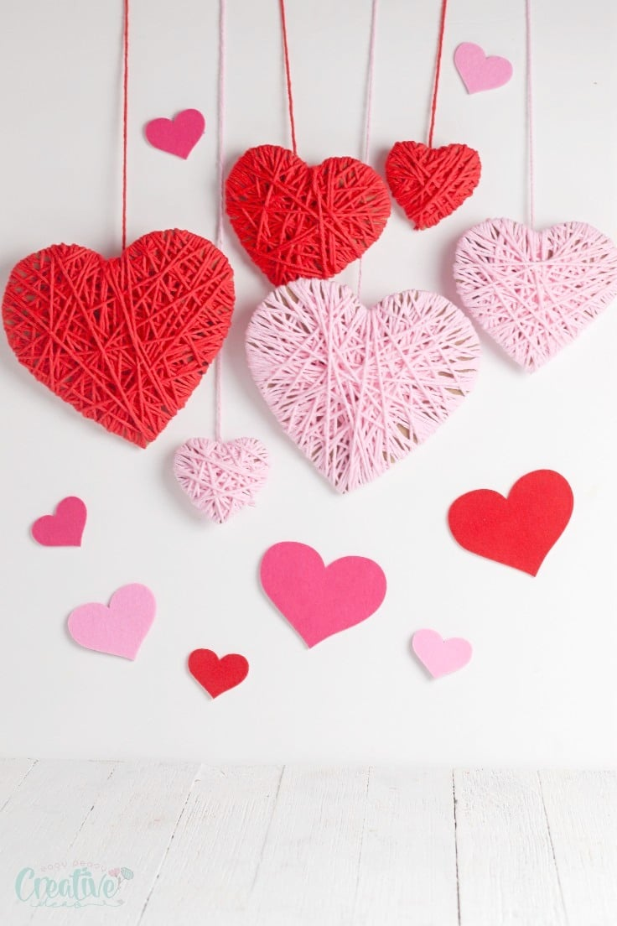
Wrap wool around a cardboard shape.
Make a woollen pom pom.
How many buttons or coins can you put into a tower before they collapse?
Use your pincer finger and thumb to pop bubble wrap. Don’t forget to try with your non writing hand!
Make your favourite animal from Play dough.
Squeeze your Play dough throw a garlic press or a cheese grater.
Draw some straight, wavy and zig zag lines and then cut along them with a pair of scissors.
Paint a picture using cotton wool buds.

Slide 6
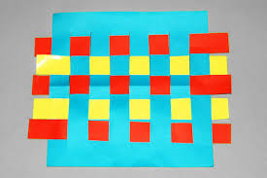
Build with building blocks or Lego.
Practice picking things up with kitchen tongs.
Link paperclips together.
Play Tiddly Winks.
Use chopsticks to eat your dinner!
Wrap Loom Bands around a lolly stick or a wooden spoon handle.
Make a house of cards.
Weave paper strips through a slotted piece of paper.
Wrap your favourite toys up in wrapping paper.

Slide 7
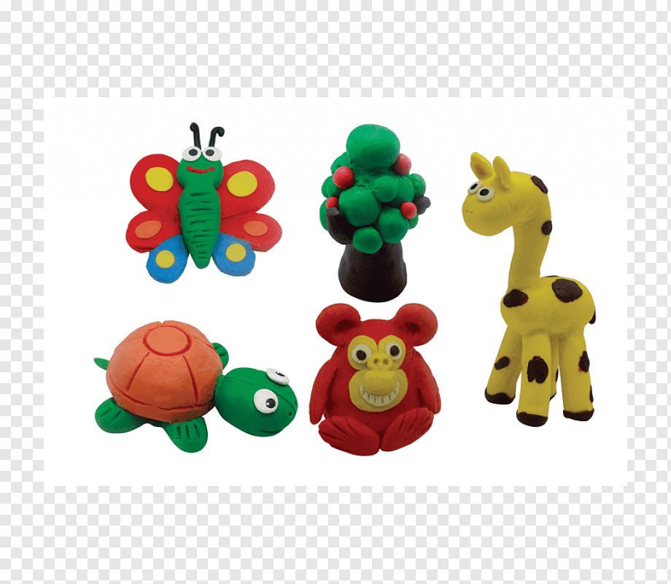

Whatever you do … have lots of fun. We look forward to seeing what you do!

