Slide 1
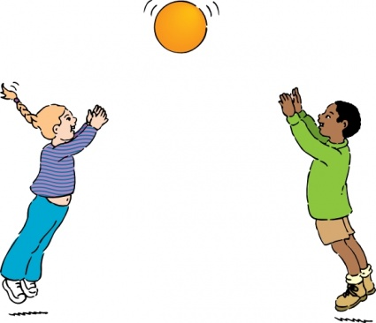
25 Sensory Sports Activities To Do At Home
Hardwick and Cambourne Community Primary School
June 2020

Slide 2
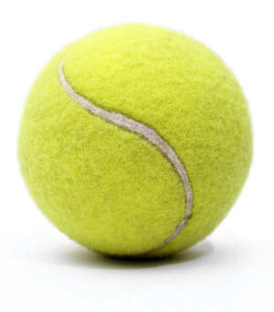
Here are a few ideas that you can do at home to keep up your Sensory Sports Skills.
Will you be able to complete all 25 challenges?
Throw a tennis ball against a wall and catch it. You can
have one bounce.
Throw a tennis ball against a wall and catch it without a
bounce.
Throwing a ball up and catching it.
Bouncing a ball on the ground and catching it.
Bouncing a ball on a racquet.
Throw and catch a ball with another person with one
bounce in the middle.
Throw and catch the ball with another person without a
bounce in the middle.
Can you do this 20 times without missing a ball?

Slide 3
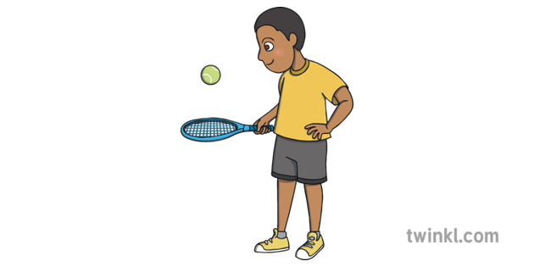
Hot potato – in a circle with family members throw the ball back and forth. Be as quick as you can and don’t drop the ball or you’re out!
Who can throw a ball the furthest?
Walk with as many balls as you can on a tennis racquet.
Throw and catch a tennis ball using a plastic bowl.
Rolling a tennis ball and knocking over bottles filled with water.
Kneeling on one knee throw a ball to a partner and then catch it.
In a push up position, have some balls to one side and one at a time pick up and put in a container in front of you. Swap sides and do it again.

Slide 4

Use a balloon and it back and forth to a partner.
Keep a balloon in the air for as long as you can! Don’t just use your hands, use your feet, your elbows, your knees!
Create an obstacle course in the garden using anything you have – walking along a skipping rope, going over and under different items including a blanket etc. Make it as much fun as you can!
Stacking plastic cups into a pyramid. Time it. Who is the quickest?
Put a plastic cup sideways on the floor and roll a small ball into it. How far away from the cup can you get?

Slide 5

Use plastic cups to throw and catch.
Kick a football. If you don’t have someone to kick it to, try and kick it between two objects. How small can you get the gap?
Dribble your football around a homemade course, it doesn’t have to be cones!
Practice skipping. How many jumps can you do before your feet get tangled?
Sockball – roll up and ball a pair of socks and throw them into a container or at a homemade target. How far from the container can you get? Can you do it with your writing hand and then your non writing hand?

Slide 6

25. Make your own hopscotch grid.
A fun warm up is the Mr. Man Game. Ask an adult to call out the names and you do the actions!
Mr. Slow – walk slowly
Mr. Rush – walk quickly
Mr. Jelly – shake your whole body
Mr. Bounce – jump up and down
Mr. Wide – make yourself as tall as you can.
Mr. Small – make yourself as small as you can.
Mr. Tall – stretch up as tall as you can.
Have lots of fun and we look forward to hearing all about it!

