Slide 1
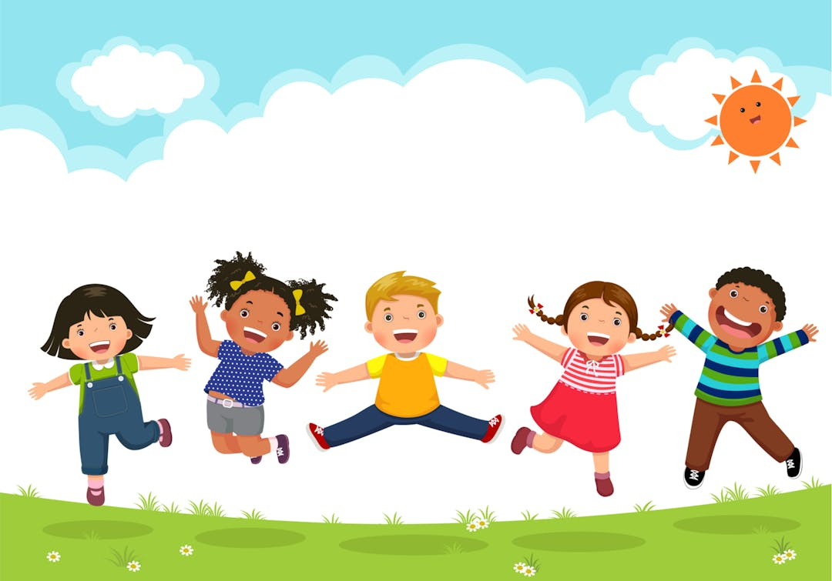



School Readiness

Slide 2
A School Readiness Survey conducted by Cambridgeshire County Council reported that parents felt they were not informed soon enough about what they need to do to prepare their children to school.
Schools have also seen an increasing trend whereby children are coming to school lacking basic skills, such as being able to use a toilet. You may well have seen this in the news.
By holding this meeting, during the Spring Term, our aim is to support parents sooner, giving them an understanding of what school readiness looks like and much longer to prepare children, developing their skills and independence.
Being ‘school ready’ isn’t just about having the uniform ready, eating breakfast, and arriving on time. It is about far more than that.
Children have the potential to become school ready when families and school work together to support the development of their confidence, resilience and curiosity.

Slide 3

So what does ‘school ready’ or ‘school readiness’ mean?
School readiness refers to how simple and smooth the transition is for children heading from Pre-School to Reception, and how adjusted they are socially, physically, and intellectually beforehand.
Do keep in mind that school readiness is as much about what parents, carers, and practitioners can do to help children as much as it is about what children can do.
After all, they can’t develop the characteristics of school readiness all on their own.
Why is school readiness important?
How school ready a child is will determine everything from how they perform, to how they develop, to how they feel. Working out how school ready a child is will help parents and practitioners identify areas where they can provide support to help.
How can you tell if a child is ready to start school?
There are various ways to tell whether or not a child is prepared for school. Ways to identify this include how dependent they are on parents, their social skills, and their responsive skills.

Slide 4
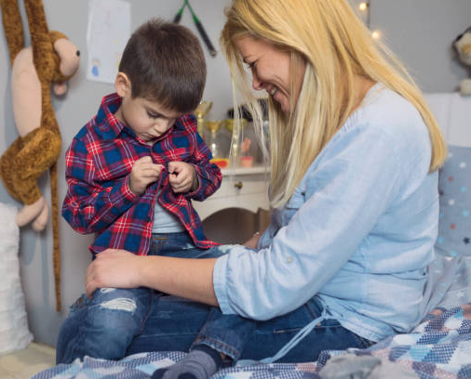
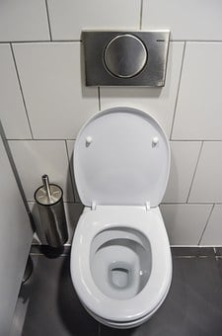

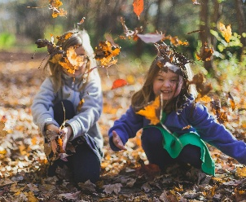
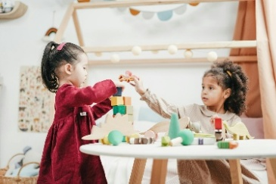
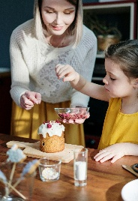
So How can we help our Child to become School Ready
Encourage independence:
      Practice dressing and undressing independently. Learn to do zips and buttons and put shoes and socks on and off.
      Practice using the toilet independently, wiping themselves, flushing and washing hands. If you require more support and advice, the DFE have produced a document with very useful information and links. The link for this will be at the end of this presentation and is available on the Pre-School area on the School website.
      Practice eating independently using knives, forks and spoons.
Encourage Social Skills: Schedule ‘play dates’ with other children to help them communicate and share with others. Parents are typically the ones who facilitate this type of interaction. If a child struggles socialising with others, then taking them to the local park could help simulate the feeling of being in a classroom amongst other children.
        Encourage sharing and turn taking – Play games and help children learn to wait for their turn.
Encourage listening, paying attention and following instructions- Playing games, pretend role play, reading stories, cooking, arts and crafts all offer opportunities for children to practice these important skills.

Slide 5
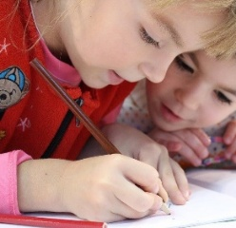

Time to Talk: Engage in conversations and activities that promote speaking. Parents who just go about talking to their child about their daily activities expose their children to 1000-2000 words every hour! Encourage children to express their needs and feelings clearly, such as when they are hungry, tired or need help. Model speaking in full sentences.
. Encourage asking for help: If your child needs help with something they will need to ask an adult. Encourage your child to speak in full sentences to communicate their needs to you rather than pointing or by you guessing. It is really helpful for your child to be able to communicate their needs, e.g. if they are wet, need the toilet, are thirsty or hurt.
Encourage fine motor skills : Help a child prepare for school by drawing, colouring, cutting, and writing their own name at home. Show them how to hold a pencil correctly and encourage this. Repeated actions like these will help them adjust and feel more confident for when they have to do the same in school.
Encourage Gross Motor Skills: Practice running, jumping and climbing. Visit the park, attempt the monkey bars, go swimming. Anything that encourages physical strength and co ordination is great (Please check out our ’ 50 things to do before I start Reception’ which has lots of free ideas. This is available in the Pre-School area our School website)

Slide 6


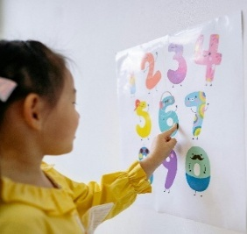
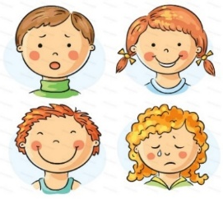
      Encourage a love of reading: Enjoy sharing books and reading together daily. This really helps children grow and develop their vocabulary. When the majority of children start school they will not be able to read books but if they can enjoy a book, know how to hold it and know how to turn the pages this helps with some of the foundations for learning to read. We have a suggested reading list for Pre-School and Reception on our Year Group pages on our School website. A visit to the local library is free and a great experience.
Sing Nursery Rhymes together: Did you know that if a child knows 8 nursery rhymes by heart by the time they are 4 years old they are usually among the best spellers and readers in their class by age 8.
Encourage basic Maths skills: Counting aloud, counting objects, spotting numbers out and about, spotting patterns, spotting and labelling shapes. Recognising colours. These are all skills that can be practiced out and about or around the house.
Encourage resilience and perseverance: Encourage your child to keep on trying when things get tricky and not give up when faced with challenges or setbacks. Can they find another way to do something?
Help children to label and understand their emotions:

Slide 7
Children’s emotions: How to help children understand their emotions
As children’s emotions develop, there are bound to be ups and downs for both them and you as a parent.
So how can you help your child understand their emotions?
How do children come to understand their feelings?
By the time children are between the ages of 2 and 3 years old, they’re starting to name some of their feelings - such as ‘sad’, ‘scared’ or ‘happy’.
Later on, between the ages of 2 and 4, they begin to really tune into their own feelings and notice similar feelings in other people around them.
Tips for helping children understand emotions
  1. Help them to label feelings.
  Help them label feelings like ‘happy’, ‘sad’ and ‘angry’ as they are experiencing them.
  2. Chat about feelings throughout their day.
  Chat to them regularly about feelings, whether it’s theirs or the people around them
  Talk to them about a range of feelings, not just when there’s a problem. Talk about times they feel excited, surprised or left out.
  3. Set a good example.
  Try to be open and share feelings as a family.
  Make it clear that all feelings are OK, but not all behaviours are.
  Tell your child how you are feeling and what you are going to do about it.
Short helpful 2 min video:
Emotional development in children: How to help children understand their emotions - BBC Tiny Happy People

Slide 8
Getting children to share with others
Why do children struggle with sharing and when do they learn to share?
Often between the ages of 3 and 5, children begin to learn to control themselves and not get angry when sharing with others or if someone else takes something of theirs for a moment.
Even at this age, however, some children might still struggle with sharing when their impulses take over. Most 3-year-olds and 4-year-olds put their own needs first, and can get upset when the needs of others get in the way.
Be patient and reward them when they take turns nicely. Try some of the tips below to help encourage young children to share.
Tips for encouraging children as they learn to share
  1. Communicate clearly, using words like ‘share’ and talk about being ‘fair’.
  Explain to your child what’s theirs and what isn’t, for example, ‘yes, that’s your jumper - and that’s Daddy’s.’
  2. Show them how to share – and make it fun!
  Pretend games are great for showing children what sharing is.
  3. Play turn-taking games, like rolling a ball back and forth to one another. As you do this, say ‘my turn/your turn’. Remember children cannot always win and this will really help them when they start school.
  4. Set good examples. As a whole family, try to set good examples like sharing snacks or crayons.
The more you show them what sharing looks like and are generous with one another, the more they will learn to be generous themselves.
Short helpful 2 min video:
What do you do when your toddler won't share? Tips for encouraging your children to share - BBC Tiny Happy People

Slide 9
Temper tantrums and how to deal with them
Why do children have tantrums?
A lot of the time they happen when children are feeling an emotion or sensation that they just don’t have the words for yet. This could be ‘I’m hungry!’ or ‘I’m tired!’ or ‘I’m frustrated!’. They become dysregulated. At this stage, children need your support to calm down and understand what they are feeling.
Tantrums are a way of expressing these feelings without the ability to let you know clearly.
The good news is, as children’s speech develops, they usually grow out of tantrums as they become able to communicate their feelings more effectively.
Top tips for dealing with tantrums
  1. Stay as calm as possible.
  Take deep breaths, use a calm voice and get close to your little one as you speak to them. Remember they’ve lost control and they need your help.
  2. Try to identify the problem.
  Get down to their level and calmly ask them simple questions like ‘are you hungry?’, ‘are you tired?’ , ‘are you hurt?’, ‘are you feeling angry?’.
  Don’t shut them down by telling them to ‘stop’ or ‘be quiet’.
  3. Give them words to express their emotions.
  Give your child words to express how they feel and they’ll hopefully start to tell you what’s going on rather than acting it out.
  Start with simple words like ‘sad’ and ‘angry’.
  Always try to reason and explain to your child situations and consequences like ‘why we need to be in the supermarket?’, ‘why can’t we have that thing?’, ‘why we need to get in the car?’, ‘why we need to go to sleep?’
Short helpful 2 min video:
What is a tantrum?: How to deal with toddler tantrums - BBC Tiny Happy People

Slide 10
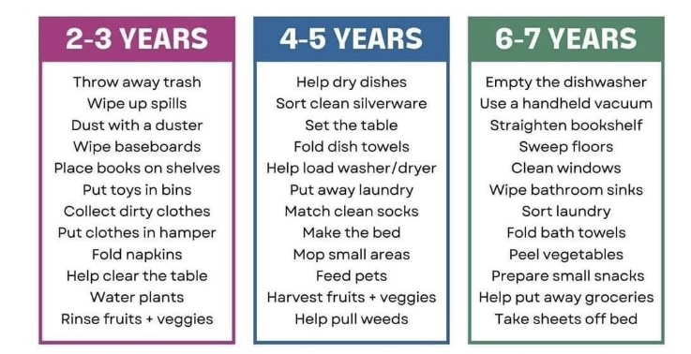
Encourage children to tidy away their toys after playing. Model tidying so they know what you mean. Encourage children to look after things and take some responsibility. This will help them greatly when starting school.
Children as young as 2 are able to help out. Here are some ideas of age appropriate jobs.
rubbish
cutlery

Slide 11
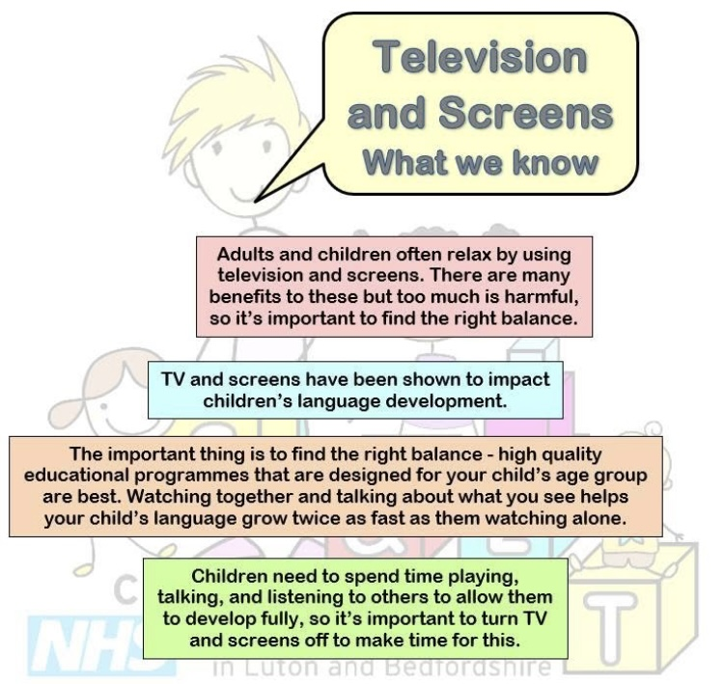

Slide 12
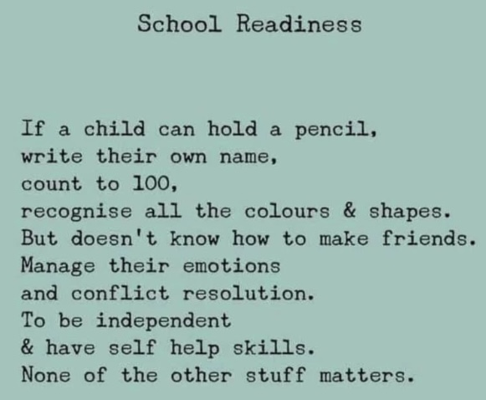
We hope that you now have a greater understanding of what school readiness really means and that you have found this information useful. You will find all the link on the final page.
It is our responsibility as parents, carers and practitioners, to support children on their journey towards starting Reception in September and we will continue to support children in these areas throughout their Reception year.

Slide 13


Useful links
Books for EYFS | 100 picture books to read before you are 5
Toilet training support: Help for early years providers : Toilet training
50 things I did before I started Reception
‘ The more that you read, the more things you will know. The more that you learn, the more places you’ll go. ’
Dr. Seuss

